Slide 1
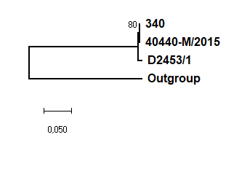
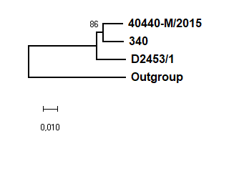
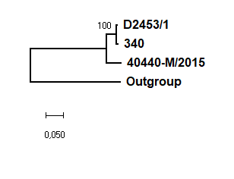
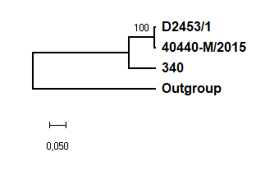
ORF14A
Hexon
Fiber
ORF19
Phylogenetic trees generated from deduced amino acid sequences of selected genes of known FAdV-B strains (neighbor-joining method; p-distance)

