Slide 1
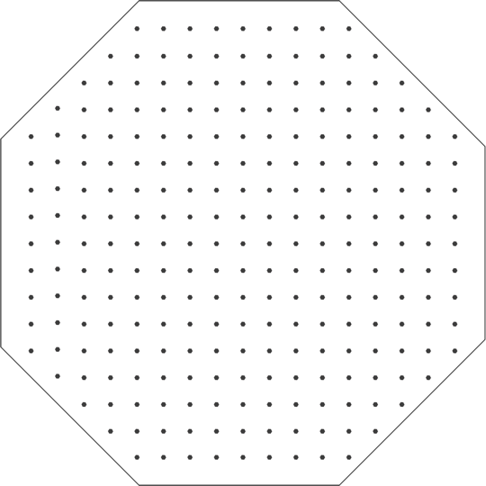
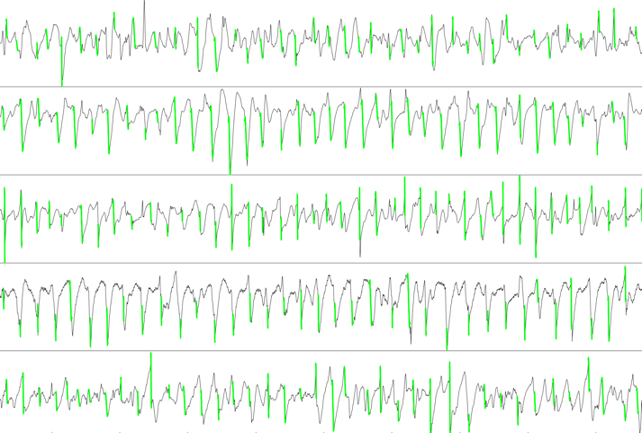
Bi-atrial mapping
249 electrodes per atrium
1.5 mm interelectrode distance
Electrode diameter 0.25mm
Unipolar electrograms
Videos visualize 10 s AF recordings (identical frame rates for all)
color fades over a period of 100 ms
grey boxes within the mapping area indicate where electrograms were excluded due to technical reasons
Octagonal shaped mapping electrodes
Unipolar electrograms with activation time annotation
North
West
North
Centre
Centre
West
East
East
South
South

