Slide 1



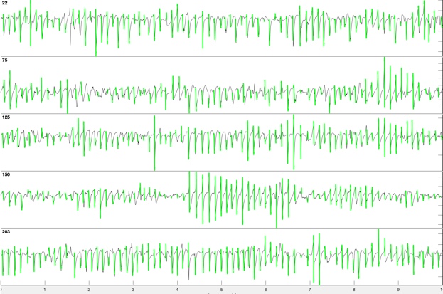
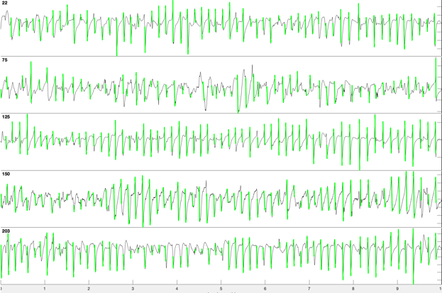
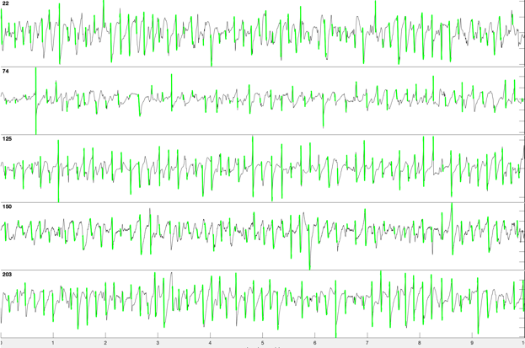
Horse 5, Left atrium
T₋₅
T₁₀
T₂₀
West
West
North
North
Centre
Centre
East
East
South
South
1 second

