Slide 1
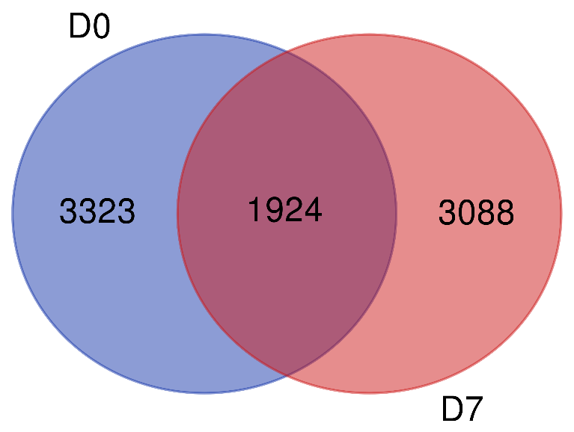
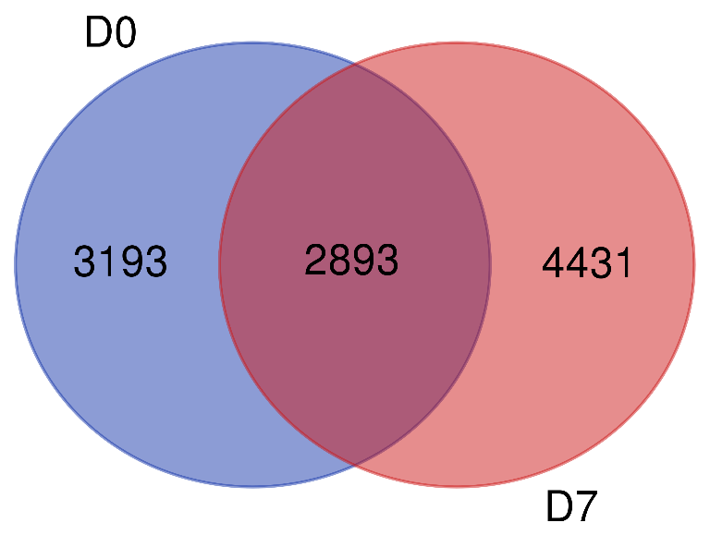
Supp Fig,1
(A) (B)
D7 TCQA vs DO control
***
***
***
* P ≤0.01
** P ≤0.001
*** P ≤0.0001
***
***
***
***
D7 TCQA vs D7 control
***
(C) (D)
D7 TCQA vs DO control
***
***
***
***
* P ≤0.01
** P ≤0.001
*** P ≤0.0001
***
***
***
***
D7 TCQA vs D7 control

