Slide 1
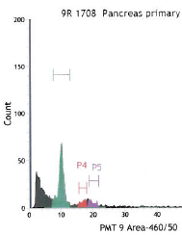
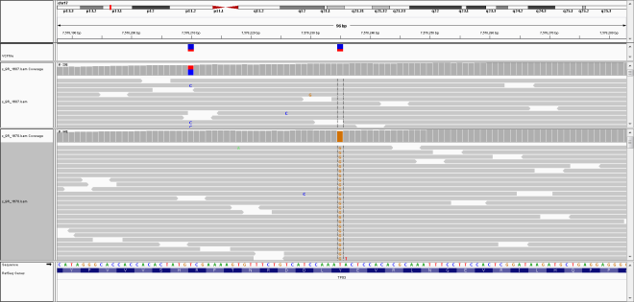
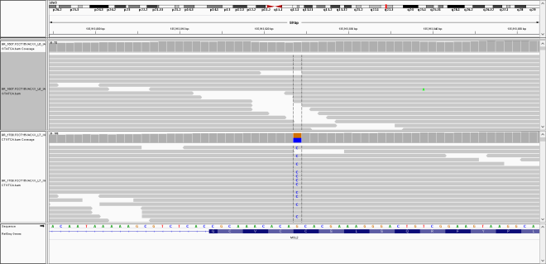
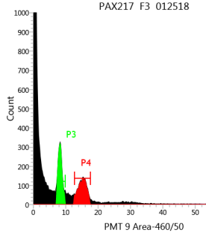
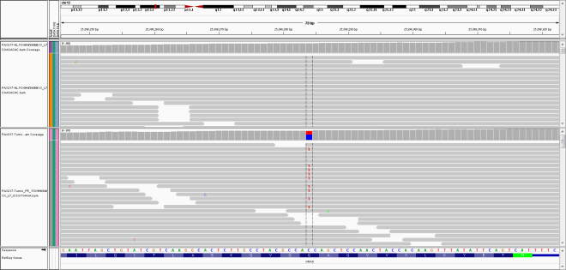
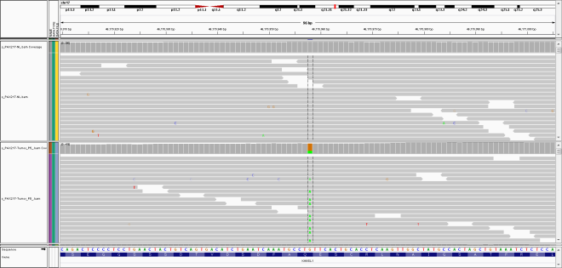
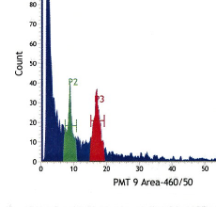
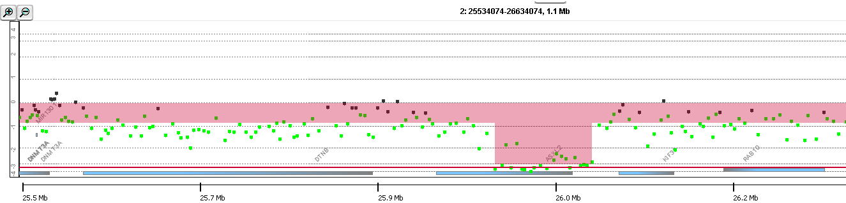
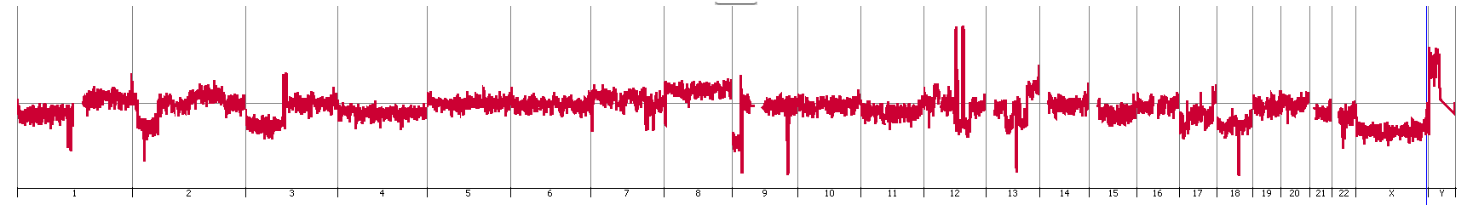
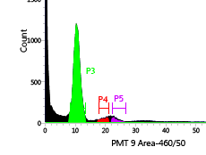
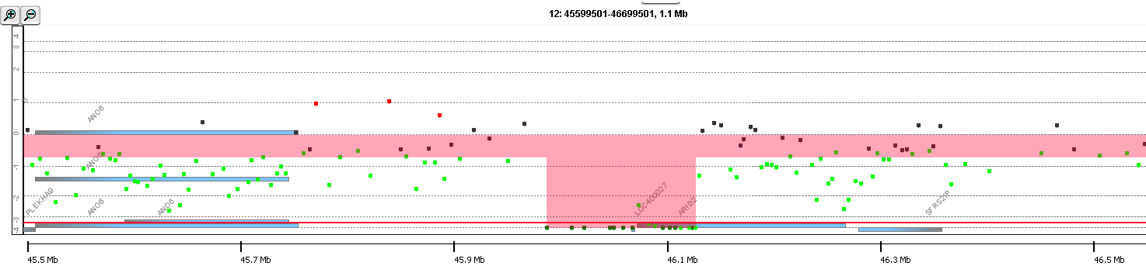
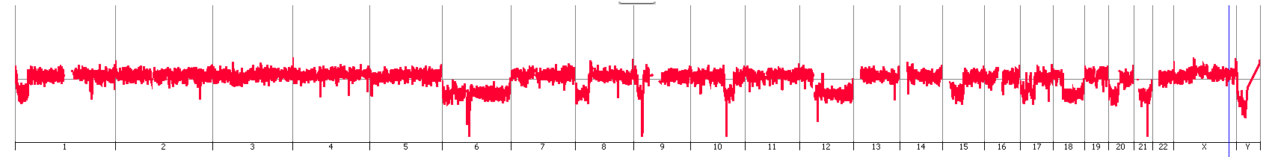
A
2.0N
2.0N
2.0N
3.8N
3.8N
TP53^{Y205S}
3.8N
MSL2^{C44W}
B
Host
NL
NL
Tumor
ASCP
KRAS^{G12D}
ASCP
KANSL1^{Q396X}
2p23.3
+
C
2.0N
ASXL2
0
Log₂ratio
-
3.9N
+
Log₂ratio
0
CDKN2A^{-/-}
SMAD4^{-/-}
-
D
Host
ARID2
+
Tumor
PTEN^{-/-}
Log₂ratio
0
CDKN2A^{-/-}
-
Supplemental Figure 4: Somatic mutations and homozygous deletions targeting chromatin regulators in ASCP genomes. IGV views of A) TP53^{Y205S} and MSL2^{C44W} in 3.8N population sorted from primary tumor 9R. B) KRAS^{G12D} and KANSL1^{Q396X} in flow sorted tumor fraction in PAX217. Sorted 2.0N fraction was used as a patient matched normal for 9R while patient matched lymphocytes were used as a source of normal DNA for PAX217. Homozygous deletions (log₂ ratio <-3.0) targeting ASXL2 and ARID2 in C) PENN040 and D) PAX208.

