Slide 1
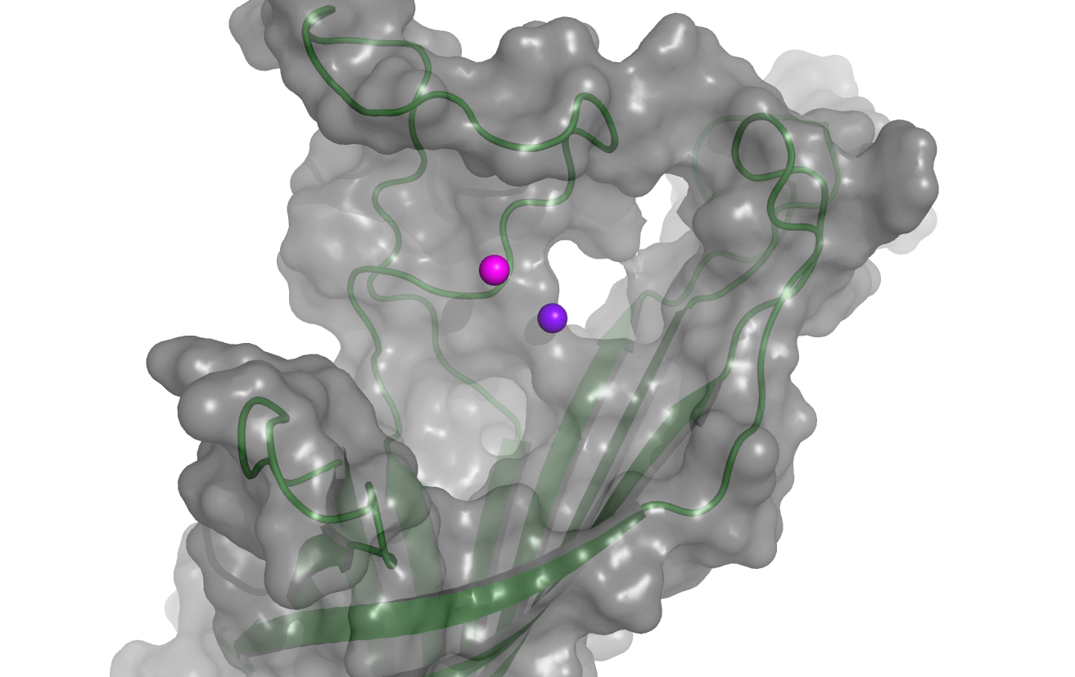
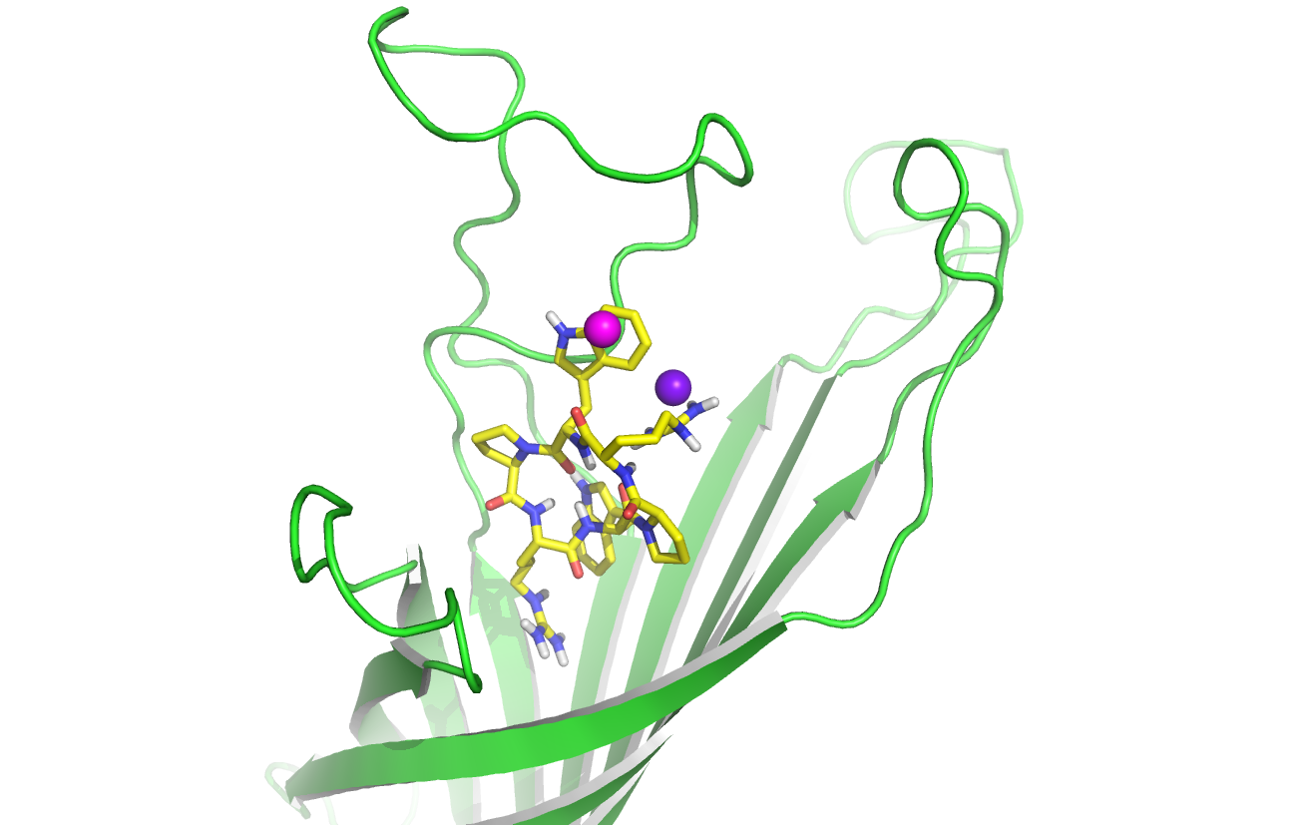
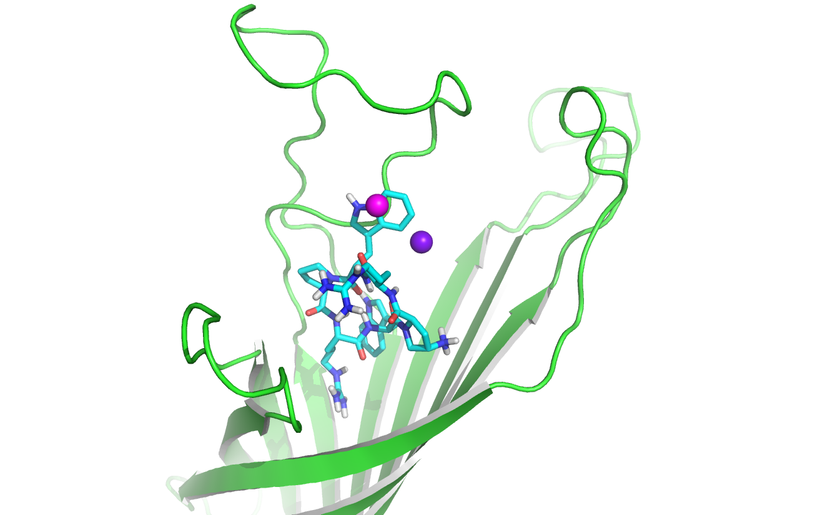
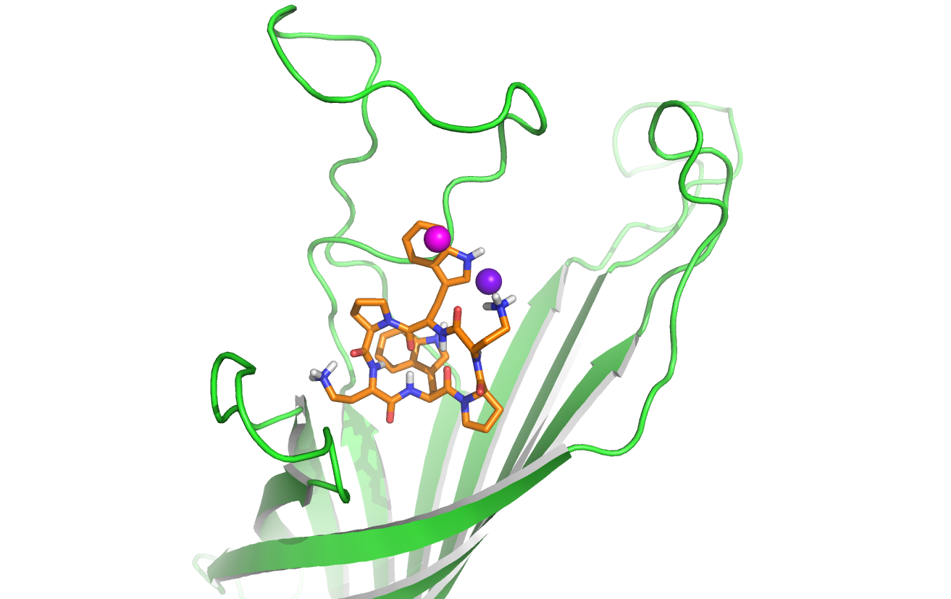
A
B
C
D
Notes:
A) Lateral perspective of OmpA transmembrane homology modeling cartoon representation with pharmacophore positions. In pink and violet, the aromatic and cationic pharmacophores respectively. B) Best docked conformation of parent hit AOA-2. C) Best docked conformation of analog RW01. D) Best docked conformation of analog RW06. All images were created with PyMOL. The protein is depicted in green cartoon mode while cyclic peptide inhibitors are detailed in sticks.

