Slide 1
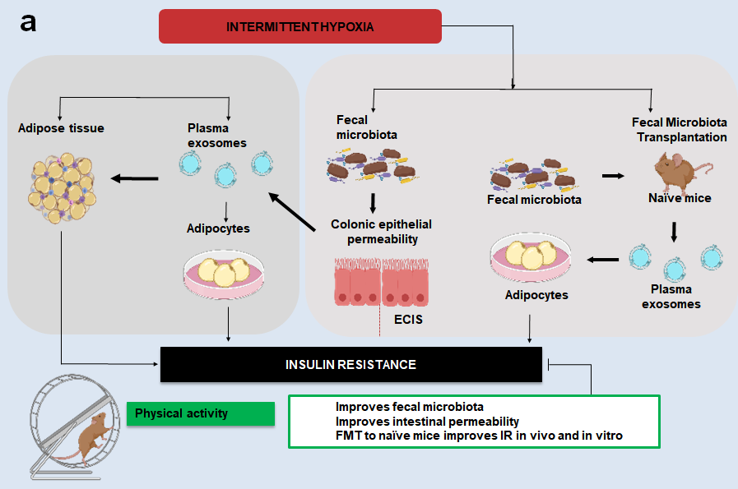
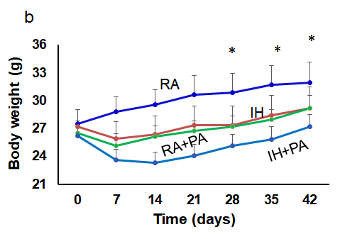
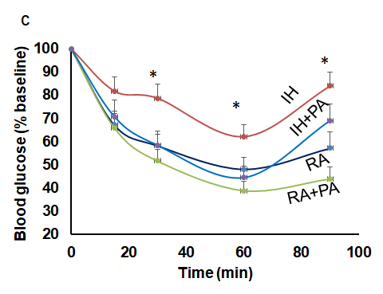
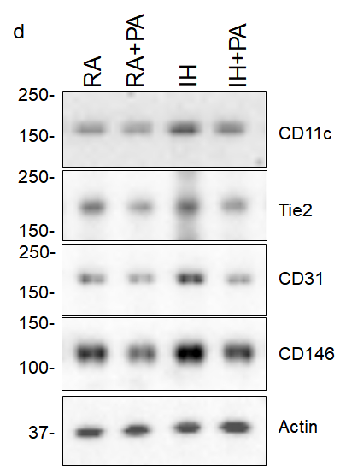
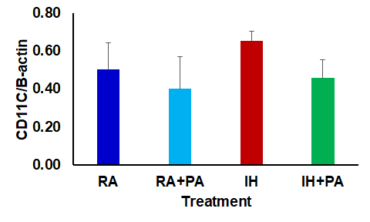
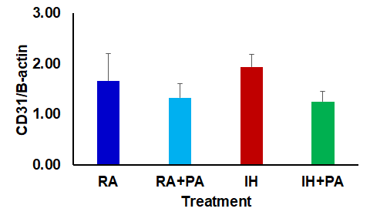
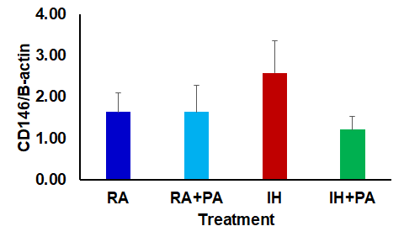
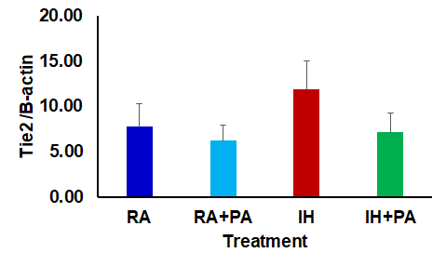
Figure 1
e
*
*
*
*
*
*
*
*
*
*
*
*

Slide 2
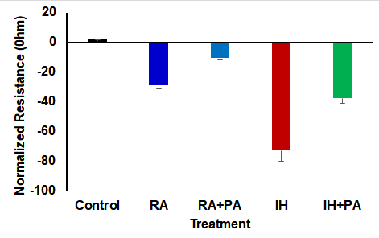
Figure 2
a
b
*
*
*
*

Slide 3
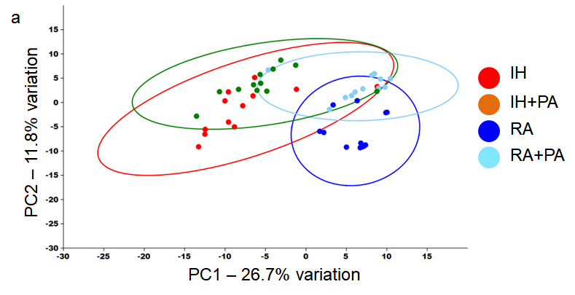
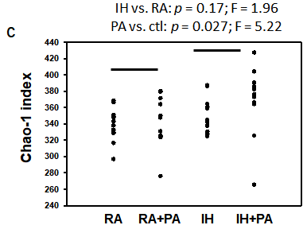
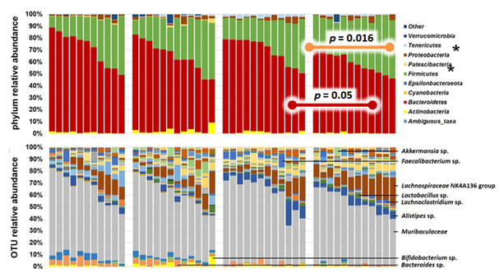
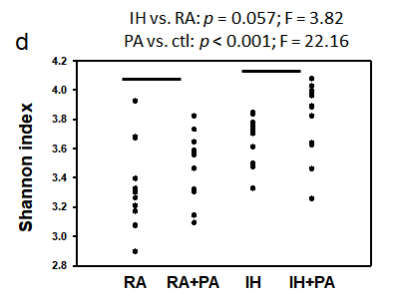
Figure 3
*
*
e
f
*
RA
RA+PA
IH
IH+PA

Slide 4
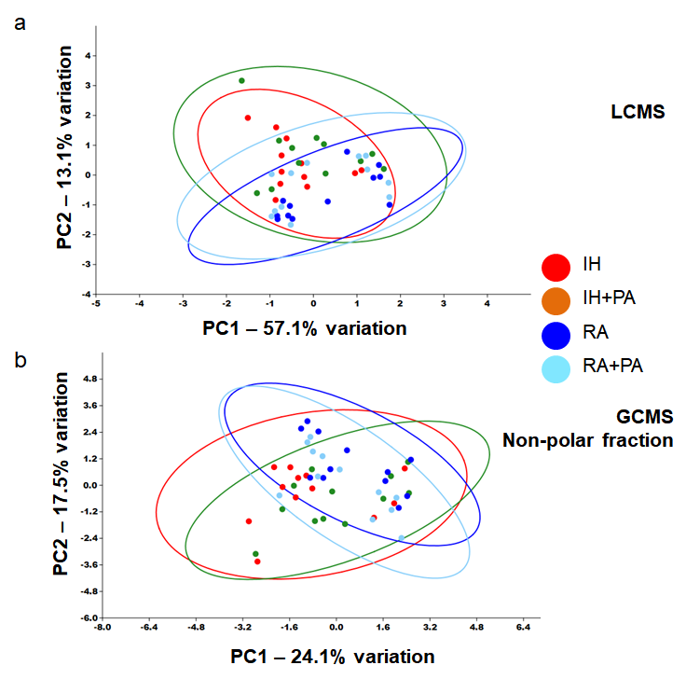
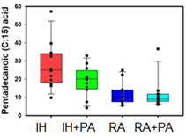
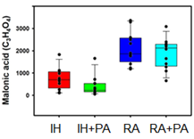
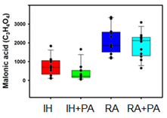
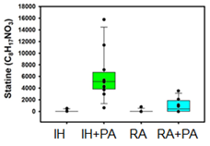
Figure 4
c
IH vs. RA p< 0.001; F=19.3
PA vs. RA: p =0.10; F=2.8
No significant interaction (p=0.12)
d
IH vs. RA p< 0.001; F=67.8
PA vs. RA: p =0.12; F=2.5
No significant interaction (p=0.74)
f
IH vs. RA p< 0.001; F= 17.3
PA vs. RA: p =0.0.001; F= 30.3
Interaction (p<0.001; F= 17.2
e
IH vs. RA p< 0.001; F=67.8
PA vs. RA: p =0.12; F=2.5
No significant interaction (p=0.74)

Slide 5
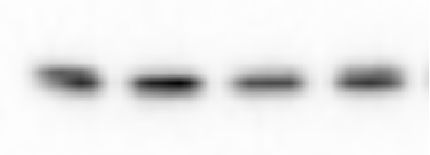

Figure 5
RA
RA+PA
IH
IH+PA
a
56 kDa
←pAKT
56 kDa
←Total AKT
c
b
*
NS
*
*
*
*
NS
*

Slide 6
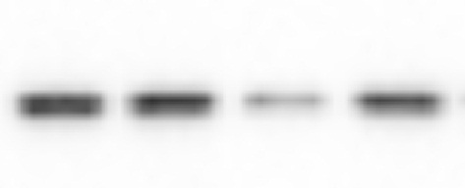
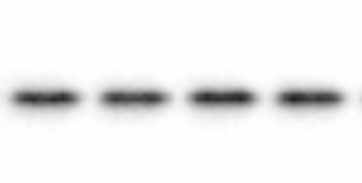
Figure 6
a
RA+FMT
H+PA+FMT
H+FMT
RA
56 kDa
→
p-AKT
56 kDa
→
t-AKT
*
*
b
NS
*

Slide 7
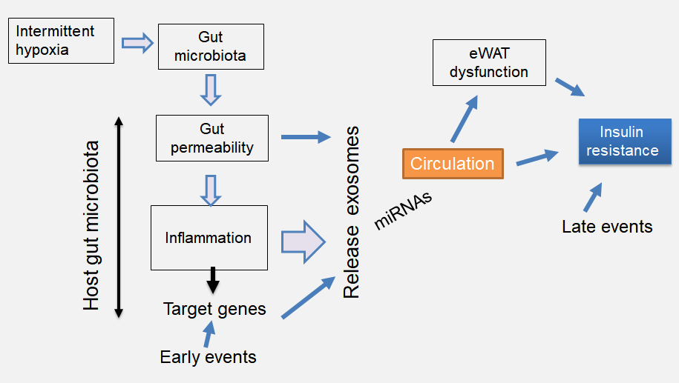
Figure 7

