Slide 1
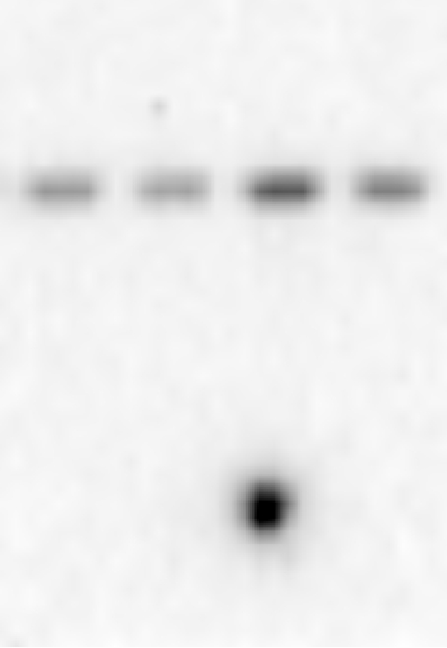
Figure 1
CD11c
RA
RA/PA
IH
IH/PA
250-
150-
←CD11c
100-
75-
50-

Slide 2
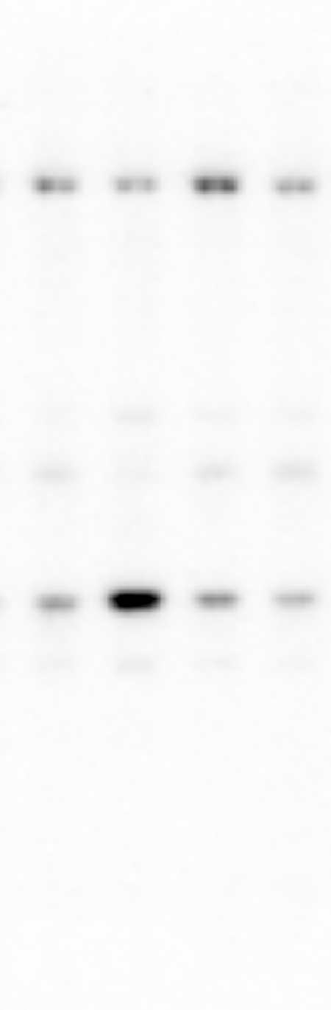
CD31(PECAM-1)
RA
RA/PA
IH
IH/PA
250-
150-
←CD31
100-
75-
50-
37-

Slide 3
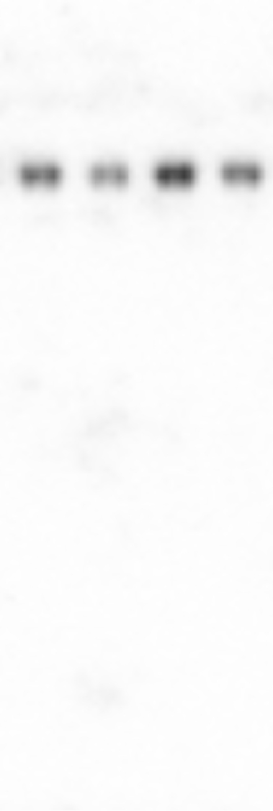
CD146(MCAM)
250-
RA
RA/PA
IH
IH/PA
150-
←CD146
100-
75-
50-
37-

Slide 4
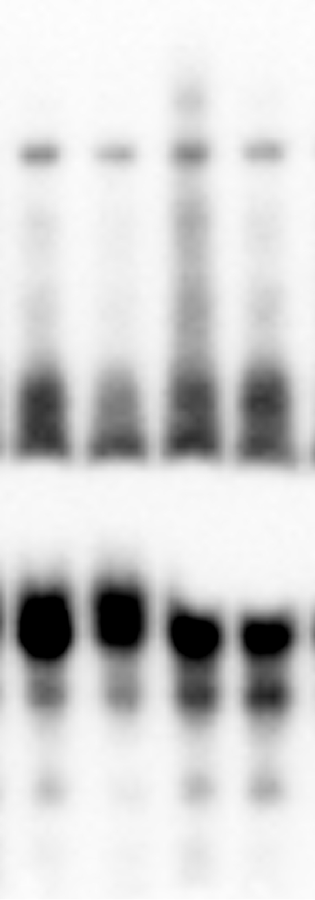
Tie2/TEK
RA
RA/PA
IH
IH/PA
250-
150-
←Tie2
100-
75-
50-
37-

Slide 5
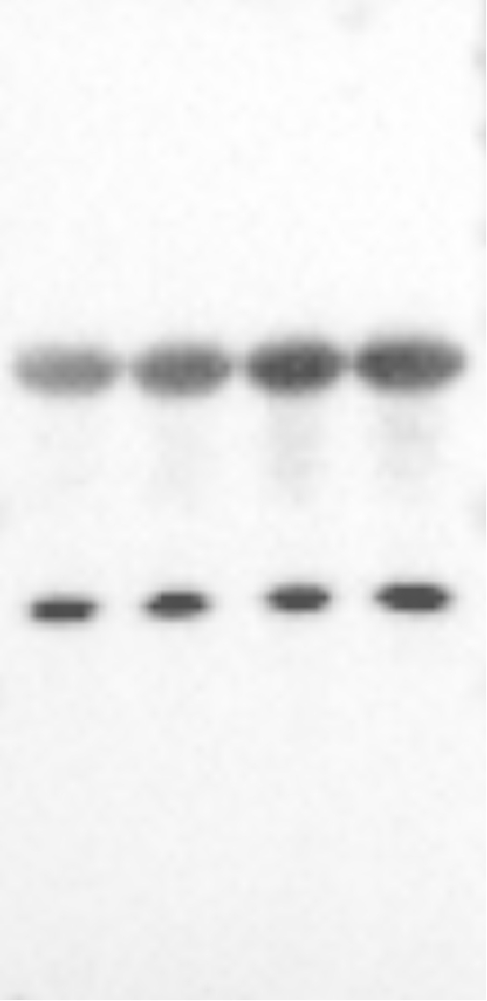
β-Actin
RA
RA/PA
IH
IH/PA
250-
150-
100-
75-
50-
← β-Actin
37-
25-
B-actin was re-probed with the used membrane.
The band β-actin from previously used membrane

