Slide 1
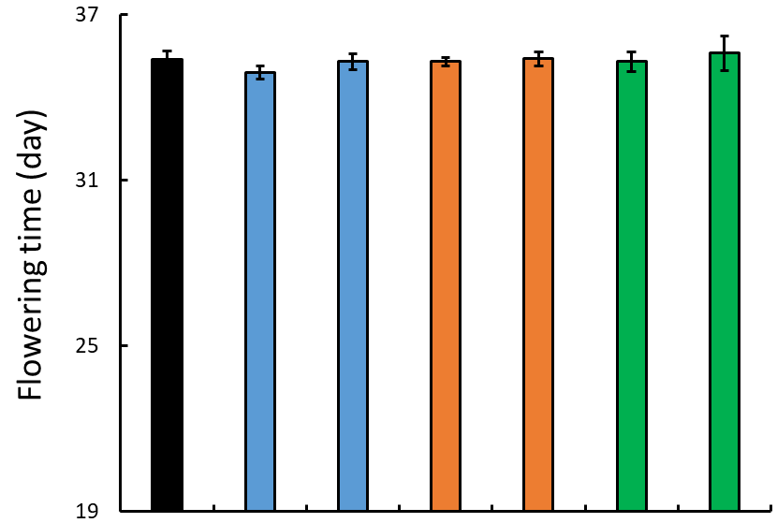
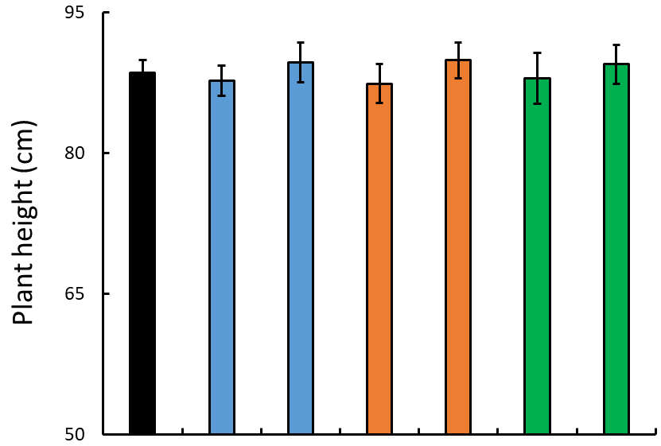
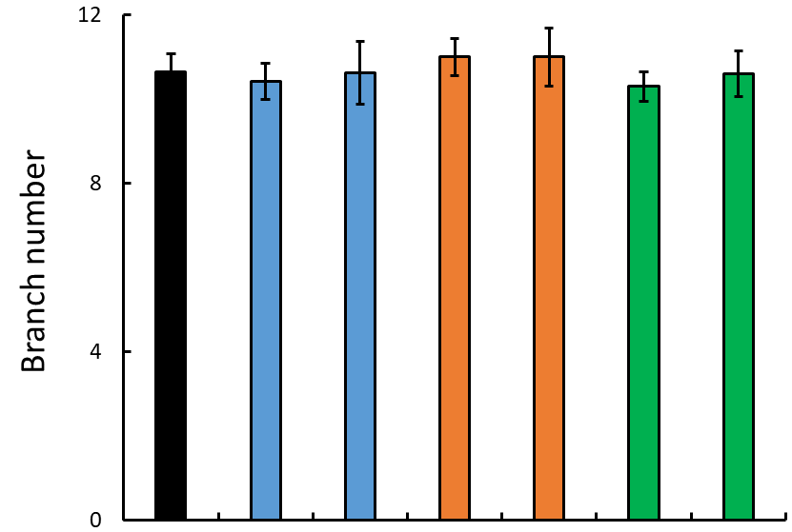
WT
FAX1-1
FAX1-2
ABCA9-1
ABCA9-2
FAX1/ABCA9-2
FAX1/ABCA9-1
Additional file 1: Figure S1. Effect of AtFAX1- and AtABCA9-OEs on other major agronomic traits. Flowering time, plant height, and branch number of mature camelina plants. Values are means ± SE (n=18).

