Slide 1
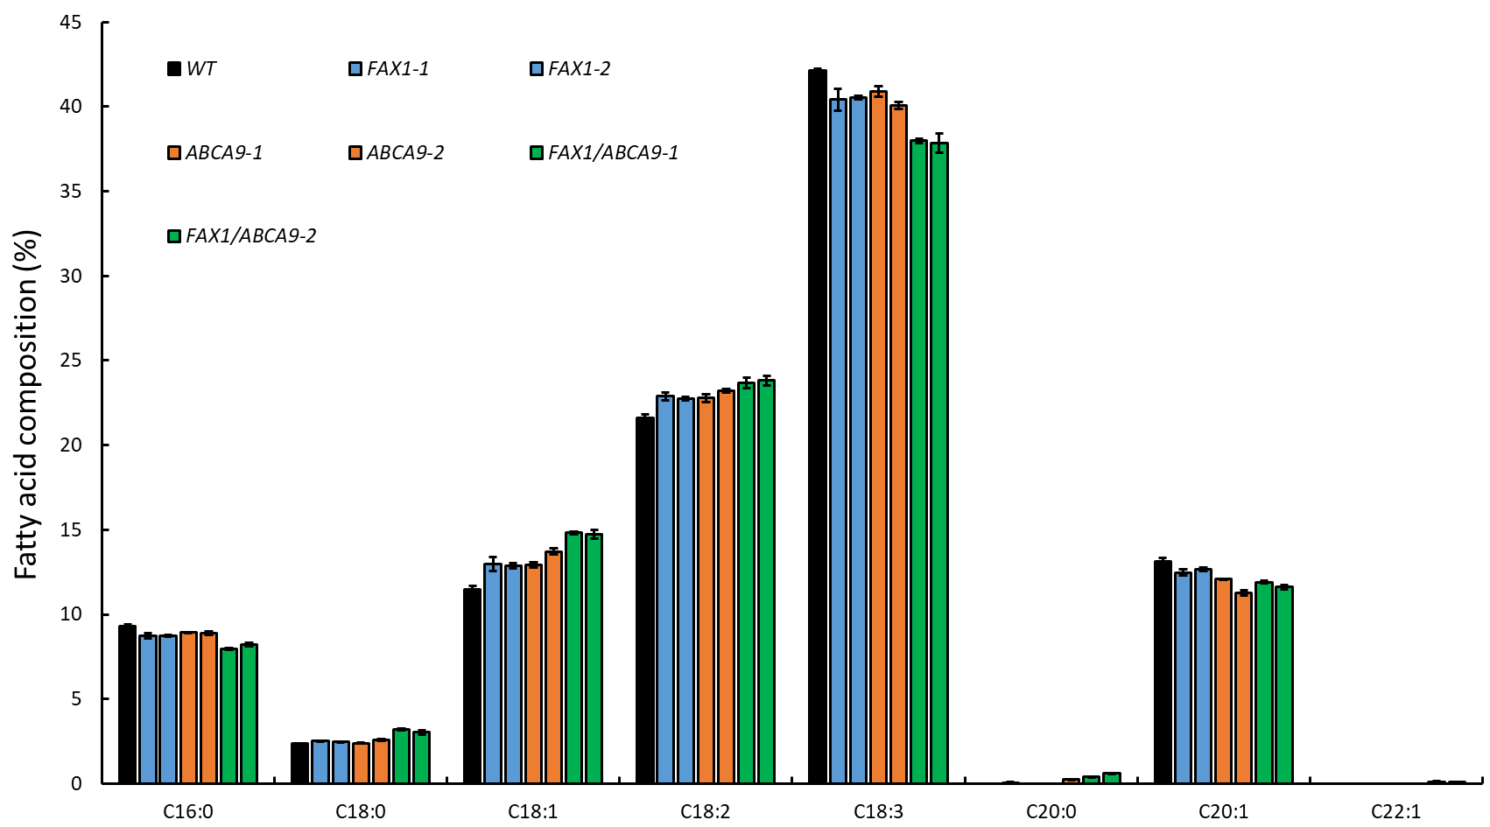
A
BC
B
B
C
D
D
B
B
B
B
A
A
C
C
B
A
A
A
D
C
C
B
B
C
D
C
CD
A
B
B
B
B
C
C
C
B
B
B
A
A
A
D
C
D
D
B
B
A
B
B
B
B
B
A
A
Additional file 2: Figure S2. Effect of AtFAX1- and AtABCA9-OEs on seed fatty acid composition. Seed fatty acid composition was measured by gas chromatography, and calculated based on the peak area. Values are means ± SE (n=3). Capital letters indicates a significant difference (P < 0.01) based on Duncan-test.

