Slide 1
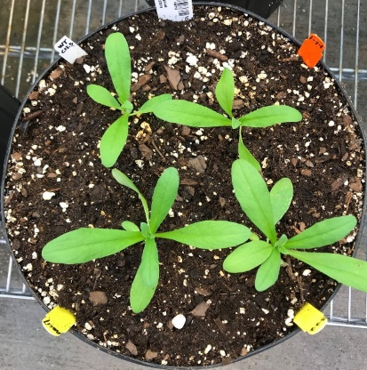
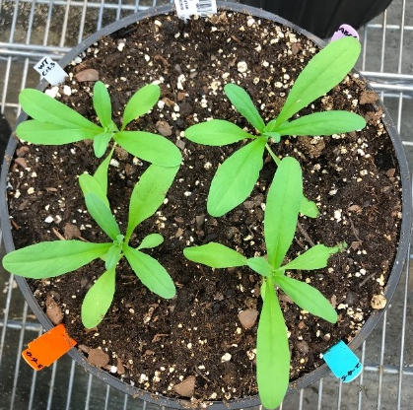
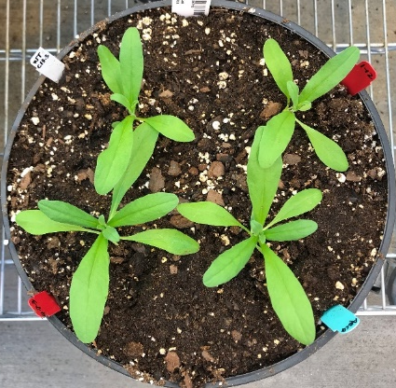
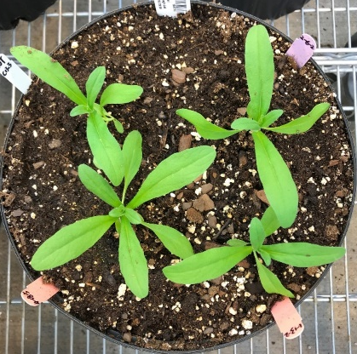
a
WT
FAX1-1
WT
ABCA9-2
WT
WT_{seg}
WT
FAX1-4
ABCA9-3
FAX1/ABCA9-1
FAX1/ABCA9-2
FAX1-3
FAX1/ABCA9-3
ABCA9-1
FAX1/ABCA9-4
FAX1-2
b
A
C
C
B
B
B
B
A
D
D
D
C
C
E
WT
FAX1-1
FAX1-2
WT
FAX1-1
FAX1-2
ABCA9-2
ABCA9-1
ABCA9-2
ABCA9-1
FAX1/ABCA9-2
FAX1/ABCA9-2
FAX1/ABCA9-1
FAX1/ABCA9-1
Additional file 4: Figure S4. Effect of AtFAX1- and AtABCA9-OEs on vegetative tissues. a Morphology of 3-week-old plants. Bar=5 cm. b The fresh weight and leaf number of 3-week-old overground plants. Values are means ± SE with three batch of repeats, each repeat with 12 plants of each line. Capital letters indicate a significant difference (P < 0.01) based on Duncan-test.

