Slide 1
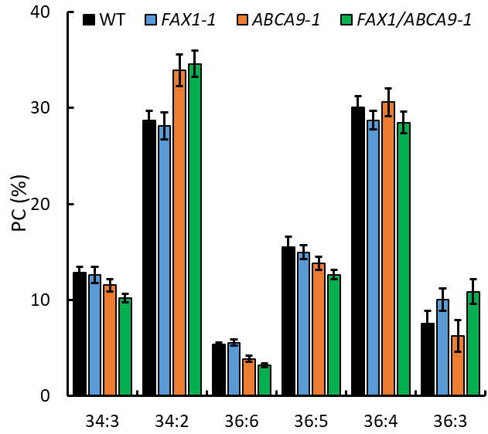
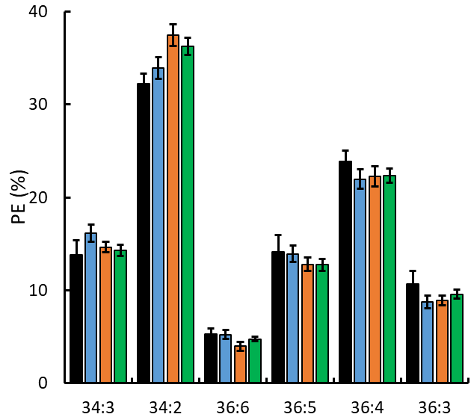
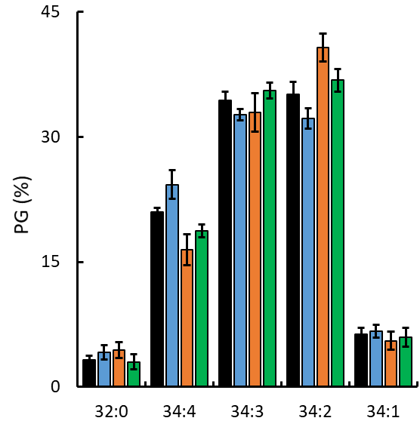
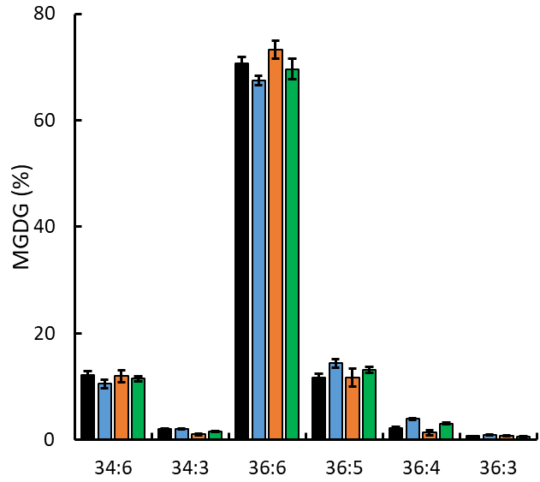
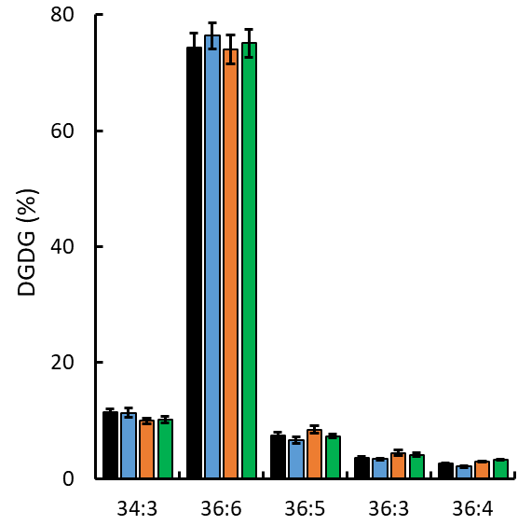
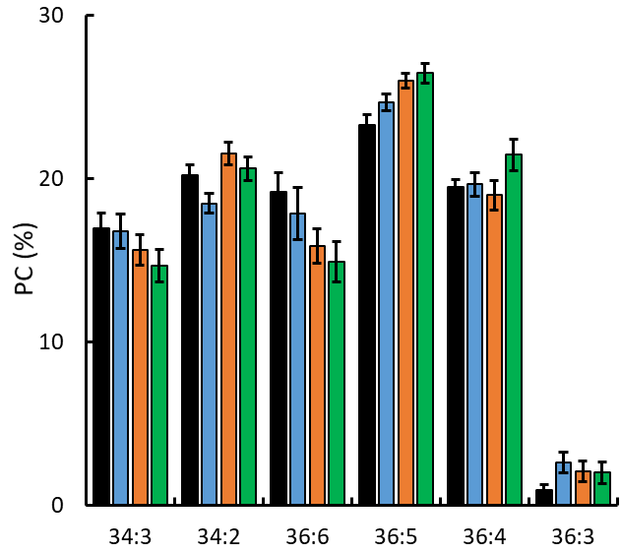
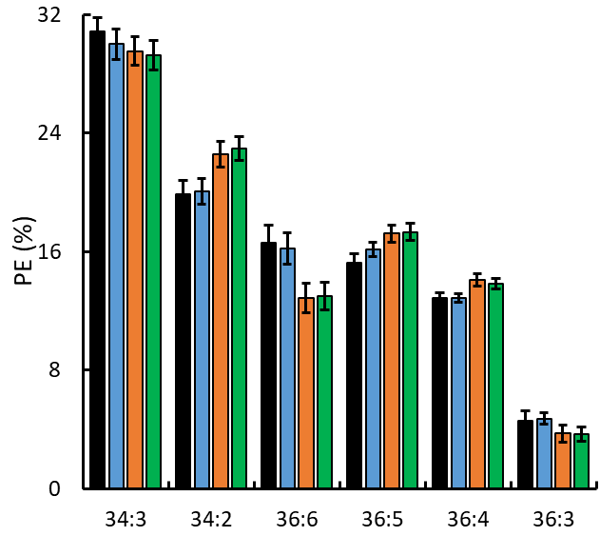
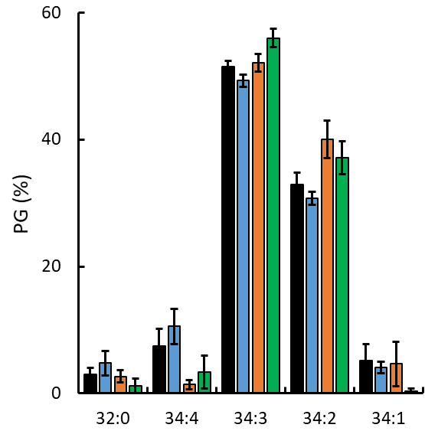
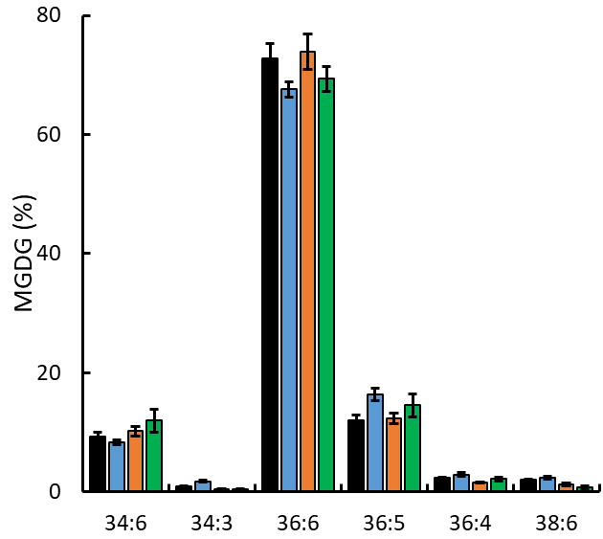
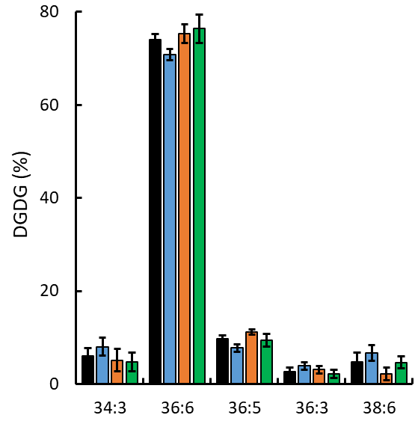
A
A
A
A
A
B
A
B
A
A
A
A
A
B
B
A
A
B
B
C
A
AB
B
B
B
B
B
C
A
B
B
B
A
A
B
B
A
A
B
C
C
A
A
C
D
A
B
B
A
B
B
A
AB
A
B
B
B
B
B
B
A
A
A
A
A
A
A
A
B
C
A
A
B
A
A
A
A
A
A
A
B
A
B
AB
A
A
B
B
A
B
A
B
A
A
A
B
A
B
A
B
A
A
A
A
A
B
B
A
A
B
A
A
A
A
A
A
A
A
A
A
A
B
A
A
C
B
A
B
C
B
B
B
A
A
A
A
A
B
AB
A
B
B
B
B
B
A
A
A
C
AB
B
AB
B
B
A
A
A
A
B
B
B
B
B
B
A
A
B
B
A
A
A
A
AB
A
B
B
A
A
A
A
B
B
B
A
B
A
A
A
A
A
A
B
B
B
A
A
B
B
A
B
A
A
A
A
A
C
AB
A
A
A
A
A
A
B
A
B
B
A
B
B
C
A
B
B
Additional file 6: Figure S6. Alterations of PC, PE, PG, MGDG, and DGDG species (mol%) in developing pods of AtFAX1- and AtABCA9-OEs. 2-week (upper panel) and 4-week (lower panel) old developing pods were sampled for lipid profiling by ESI-MS/MS. The species levels were measured by internal standards. Values are means ± SE with 5 biological replicates. Capital letters on the top of each panel indicate a significant difference (P < 0.01) based on Duncan-test. PC: phosphatidylcholine; PE: phosphatidylethanolamine; PG: phosphatidylglycerol; MGDG: monogalactosyldiacylglycerol; and DGDG: digalactosyldiacylglycerol.

