Slide 1
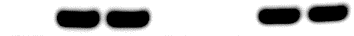
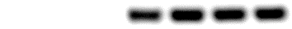
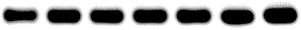
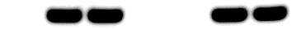
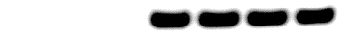

ABCA9/FAX1-1
ABCA9-2
ABCA9/FAX1-2
FAX1-1
ABCA9-1
WT
FAX1-2
2W
AtFAX1
AtABCA9
CsACT2
4W
AtFAX1
AtABCA9
CsACT2
Additional file 7: Figure S7. Gene expression level of AtFAX1 and AtABCA9 in developing seeds of camelina OE lines. The RNA was extracted from 2- (upper) and 4- (lower) week (W) old developing seeds. ACT2 (actin2) was used as the internal standard for cDNA input adjustment. The expression of AtFAX1 and AtABCA9 were semi-quantified by PCR with the primers specific binding to AtFAX1 and AtABCA9. The experiment was performed at least three times with similar results.

