Slide 1
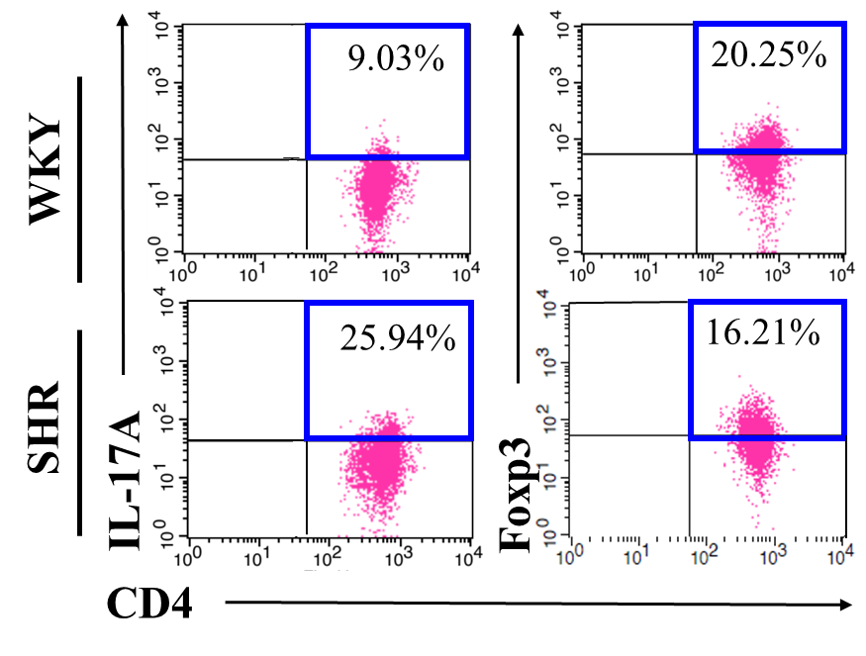
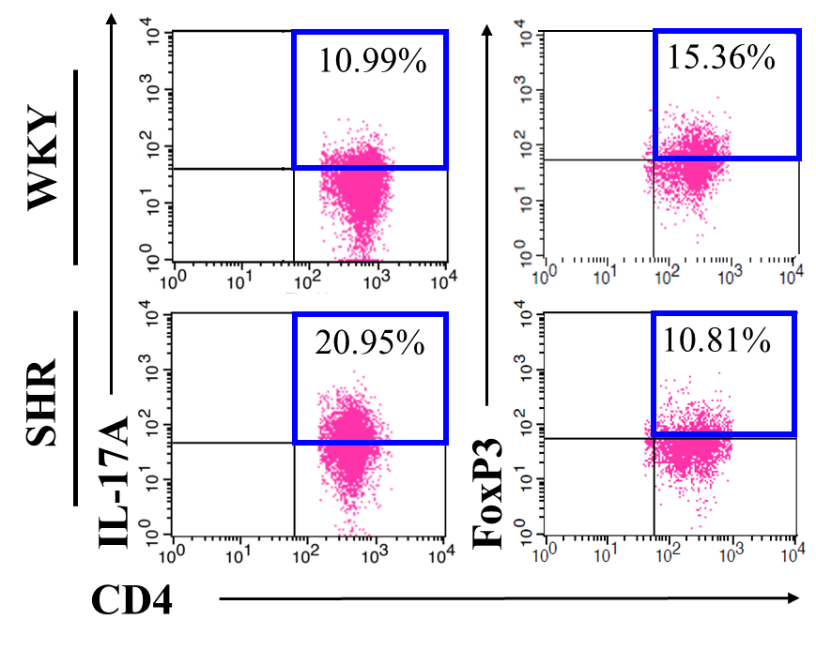
Additional file: Supplementary Fig. 1
○ WKY ● SHR
a.
b.
**
c.
d.

Slide 2


Additional file: Supplementary Fig. 2
a.
Donors (15 weeks)
Recipients (15 weeks)
WKY
Vehicle
Cell isolation
1×10⁵ cells/300ul (PBS)
(i.p injection)
Th17 cells
WKY
SHR
b.
Cell transferred: ○ Vehicle □ Th17 cells from SHR
△ Th17 cells from WKY

Slide 3
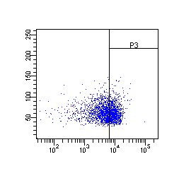
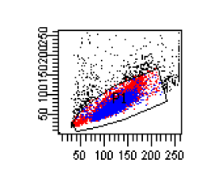
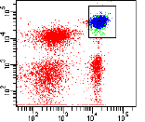
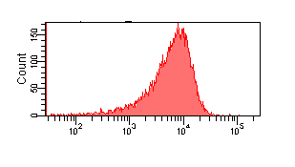
Additional file: Supplementary Fig. 3
SSC
SSC
CD3
IL-17A
FSC
CD4
Count
IL-17A

Slide 4
Additional file: Supplementary Fig. 4
a.
Recipient WKY
Recipient SHR
○ Vehicle △ Th cells □ Th17 cells
● Vehicle ▲ Th cells ■ Th17 cells
**
*
*
Cell transferred: Vehicle Th cells Th17 cells
b.
**
*
*
*
c.
*
**
**
*
d.

Slide 5
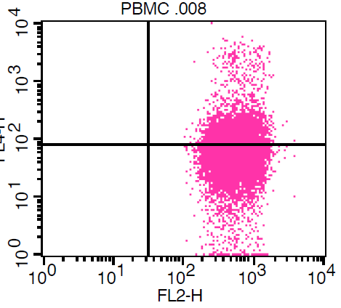
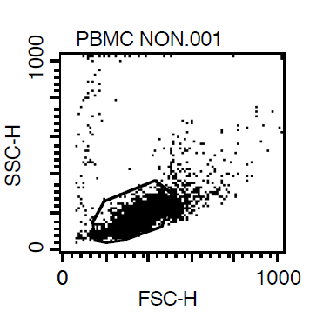
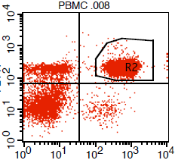
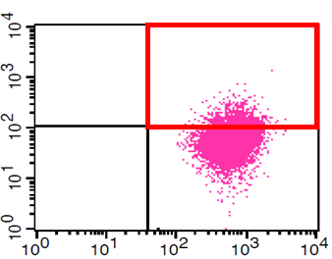
Additional file: Supplementary Fig 5a.
R3
a.
PBMCs
IL-17A
CD4⁺ IL-17A⁺
(Th17)
SSC
CD3
CD4
R1
R3
FSC
CD4
FoxP3
CD4 ⁺ FoxP3 ⁺
(Treg)
CD4

Slide 6
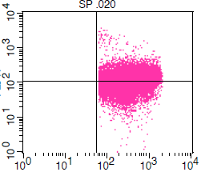
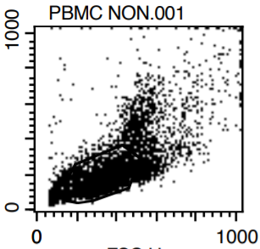
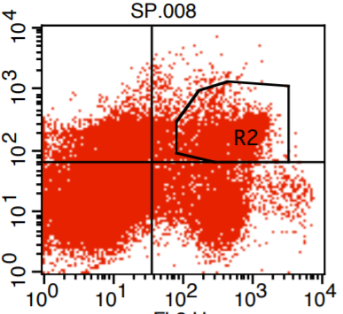
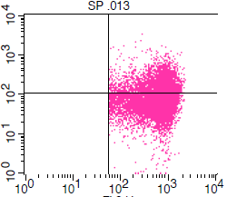
Additional file: Supplementary Fig 5b.
b.
Spleen
R3
IL-17A
CD4⁺ IL-17A⁺
(Th17)
SSC
CD3
CD4
R1
R3
FSC
CD4
CD4 ⁺ FoxP3 ⁺
(Treg)
FoxP3
CD4

Slide 7
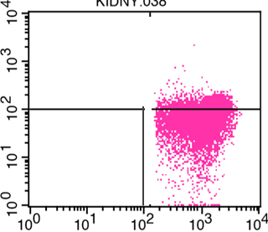
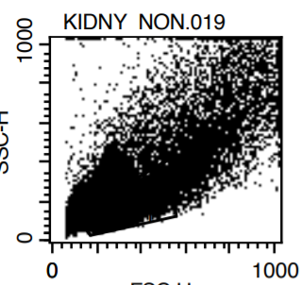
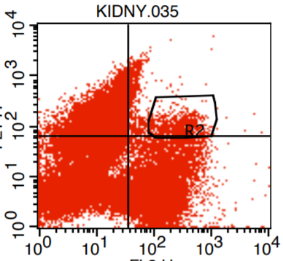
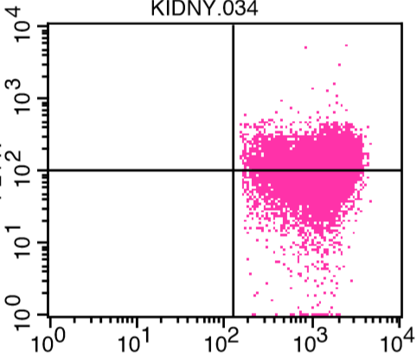
Additional file: Supplementary Fig 5c.
c.
Kidney
R3
IL-17A
CD4⁺ IL-17A⁺
(Th17)
SSC
CD3
CD4
R1
R3
FSC
CD4
FoxP3
CD4 ⁺ FoxP3 ⁺
(Treg)
CD4

