Slide 1
Pre-processing
Adapter Trimming
Length Distribution Confirmation
Read Collapse
Remove Reads generated from rRNA loci or plastid genome
Read Mapping to Genome with bowtie1
Prediction
Pre-filtering:
Length of Mature miRNA: 20~22nt;
Minimum Abudance of miRNA: ≥ 10;
Genome Matches on Genome: ≤ 20
Structure-filtering:
Minimal space size between miRNA and miRNA*: 5
Maximum space size between miRNA and miRNA*:300
Maximum mismatch in pairing region of miRNA duplex: 5
Maximum Mature BulgeSize: 4
Maxmum Size Different: 2
Maximum number of asymmetry : 3
Workflow for miRNA annotation
Abundance-filtering:
Strand bias filter: sense/total ≥ 0.9
Abundance bias: (mature + star) / total ≥ 0.7
Final-filtering
Blast against miRbase, version 22
    (≤ 4 nucleotide differences)
Found Matches in miRbase
No Matches in miRbase
Star expressed?
Known
Probable
Novel
Filtered
Filter loci found in less than 2 library if number of Library ≥ 10
Figure S1. Workflow of miRNA annotation.

Slide 2
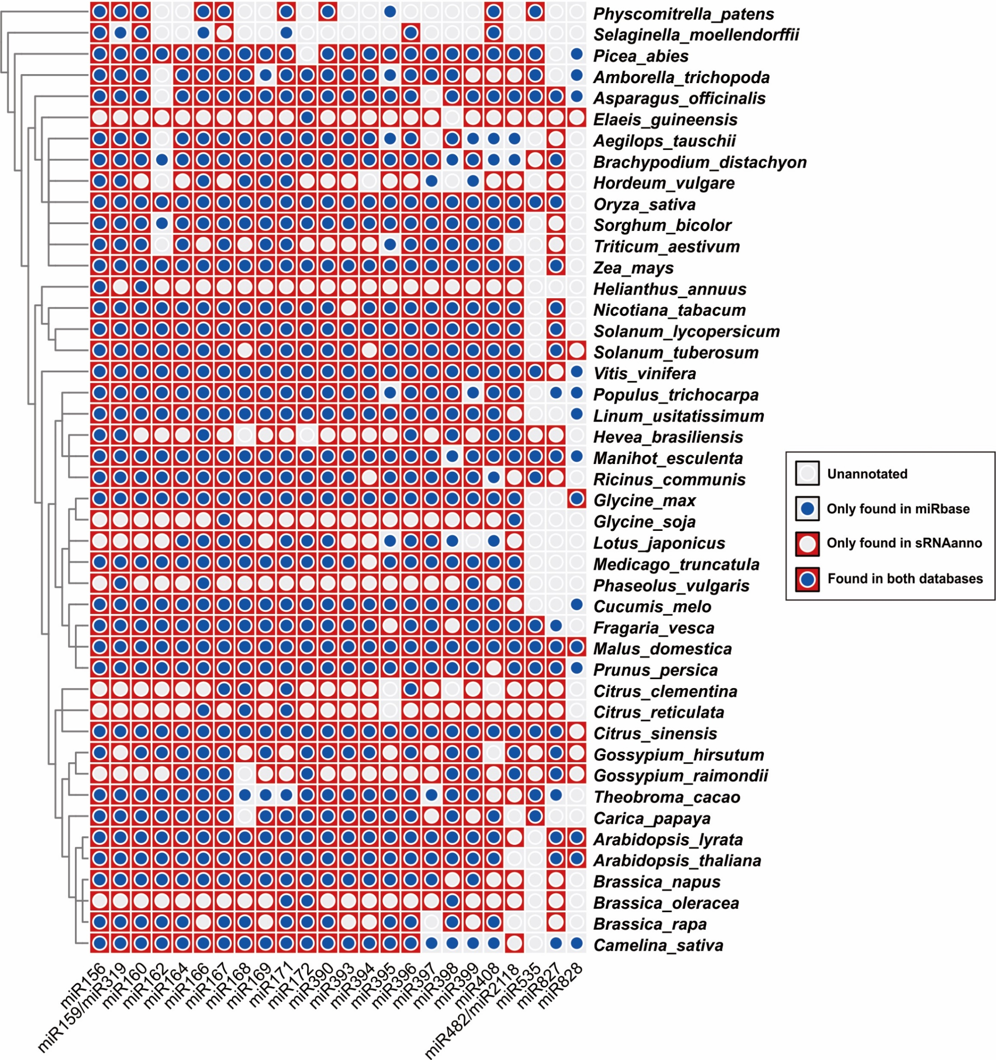
Figure S2. Conserved miRNAs overlapped between sRNAanno and miRbase. Conserved miRNAs of 45 plants were compared between sRNAanno and miRbase. All species are ordered according to the phylogenetic relationship of APG IV. Each cell represents whether a miRNA family (column) is annotated in a species (row) or not.

Slide 3
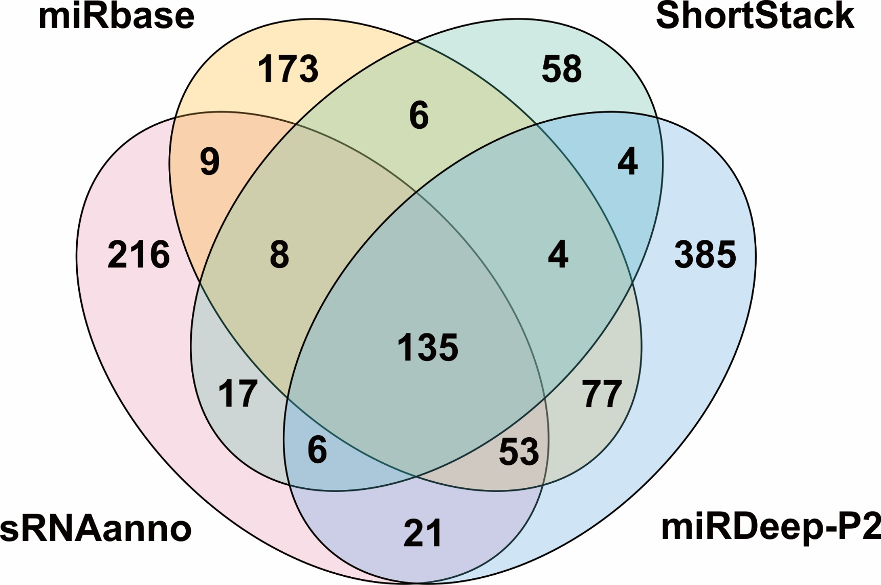
Figure S3. Comparison of miRNA annotation results of rice from miRbase, ShortStack, sRNAanno and miRDeep-P2.

Slide 4
Pre-processing
Adapter Trimming
Length Distribution Confirmation
Read Collapse
Workflow for PHAS analysis
Remove Reads generated from rRNA loci or plastid genome
Read Mapping to Genome with bowtie1
Prediction
Pre-filtering:
Minimum LocusLen: 100
Most abundance siRNA length: 21 nt or 24 nt
Phase pattern-filtering:
Maximum p-value: 1e-10
Minimum phase ratio: 0.3
Final-filtering
Minimum max region phase score: 15
21 nt PHAS
24 nt PHAS
Maximum Mean kmer frequency: ≤ 5
Filter loci found in less than 2 library if number of Library ≥ 10
Figure S4. Workflow of PHAS annotation.

Slide 5
Pre-processing
Adapter Trimming
Length Distribution Confirmation
Workflow for hc-siRNA loci annotation
Read Collapse
Remove Reads generated from rRNA loci or plastid genome
Read Mapping to Genome with bowtie1
Prediction
Pre-filtering:
(Abundance of 23/24 nt siRNA) / total abundance ≥ 0.5
Final-filtering
Remove loci overlapping with bona fine 24 nt PHAS loci
Figure S5. Workflow of hc-siRNA loci annotation.

Slide 6
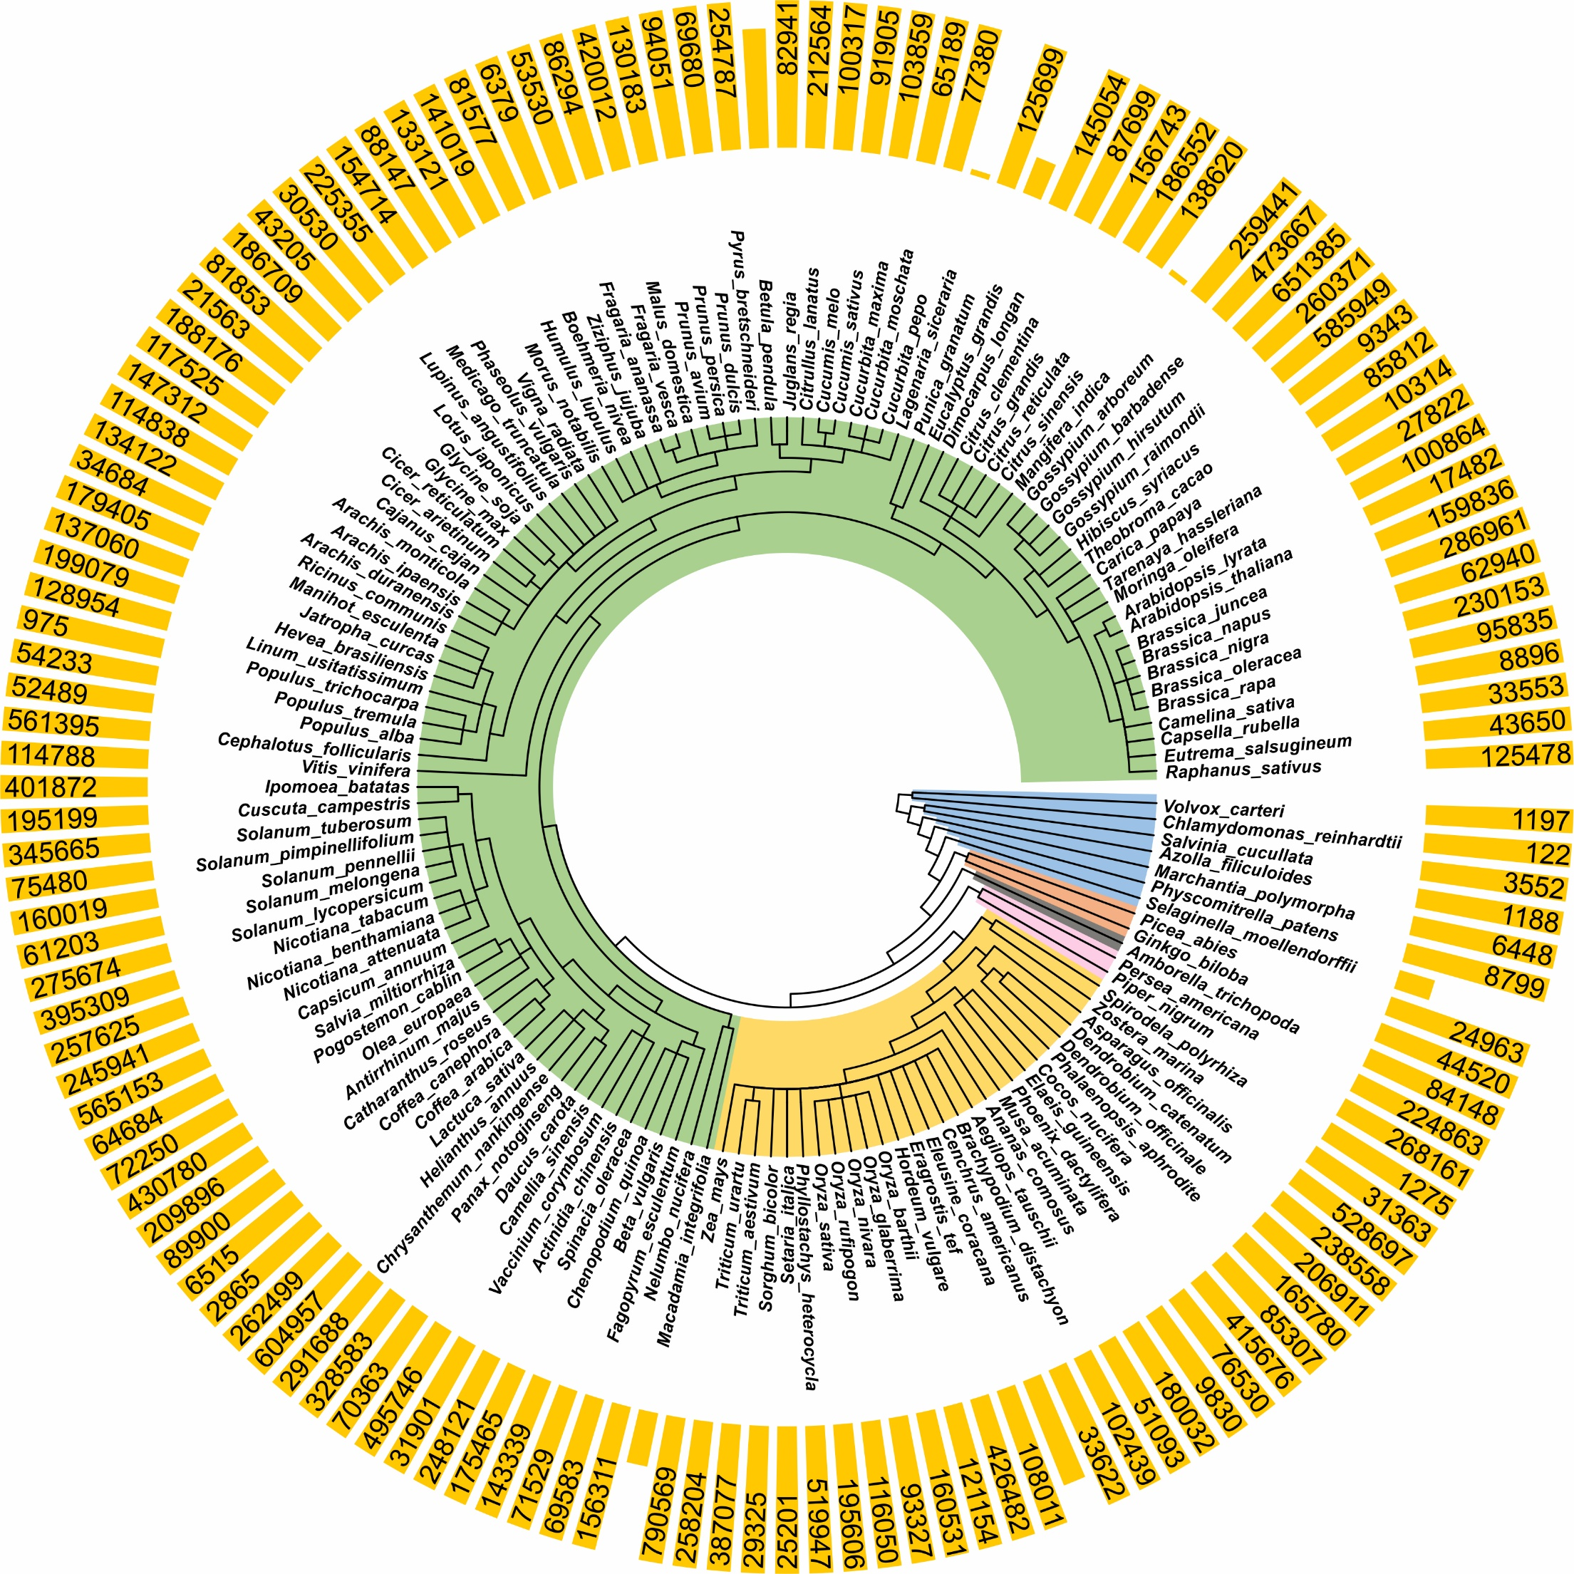
Figure S6. Overview of hc-siRNA loci of each species annotated in sRNAanno.

