Slide 1
ZT0
12
24
0
12
24
0
12
24
0
12
24
0
12
24
D1
A
B
C
D
E
Light
Dark
D8
Food
D14
LPS
ZT6
12
24
6
12
24
12
24
12
24
12
24
Figure S1. Design of TRF regimens for the first set of mice. All mice were subjected to a 6-h advanced shift on D8. They were divided into 5 groups based on TRF schedules. A: no TRF; B, TRF during ZT12-18 both before and after the shift; C, TRF during ZT12-18 before the shift and ZT18-24 after the shift; D, TRF during ZT18-24 before the shift and ZT12-18 after the shift; E, TRF during ZT18-24 both before and after the shift. One week after the 6-h advanced shift, mice were treated with LPS (15mg/kg body weight, ip) at ZT3. Health status was monitored for 7 days.

Slide 2
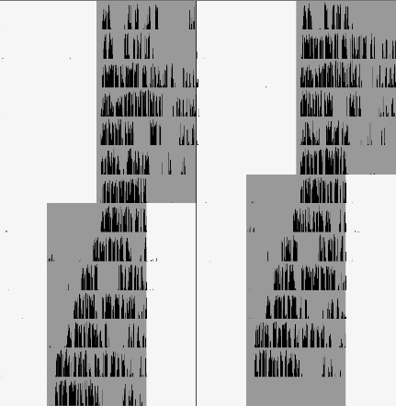
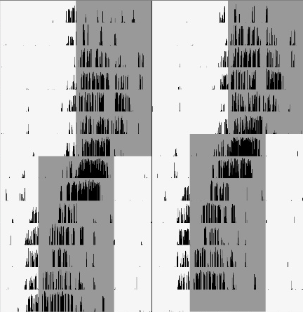
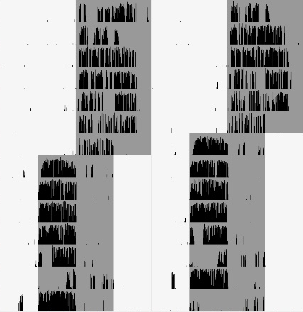
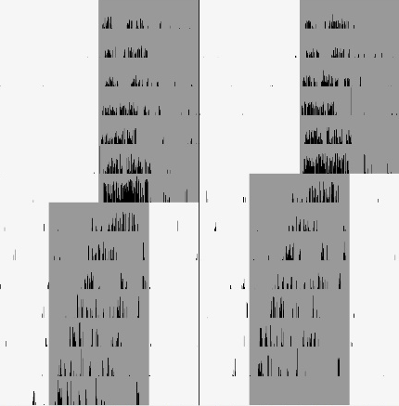
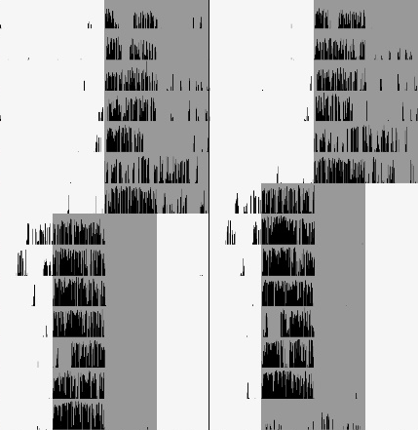
A
B
C
D
E
D1
D8
D14
Light
Dark
Food availability
Re-entrained from the shift
Figure S2. Additional representative double‐plotted actograms of wheel running activity of mice in group A-E. Blue arrows indicate the date by which the mice were re-entrained to the new LD cycle. The dashed arrows represent that the mice did not adapt to the new schedule within 7 days and were considered re-entrained on day 8.

Slide 3
Control
Jet lag
Jet lag + TRF
ZT0
12
24
0
12
24
0
12
24
D1
Light
Dark
D8
Food
D15
LPS
ZT0
12
24
12
24
12
24
Figure S3. Design of TRF regimens for the second set of mice. They were divided into 3 groups based on the 6-h advanced shift and TRF schedules. 1, Control, no TRF, no shift; 2, Shift, no TRF. 3, Shift plus TRF in ZT18-24 after the shift. One week after the advanced shift (D15), mice were treated with LPS (15mg/kg body weight, ip) at ZT3. Health status was monitored for 7 days.

Slide 4
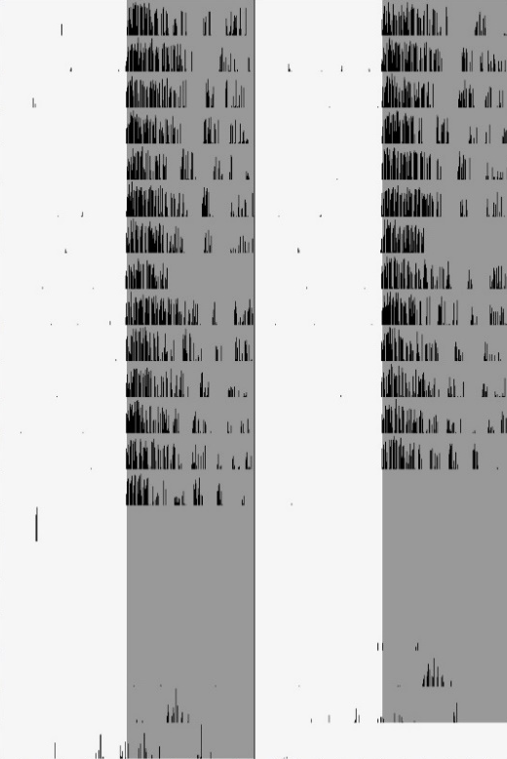
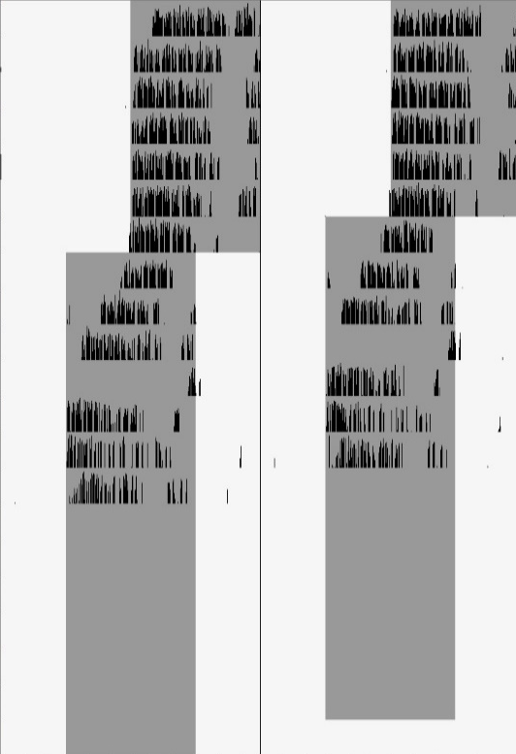
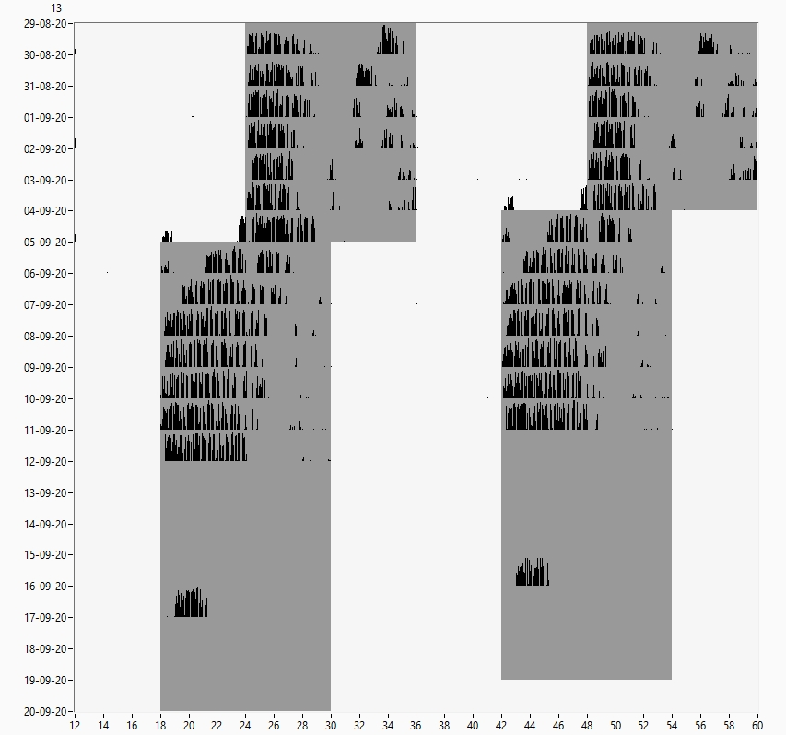
Control
Jet lag
Jet lag + TRF
D1
D8
D14
D21
Light
Dark
Food availability
Re-entrained from the shift
LPS treatment
Post-treatment period
Figure S4. Additional representative double‐plotted actograms of wheel running activity in experiment 2. Blue arrows indicate the date by which the mice were re-entrained to the new LD cycle.

