Slide 1
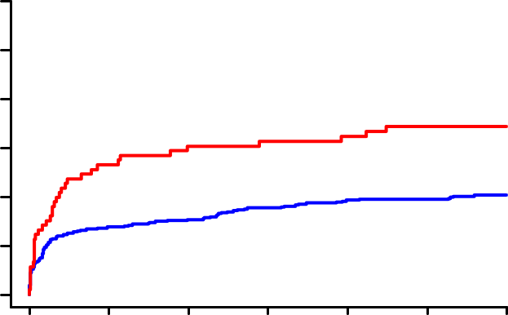
A
60
Reduced EF
B
60
Preserved EF
With CTO
Log-rank P=0.03
With CTO
Log-rank P=0.27
Without CTO
Without CTO
40
40
Death (%)
31.9%
Death (%)
20
20.5%
20
6.8%
0
0
3.4%
Number at risk
0
2
4
6
8
10
12
Number at risk
0
2
4
6
8
10
12
With CTO
Months after admission
With CTO
Months after admission
Without CTO
92
70
66
65
59
57
57
Without CTO
60
57
57
56
54
54
54
276
231
227
223
216
215
212
180
172
172
169
169
167
166
C
60
Reduced EF
D
60
Preserved EF
With CTO
Log-rank P=0.01
With CTO
Log-rank P=0.88
Without CTO
37.0%
Without CTO
40
40
MACE (%)
MACE (%)
22.2%
20
20
5.7%
0
0
5.2%
Number at risk
0
2
4
6
8
10
12
Number at risk
0
2
4
6
8
10
12
With CTO
Months after admission
With CTO
Months after admission
Without CTO
92
68
60
56
47
47
47
Without CTO
60
56
55
54
52
52
52
276
221
211
202
196
194
190
180
170
169
165
163
161
159
Supplementary Figure 1. Kaplan-Meier curves for the cumulative incidence of 1-year all-cause death (A, B) and MACE (C, D) in the propensity-score matched patients with and without CTO. A, C: Comparison in the reduced EF group; B, D: Comparison in the preserved EF group. MACE: major adverse cardiac event; EF: ejection fraction; CTO: chronic total occlusion.

Slide 2
A
Reduced EF
B
Preserved EF
100
100
No CTO-PCI
No CTO-PCI
80
CTO-PCI: within 30 days
80
CTO-PCI: within 30 days
CTO-PCI: over 30 days
CTO-PCI: over 30 days
60
Log-rank P=0.01
60
Log-rank P=0.74
Death (%)
44.0%
Death (%)
40
31.6%
40
20
20
16.7%
5.6%
7.7%
0
0
6.8%
0
2
4
6
8
10
12
0
2
4
6
8
10
12
Number at risk
Months after admission
Number at risk
Months after admission
No CTO-PCI
67
19
18
42
15
18
41
13
17
40
13
17
35
12
17
33
12
17
33
12
17
No CTO-PCI
46
13
6
42
12
6
42
12
6
41
12
6
41
11
5
41
11
5
41
11
5
CTO-PCI: within 30 days
CTO-PCI within 30 days
CTO-PCI: over 30 days
CTO-PCI over 30 days
C
100
Reduced EF
D
Preserved EF
100
No CTO-PCI
No CTO-PCI
80
CTO-PCI: within 30 days
80
CTO-PCI: within 30 days
CTO-PCI: over 30 days
CTO-PCI: over 30 days
60
Log-rank P=0.06
60
MACE (%)
47.7%
MACE (%)
Log-rank P=0.75
40
27.0%
40
20
22.2%
20
9.3%
7.7%
0
0
0.0%
0
2
4
6
8
10
12
0
2
4
6
8
10
12
Number at risk
Months after admission
Number at risk
Months after admission
No CTO-PCI
67
19
18
40
15
18
36
13
17
26
12
14
26
12
14
26
12
14
26
12
14
No CTO-PCI
46
13
6
40
12
6
39
12
6
38
12
6
38
11
5
38
11
5
38
11
5
CTO-PCI: within 30 days
CTO-PCI within 30 days
CTO-PCI: over 30 days
CTO-PCI over 30 days
Supplementary Figure 2. Kaplan-Meier curves for the cumulative incidence of 1-year all-cause death (A, B) and MACE (C, D) among the 3 sub-groups: successful CTO-PCI attempted within 30 days (solid red line), successful CTO-PCI attempted over 30 days (solid blue line) and no CTO-PCI (black dotted line). A, C: Comparison in the reduced EF group; B, D: Comparison in the preserved EF group. A: Pair-wise P-values in the post hoc analysis are: CTO-PCI within 30 days vs. over 30 days, P=0.08; CTO-PCI over 30 days vs. no CTO-PCI, P=0.01; CTO-PCI within 30 days vs. no CTO-PCI, P=0.32. MACE: major adverse cardiac event; EF: ejection fraction; CTO: chronic total occlusion; PCI: percutaneous coronary intervention.

