Slide 1
TITLE: Acquisition of cancer stem cell capacities after spontaneous cell fusion
Authors: Candice Merle^{1,2}, Pauline Lagarde³, Lydia Lartigue^{3,4}, Frédéric Chibon^{1,5, §}
Affiliations:
¹ INSERM U1037, Cancer Research Center in Toulouse (CRCT), 31037 Toulouse, France.
² University of Toulouse 3, Paul Sabatier, 118 route de Narbonne, 31062 Toulouse Cedex 9, France
³ INSERM U1218, 229 cours de l’Argonne, F-33076 Bordeaux, France.
⁴ University of Bordeaux, 146 rue Léo Saignat, F-33000 Bordeaux, France.
⁵ Institut Claudius Régaud, IUCT-Oncopole, Toulouse, France.
§ Corresponding author: Dr Frédéric Chibon. Current address: CRCT-IUCT-O; 2 avenue Hubert Curien 31037 Toulouse Cedex 1- FRANCE. E-mail: frederic.chibon@inserm.fr

Slide 2
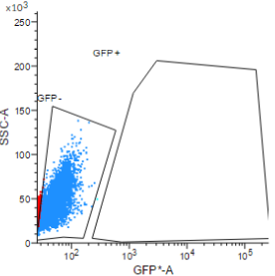
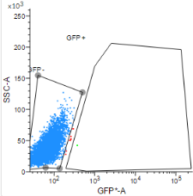
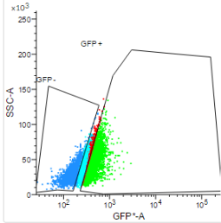
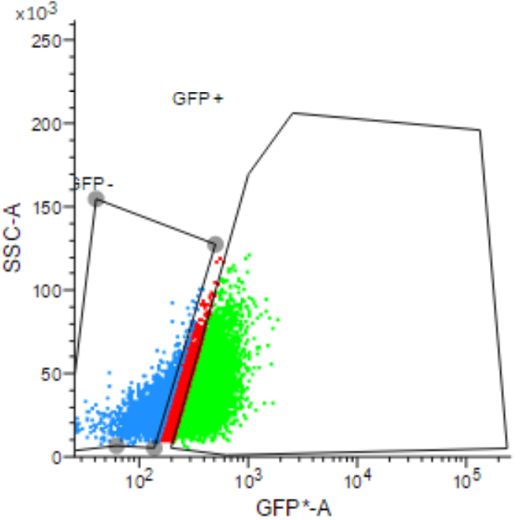
A
E6E7
RST
ALDHhigh
+DEAB
ALDHhigh
+DEAB
ALDHlow
ALDHlow
ALDHhigh
ALDHhigh
ALDHlow
ALDHlow
B
 | E6E7 | RST | H1 | H2 | H3 | H4
ALDHlow | - | 1/3093 | - | 1/2672 | 1/873 | -
ALDHhigh | 1/3203 | 1/176 | 1/422 | 1/108 | 1/104 | 1/82
p-value | 0.227 | 0.000571 | 0.0023 | 0.000159 | 0.001350 | 0.000001
 | ns | *** | ** | *** | ** | ***
Figure S1

Slide 3
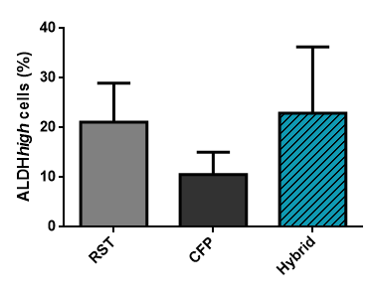
Figure S2

Slide 4
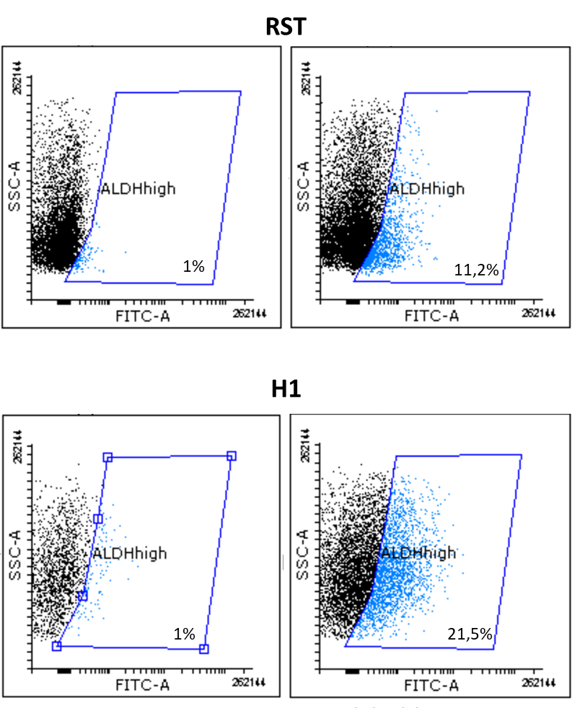
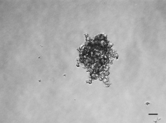
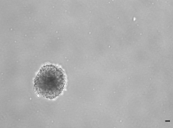
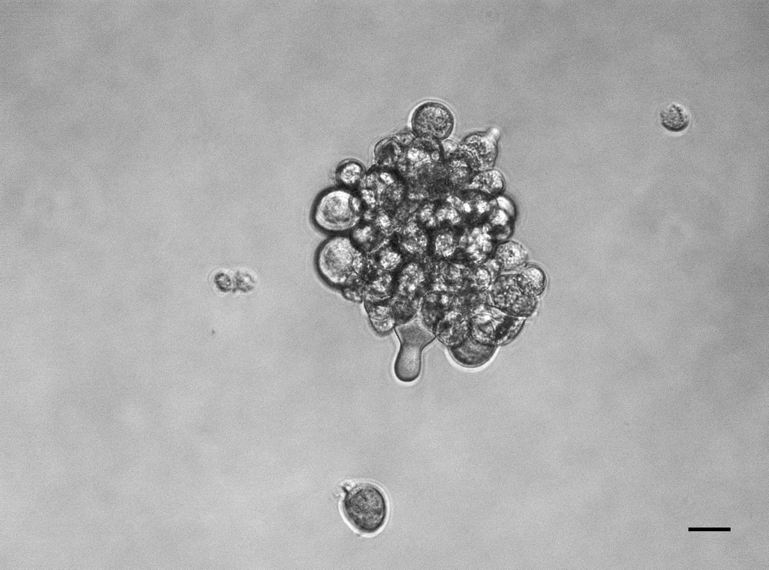
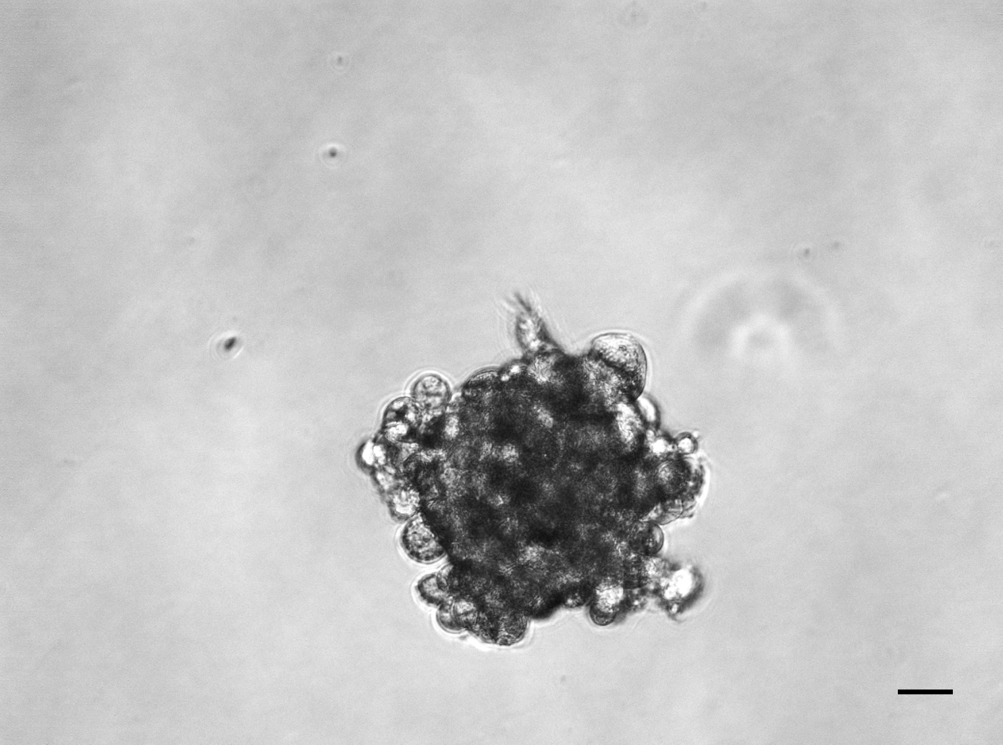
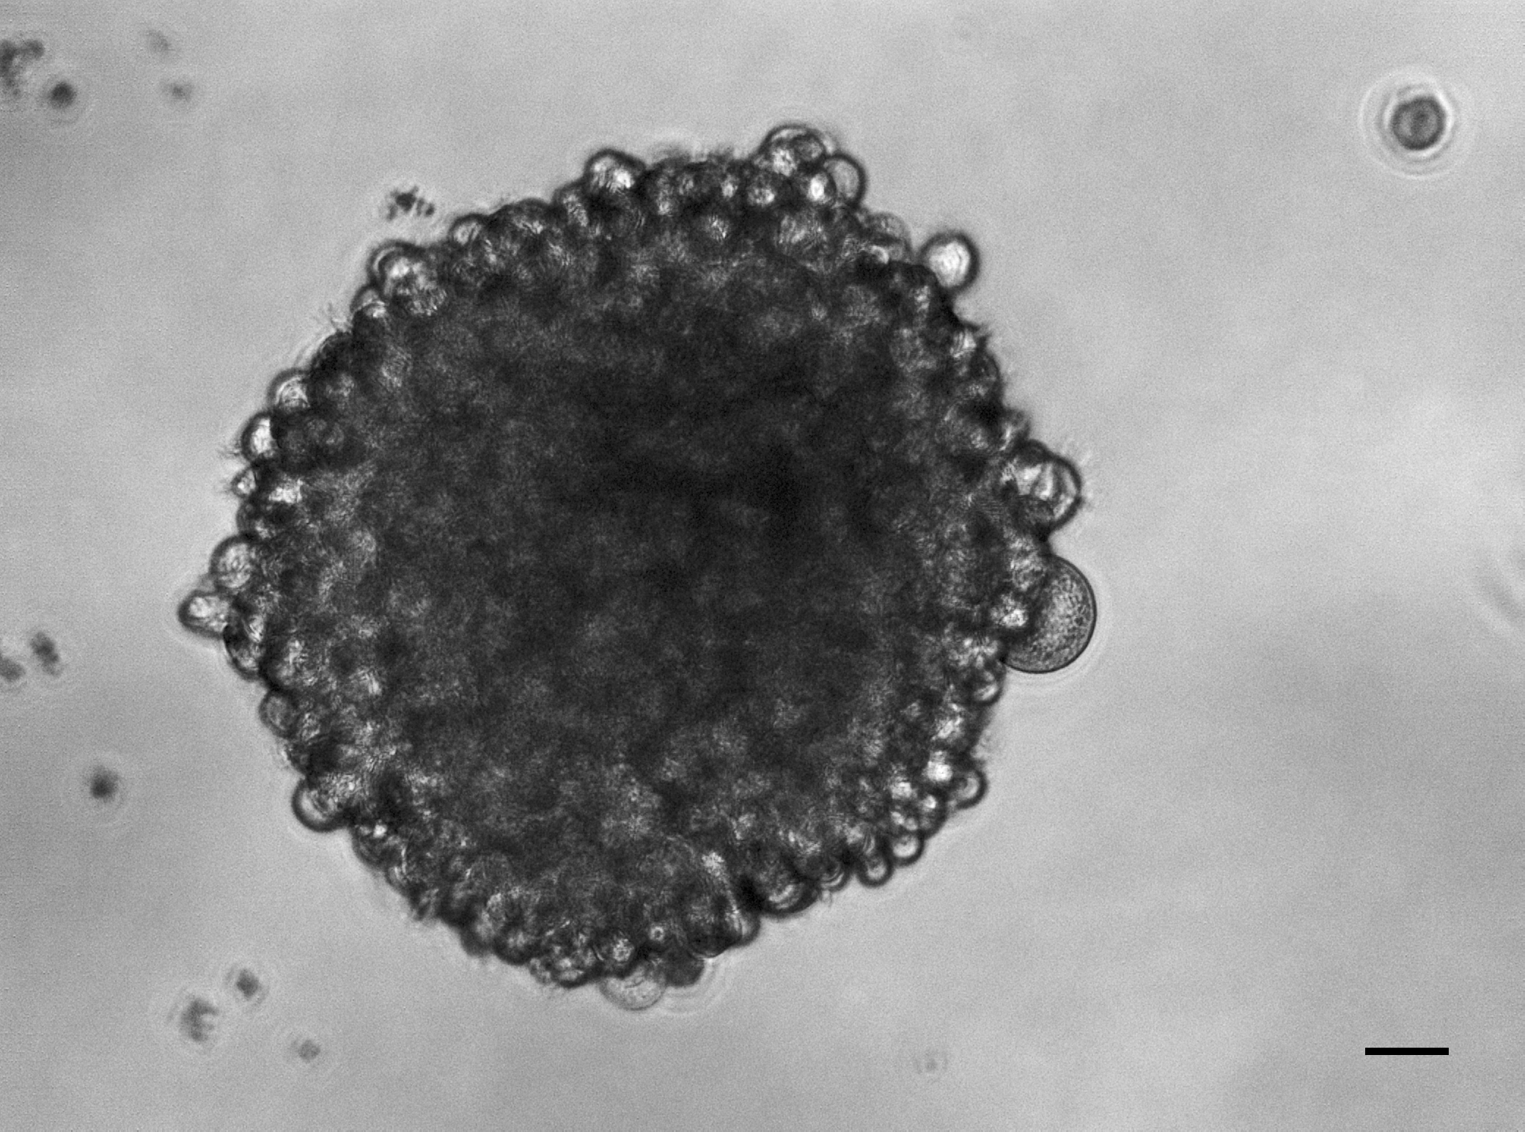
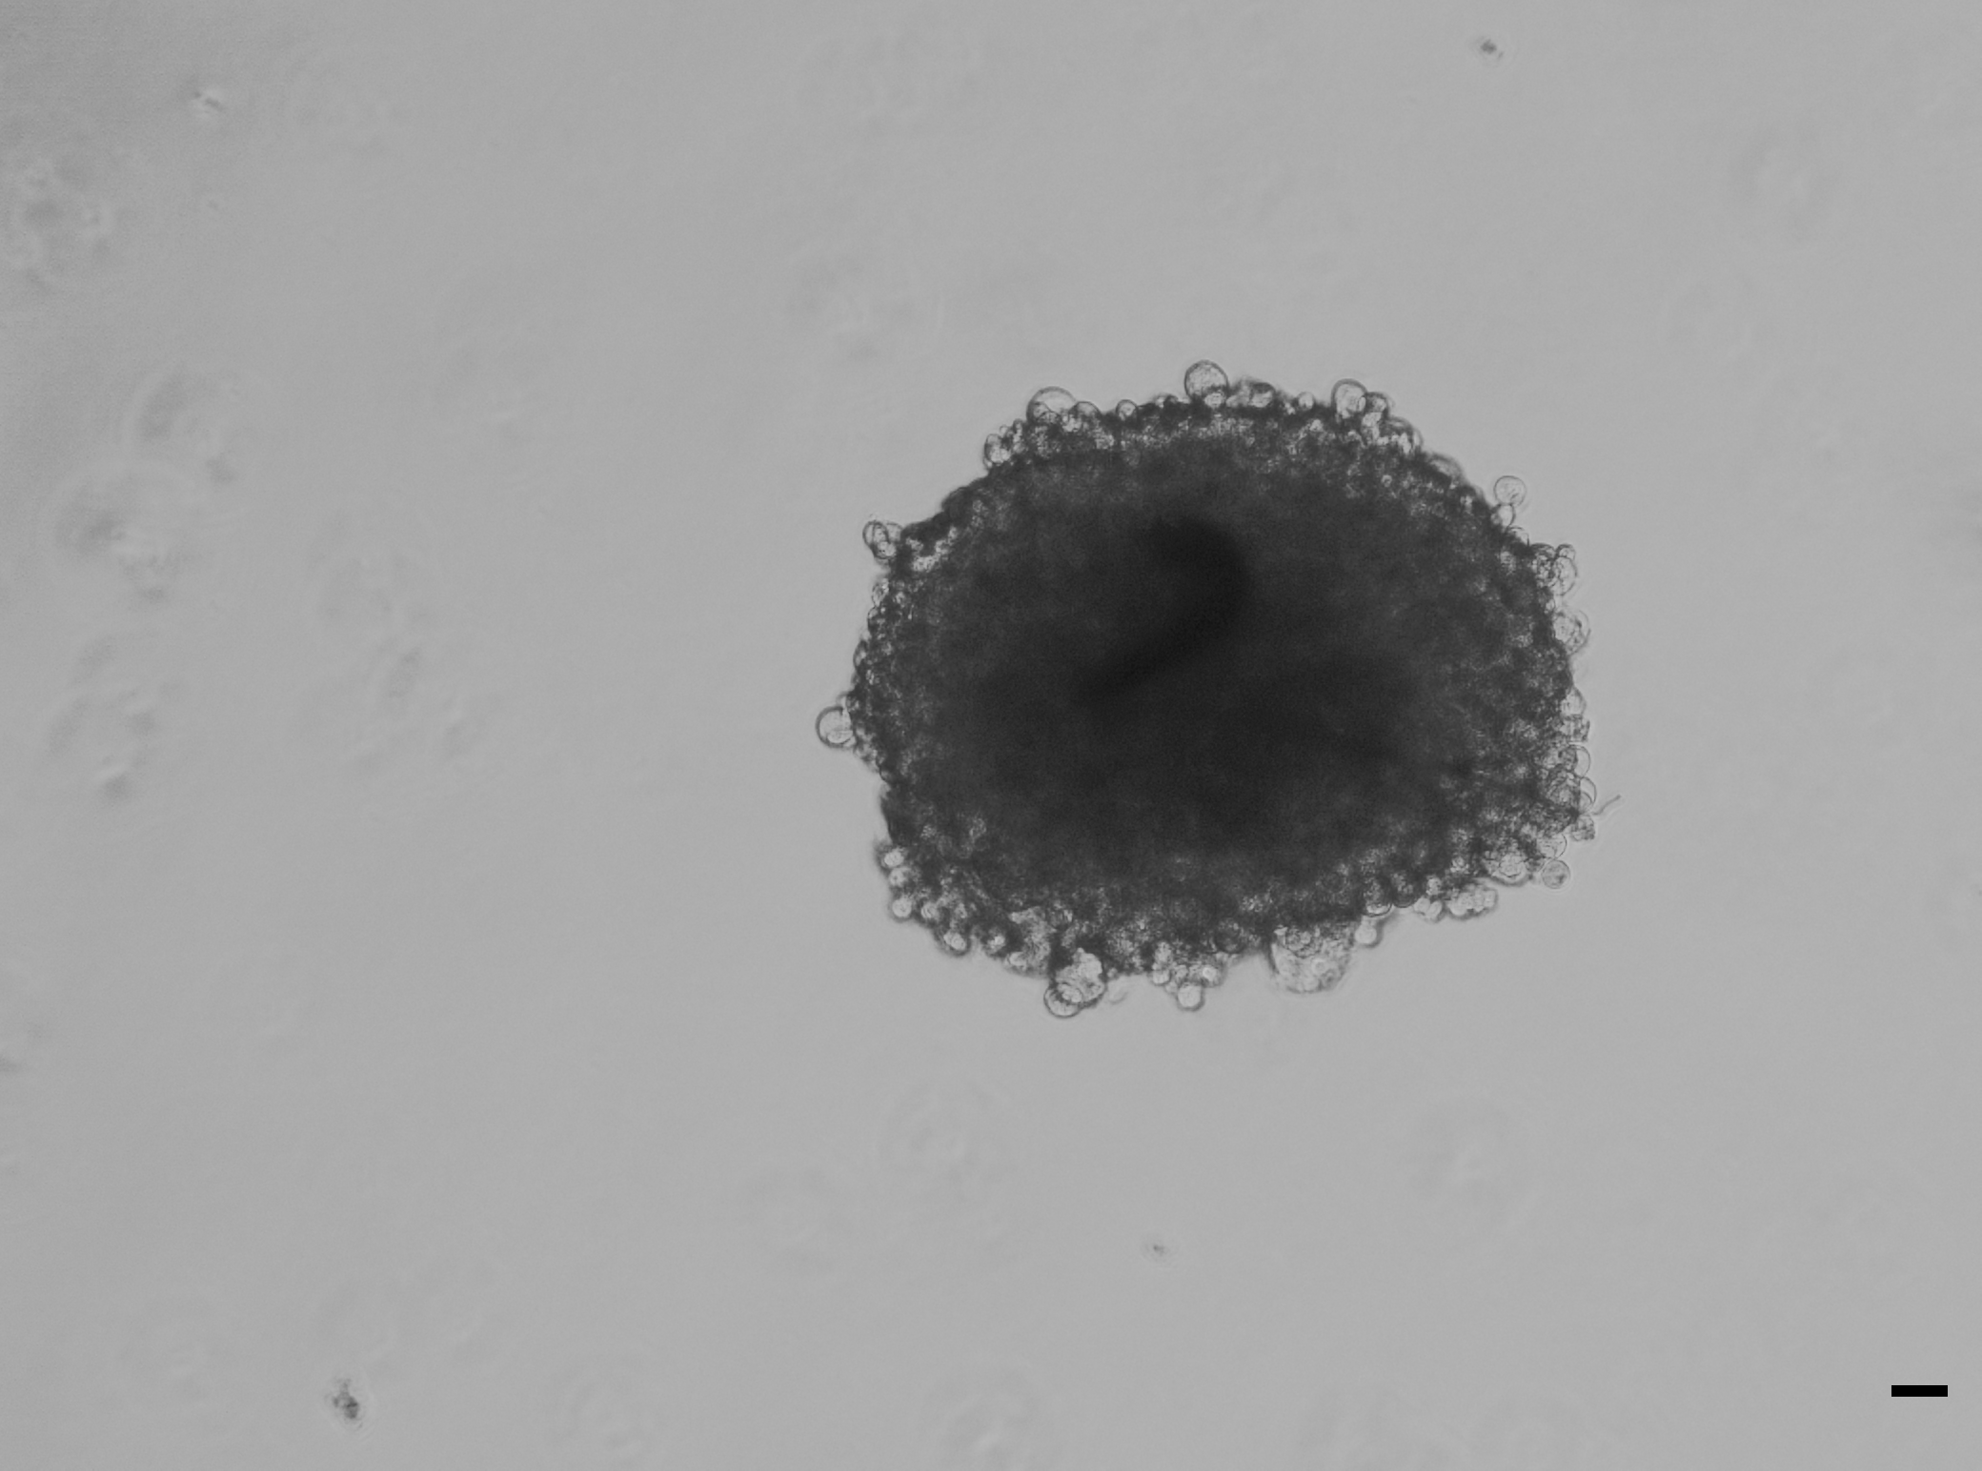
A
+DEAB
+ALDEFLUOR
RST
+DEAB
+ALDEFLUOR
H1
B
E6E7
RST
H1
H2
H3
H4
Figure S3

Slide 5
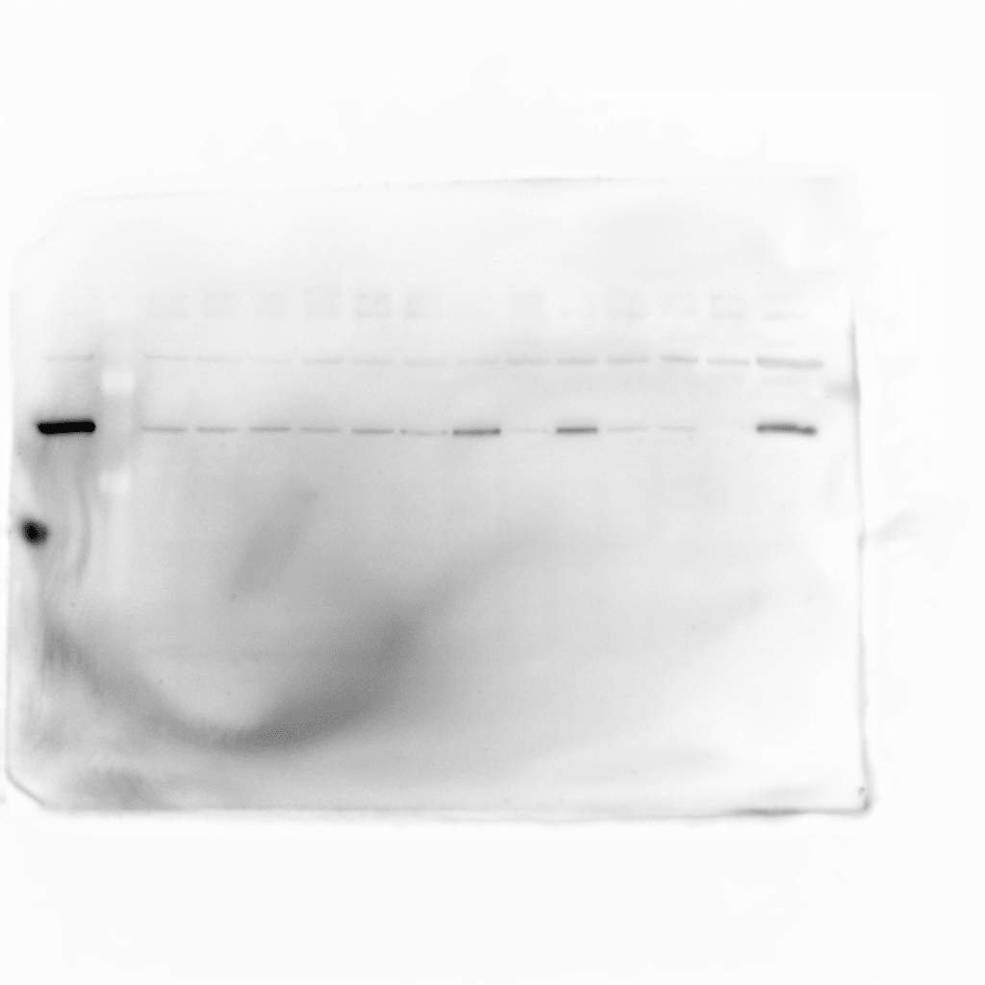
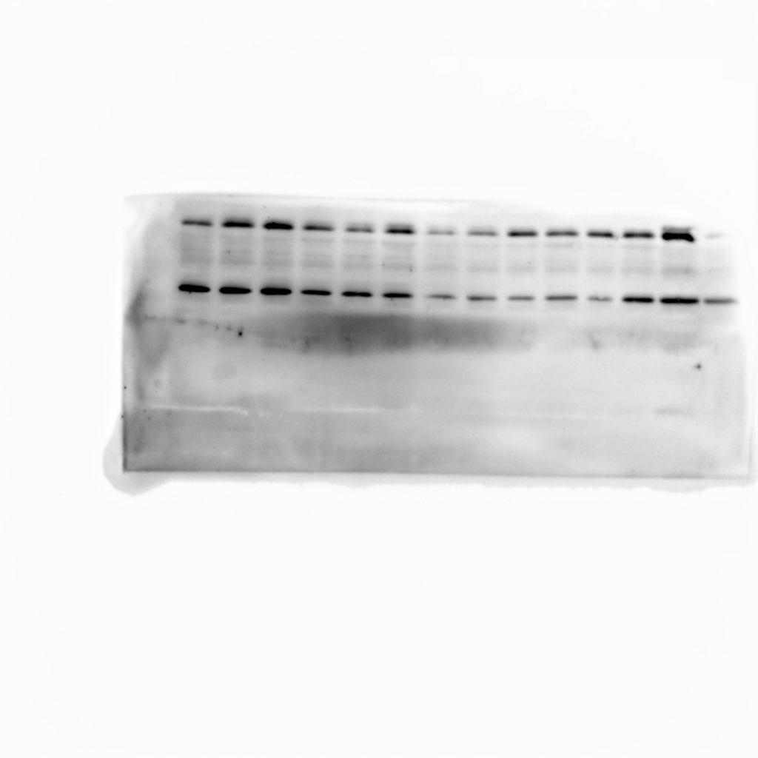
OCT4
E6E7
RST
H1
H2
H3
H4
NANOG
E6E7
RST
H1
H2
H3
H4
Figure S4

Slide 6
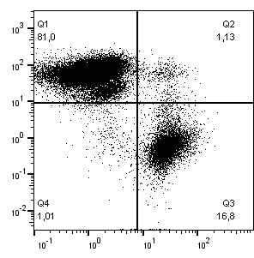
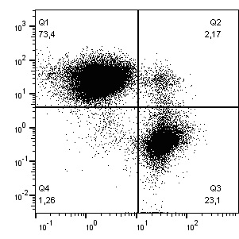
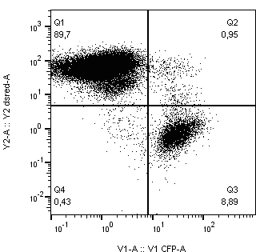
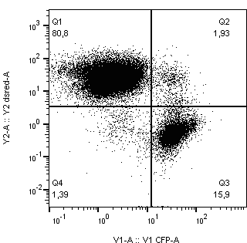
Fusion E6E7low/RSTlow
Fusion E6E7low/RSThigh
Fusion E6E7high/RSTlow
Fusion E6E7high/RSThigh
DsRed
CFP
Figure S5

Slide 7
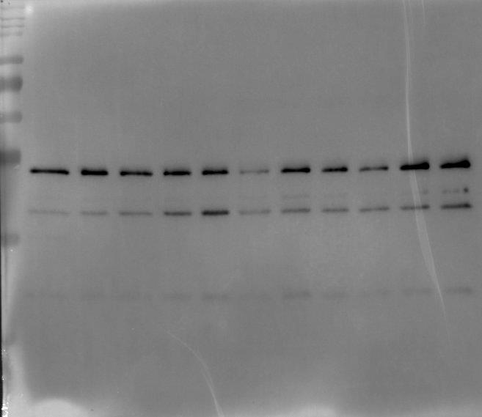
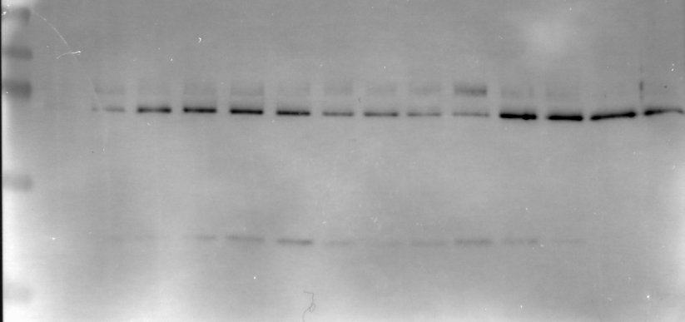
siRNA
NANOG
siRNA NT
WT
siRNA
NANOG
WT
siRNA NT
Figure S6

