Slide 1
Supplementary Figures
Natural killer anti-tumor activity can be achieved by in vitro incubation with heat-killed BCG
Gloria Esteso, Nacho Aguiló, Esther Julián, Omodele Ashiru, Mei. M. Ho, Carlos Martín and Mar Valés‐Gómez

Slide 2
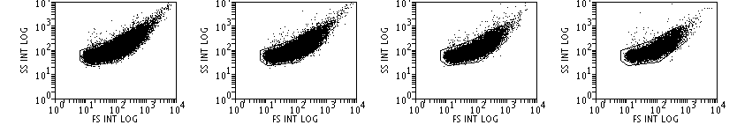
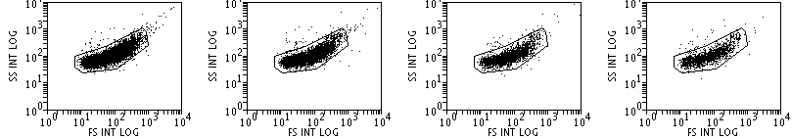
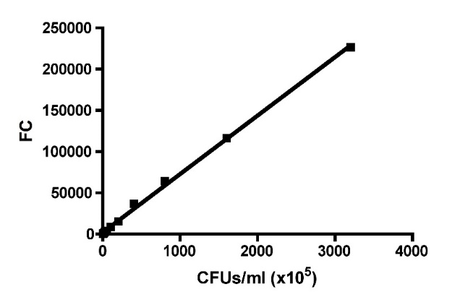
Supplementary Figure 1
1:1
1:2
1:4
1:8
226530 events
116637 events
64555 events
37013 events
1:16
1:32
1:64
1:128
15555 events
8556 events
4079 events
2428 events
r² = 0.9981
Supplementary Figure 1. The number of BCG cells estimated by flow cytometry. Serial dilutions, as indicated, of BCG grown in Middlebrook 7H10 medium were prepared and analysed by flow cytometry at constant speed during 30 seconds. The number of events within the FSC vs SSC region corresponding to bacteria (A) were used to build a calibration curve (B).

Slide 3
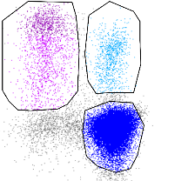
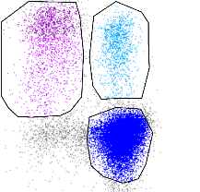
Supplementary Figure 2
UNTREATED
TICE 100% viable
TICE 50% viable
TICE 0%
viable
Activated
0.67%
Activated
33%
Activated
37.1%
Activated
35.4%
Number represented in activated lymphocytes graph
NK
NK
NK
NK
CD56 PE-Cy5
CD3 FITC
CD3 FITC
CD3 FITC
CD3 FITC
NK CD56 bright /dim
CD56 PE-Cy5
CD56^{bright} 7%
CD56^{bright} 42%
CD56^{bright} 53%
CD56^{bright} 55%
Number represented in CD56^{bright} graph
CD56^{dim} 93%
CD56^{dim} 58%
CD56^{dim} 47%
CD56^{dim} 45%
CD3 FITC
Supplementary Figure 2. Gating strategy for activated lymphocytes and NK CD56^{bright} population after co-culture with BCG. PBMCs from a healthy donor were incubated with the indicated concentrations of BCG-Tice at a 6:1 ratio (bacteria to PBMC). At day 7, cells in suspension were recovered from the co-culture, centrifuged and analysed by flow cytometry. Once dead cells were eliminated, the percentage of activated lymphocytes was determined by identifying the resting and activating lymphocyte regions in the FSC vs SSC plot. The percentage of activated lymphocytes from this plot was included in the subsequent graphs. NK cells were selected within the whole lymphocyte population in a CD3 vs CD56 plot. The percentage of CD56^{bright} population, within the NK cell region, was plotted.

Slide 4
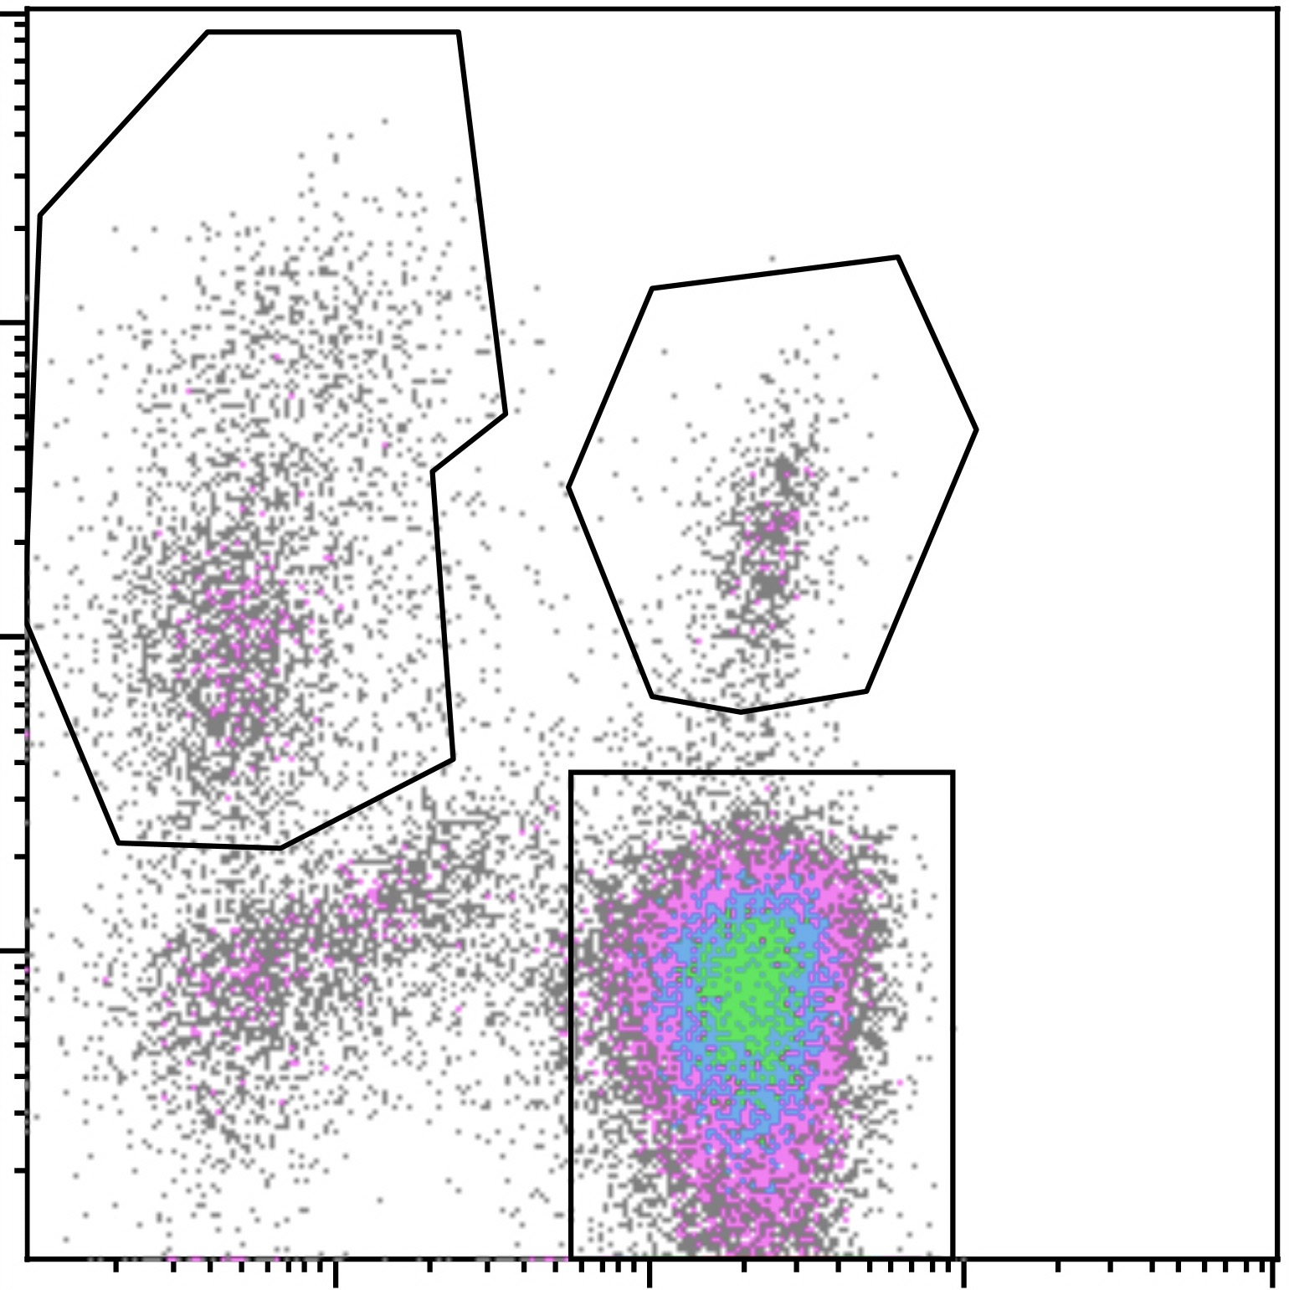
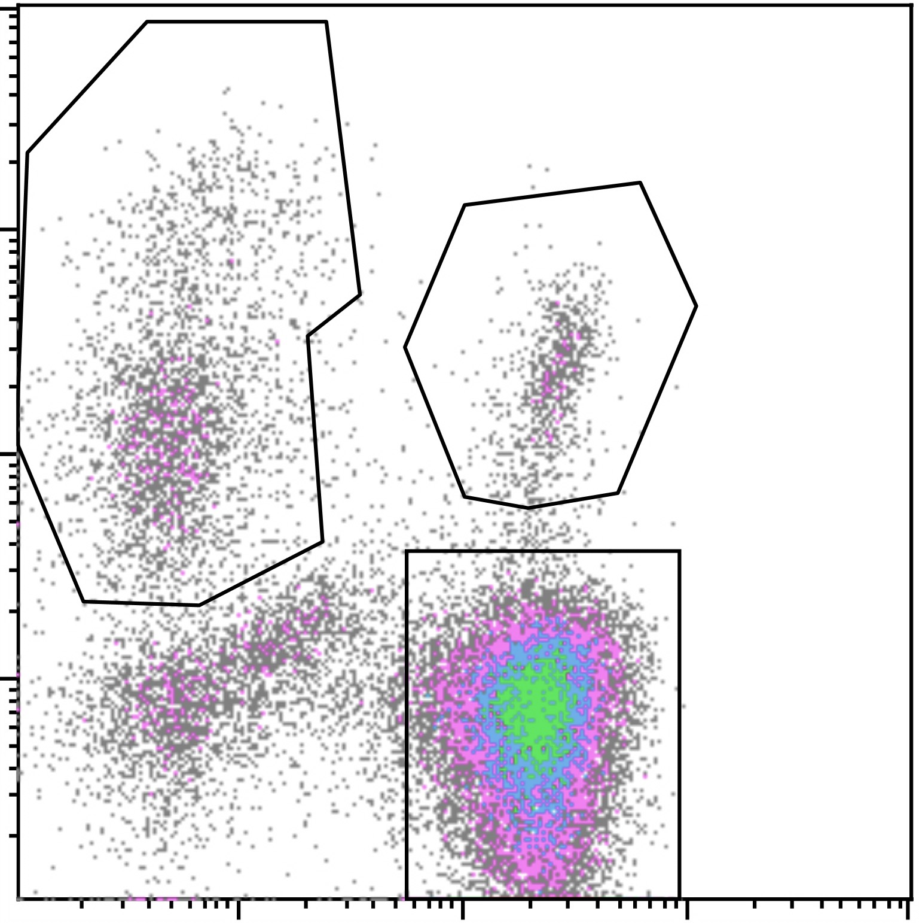
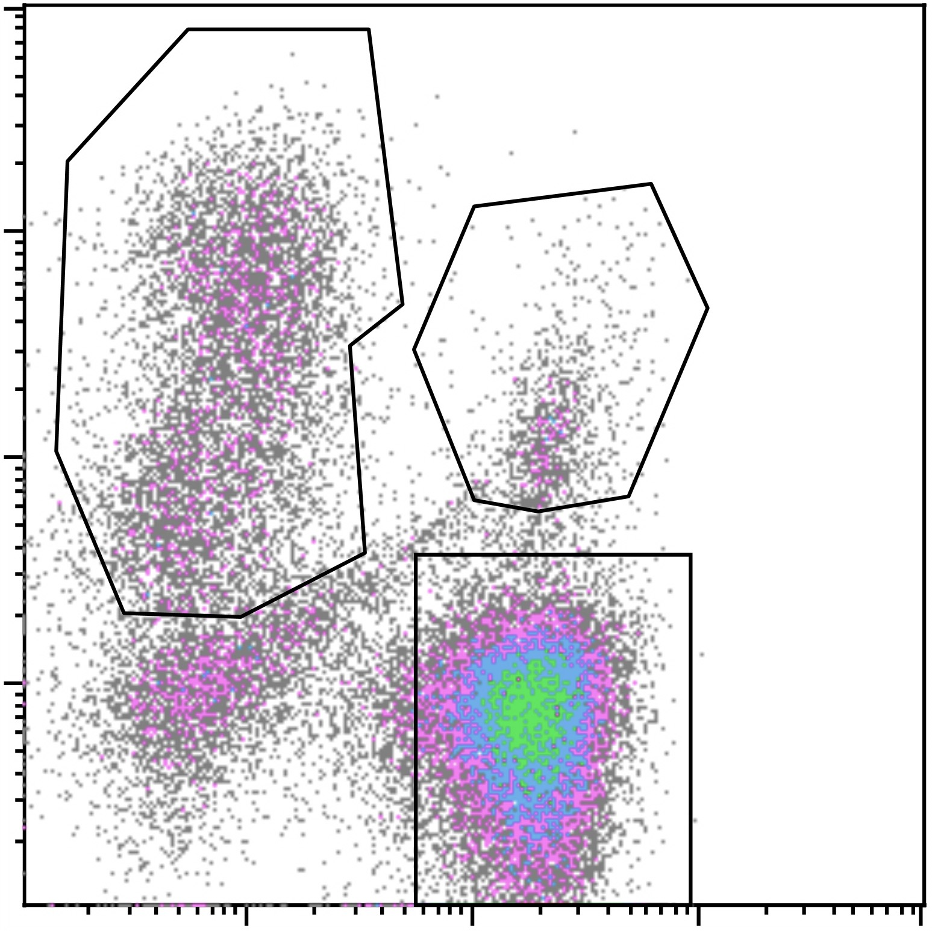
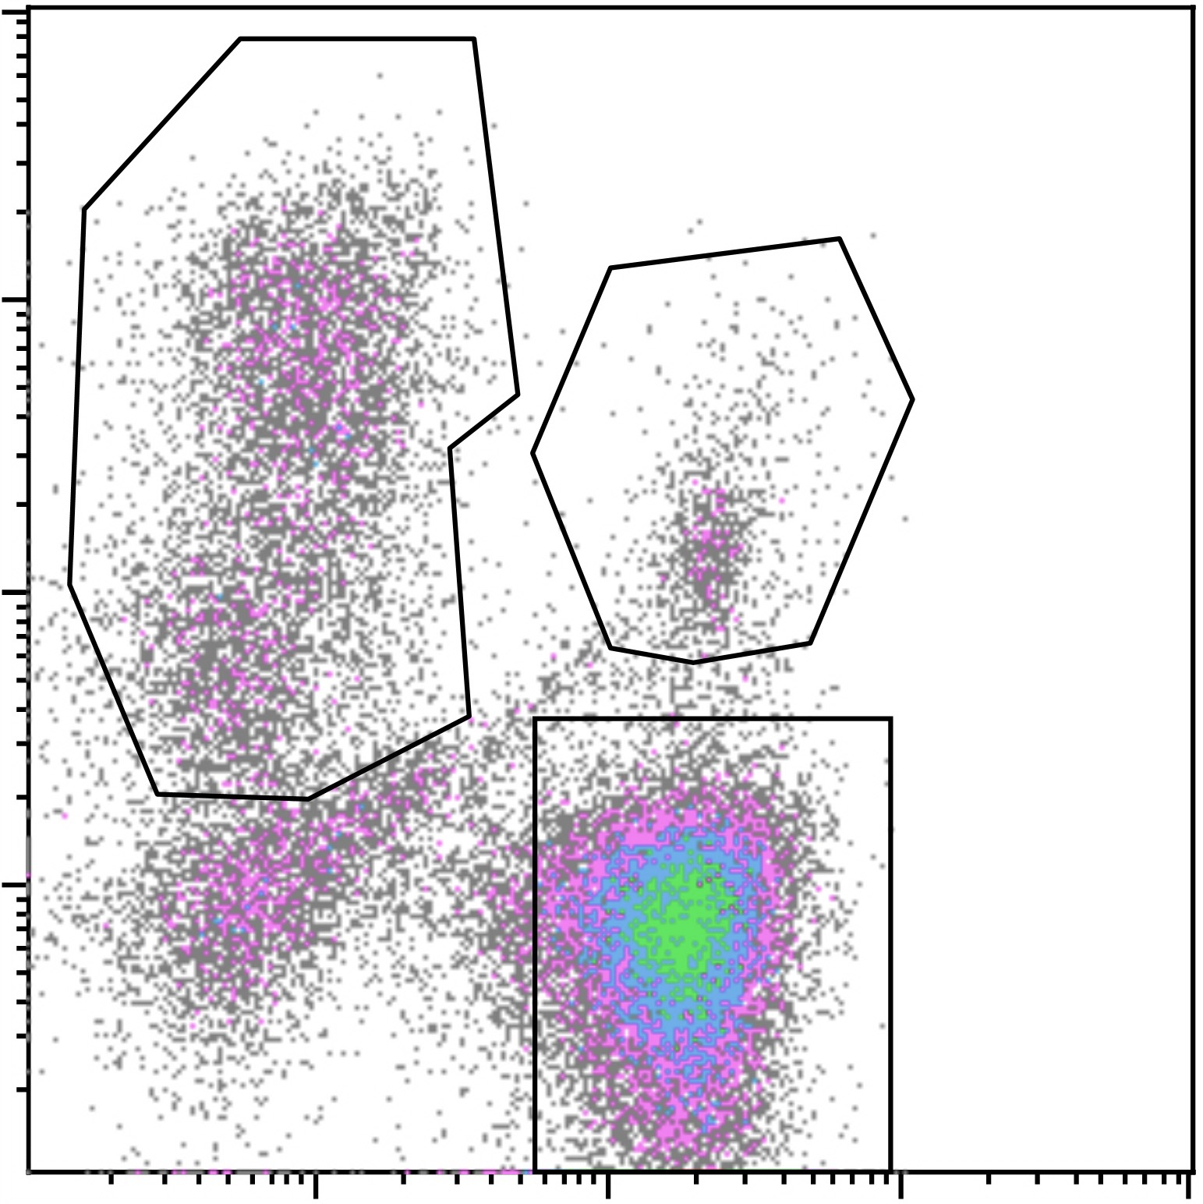
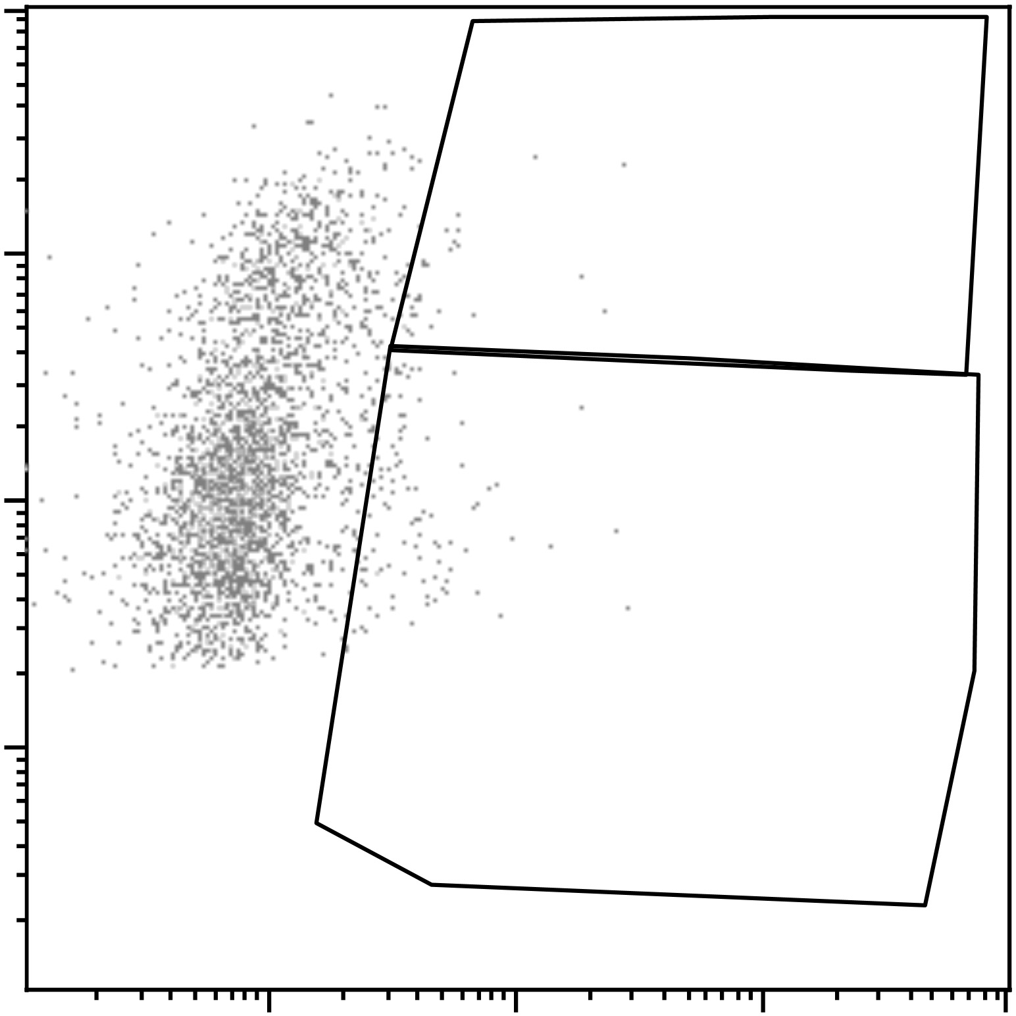
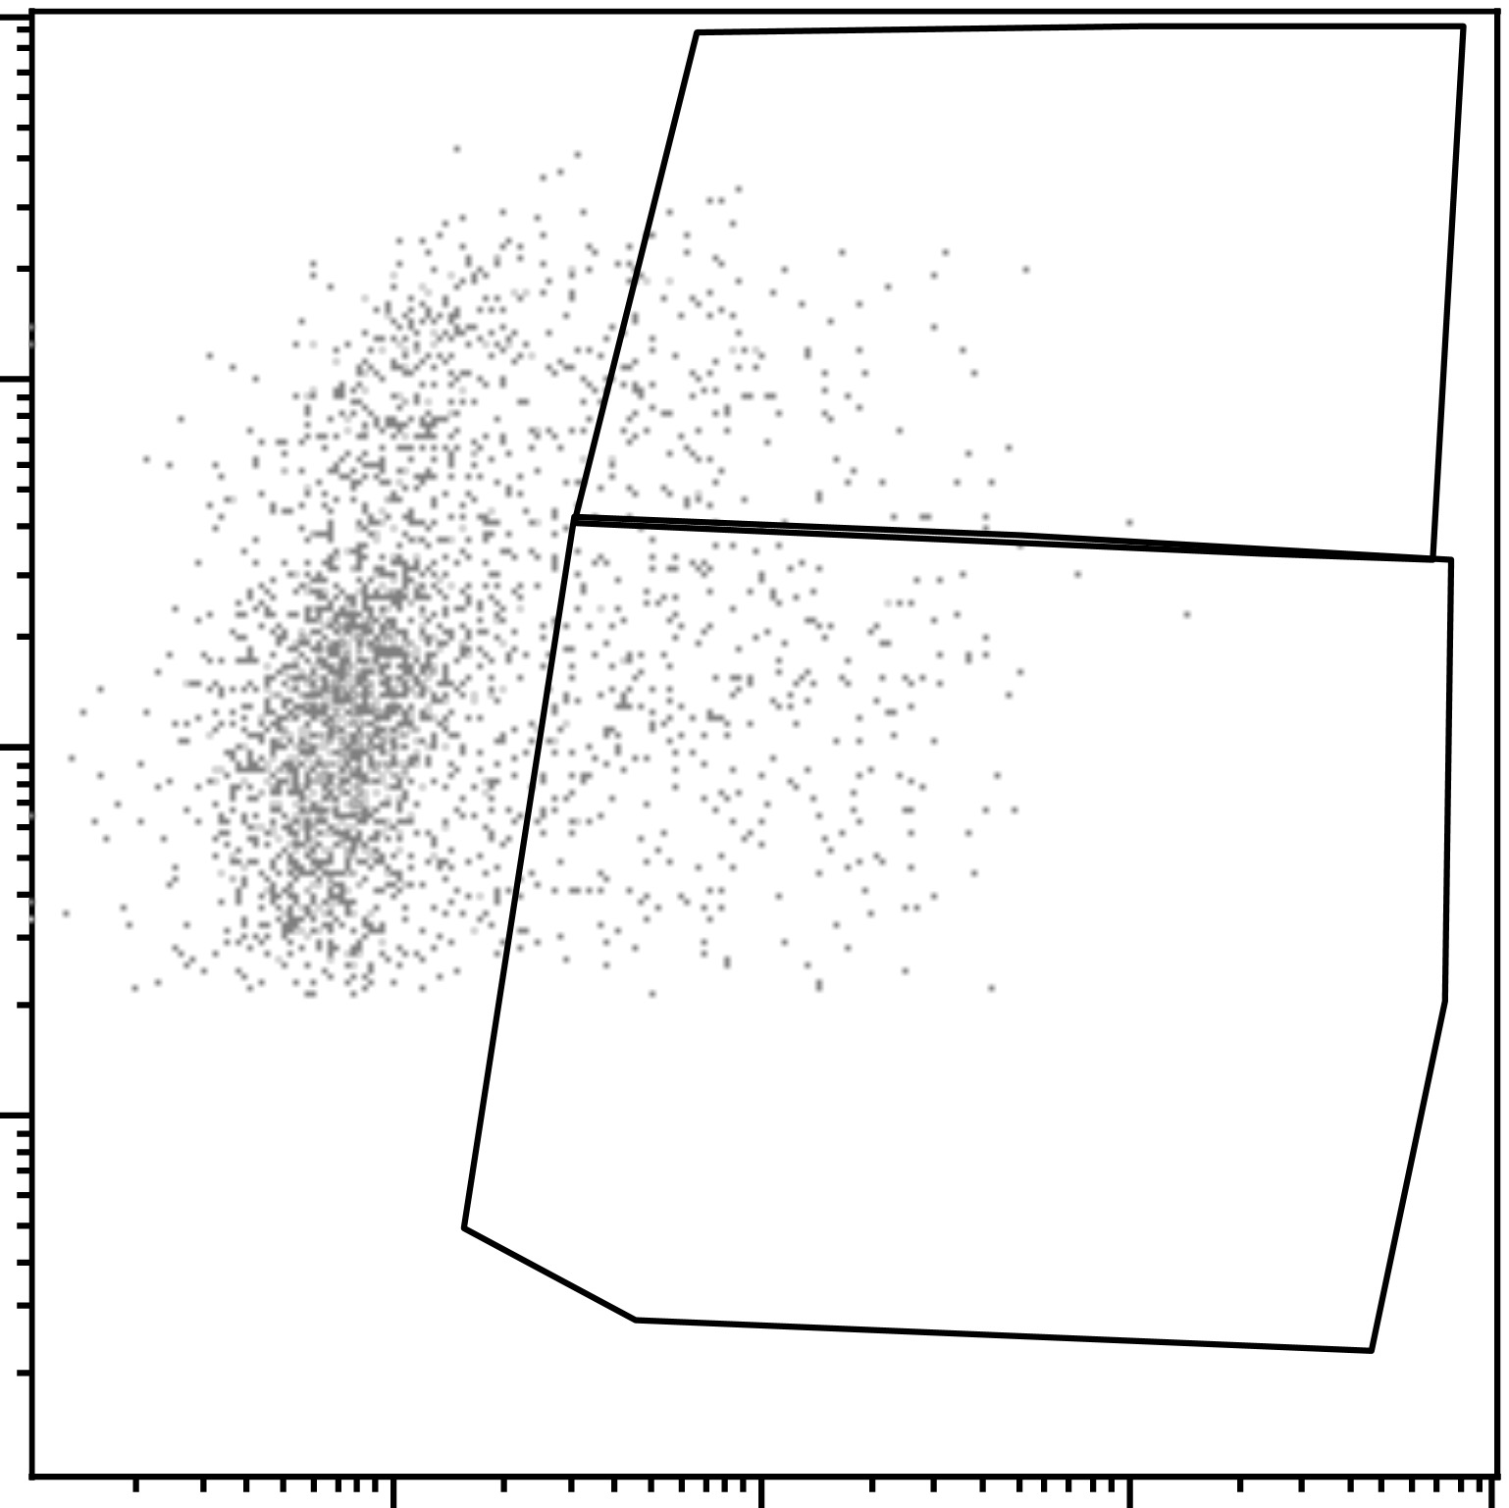
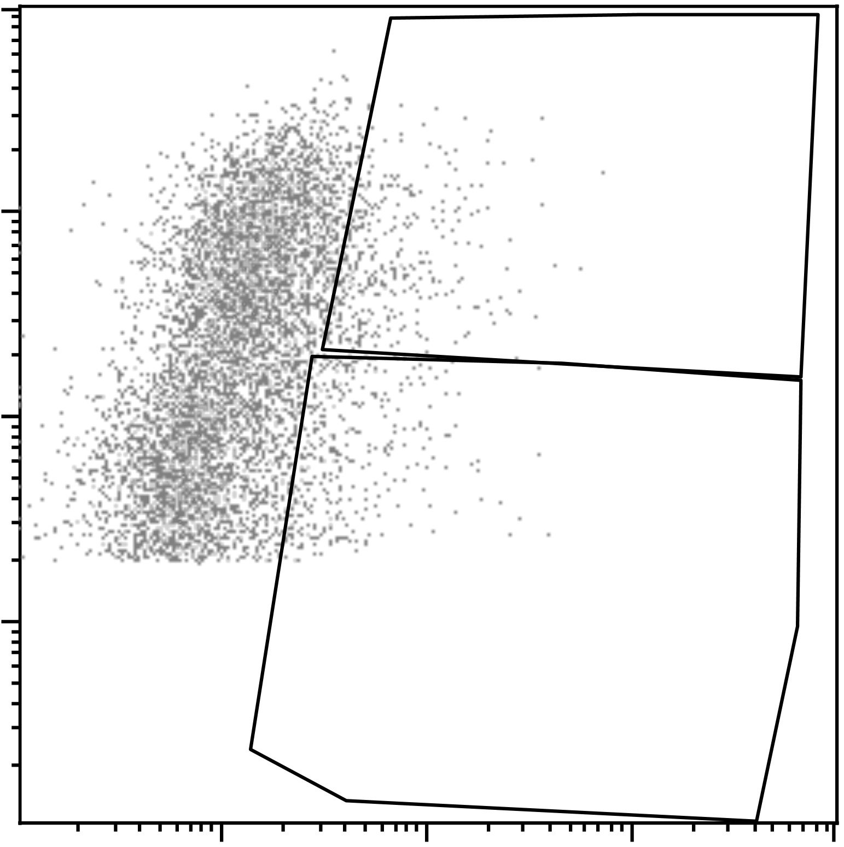
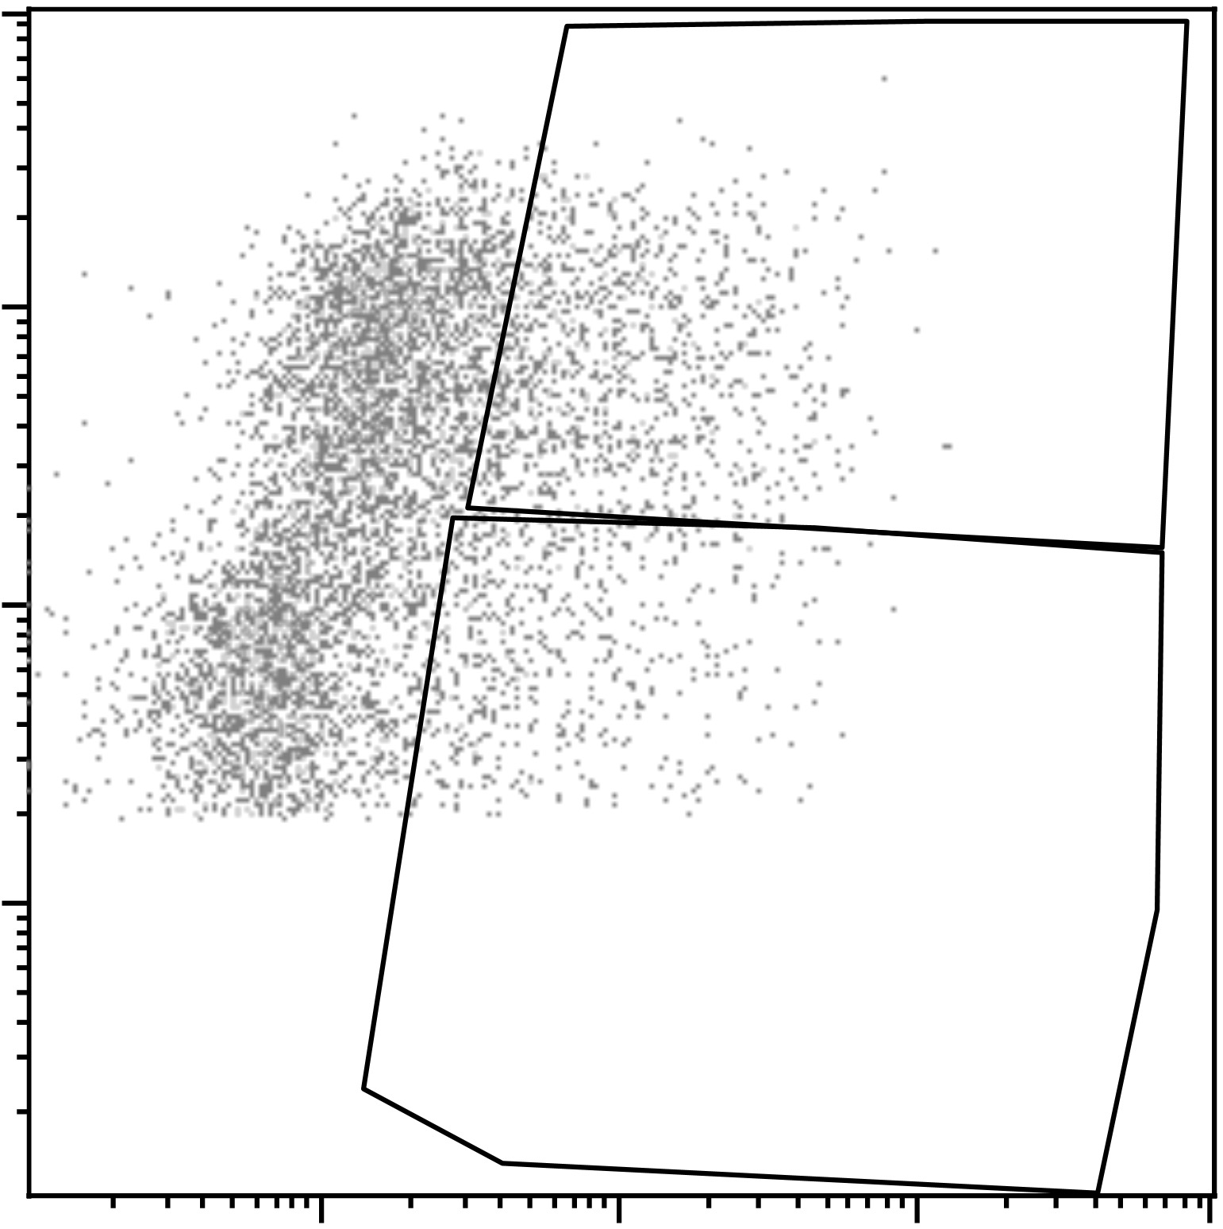
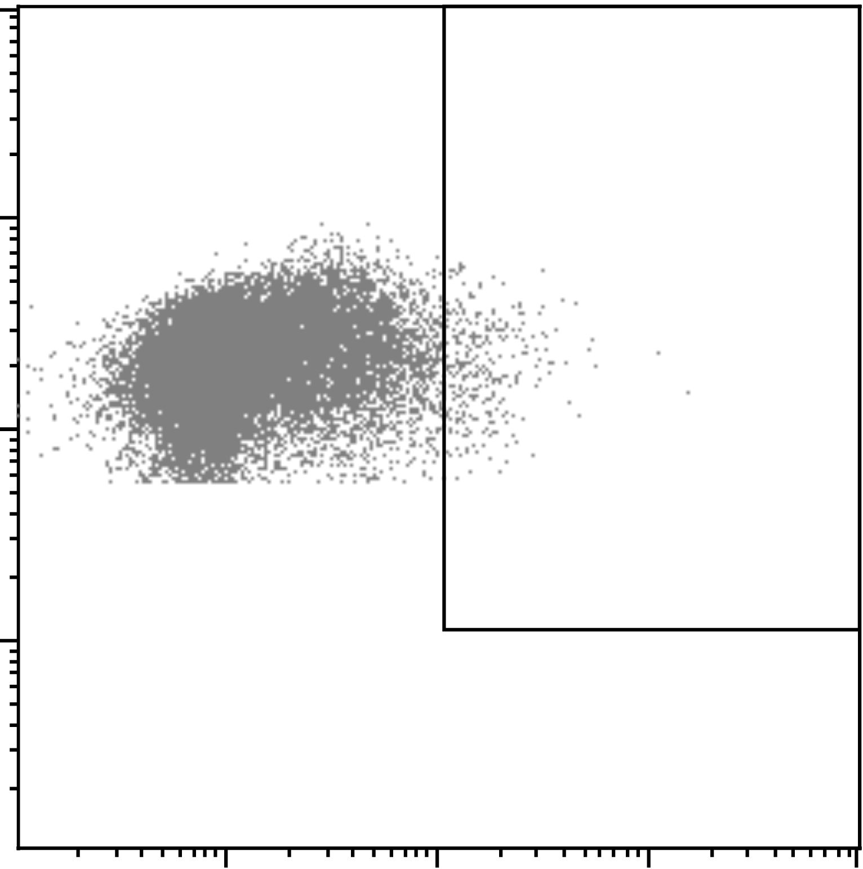
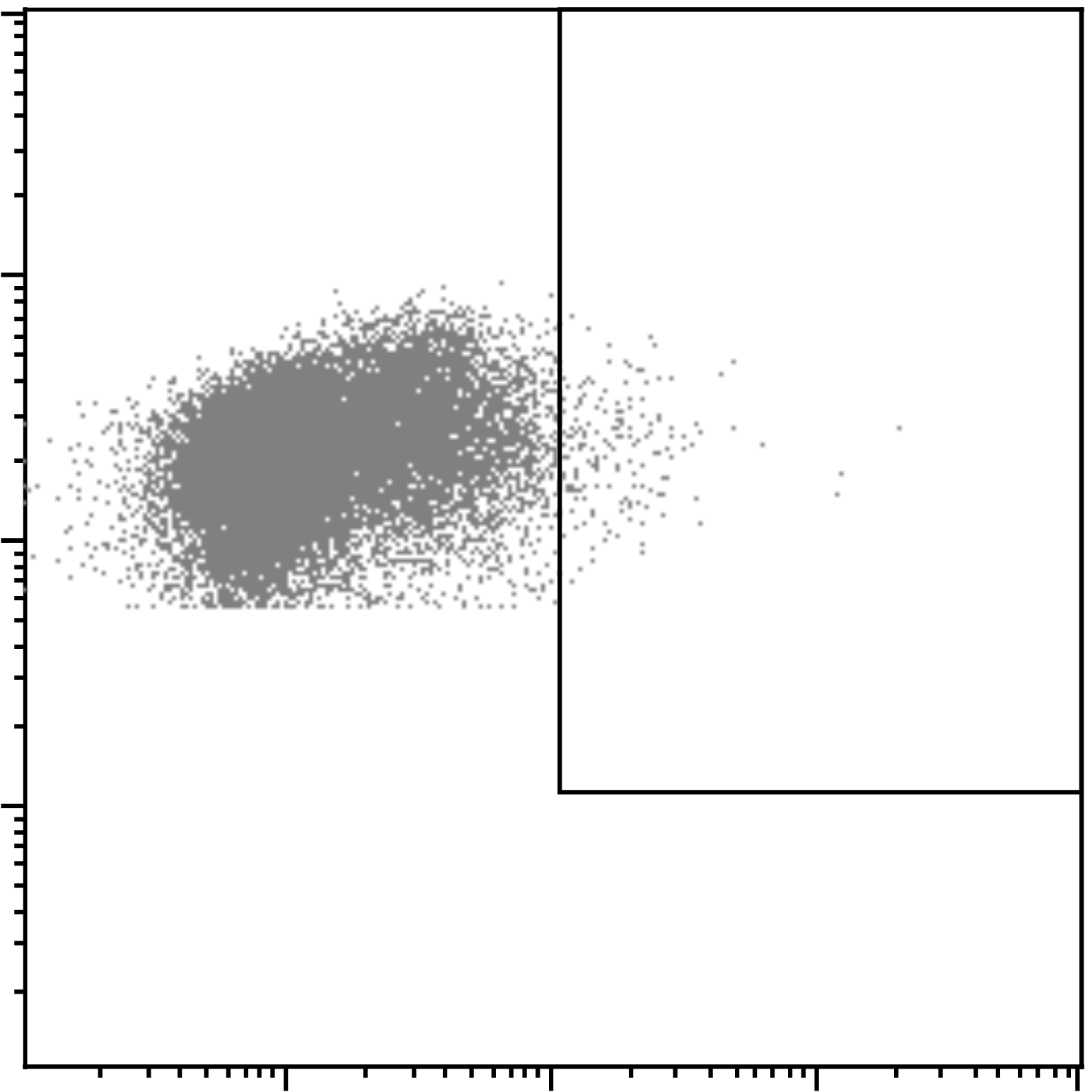
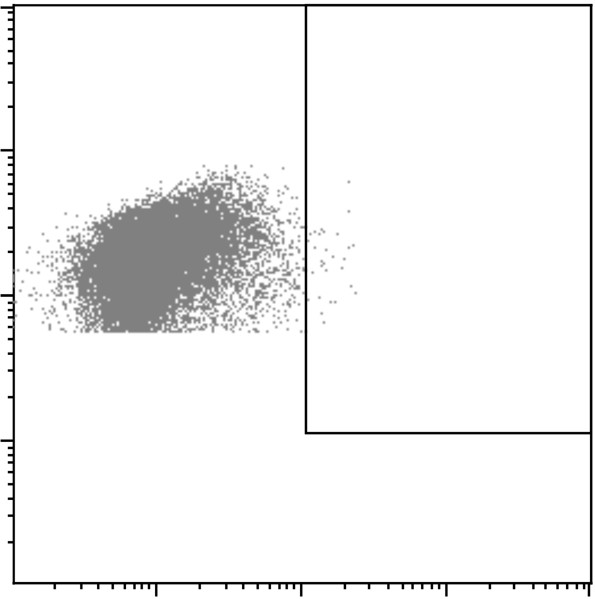
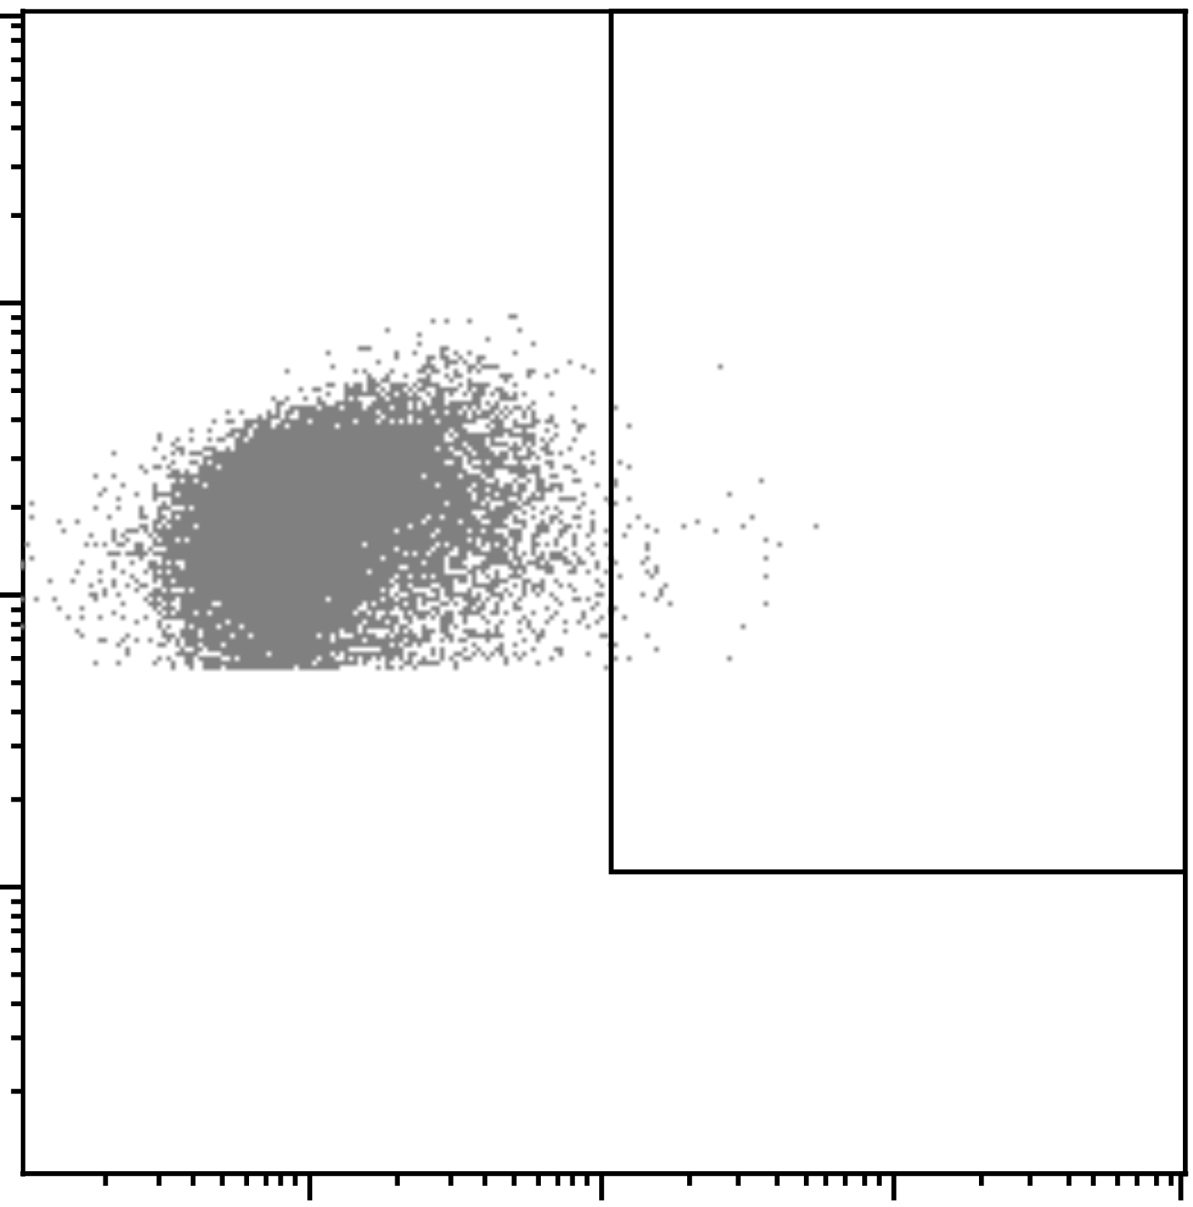
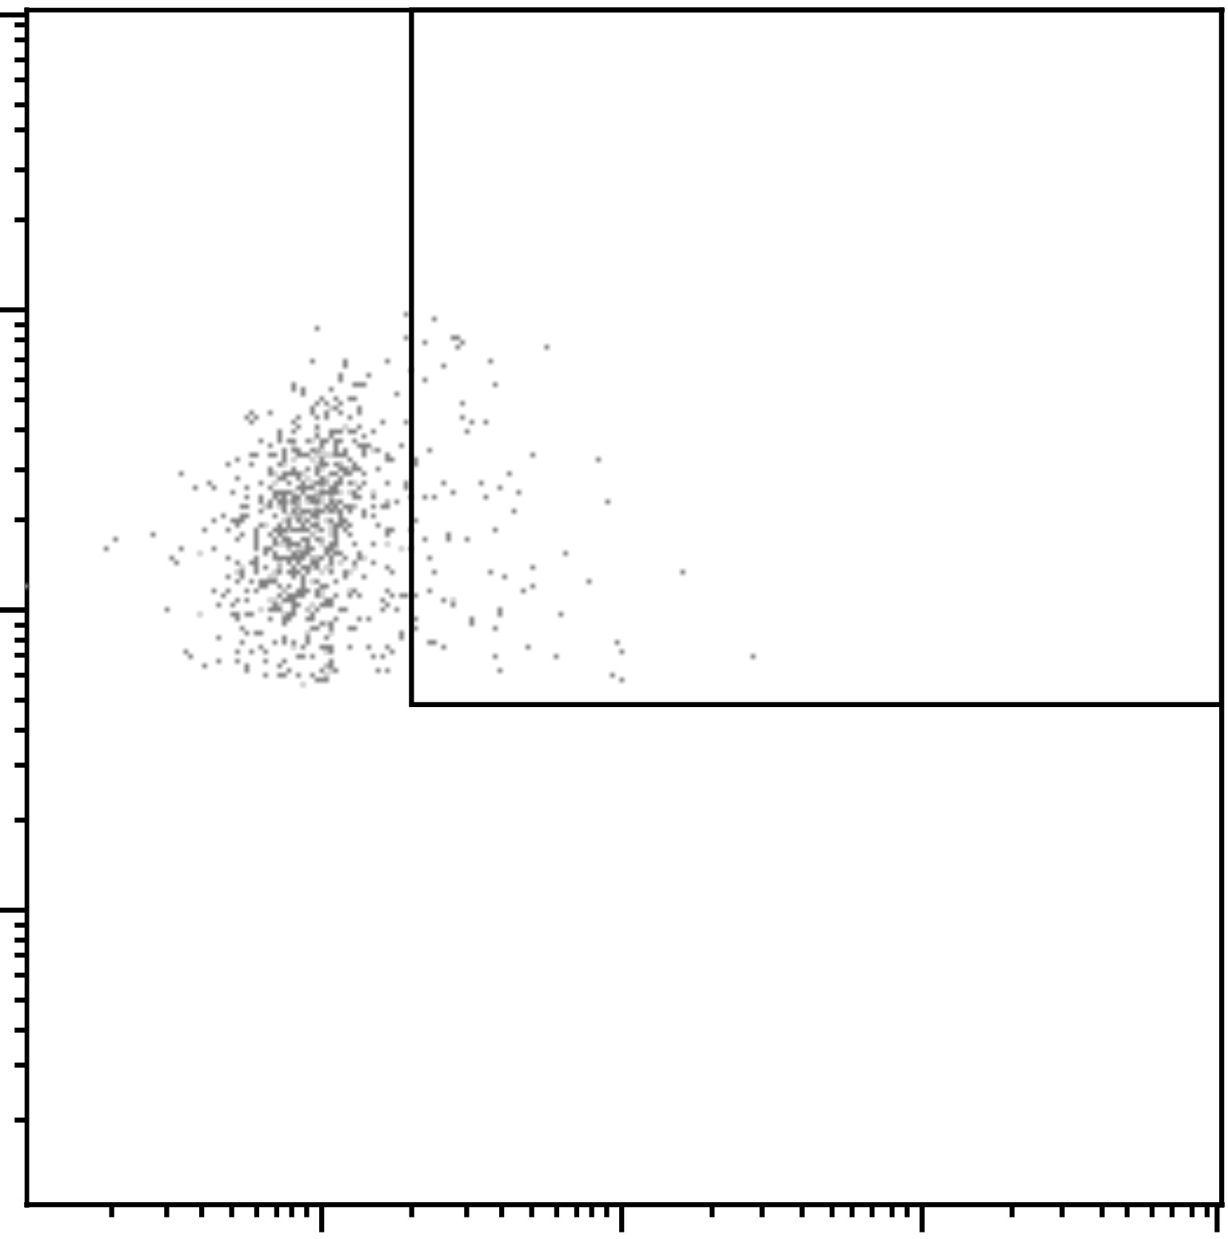

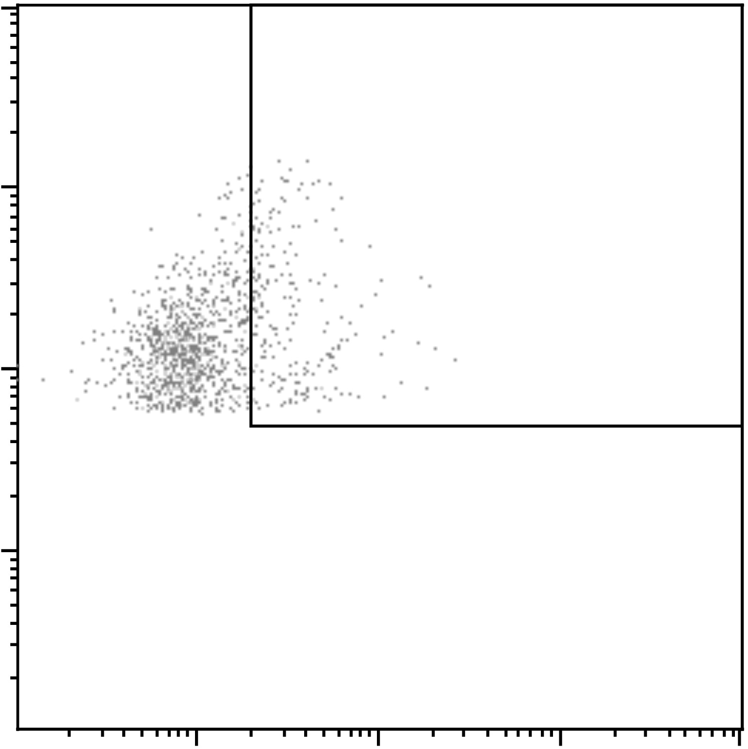
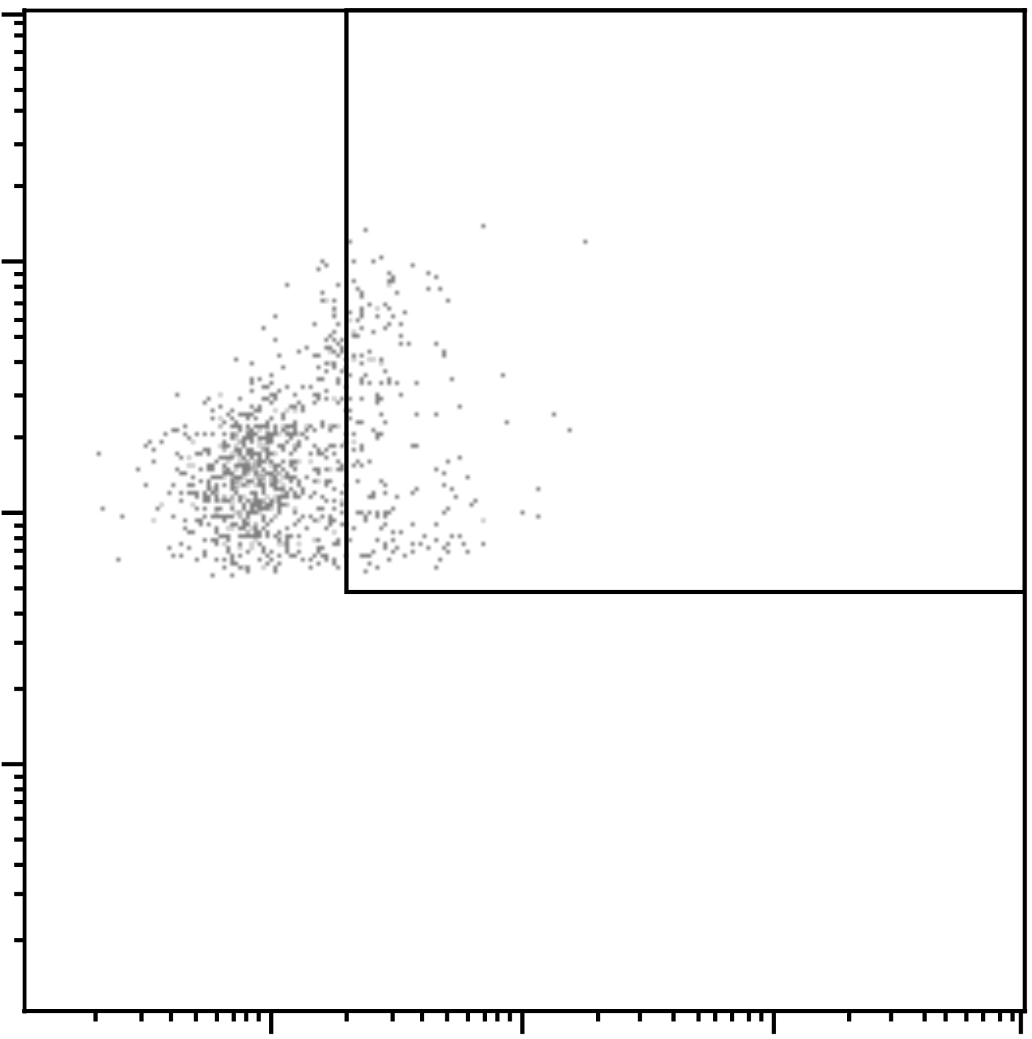
Supplementary Figure 3
UNTREATED
ONCOTICE
NO TARGET
T24
NO TARGET
T24
NK
CD3+
CD56+
CD56 PE
CD3
CD3 FITC
NK
50
40
30
% LAMP 1
CD56 PE
20
10
LAMP1 APC
0
T24
CD3
NO TARGET
CD3 FITC
LAMP1 APC
CD3+CD56+
CD56 PE
LAMP1 APC
Supplementary Figure 3. Gating strategy for degranulation experiments after co-culture with BCG. PBMCs from a healthy donor were incubated with BCG-Tice at a 6:1 ratio (bacteria to PBMC). At day 7, cells in suspension were recovered from the co-culture, an used in degranulation experiments against bladder cancer cells. The conditions without any target and with T24 bladder cancer cells are shown. The percentage of degranulation was measured by analyzing surface LAMP-1 (CD107a) within the CD3-CD56+ region, corresponding to NK cells. As an example, the numbers obtained for NK cells are plotted. In the lower panels, degranulation corresponding to T cells (both CD3+CD56- and CD3+CD56+) is also shown. Degranulation was not observed in the regions corresponding to T cells. In the case of untreated PBMC, CD56dim cells were the only population able to degranulate against bladder cancer cells. In contrast, after co-incubation with BCG, fluorescence intensity for CD56 was clearly increased and these BCG-activated CD56hi were the main population mobilising granules in response to bladder cancer cells

Slide 5
A. NK activation using M. bovis fragments
Supplementary Figure 4
IRRADIATED WHOLE CELLS
MEMBRANE FRACTION
100
% LYMPHOCYTES
100
% CD56 BRIGHT
100
% LYMPHOCYTES
100
% CD56 BRIGHT
80
80
80
80
60
% CD56 BRIGHT
% CD56 BRIGHT
% LYMPHOCYTES
60
60
60
40
40
% LYMPHOCYTES
20
20
40
40
0
0
20
20
0.5 μg/ml
0.5 μg/ml
0
0
UNTREATED
5 μg/ml
5 μg/ml
0.5 μg/ml
0.5 μg/ml
ONCOTICE
5 μg/ml
5 μg/ml
UNTREATED
UNTREATED
UNTREATED
ONCOTICE
ONCOTICE
ONCOTICE
CYTOSOL FRACTION
TOTAL LIPIDS
100
% LYMPHOCYTES
100
% CD56 BRIGHT
100
% LYMPHOCYTES
100
% CD56 BRIGHT
80
80
80
80
% LYMPHOCYTES
% CD56 BRIGHT
% CD56 BRIGHT
60
60
60
40
40
% LYMPHOCYTES
60
20
20
40
40
0
0
20
20
UNTREATED
0.5 μg/ml
0.5 μg/ml
0
0.5 μg/ml
0
5 μg/ml
ONCOTICE
5 μg/ml
5 μg/ml
ONCOTICE
UNTREATED
ONCOTICE
0.5 μg/ml
UNTREATED
ONCOTICE
5 μg/ml
UNTREATED
% LYMPHOCYTES
TDM
% CD56 BRIGHT
% LYMPHOCYTES
MYCOLIC ACID
% CD56 BRIGHT
100
100
100
100
80
80
80
80
% LYMPHOCYTES
% CD56 BRIGHT
% CD56 BRIGHT
60
60
60
60
40
40
% LYMPHOCYTES
40
20
20
40
20
0
0
20
0
UNTREATED
0.5 μg/ml
0.5 μg/ml
0
0.5 μg/ml
0.5 μg/ml
5 μg/ml
ONCOTICE
5 μg/ml
5 μg/ml
5 μg/ml
ONCOTICE
UNTREATED
UNTREATED
UNTREATED
ONCOTICE
ONCOTICE
B. NK activation using BCG-Tice fragments
IRRAD TICE
DELIPID
80
% LYMPHOCYTES
80
% CD56 BRIGHT
80
% LYMPHOCYTES
80
% CD56 BRIGHT
60
60
60
% CD56 BRIGHT
60
% ACTIVATED
LYMPHOCYTES
% ACTIVATED
LYMPHOCYTES
% CD56 BRIGHT
40
40
40
40
20
20
20
20
0
0
0
1 μg/ml
0
2 μg/ml
4 μg/ml
1 μg/ml
8 μg/ml
8 μg/ml
2 μg/ml
1 μg/ml
4 μg/ml
2 μg/ml
4 μg/ml
1 μg/ml
8 μg/ml
8 μg/ml
2 μg/ml
UNTREATED
4 μg/ml
UNTREATED
UNTREATED
UNTREATED
LIPIDS
AQUEOUS
80
% LYMPHOCYTES
80
% CD56 BRIGHT
80
% LYMPHOCYTES
80
% CD56 BRIGHT
% CD56 BRIGHT
% CD56 BRIGHT
60
60
60
60
% ACTIVATED
LYMPHOCYTES
40
% ACTIVATED
LYMPHOCYTES
40
40
40
20
20
20
20
0
0
1 μg/ml
0
0
2 μg/ml
4 μg/ml
8 μg/ml
8 μg/ml
1 μg/ml
1 μg/ml
2 μg/ml
1 μg/ml
2 μg/ml
4 μg/ml
2 μg/ml
4 μg/ml
8 μg/ml
4 μg/ml
UNTREATED
UNTREATED
UNTREATED
UNTREATED
8 μg/ml

Slide 6
Supplementary Figure 4. Lymphocyte activation after co-culture with mycobacterial subcellular fragments. (A) M. bovis. (B) BCG-TICE. PBMCs from healthy donors were incubated with the indicated concentrations of mycobacterial fractions (see methods). OncoTice was used as control at a 1:10 ratio (bacteria to PBMC). At day 7, cells in suspension were recovered from the co-culture, centrifuged and analysed by flow cytometry. The percentage of activated lymphocytes was determined by identifying the resting and activating lymphocyte regions by FSC vs SSC and further analysed to distinguish NK cells by staining with antibodies against population markers (CD3, CD56). The percentage of activated lymphocytes (left) and the percentage of the CD56^{bright} population within the NK cell region (right) were plotted for each donor (different symbols). Statistical analysis was performed by one-way ANOVA (*, p<0.05; **, p<0.01; ***, p<0.001; ****, < 0.0001; ns, non-significant).

