Slide 1
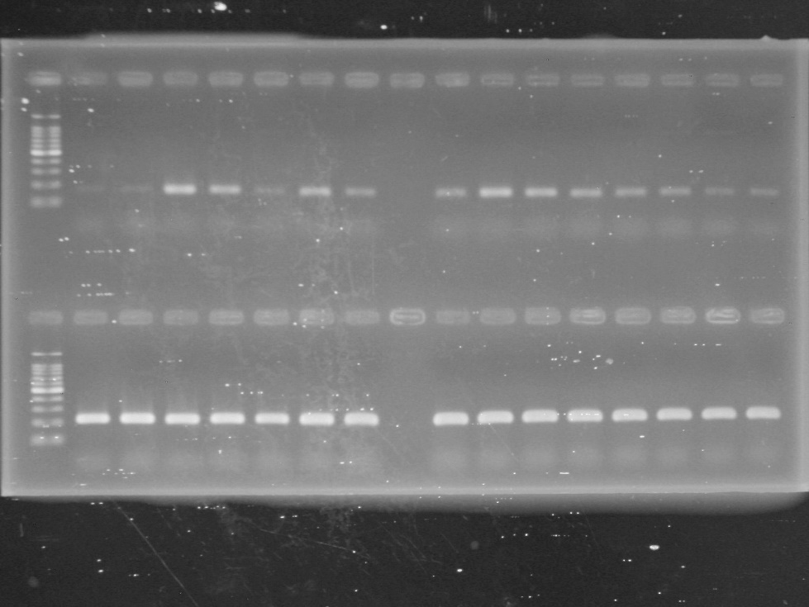
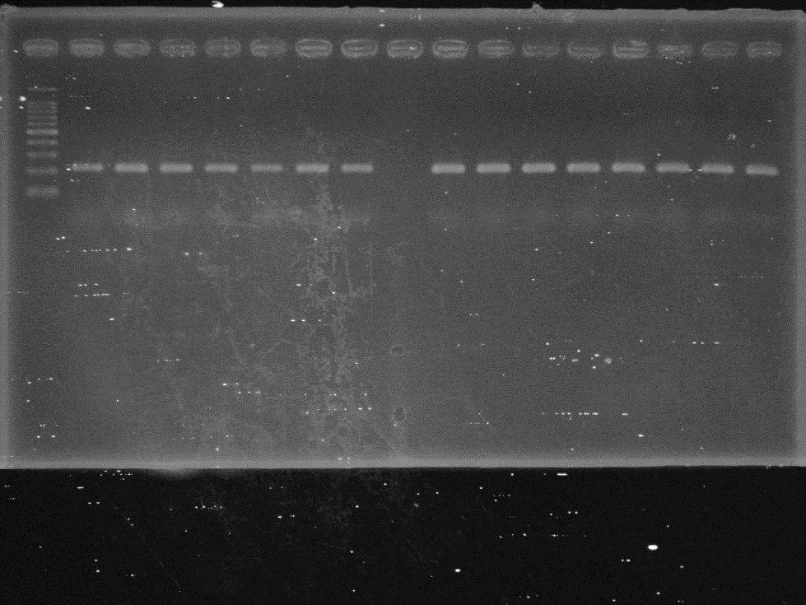
Posterior silkgland
Malpighian tubule
Posterior silkgland
Malpighian tubule
Middle silkgland
MSG in 5th instar larvae
Middle silkgland
MSG in 5th instar larvae
Body liquid
Body liquid
Fat body
Middle gut
Day
Fat body
Middle gut
Day
Testis
0
1
2
3
4
5
6
7
Testis
0
1
2
3
4
5
6
7
BmGalNAcT
bp
Bmrp49
(28 cycles)
bp
1000
1000
500
500
200
200
100
100
Bmrp49
(30 cycles)

