Slide 1
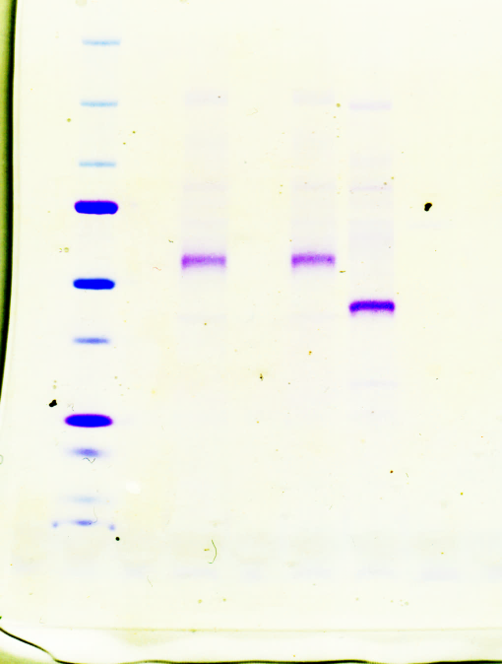
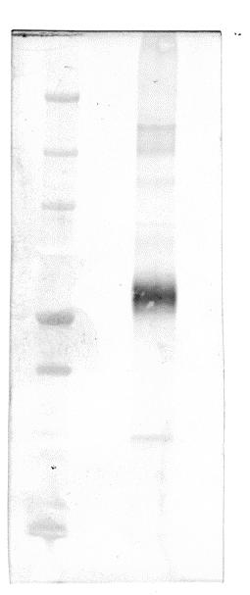
CBB staining
Anti-His-tag
Glycan staining
kDa
kDa
kDa
250
150
250
150
100
150
100
75
100
75
75
50
50
50
37
37
37
25
20
25
25
20
20
Fig. 2a
Fig. 2b

