Slide 2
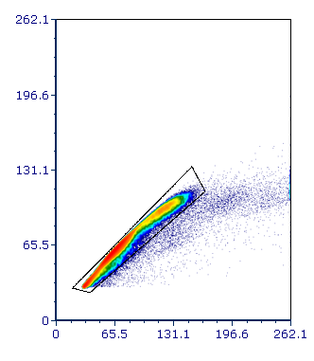
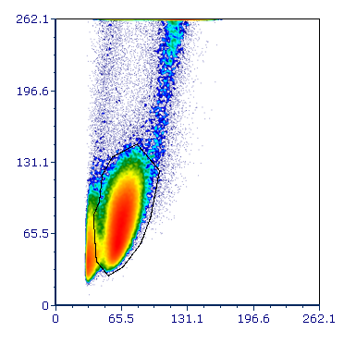
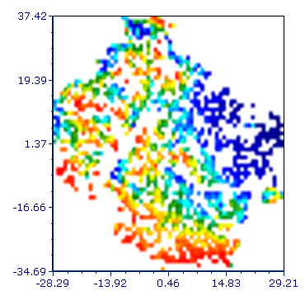
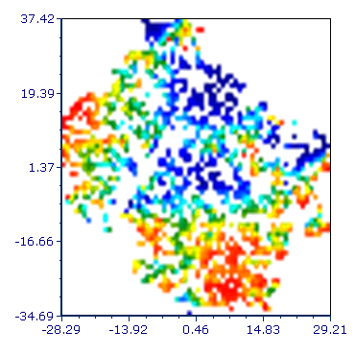
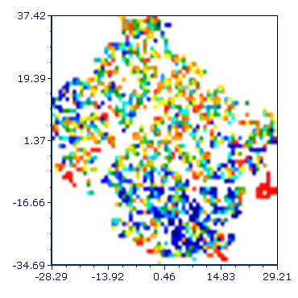
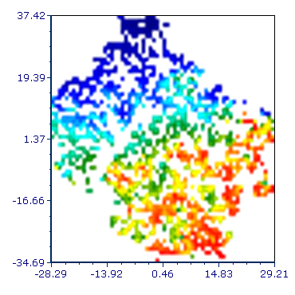
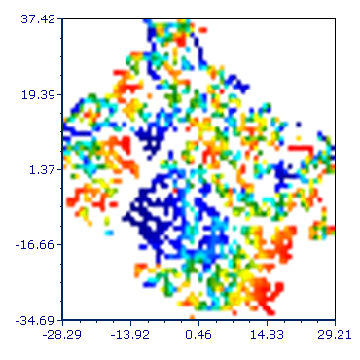
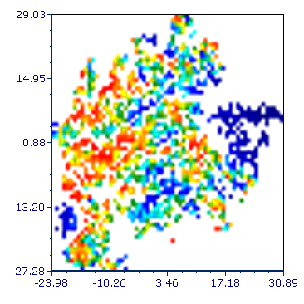
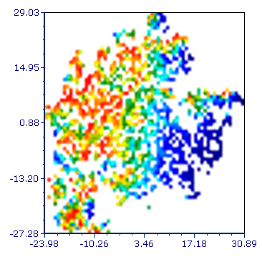
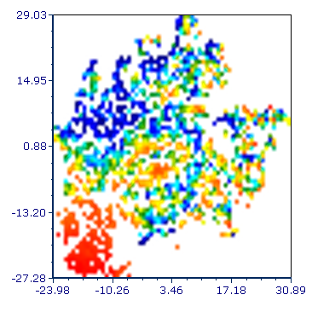
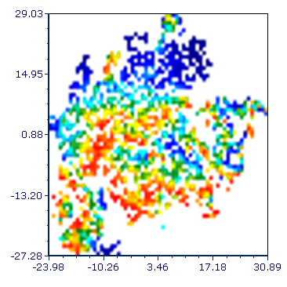
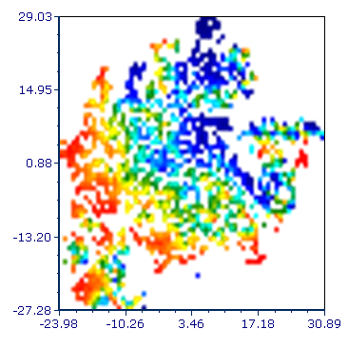
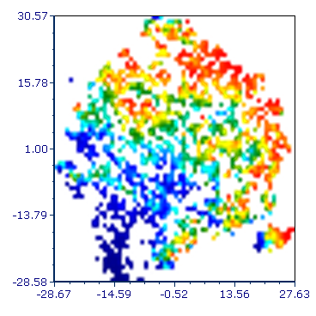
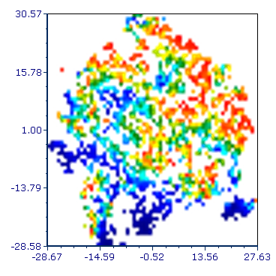
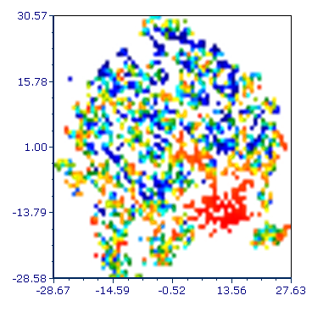
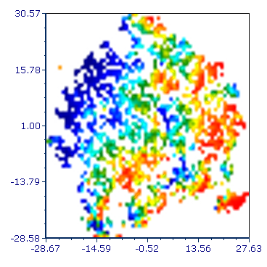
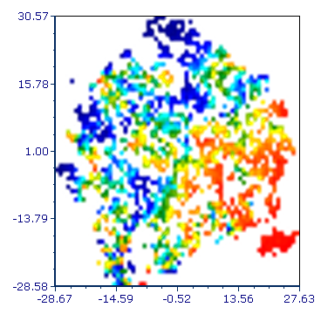
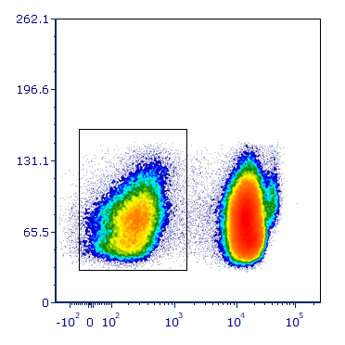
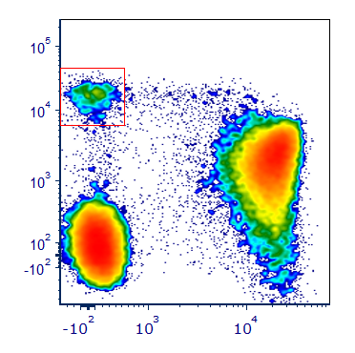
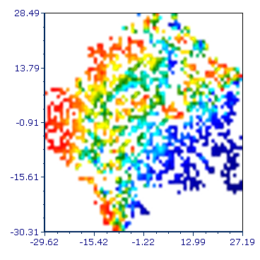
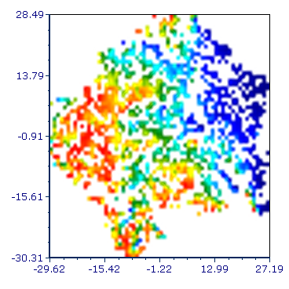
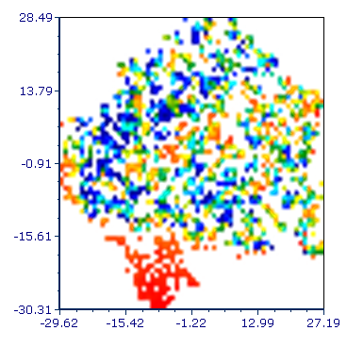
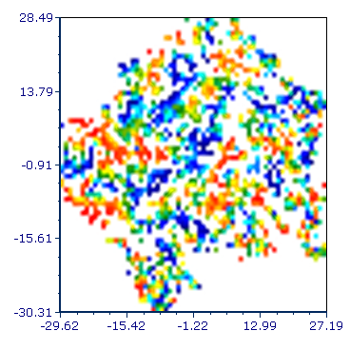
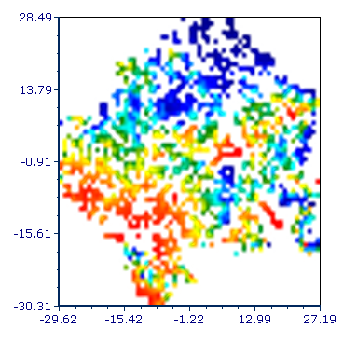
A)
CD56^{bright} CD16^{neg} NK cells
B)
Singlets
DNAM-PE
NKG2D-APC-Cy7
TIGIT-APC
PD1-BV421
Tim-3 BV510
HD
FSC-H
Singlets
97.5 %
SSC-A
Lymphocyte
79.4%
LG
FSC-A
FSC-A
tSNE2
Lymphocyte
CD3-
HG
CD3-
26.6%
CD56^{bright} CD16⁻ (1.7%)
SSC-A
CD56-PE-Cy7
CC
CD3-FITC
CD16-PerCP-Cy5.5
tSNE1
Low
High
C)
D)
E)
PD-1+ (%)
PD-1+ Tim-3+ (%)
NKG2D+ PD-1+ (%)
F)
HD
LG
HG
CC
G)
HD
LG
HG
CC
H)
HD
LG
HG
CC
DNAM-1+ TIGIT+PD-1+ (%)
PD-1+TIGIT+Tim-3+ (%)
DNAM-1+TIGIT+PD-1+Tim-3+ (%)
I)
HD
LG
HG
CC
HD
LG
HG
CC
HD
LG
HG
CC
J)
HD
HD
DNAM-1+NKG2D
DNAM-1+TIGIT
NKG2D+PD-1
PD-1+TIGIT
PD-1+Tim-3
Tim-3+TIGIT
PD-1+TIGIT+Tim-3
LG
LG
HG
HG
CC
CC
DNAM-1
NKG2D
TIGIT
PD-1
Tim-3
1
2
3
4
5
6
7

Slide 3
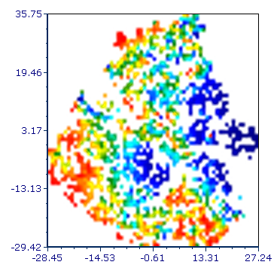
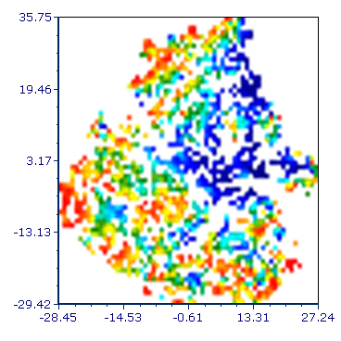
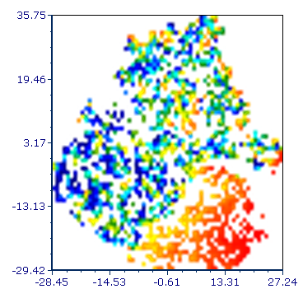
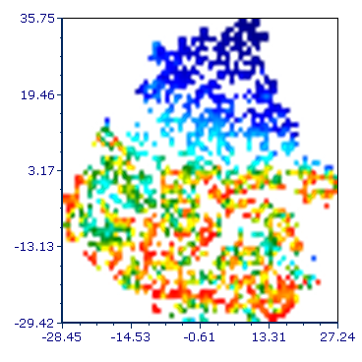
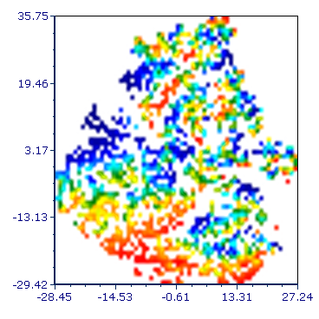
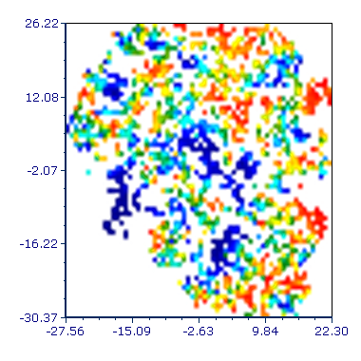
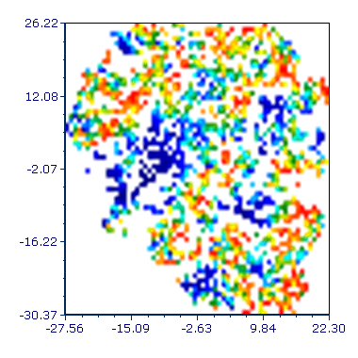
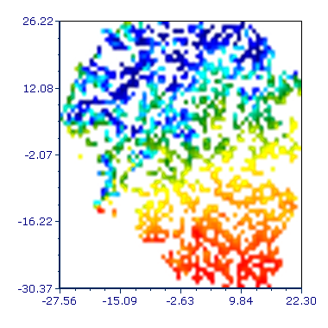
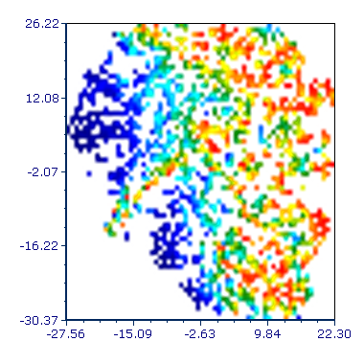
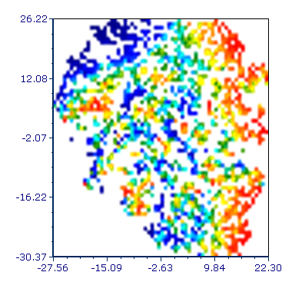
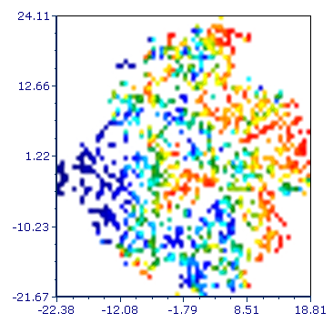
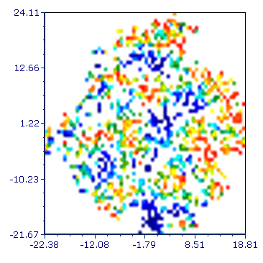
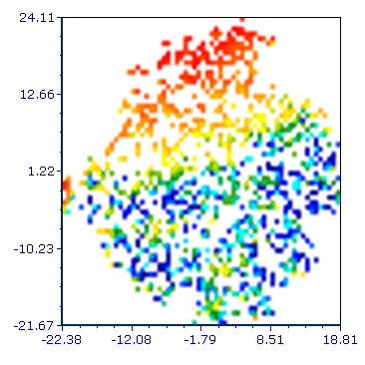
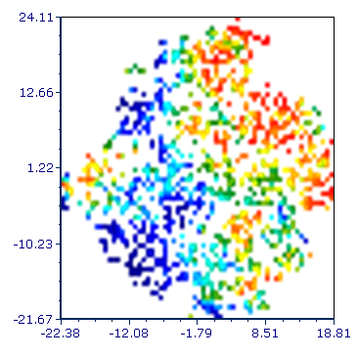
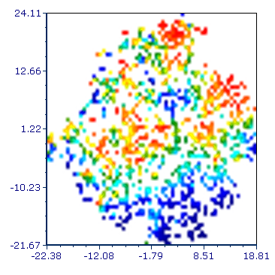
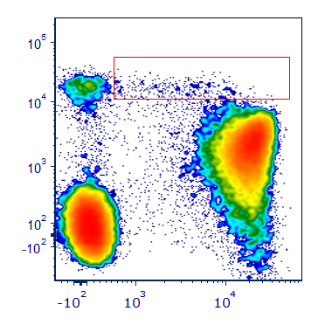
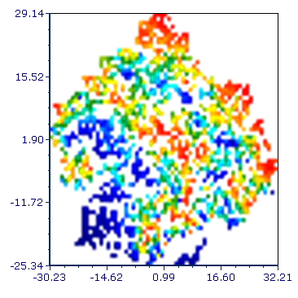
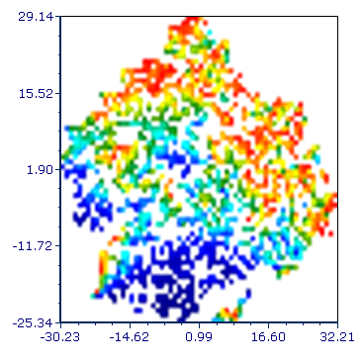
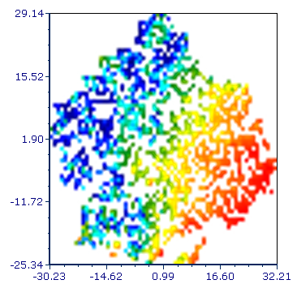
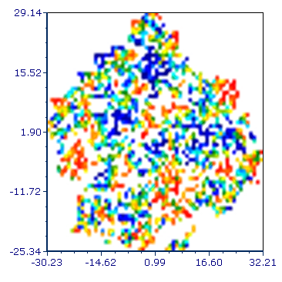
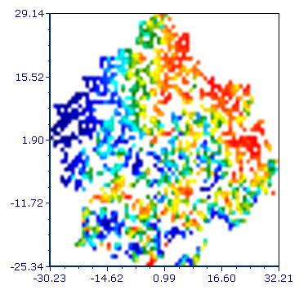
A)
CD56^{bright} CD16^{dim}
B)
DNAM-PE
NKG2D-APC-Cy7
TIGIT-APC
PD1-BV421
Tim-3 BV510
Singlets
HD
FSC-H
Singlets
97.5 %
SSC-A
Lymphocyte
79.4%
LG
FSC-A
FSC-A
tSNE2
Lymphocyte
CD3-
HG
CD3-
26.6%
CD56^{bright} CD16^{dim}
0.7%
SSC-A
CD56-PE-Cy7
CC
CD3-FITC
CD16-PerCP-Cy5.5
Low
tSNE1
High
C)
D)
E)
PD-1+ (%)
PD-1+ TIGIT+ (%)
PD-1+Tim-3+ (%)
F)
HD
LG
HG
CC
G)
HD
LG
HG
CC
H)
HD
LG
HG
CC
NKG2D+ PD-1 + (%)
DNAM-1+TIGIT+PD-1+ (%)
PD-1+TIGIT+Tim-3+ (%)
I)
HD
LG
HG
CC
HD
LG
HG
CC
J)
HD
LG
HG
CC
HD
HD
DNAM-1+NKG2D
DNAM-1+TIGIT
NKG2D+PD-1
PD-1+TIGIT
PD-1+Tim-3
Tim-3+TIGIT
PD-1+TIGIT+Tim-3
LG
LG
HG
HG
CC
CC
DNAM-1
NKG2D
TIGIT
PD-1
Tim-3
1
2
3
4
5
6
7

Slide 4
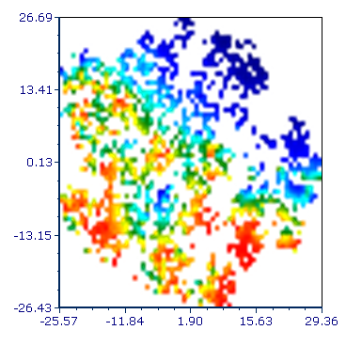
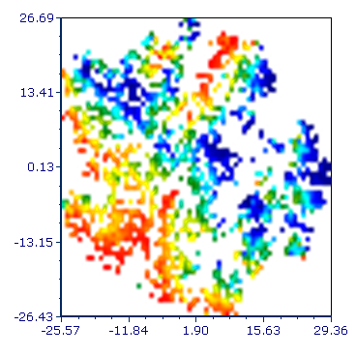
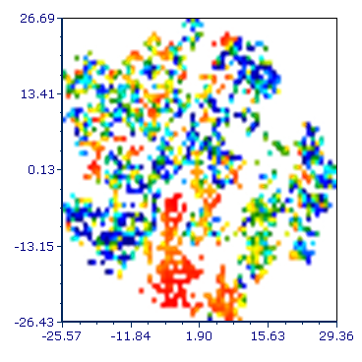
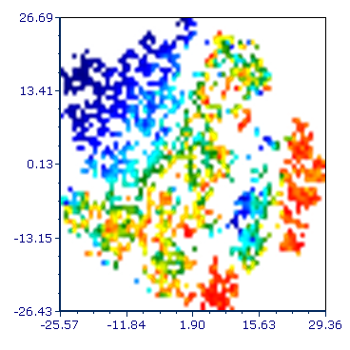
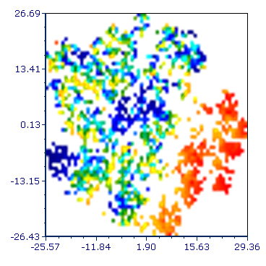
















A)
CD56^{dim} CD16^{neg} NK cells
B)
Singlets
DNAM-PE
NKG2D-APC-Cy7
TIGIT-APC
PD1-BV421
Tim-3 BV510
HD
FSC-H
Singlets
97.5 %
SSC-A
Lymphocyte
79.4%
LG
FSC-A
FSC-A
tSNE2
Lymphocyte
CD3-
CD56^{dim} CD16⁻
0.7%
HG
CD3-
26.6%
SSC-A
CD56-PE-Cy7
CC
CD3-FITC
CD16-PerCP-Cy5.5
Low
tSNE1
High
C)
D)
E)
F)
PD-1+ (%)
PD-1+ TIGIT+ (%)
PD-1+ Tim-3+ (%)
NKG2D+ PD1-+ (%)
G)
HD
LG
HG
CC
H)
HD
LG
HG
CC
I)
HD
LG
HG
CC
HD
LG
HG
CC
PD-1 + TIGIT+
Tim-3+ (%)
DNAM-1+ TIGIT+
PD-1+ (%)
DNAM-1+ TIGIT+
PD-1+ Tim-3+ (%)
K)
HD
LG
HG
CC
HD
LG
HG
CC
L)
HD
LG
HG
CC
HD
HD
DNAM-1+NKG2D
DNAM-1+TIGIT
NKG2D+PD-1
PD-1+TIGIT
PD-1+Tim-3
Tim-3+TIGIT
PD-1+TIGIT+Tim-3
LG
LG
HG
HG
CC
CC
DNAM-1
NKG2D
TIGIT
PD-1
Tim-3
1
2
3
4
5
6
7

Slide 5





















A)
CD56^{dim}CD16^{dim} NK cells
B)
Singlets
DNAM-PE
NKG2D-APC-Cy7
TIGIT-APC
PD1-BV421
Tim-3 BV510
HD
FSC-H
Singlets
97.5 %
SSC-A
Lymphocyte
79.4%
LG
FSC-A
FSC-A
tSNE2
Lymphocyte
CD3-
HG
CD56^{dim}CD16^{dim} (0.8%)
CD3-
26.6%
SSC-A
CD56-PE-Cy7
CC
CD3-FITC
CD16-PerCP-Cy5.5
tSNE1
D)
Low
High
C)
E)
PD-1+ (%)
PD-1+ TIGIT+ (%)
PD-1+ Tim-3+ (%)
F)
HD
LG
HG
CC
G)
HD
LG
HG
CC
H)
HD
LG
HG
CC
NKG2D+ PD-1+ (%)
PD-1+ TIGIT+
Tim-3+ (%)
DNAM-1 +TIGIT+
PD-1+ (%)
HD
LG
HG
CC
HD
LG
HG
CC
HD
LG
HG
CC
I)
J)
HD
HD
DNAM-1+NKG2D
DNAM-1+TIGIT
NKG2D+PD-1
PD-1+TIGIT
PD-1+Tim-3
Tim-3+TIGIT
PD-1+TIGIT+Tim-3
LG
LG
HG
HG
CC
CC
DNAM-1
NKG2D
TIGIT
PD-1
Tim-3
1
2
3
4
5
6
7

Slide 6





















A)
CD56^{dim} CD16^{bright} NK cells
B)
Singlets
DNAM-PE
NKG2D-APC-Cy7
TIGIT-APC
PD1-BV421
Tim-3 BV510
HD
FSC-H
Singlets
97.5 %
SSC-A
Lymphocyte
79.4%
LG
FSC-A
FSC-A
tSNE2
Lymphocyte
CD3-
HG
CD56^{dim} CD16^{bright}
41.1%
CD3-
26.6%
SSC-A
CD56-PE-Cy7
CC
CD3-FITC
CD16-PerCP-Cy5.5
Low
tSNE1
High
C)
D)
E)
F)
PD-1+ (%)
PD-1+ TIGIT + (%)
PD1-+ Tim-3+ (%)
PD-1+ TIGIT+
Tim-3+ (%)
G)
HD
LG
HG
CC
H)
HD
LG
HG
CC
I)
HD
LG
HG
CC
J)
HD
LG
HG
CC
NKG2D+PD-1+ (%)
DNAM-1+ TIGIT+
PD-1+ (%)
DNAM-1+ NKG2D+
TIGIT+ PD-1+Tim-3+ (%)
DNAM-1+ TIGIT+
PD-1+ Tim-3+ (%)
K)
HD
LG
HG
CC
HD
LG
HG
CC
HD
LG
HG
CC
HD
LG
HG
CC
L)
HD
HD
LG
LG
DNAM-1+NKG2D
DNAM-1+TIGIT
NKG2D+PD-1
PD-1+TIGIT
PD-1+Tim-3
Tim-3+TIGIT
PD-1+TIGIT+Tim-3
HG
HG
CC
CC
DNAM-1
NKG2D
TIGIT
PD-1
Tim-3
1
2
3
4
5
6
7

Slide 7





















A)
CD56^{neg} CD16^{bright} NK cells
B)
Singlets
DNAM-PE
NKG2D-APC-Cy7
TIGIT-APC
PD1-BV421
Tim-3 BV510
HD
FSC-H
Singlets
97.5 %
SSC-A
Lymphocyte
79.4%
LG
FSC-A
FSC-A
tSNE2
Lymphocyte
CD3-
HG
CD56^{neg}CD16^{bright} (5.4%)
CD3-
26.6%
SSC-A
CD56-PE-Cy7
CC
CD3-FITC
CD16-PerCP-Cy5.5
Low
tSNE1
High
C)
D)
E)
PD-1+ (%)
PD-1+ TIGIT+ (%)
PD-1+ Tim-3+ (%)
F)
HD
LG
HG
CC
G)
HD
LG
HG
CC
H)
HD
LG
HG
CC
NKG2D+ PD-1+ (%)
DNAM-1 +TIGIT+
PD-1+ (%)
DNAM-1+ TIGIT+
PD-1+ Tim-3+ (%)
HD
LG
HG
CC
HD
LG
HG
CC
HD
LG
HG
CC
I)
J)
HD
HD
DNAM-1+NKG2D
DNAM-1+TIGIT
NKG2D+PD-1
PD-1+TIGIT
PD-1+Tim-3
Tim-3+TIGIT
PD-1+TIGIT+Tim-3
LG
LG
HG
HG
CC
CC
DNAM-1
NKG2D
TIGIT
PD-1
Tim-3
1
2
3
4
5
6
7

