Slide 1





Use of a convolutional neural network to identify infarct core using computed tomography perfusion parameters
Ryan A. Rava^{1,2}, Alexander R. Podgorsak^{1,2,3}, Muhammad Waqas^{2,4}, Kenneth V. Snyder^{2,4}, Elad I. Levy^{2,4}, Jason M. Davies^{2,4}, Adnan H. Siddiqui^{2,4}, and Ciprian N. Ionita^{1,2,3,4}
¹Department of Biomedical Engineering, University at Buffalo, Buffalo NY
²Canon Stroke and Vascular Research Center, University at Buffalo, Buffalo NY
³Department of Medical Physics, University at Buffalo, Buffalo NY
⁴Department of Neurosurgery, University at Buffalo Jacobs School of Medicine, Buffalo NY
Notes:
The title of my presentation is use of a convolutional neural network to identify infarct core using computed tomography perfusion parameters.

Slide 2

Disclosure Statement of Financial Interest
I have no financial interests or relationships to disclose with regard to the subject matter of this presentation
Sources of Funding
The research in this study was partially supported by Canon Medical Systems, USA.
Notes:
For the research conducted I have no financial interests or relationships to disclose though the research was partially funded by Canon Medical Systems USA.

Slide 3
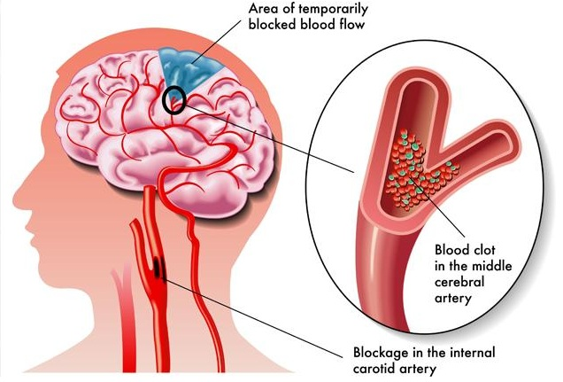
Introduction
Ischemic stroke is leading cause of longer term disability in the U.S.
15 million individuals suffer a stroke annually worldwide
Occurs due to vessel obstruction (i.e. embolus or stenosis) leading to tissue oxygen deprivation
Symptoms:
  Facial droop
  Headache
  Aphasia
  Vision loss
Tamboli. I., et al. “Ischemic Stroke– API Insights 2019, Healthcare Analysis, Expert Reviews and Precise Outlook”, Nevada Green Times, (2019).
Notes:
Within the United States, 7 million individuals self-report having a stroke, of which 87% experience an ischemic stroke. On a more widespread scale, approximately 15 million individuals suffer from a stroke worldwide. An ischemic stroke occurs when regions of the brain are deprived of oxygenated blood, which typically occurs due to an embolus or stenosis. In the image on the right, the presence of an embolus is seen within the bifurcation of the middle cerebral artery where this clot prevents distal flow of blood past the bifurcation. A stenosis is then represented as a narrowing of the internal carotid artery which can occur due to a build up of plaque within the vessel. Common symptoms exhibited from an ischemic stroke include one sided facial droop, worst headache of one’s life, aphasia, and vision loss. The prevalence of this disease and potential long term nature of the associated symptoms has led to ischemic strokes becoming the leading cause of long term disability within the United States.

Slide 4
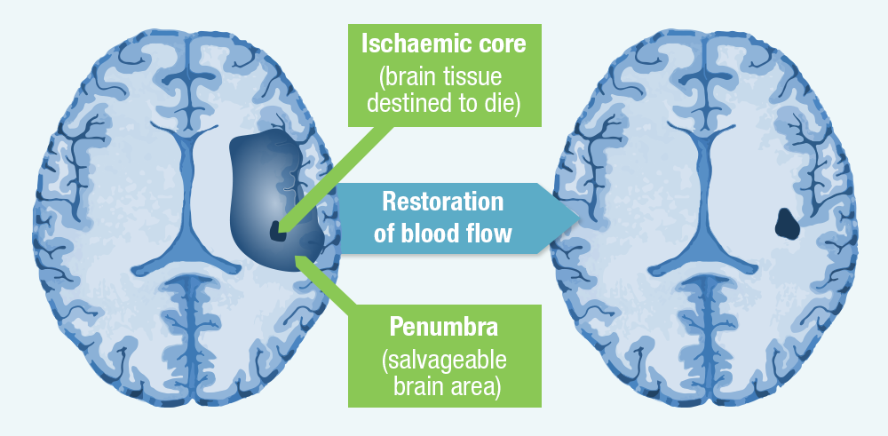
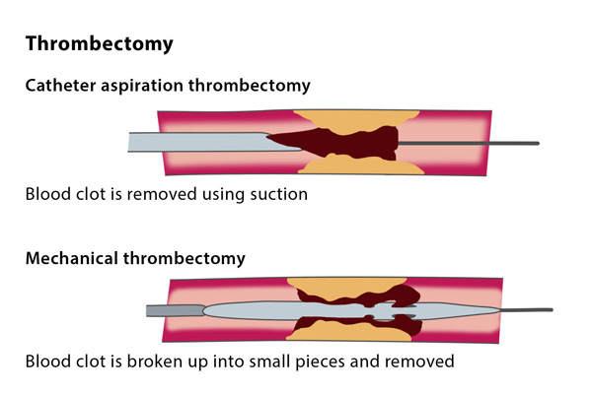
Introduction
Infarct (unsalvageable) and penumbra (salvageable) tissue results from stroke
  Penumbra converts to infarct without blood flow restoration
American Heart Association (AHA) guidelines used to determine reperfusion eligibility from infarct present
Mechanical thrombectomy used to remove embolus
  Feed stent retriever through artery, through embolus, and remove
Thrombectomy. Cardiovascular and Interventional Radiological Society of Europe. 2020.
“Thrombectomy”, Cardiovascular and Interventional Radiological Society of Europe, (2019).
Notes:
During an ischemic stoke, regions of the brain that are deprived of oxygenated blood begin to convert from healthy tissue to incorrectly functioning but salvageable tissue known as penumbra. This salvageable tissue then converts from penumbra to infarct, or unsalvageable tissue, at a rate of 10 mL per hour. Once converted to infarct, any neurological function associated with this tissue is lost forever. In order to prevent the conversion of penumbra to infarct and restore proper neurological function to salvageable tissue, the American Heart Association has put forth guidelines based on the amount of infarct currently present making individuals eligible for mechanical thrombectomy. Mechanical thrombectomy is an endovascular procedure where a catheter is fed from the femoral artery to the site of occlusion within the brain. A stent retriever is then run through the embolus, lodging the stent retriever in the embolus, and the embolus is pulled out along the path the catheter was fed through. The bottom image represents the process of mechanical thrombectomy while the upper image indicates the conversion of ischemic tissue during this process. The upper left brain indicates infarct in the center of salvageable penumbra prior to thrombectomy, while the upper right image shows all penumbra has been salvaged but infarct still remains following thrombectomy.

Slide 5
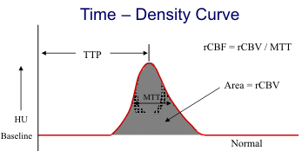
Introduction
Computed tomography perfusion (CTP) used to quantify ischemic tissue
  Contrast tracing during acquisition of multiple CT acquisitions
CTP generates perfusion parameter maps demonstrating current patient specific hemodynamics
Maps generated from time density curve at each voxel
"Perfusion Imaging," Regents of the University of California, San Diego, CA 2019.
Notes:
The current modality used to quantify infarct tissue to determine thrombectomy eligibility is computed tomography perfusion. This method involves the injection of contrast media into neurovasculature and multiple CT acquisitions are taken to show the progression of contrast over time. Time density curves are then generated for each corresponding voxel throughout the entire acquisition process. These curves simply represent the contrast intensity at each voxel as time progresses. From these curves, perfusion parameter maps can be generated through extraction of patient specific hemodynamics. An example time density curve is shown representing which parameters are extracted from the curve. Time to peak is the time to reach peak contrast enhancement, mean transit time is the full width half maximum of the curve, delay time is the time for contrast to arrive at a specific voxel, cerebral blood volume is area under the time density curve, and cerebral blood flow is cerebral blood volume divided by mean transit time.

Slide 6
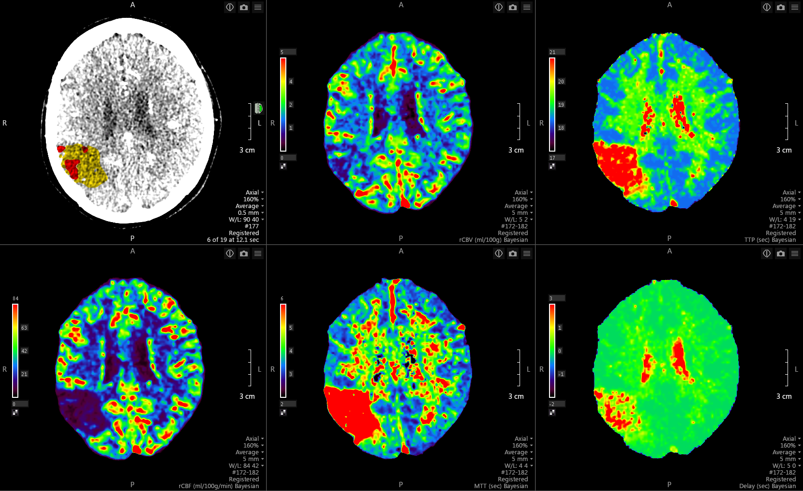
Introduction
Vitrea generated perfusion maps: CBV, TTP, CBF, MTT, Delay time
Infarct quantified through contralateral hemisphere comparison thresholds
Issues with current method:
  Thresholds are patient specific
  Optimal thresholds vary between commercial software
  Optimal perfusion parameter varies between software
Notes:
The images on the bottom of the slide are example perfusion parameter maps for a single axial slice within an ischemic stroke patient with a right middle cerebral artery occlusion. From left to right, the maps shown are: cerebral blood volume, time to peak, cerebral blood flow, mean transit time, and delay time. Within the perfusion parameter maps, increases in time related parameters and decreases in flow and volume related parameters typically represent ischemic tissue regions. Currently, commercially available software utilize contralateral hemisphere comparison thresholds to segment infarct tissue. RAPID and Pulse computed tomography perfusion software, for example, identify 70% and 75% decreases in cerebral blood flow in the contralateral hemisphere to healthy tissue as infarct. This shows that optimal thresholds for identifying infarct have yet to be agreed upon across different commercial software. This is because contralateral hemisphere thresholds are patient specific, meaning there is no universal threshold that can be applied. Additionally, Vitrea perfusion software utilizes cerebral blood volume to identify infarct so it cannot even be agreed upon which perfusion parameter is optimal in determining infarct tissue.

Slide 7
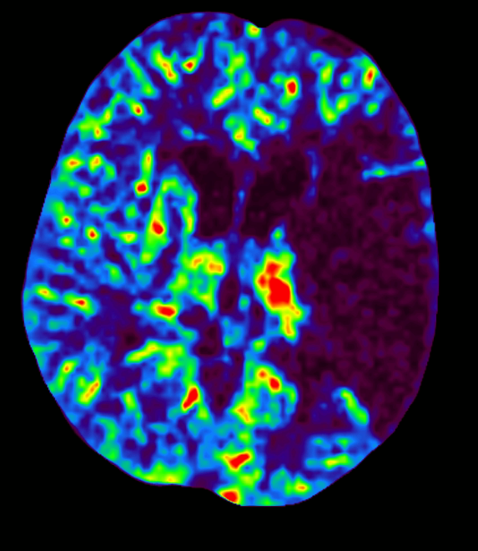
Introduction
Utilize machine learning techniques to locate and quantify infarct tissue
Examines patterns within perfusion volumes as opposed to only contralateral hemisphere comparisons
  Utilizes additional features such as spatial location and adjacent parameter values (gradients)
Utilize more than traditional CBV and CBF parameters used in commercial software (Vitrea and RAPID)
Notes:
Machine learning techniques, specifically convolutional neural networks, may supply the ability to locate and quantify infarct tissue. Neural networks have already proven to aid in the diagnosis of neurovascular diseases such as the segmentation of aneurysms. These networks may provide the ability to decrease the reliance upon contralateral hemisphere comparisons when segmenting infarct. Although the network may take contralateral intensities into consideration when segmenting infarct, it will also consider other features current commercial software do not, such as the spatial location of where the infarct is and intensity gradients within a hemisphere. The image on the right shows the presence of a steep intensity gradient between infarct and healthy tissue in the same hemisphere which commercial software do not currently take into consideration. Additionally, the image indicates the location of the ventricles which have in the past been included in infarct calculations by Vitrea. The network taking into consideration where the ventricles are typically located may prevent them from being erroneously included in infarct calculations.

Slide 8
Methods
Included 63 emergent large vessel occlusion patients
  Present with stroke symptoms and hemorrhage negative
Obtained raw perfusion data (all 5 parameters) for all patients using Vitrea 7.10
Obtained ground truth infarct from 48 hour follow-up diffusion-weighted imaging (DWI)
  DWI commonly utilized as infarct ground truth for CTP studies
  Infarct labels created using 162% intensity difference between contralateral hemispheres
Notes:
For our study, we included 63 patients who presented at our comprehensive stroke center with an emergent large vessel occlusion. All patients presented with stroke like symptoms and had a non-contrast CT to rule out hemorrhage. Patients then received baseline CT perfusion imaging in addition to 48 hour follow-up diffusion weighted imaging or DWI. Following baseline CT perfusion imaging, raw perfusion data was loaded into Vitrea 7.10 to generate cerebral blood volume, cerebral blood flow, time to peak, mean transit time, and delay time perfusion maps for each patient in the study. Generated raw perfusion maps were exported from Vitrea to be used as inputs in our neural network. DWI volumes were then utilized to generate our ground truth infarct labels as DWI is considered the gold standard for infarct imaging. Labels were generated from DWI through a 162% increase in intensity from healthy tissue within the scan and any errors in the segmentations were manually corrected. The images at the bottom of the slide show corresponding slices from a cerebral blood flow CT perfusion map, DWI scan, and segmented binary label created from the same DWI slice.

Slide 9
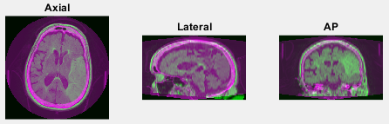
Methods
Register CTP and DWI volumes using geometric and intensity based registration (MATLAB)
  Linear interpolation and affine transformation
Assess registration using ventricle overlap
  Manual segmentation of the ventricles within both the DWI and CTP volumes
  Dice coefficient: 0.78±0.02
Notes:
In order to ensure our ground truth infarct segmented from our DWI scans correctly lined up with our baseline CT perfusion scans, volumetric image registration was performed between our CT perfusion and DWI volumes. This registration was conducted using MATLAB’s geometric and intensity based registration tool which utilizes linear interpolation and an affine transformation. The three images grouped on the left indicate axial, lateral and anteroposterior slices following registration with pink regions corresponding to the CT perfusion scan and green regions corresponding to the DWI scan. From a qualitative standpoint, we can see in both the axial and AP slices the skull from the CT perfusion volume aligns perfectly between the outer skin and brain from the DWI scan. To quantitatively assess our registration method, we manually segmented the ventricle regions from both the CT perfusion and DWI volumes and calculated the degree of spatial overlap. An average Dice coefficient for ventricle overlap was found to be 0.78 which is likely due to the high degree of interpolation since CT perfusion and DWI volumes have slices thickness of 5 mm and 0.5 mm respectively. The grouping of images on the right indicate corresponding CT perfusion and DWI slices along with CT perfusion ventricles in green, DWI ventricles in pink, and the overlap of the two in white.

Slide 10
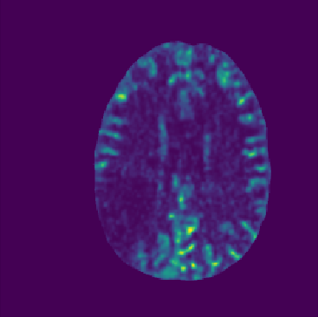

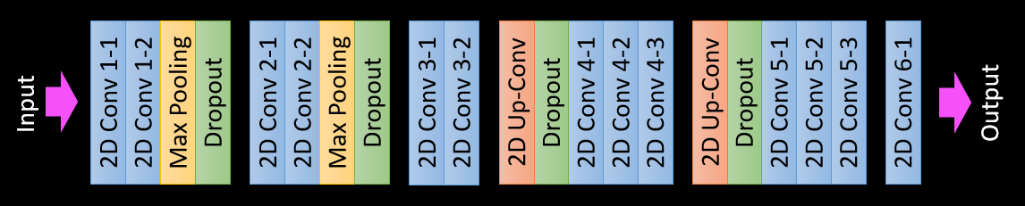
Methods
Utilized modified U-net architecture
Input – individual slices from CTP volumes
Output – binary maps indicating infarct location
Downsized images to 64x64 for computational efficiency
Training:Testing:Validation split = 60:10:30
  37:7:19 patient split
  5,038:795:2,519 slice split (8,352 total slices)
Input
Output
Notes:
Following registration, we utilized individual slices from our CT perfusion maps as the input to our network with the output being binary image labels indicating the location of infarct. Individual slices were utilized instead of the entire perfusion map volume to increase the size of our dataset and increase the generalizability of the network. Additionally, a modified u-net architecture was used as our network with a general outline of the network shown at the bottom of the slide. Images were downsized to 64 pixels by 64 pixels to increase the computation efficiency of the network during training. A training, validation, testing split of 60:10:30 was utilized for our study. When allocating image data to each cohort, we conducted the split based on patients as opposed to individual slices. This was done to prevent overfitting of the network as some slices within the same patient could be very similar to others in the same volume. This led to 37, 7, and 19 patients being allocated to the training, validation, and testing sets respectively, but the thousands of images from these patients were used for the training and testing processes. The network was trained and tested 5 separate times, once for each perfusion parameter.

Slide 11
Methods
Reconstruct infarct volumes for each patient from segmentations from individual slices
Utilized watershed method to remove erroneous infarct segmentations
  Instances of non continuous segmentation due to use of slices
  Instances of contralateral hemisphere segmentations
Pre-watershed
Post-watershed
Notes:
Following the segmentation of infarct from two-dimensional slices, three-dimensional infarct prediction volumes were reconstructed for each patient by simply placing the two-dimension slice prediction in its correct spot in the original three-dimensional volume. After visual inspection of the reconstructed volumes, it was determined that erroneous infarct predictions were present in the volumes. These erroneous segmentations tended to occur within the contralateral hemisphere of where the true lesion was present. Additionally, there were instances of non continuous segmentations since slices were used instead of the entire volume. To remove these errors, a watershed method was utilized to isolated the largest lesion within the infarct prediction volume. All lesions apart from the largest one were then removed from the prediction eliminating all erroneous segmentations. The image on this slide shows the removal of erroneous segmentations within a mean transit time predicted infarct volume.

Slide 12
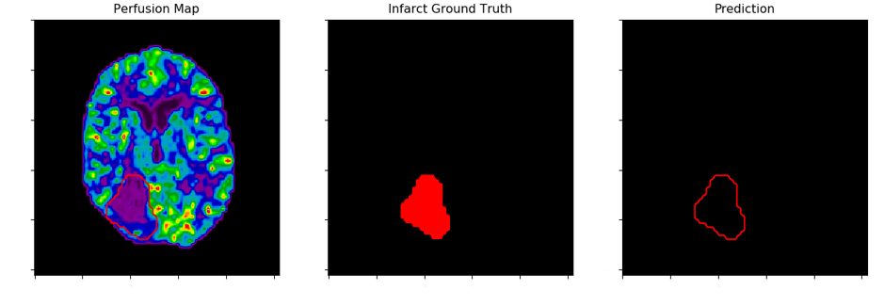
Results and Discussion
CBF parameter
Successful segmentation:
  Dice: 0.87
  ICA/MCA territory (most common region)
Failed segmentation:
  Dice: 0.00
  PCA territory
  Smaller sample size
  Located near ventricle
Notes:
Two-dimensional infarct segmentation results are indicated in the image sequences on the right. The first image indicates a cerebral blood flow perfusion map used as the input for infarct segmentation. The middle image indicates the ground truth infarct label generated from DWI and the last image indicates the predicted infarct region in gray and an outline of the ground truth label in red. For the upper image sequence, we can see a successful segmentation of infarct with a Dice of 0.87. This successful segmentation is likely due to the infarct being located in the middle cerebral artery territory which is the most common region for infarct to be in an ischemic stroke patient. The lower image sequence meanwhile indicates a failed segmentation with a Dice of 0.00. The infarct in this image is located in the posterior cerebral artery territory which explains the failed segmentation since fewer occlusions tend to occur here compared to the middle cerebral artery territory. Additionally, the infarct is located very close to a ventricle so the network may have mistakenly confused this infarction with an enlarged ventricle.

Slide 13
Results and Discussion
Blue = DWI, Green = CTP prediction, Maroon = overlap
Majority of erroneous segmentations occur at skull base
Watershed eliminates potential segmentation of bilateral infarctions
Notes:
Qualitative results in this slide indicate the post processing watershed method utilized on all five perfusion parameter infarct prediction volumes. Within the images, blue regions indicate ground truth infarct from DWI, green regions are the predicted infarct from CT perfusion, and maroon regions are regions of infarct overlap. It can be seen that the majority of erroneous infarct predictions are located near the skull base, particularly in the cerebral blood volume prediction. This is likely due to the high degree of perfusion parameter fluctuation within this region because fewer vessels are located here compared to the other regions of the brain. One downside to using this watershed method to remove the erroneous segmentations however, is it prevent the segmentation of any bilateral infarctions that may occur. Although, it should be noted that bilateral infarctions tend to be rare.

Slide 14
Results and Discussion
Metrics following segmented infarct volume reconstruction (95% confidence intervals)
Prefer underestimation of infarct to include more patients in reperfusion procedures (AHA guidelines have infarct thresholds based on age)
Too much underestimation can lead to reperfusion injury
Perfusion Parameter | Infarct Volume, mL | Mean Infarct Difference, mL
DWI | 89.0±9.6 | NA
CBF | 74.7±9.0 | 14.3±11.5
CBV | 59.4±23.2 | 29.6±21.2
TTP | 81.3±13.8 | 7.7±15.2
MTT | 99.7±16.8 | -10.7±18.6
Delay Time | 94.8±22.7 | -5.7±23.6
Notes:
Mean infarct volumes are indicated for the ground truth infarct from DWI and three-dimension predictions of infarct from each CT perfusion parameter in the first column of the table. In the second column, mean infarct differences between each CT perfusion parameter prediction and DWI ground truth infarct volumes are indicated. In order to ensure as many patients as possible are enrolled in reperfusion procedures to regain lost neurological function, it is preferred that our infarct prediction is underestimated which makes the MTT and delay time parameters suboptimal. It should also be noted however that underestimating the amount of infarct by too much of a degree can lead to a reperfusion hemorrhage during thrombectomy. This occurs when oxygenated blood is restored to a significant region of dead tissue making the cerebral blood volume parameter suboptimal. Therefore, cerebral blood flow and time to peak are the optimal parameters based on infarct volume predictions.

Slide 15
Results and Discussion
Spatial overlap metrics following segmented infarct volume reconstruction (95% confidence intervals)
Dice will never be perfect due to infarct growth between baseline CTP and follow-up DWI
PPV potential better indicator representing the portion of CTP lesion encompassed within the DWI lesion
Perfusion Parameter | Dice Coefficient | Sensitivity | Specificity | Accuracy | PPV | NPV
CBF | 0.67±0.01 | 0.67±0.04 | 0.99±0.01 | 0.99±0.01 | 0.76±0.03 | 0.99±0.01
CBV | 0.44±0.04 | 0.39±0.06 | 0.99±0.01 | 0.99±0.01 | 0.62±0.08 | 0.99±0.01
TTP | 0.60±0.02 | 0.58±0.05 | 0.99±0.01 | 0.99±0.01 | 0.67±0.04 | 0.99±0.01
MTT | 0.58±0.02 | 0.64±0.05 | 0.99±0.01 | 0.99±0.01 | 0.62±0.04 | 0.99±0.01
Delay Time | 0.57±0.03 | 0.61±0.06 | 0.99±0.01 | 0.99±0.01 | 0.60±0.05 | 0.99±0.01
Notes:
Spatial overlap metrics in the table indicate cerebral blood flow to be the optimal parameter for infarct prediction with time to peak again being another accurate predictor. Within the table, Dice indicates the degree of spatial overlap, but it needs to be considered that a perfect Dice can never be achieved. This is due to the amount of infarct growth that will occur between baseline CT perfusion imaging and follow-up DWI. Even in the event of reperfusion, there will still be infarct growth between the time of baseline imaging and when penumbra is salvaged. For this reason, positive predictive value, or PPV, may be a better indicator of which parameter is optimal since positive predictive value represents the amount of the predicted CT perfusion lesion encompassed within the final DWI lesion. For this metric, we can see that 76% of the infarct lesion predicted using the cerebral blood flow map is encompassed within the final infarct lesion from DWI. We can also see that parameters such as MTT and delay time, which have shown to overestimate the infarct volume, tend to have lower positive predictive values which intuitively makes sense.

Slide 16
Conclusion
CNNs can be utilized with various perfusion parameters to spatially located and assess ischemic stroke patients’ infarct volumes
Of 5 perfusion maps, CBF and TTP are the optimal perfusion parameters for spatial and volumetric assessment, respectively
Eliminates need for non-universal contralateral hemisphere comparisons in current commercial CTP software
Notes:
In conclusion, convolutional neural networks can be utilized with various perfusion parameters to spatially locate and quantitatively assess the amount of infarct present in ischemic stroke patients. From our study, it can be determined that the cerebral blood flow and time to peak parameters are the optimal perfusion parameters for assessing infarct tissue. These assessments are then able to eliminate the need for non-universal contralateral hemisphere comparison thresholds currently used in commercial software to identify infarct. Additionally, this method could aid in the accurate diagnosis of those eligible for mechanical thrombectomy.

