Slide 1
Cohort 1 patients | D100 post ASCT | Healthy donors
Total Number | 61 | 15
Sex | M 43 (70.5%) F 18 (29.5%) | M 8 (53.3%) F 7 (43.8%)
Median age | 58 years (36-71) | 36 years (27-60)
MM Isotype IgG IgA Light chain only Non-Secretory | 37 (60.7%) 7 (11.5%) 16 (26.2%) 1 (1.6%)
ISS stage Stage I Stage II Stage III Unknown | 22 (36.1%) 13 (21.3%) 11 (18.0%) 15 (24.6%)
FISH Standard risk High risk Unknown | 40 (65.6%) 10 (16.4%) 11 (18.0%)
Extramedullary disease | 5 (8.2%)
Lines of chemotherapy pre-ASCT One Two Three Four | 33 (54.1%) 22 (36.1%) 5 (8.3%) 1 (1.6%)
Induction therapy received Proteasome inhibitor (PI) Immunomodulatory drug (IMiD) Both PI and IMiD | 26 (42.6%) 2 (3.3%) 33 (54.1%)
Initial induction regimen VCD VTD KCD CTD PAD Other | 24 (39.3%) 14 (23.0%) 10 (16.4%) 4 (6.6%) 4 (6.6%) 5 (8.2%)
Stem cell mobilisation Cycloprime GCSF only VTD PACE ESHAP | 52 (85.2%) 5 (8.2%) 3 (4.9%) 1 (1.6%)
1st ASCT 2nd ASCT | 54 (88.5%) 7 (11.5%)
Supplementary Table 1: Patient characteristics of cohort 1(61) and demographics of healthy donors (HD, 15).

Slide 2
 | D100 post ASCT | Healthy donors
ASCT as frontline ASCT at relapse | 51 (83.6%) 10 (16.4%)
Melphalan 200 mg/m2 140 mg/m2 Unknown | 61 (100%) 52 (85.2%) 3 (4.9%) 6 (9.8%)
Median stem cell dose | 3.3 x10⁶/kg (1.3 x10⁶/kg – 16.1 x10⁶/kg)
Maintenance/consolidation therapy | 13 (21.3%) (all >D100 post-ASCT)
Depth of response at 3 months CR VGPR PR SD Unknown | 15 (24.6%) 29 (47.5%) 13 (21.3%) 3 (4.9%) 1 (1.6%)
Abbreviations:
ISS Stage I: B2 microglobulin < 3.5mg/L and Albumin>35g/L, ISS Stage III: B2 microglobulin > 5.5mg/L, and ISS Stage II: patients who did no fulfil the criteria for ISS Stage I and III.
CR: complete remission, VGPR: very good partial remission, PR: partial remission, SD: stable disease.
FISH-Fluorescence in situ hybridization, high risk is any one of: t(4,14), t(14,16), t(14,20), or del(17p)
ASCT-Autologous stem cell transplant.
PI: Proteasome inhibitor
IMiD: Immunomodulatory drug
VCD: Bortezomib Cyclophosphamide Dexamethasone, VTD: Bortezomib Thalidomide Dexamethasone, KCD: Carfilzomib Cyclophosphamide Dexamethasone, CTD: Cyclophosphamide Thalidomide Dexamethasone, PAD: Bortezomib Doxorubicin Dexamethasone, PACE: Cisplatin Doxorubicin Cyclophosphamide Etoposide, ESHAP: Etoposide Methylprednisolone Cytarabine, Cisplatin
GCSF: granulocyte stimulating growth factor
Supplementary Table 1: Patient characteristics of cohort 1(61) and demographics of healthy donors (HD, 15).

Slide 3
Cohort 2 patients | n= 9
Sex | M 8 (89%) F 1 (11%)
Median age | 61 years (45-67)
MM Isotype IgG IgA Light chain only Non-Secretory | 5 (57%) 2 (22%) 1 (11%) 0
ISS stage Stage I Stage II Stage III | 4 (44%) 3 (33%) 2 (22%)
FISH Standard risk High risk | 7 (78%) 2 (22%)
Extramedullary disease | 1 (11%)
Time from baseline sample to ASCT | 8 months (3-15)
Lines of chemotherapy pre-ASCT One Two Three | 3 (33%) 5 (56%) 1 (11%)
Induction therapy received Proteasome inhibitor (PI) Immunomodulatory drug (IMiD) Both PI and IMiD | 1 (11%) 0 8 (89%)
Initial induction regimen VCD VTD PAD IRD | 3 (33%) 4 (44%) 1 (11%) 1 (11%)
Stem cell mobilisation Cycloprime GCSF only VTD PACE | 6 (67%) 1 (11%) 2 (22%)
1st ASCT 2nd ASCT | 7 (78%) 2 (22%)
Supplementary Table 2: Characteristics of patient cohort 2 (9) with paired baseline and D100 post-ASCT samples

Slide 4
ASCT as frontline ASCT at relapse | 7 (78%) 2 (22%)
Melphalan 200 mg/m2 140 mg/m2 | 9 (100%) 7 (78%) 2 (22%)
Median stem cell dose | 2.6 x10⁶/kg (2.0 x10⁶/kg – 10.1 x10⁶/kg)
Maintenance/consolidation therapy | 1 (11%) (>D100 post-ASCT)
Depth of response at 3 months CR VGPR PR SD/PD | 2 (22%) 3 (33%) 4 (44%) 0
Abbreviations:
ISS Stage I: B2 microglobulin < 3.5mg/L and Albumin>35g/L, ISS Stage III: B2 microglobulin > 5.5mg/L, and ISS Stage II: patients who did no fulfil the criteria for ISS Stage I and III.
CR: complete remission, VGPR: very good partial remission, PR: partial remission, SD: stable disease.
FISH-Fluorescence in situ hybridization, high risk is as defined in Supp Table 1
ASCT-Autologous stem cell transplant.
PI: Proteasome inhibitor
IMiD: Immunomodulatory drug
VCD: Bortezomib Cyclophosphamide Dexamethasone, VTD: Bortezomib Thalidomide Dexamethasone, PAD: Bortezomib Doxorubicin Dexamethasone, IRD: Ixazomib Lenalidomide Dexamethasone
GCSF: granulocyte stimulating growth factor
Supplementary Table 2: Characteristics of patient cohort 2 (9) with paired baseline and D100 post-ASCT samples

Slide 5
Fluorophore | Antigen | Clone | Supplier
BV785 | CD3 | OKT3 | BioLegend
BV786 | CCR7 | G043H7 ** | BioLegend
BB515 | CD25 | 2A3 | BD Bioscience
BV650 | CD25 | BC96 | BioLegend
BUV395 | CD3 | SK7 ** | BD Bioscience
BUV661 | CD38 | HIT2 ** | BD Bioscience
BUV496 | CD4 | SK3 ** | BD Bioscience
BV650 | CD4 | OKT4 | BioLegend
AF700 | CD4 | OKT4 | eBioscience
BUV563 | CD45RA | HI100** | BD Bioscience
BV605 | CD56 | NCAM16.2 ** | BD Bioscience
V500 | CD8 | RPA-T8 ** | BD Bioscience
V500 | CD8 | SK1 | BD Bioscience
BV421 | CTLA-4(CD152) | BNI3 ** | BD Bioscience
PE | CTLA-4(CD152) | 14D3 | eBioscience
AF647 | Foxp3 | PCH101** | BioLegend
PerCP-Cy5.5 | Foxp3 | PCH101 | eBioscience
AF700 | GzmB | GB11 ** | BD Bioscience
V450 | GzmB | GB11 | BD Bioscience
BUV737 | ICOS (CD278) | DX29 | BD Bioscience
APC | ICOS (CD278) | C398.4A | BioLegend
BV650 | Ki-67 | B56 ** | BD Bioscience
FITC | Ki-67 | B56 | BD Bioscience
Biotin | LAG-3 | Goat polyclonal. Secondary stain with Streptavidin PE-Cy7 | R&D Secondary stain from BioLegend
PE/Dazzle594 | LAG-3 (CD223) | 11C3C65 ** | BioLegend
PE-Cy7 | PD-1 (CD279) | EH12.1 ** | BD Bioscience
BV605 | PD-1 (CD279) | EH12.2H7 | BioLegend
BV711 | TIM-3 (CD366) | 7D3** | BD Bioscience
FVS780 | Viability eFluor780 |  | BD Bioscience
Supplementary Table 3: Antibodies used in flow cytometric analyses
Samples labelled with ** were used for all samples from patients in cohort 2.

Slide 6
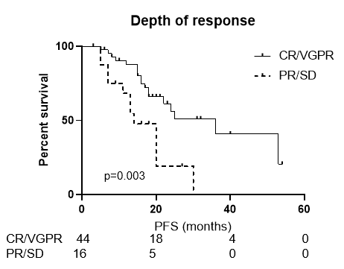
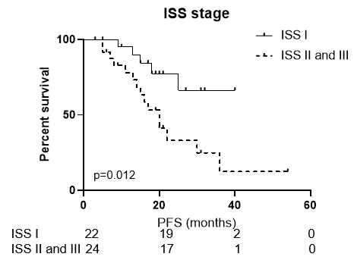
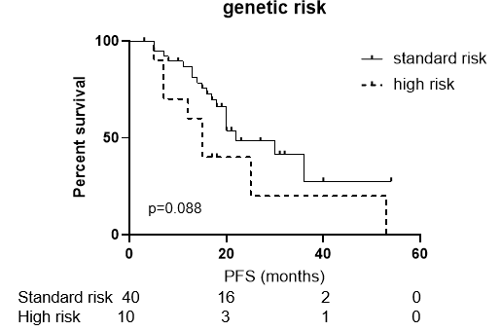
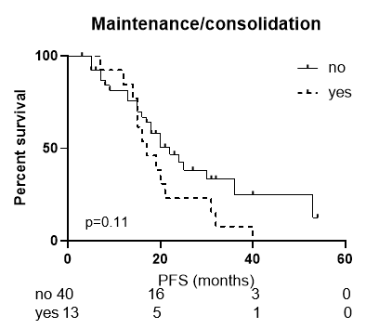
Supplementary Figure 1: Progression free survival according to known clinical risk factors. High risk cytogenetic features defined as one of: t(4,14), t(14,16), t(14,20), del(17p).

Slide 7
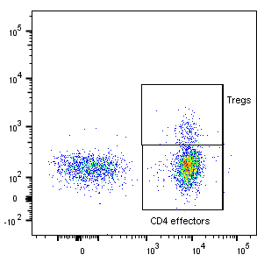
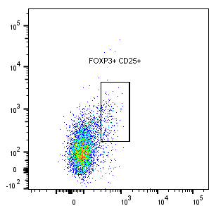
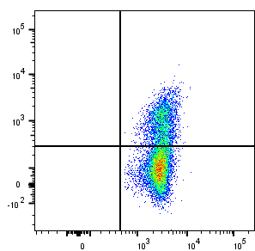
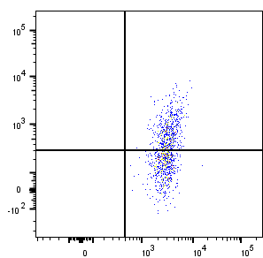
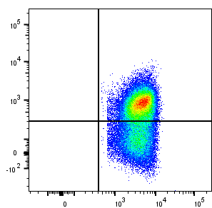
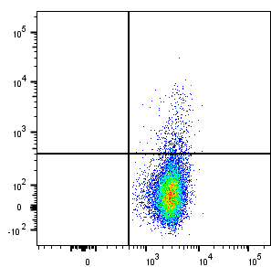
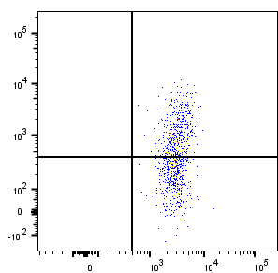
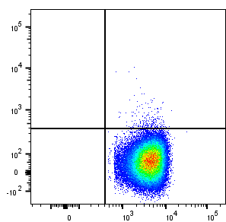
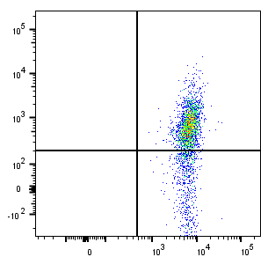
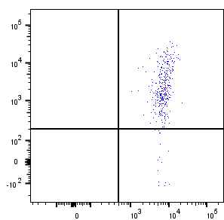
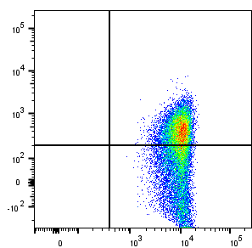
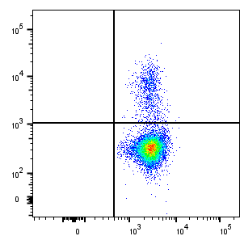
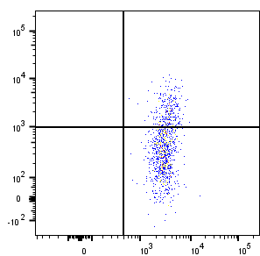
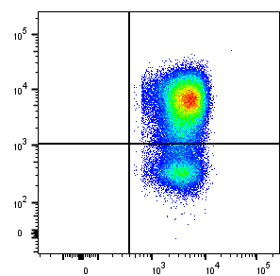
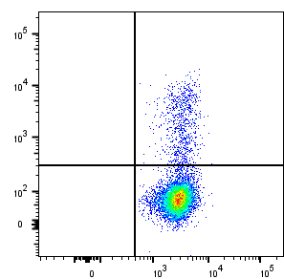
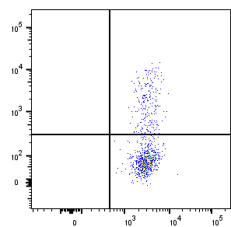
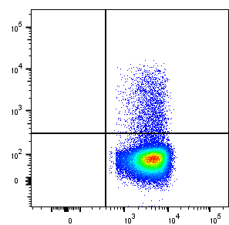
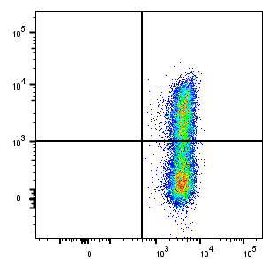
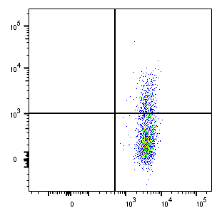
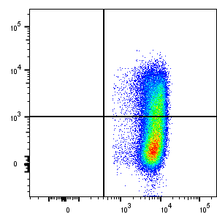
A
i
ii
FoxP3
CD25
CD4
FoxP3
B
CD4 effectors
Tregs
CD8 T cells
PD-1
CTLA-4
ICOS
GzmB
Ki-67
LAG-3
CD4
CD8
Supplementary Figure 2: FACS gating strategy of (A) Tregs (CD4+FoxP3+). (i) Dot plot histogram showing gating of FoxP3+ Tregs and FoxP3- CD4 effectors (CD4eff).(ii) Dot plot histogram showing FoxP3+CD25+ Tregs gated from CD4+ cells (B) Co-inhibitory and co-activation receptors. Representative dot plots showing the positive and negative gate of the co-inhibitory and co-stimulatory checkpoint molecules on CD4eff, Tregs, and CD8+ cells.

Slide 8
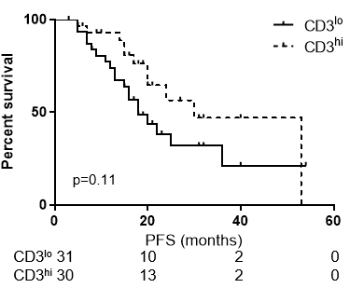
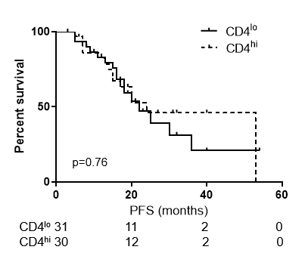
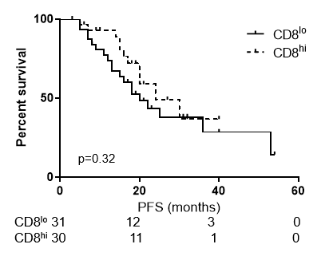
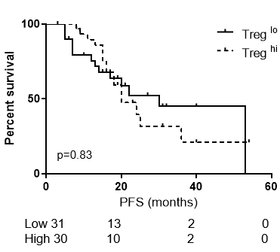
A
B
C
D
Supplementary Figure 3: T cell subsets and PFS.
PFS in patients with high (>median) and low (≤ median) frequency of (A) CD3, (B) CD4, (C) CD8, and (D) Tregs in patients 3 months post ASCT

Slide 9
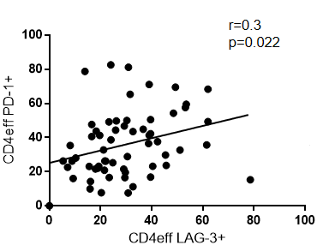
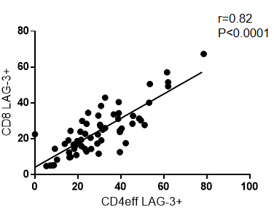
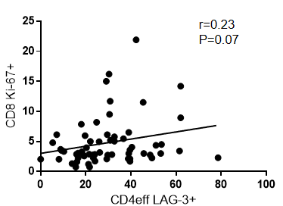
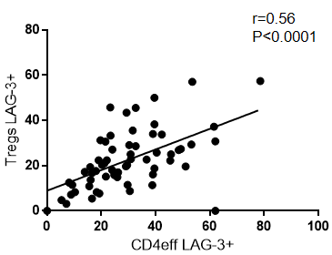
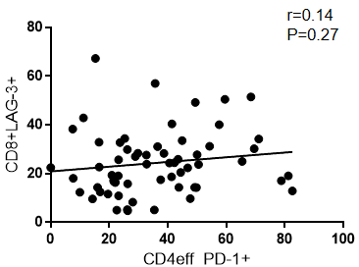
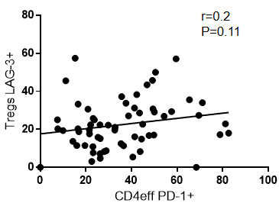
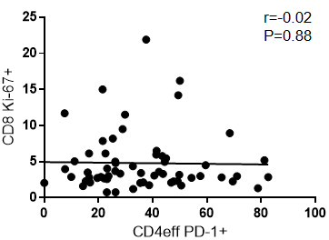
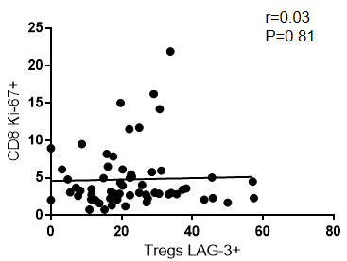
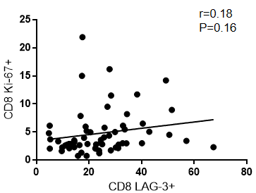
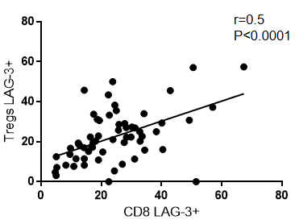
A
B
C
D
Supplementary Figure 4: Correlation between immune-regulatory and proliferation markers. Correlation between frequency of LAG-3 on CD4eff, PD-1 on CD4eff, LAG-3 on CD8 T cells, Ki-67 on CD8 T cells, and LAG-3 on Tregs.

Slide 10
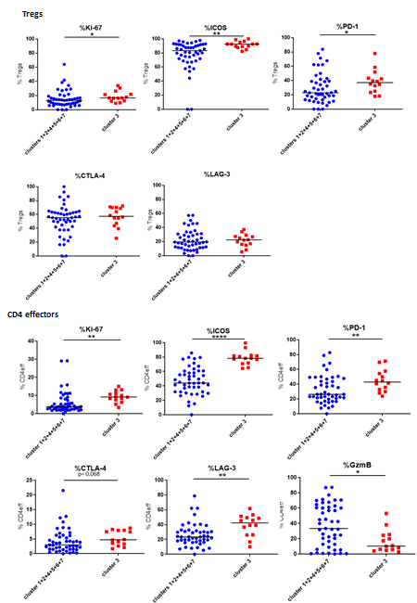

Slide 11
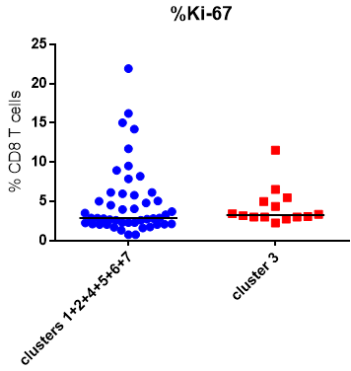
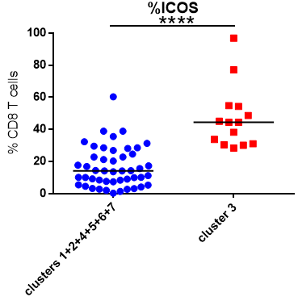
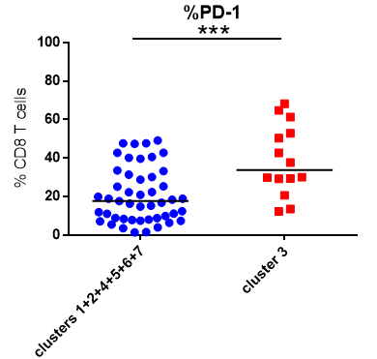
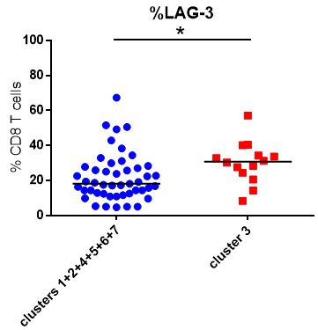
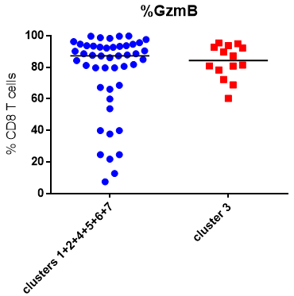
CD8 T cells
Supplementary Figure 5: Unsupervised clustering of T cell phenotype defines a cluster with distinct phenotypic and prognostic features. Frequency of activation and inhibitory receptors on Tregs, CD4eff and CD8 T cells in patients in cluster 3 and clusters 1+2+4+5+6+7+8. Statistics using student T test *p < .05 **p < 0.01, ***p <0.001, ****p <0.0001.

Slide 12
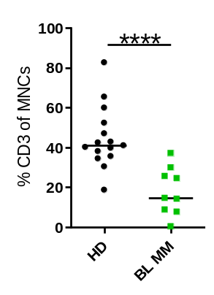
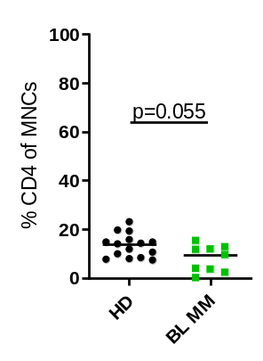
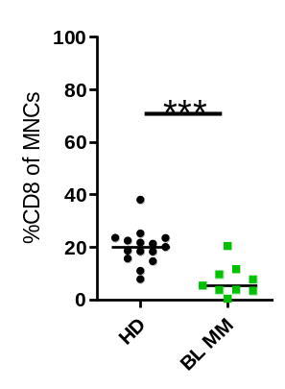
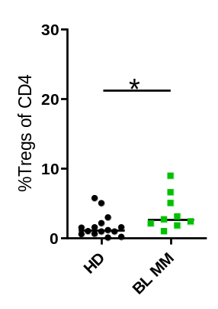
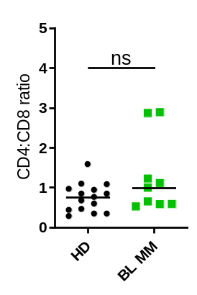
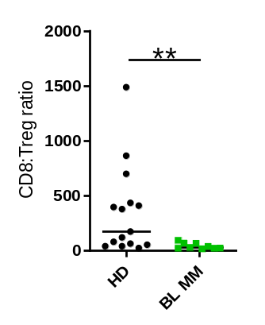

A
B
Supplementary Figure 6: : T cell subsets in MM BM at baseline from Cohort 2 patients. (A) Frequency of CD3, total CD4, CD8 T cells and Tregs. (B) CD4:CD8 and effector:Treg ratios. Ratios calculated using absolute numbers of populations in each sample. (C) Frequency of checkpoint expression on CD4eff, CD8, and Tregs. Statistical analysis by using Mann-Whitney U test *=p<0.05, **=p<0.01, ***=p<0.001, ****=p<0.0001. Lines indicate median.

Slide 13















A
T regs
CD4+
Central memory
Naive
CD4eff
Temra
Effector memory
NK cells
CD8+
Central memory
Naive
Effector memory
Temra
B
C
D
E
F
G
H
Supplementary Figure 7: (A) Lymphoid gating strategy: Samples gated on live, single cells. CD3+ CD56- lymphocytes gated on CD4+ and CD8+. CD4+ gated on FOXP3+ to define T regs. CD4+ FOXP3- effectors then gated on CCR7 and CD45RA to distinguish memory phenotype. CD8+ cells also gated on CCR7 and CD45RA to distinguish memory phenotype. (B) Change in frequency of CD3+ naïve cells between baseline and D100; (C) Change in frequency of CD3+ TEMRA; (D) Change in frequency of CD4eff PD1+, (E) Change in frequency of Ki67+ CD4eff; (F) Change in frequency of GzmB+ CD4eff; (G) Change in frequency of GzmB+ CD8+ cells, (H)Change in frequency of CD8 Ki67+. Statistical analysis by paired Student t-tests, *=p<0.05, **=p<0.01, ***=p<0.0001

Slide 14







A
B
(i)
(ii)
C
Low
High
D
Supplementary Figure 8: Three paired patient samples from baseline and D100 post ASCT were analysed. Using dimensionality reduction by UMAP and Phenograph Clustering algorithms, 19 clusters were identified from CD3+CD56-CD19- cells identified in the BM (A) Heat map to show relative expression levels of various parameters. B(i) UMAP of 3 BL samples and (ii) D100 post ASCT from the same 3 patients. (C) distribution
(D) Graph to show significant differences in size of clusters indicating mean and SD. Significance levels by student T test indicated.

Slide 15

Supplementary Figure 9: Memory phenotype of Ki67 and ICOS expressing CD8 cells in patient samples. (A) Graph of memory phenotypes of CD8 Ki67+ vs CD8 Ki67- populations. Statistical analysis by paired Student t-tests, **=p<0.01 and ***=p<0.001

Slide 16


A
B
Supplementary Figure 10: Memory phenotype of PD1 and Ki67 expressing CD8 cells in patient samples. (A) Graph of CD8 memory phenotype of CD4eff PD1hi samples vs CD4eff PD1lo samples at D100. CD4eff PD1^{hi} patients defined as >median and CD4eff PD1^{lo} defined as ≤median %PD-1+ among CD4 effectors. (B) CD8 memory phenotype of CD8 Ki67hi samples vs CD8 Ki67lo samples at D100. CD8Ki67^{hi} patients defined as >median and CD8Ki67^{lo} defined as ≤median %Ki67+ among CD8 cells. Median indicated. Statistical analysis by Student t-tests.

Slide 17
Patient | Sex | Age | Isotype | ISS Stage | Cytogenetic Risk | D100 response | Follow up (months) | Relapse
T-01 | M | 66 | IgG | I | Standard | CR | 28 | N
T-02 | M | 60 | IgG | I | High | sCR | 26 | N
T-03 | F | 57 | LC | I | High | VGPR | 26 | N
T-04 | M | 53 | IgG | I | High | PR | 17 | Y
T-05 | F | 55 | IgG | I | High | PR | 6 | Y
Supplementary Table 4: Clinical parameters of 5 patients analysed by TCR sequencing
Supplementary Fig 11: Average number of unique TCRs obtained after subsampling the BL samples (100 iterations) to equal number of TCR sequences as their paired post-ASCT samples for α-chain (A) and for β-chain (B). The black lines at the top denote standard deviation obtained from 100 iterations. The only exception is α-chain of T-04 (pink) where the post-ASCT sample is subsampled to the number of TCR sequences in BL sample.

Slide 19
Supplementary Figure 12: TCR-Sequencing analysis of 5 patient samples at baseline (BL) and post-ASCT (ASCT). (A) Number (log₂) of TCR sequences for β-chain for the 5 samples collected at BL and post-ASCT. Adjusted p=0.0038 by pairwise t-test. (B) Diversity of repertoires calculated as Renyi entropy values from 0 to infinity for the β-chain for each patient sample. Each repertoire was sub-sampled to 9000 TCRs 100 times to calculate the entropy. (C) Number of sequences for β-chain detected above a given frequency threshold. Minimum and maximum values are indicated by extreme points and the thick horizontal line in the middle indicates the median value. (D) Pie-chart for each patient sample depicting the proportion of reads encompassed by expanded TCRs (frequency threshold 1/1000) and the proportion of reads covered by the remaining TCRs for α-chain. (E) Number of clusters obtained for the expanded CDR3 (only top 50 expanded CDR3 sequences per sample were used) clustering analysis for β-chain on the basis of triplet amino acid sharing between two CDR3 sequences (see methods). (F) Proportion of post-ASCT expanded TCRs for α-chain (left) and β-chain (right) that are present in BL samples (both expanded and low frequency TCRs).

Slide 20
Sample | ALPHA
 | No. of Nodes | No. of Edges | No. of Clusters | Maximum cluster size | Average clsuter size | Average degree
T-01 BL | 436 | 332 | 130 | 22 | 3.353846 | 1.522936
T-01 ASCT | 258 | 171 | 97 | 16 | 2.659794 | 1.325581
T-02 BL | 140 | 83 | 59 | 6 | 2.372881 | 1.185714
T-02 ASCT | 57 | 40 | 23 | 8 | 2.478261 | 1.403509
T-03 BL | 698 | 783 | 125 | 153 | 5.584 | 2.243553
T-03 ASCT | 405 | 372 | 108 | 75 | 3.75 | 1.837037
T-04 BL | 574 | 558 | 132 | 115 | 4.348485 | 1.944251
T-04 ASCT | 359 | 412 | 98 | 26 | 3.663265 | 2.295265
T-05 BL | 642 | 524 | 165 | 74 | 3.890909 | 1.632399
T-05 ASCT | 176 | 117 | 65 | 23 | 2.707692 | 1.329545
Sample | BETA
 | No. of Nodes | No. of Edges | No. of Clusters | Maximum cluster size | Average clsuter size | Average degree
T-01 BL | 344 | 289 | 92 | 53 | 3.73913 | 1.680233
T-01 ASCT | 228 | 160 | 79 | 9 | 2.886076 | 1.403509
T-02 BL | 127 | 72 | 55 | 5 | 2.309091 | 1.133858
T-02 ASCT | 84 | 65 | 32 | 17 | 2.625 | 1.547619
T-03 BL | 397 | 312 | 111 | 32 | 3.576577 | 1.571788
T-03 ASCT | 303 | 237 | 97 | 21 | 3.123711 | 1.564356
T-04 BL | 260 | 175 | 97 | 15 | 2.680412 | 1.346154
T-04 ASCT | 258 | 280 | 83 | 13 | 3.108434 | 2.170543
T-05 BL | 335 | 263 | 95 | 36 | 3.526316 | 1.570149
T-05 ASCT | 183 | 137 | 60 | 16 | 3.05 | 1.497268
Supplementary Table 5: Summary of TCR clustering from samples.

