Slide 1
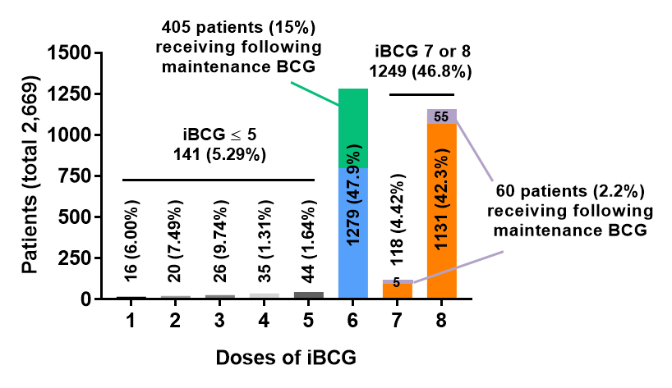
Additional file 1: Figure S1.
Distribution of doses of induction BCG (iBCG).

