Slide 1
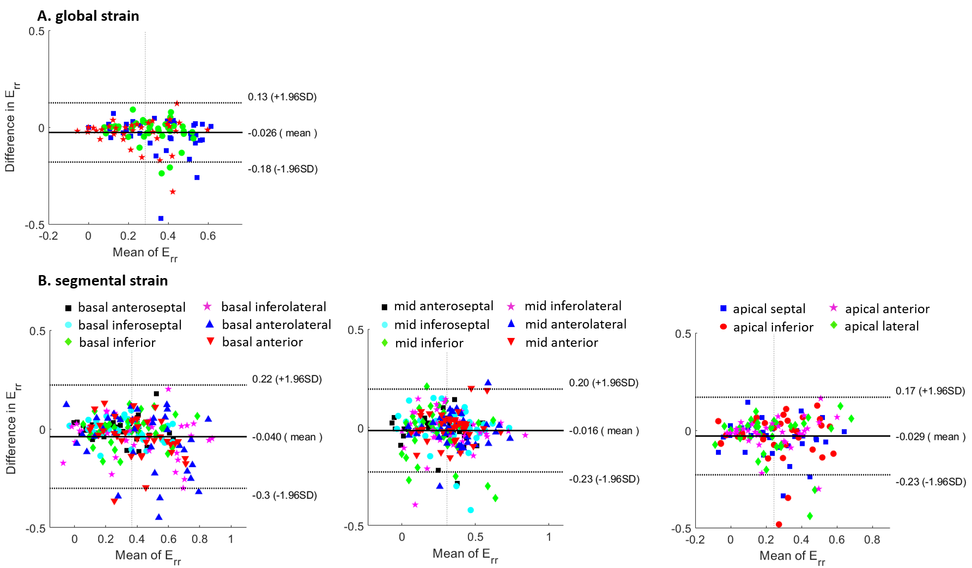
Figure S1. Bland-Altman plots for global (A) and segmental (B) radial strains at end systole of basal, mid-ventricular, and apical slices computed using the conventional user-assisted and the fully-automated DL methods.

Slide 2
Table S1. Mean and standard deviation of radial strain for healthy volunteers and patients.
 | Healthy volunteers | Mix of volunteers and patients | Patients
Global average E_{rr} | 0.32±0.17 | 0.28±0.17 | 0.23±0.16
Base average E_{rr} | 0.4±0.2 | 0.37±0.21 | 0.32±0.21
Mid-ventricular average E_{rr} | 0.35±0.14 | 0.31±0.17 | 0.25±0.19
Apex average E_{rr} | 0.25±0.19 | 0.24±0.18 | 0.23±0.17
Table S2. Mean and standard deviation of circumferential strain for healthy volunteers and patients.
 | Healthy volunteers | Mix of volunteers and patients | Patients
Global average E_{cc} | -0.17±0.05 | -0.14±0.07 | -0.1±0.07
Base average E_{cc} | -0.17±0.04 | -0.14±0.06 | -0.1±0.06
Mid-ventricular average E_{cc} | -0.18±0.03 | -0.14±0.07 | -0.1±0.08
Apex average E_{cc} | -0.2±0.04 | -0.17±0.07 | -0.14±0.07

