Slide 1
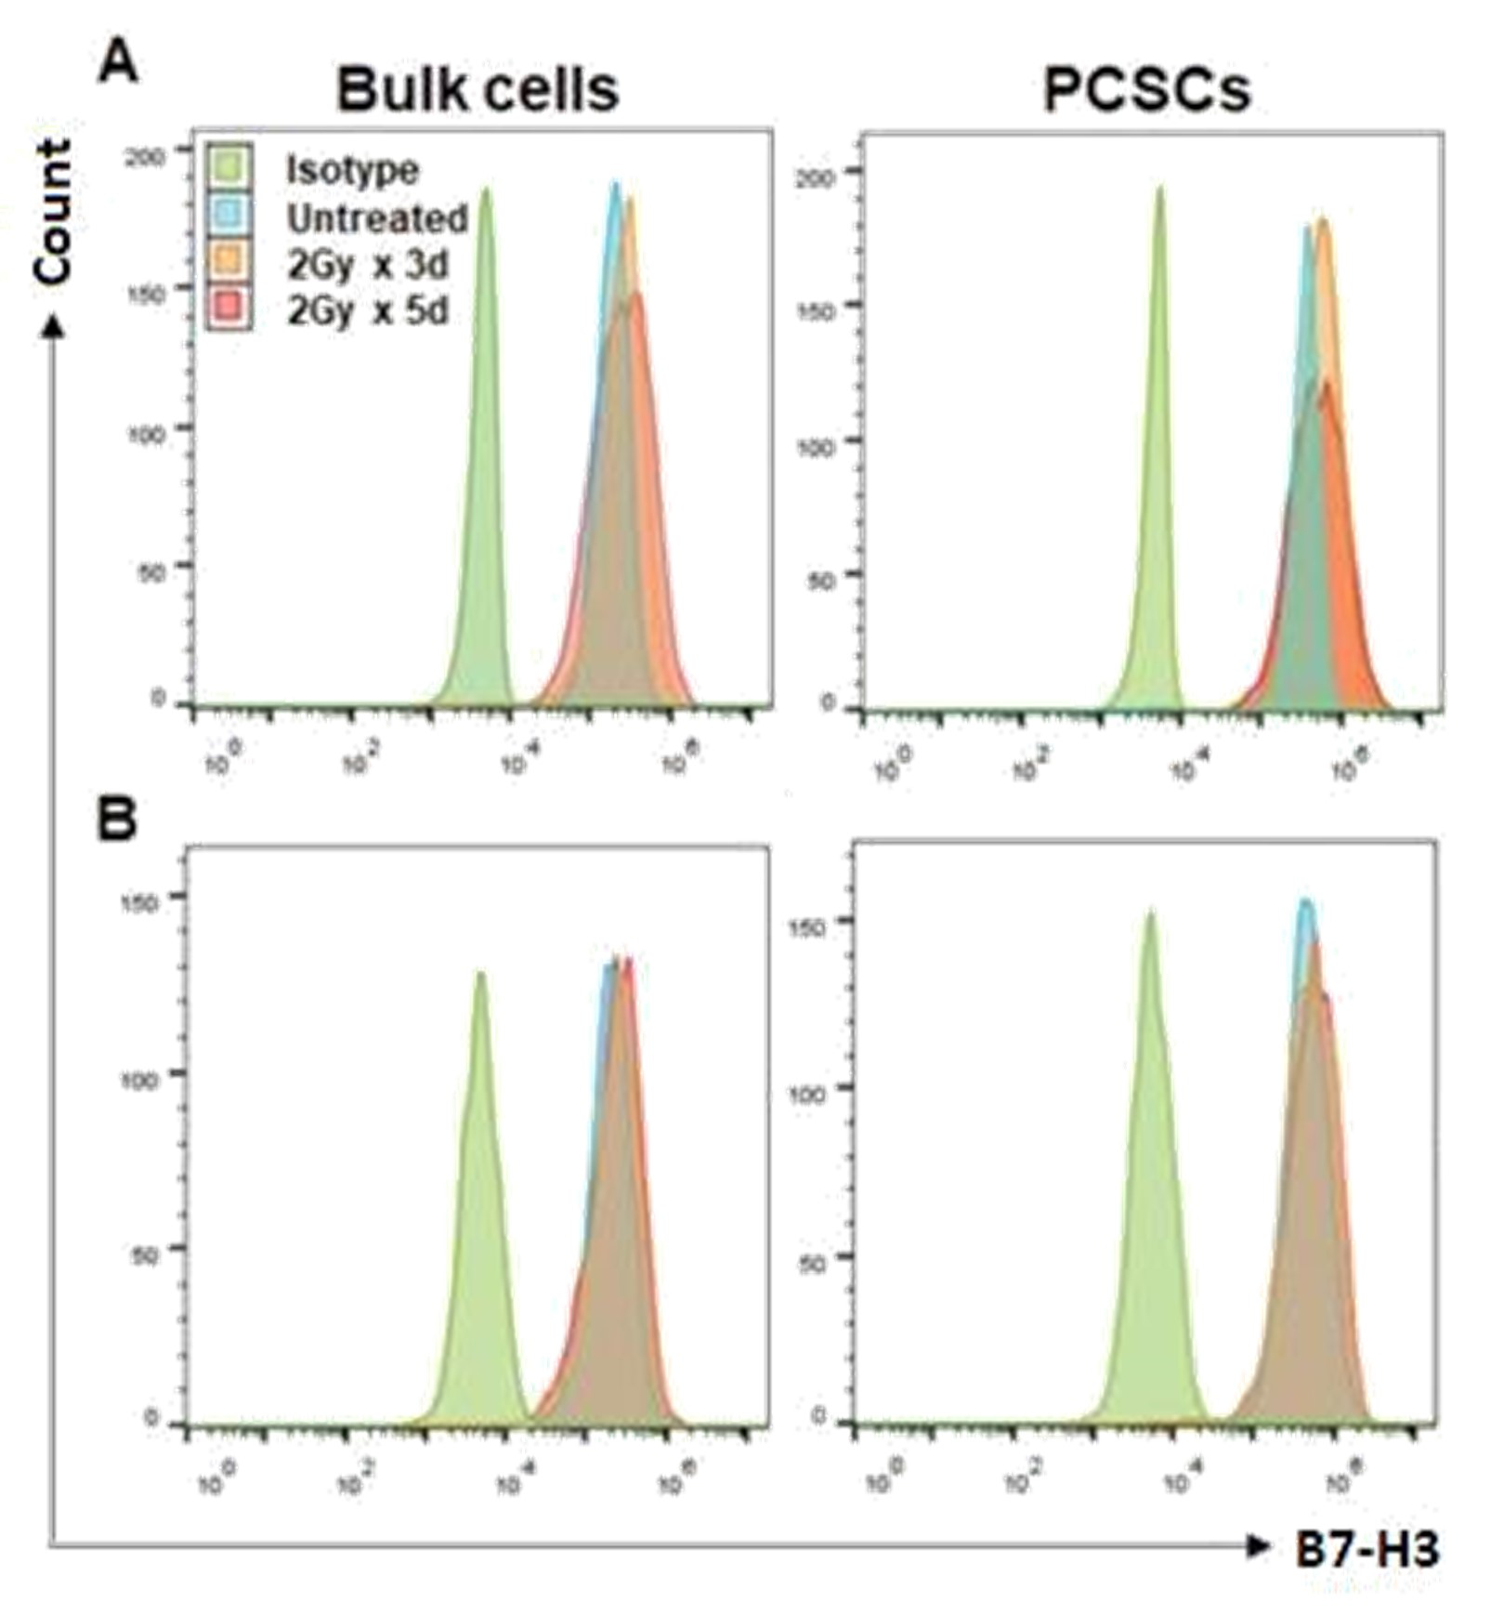
Supplementary Figure 1. FIR upregulates B7-H3 expression on PCSCs and bulk PCa cells. Sorted ALDH⁺CD44⁺ PCSCs and unsorted bulk tumor cells were irradiated at doses and times indicated and 24 hours later, the irradiated and non-irradiated (untreated) cells were stained for B7-H3 cell surface expression with B7-H3-specific mAb 376.96. Flow cytometry histograms of B7-H3⁺ bulk tumor cells and PCSCs under each indicated treatment condition are shown for DU145 (A) and PC3 (B) cell lines.

Slide 2
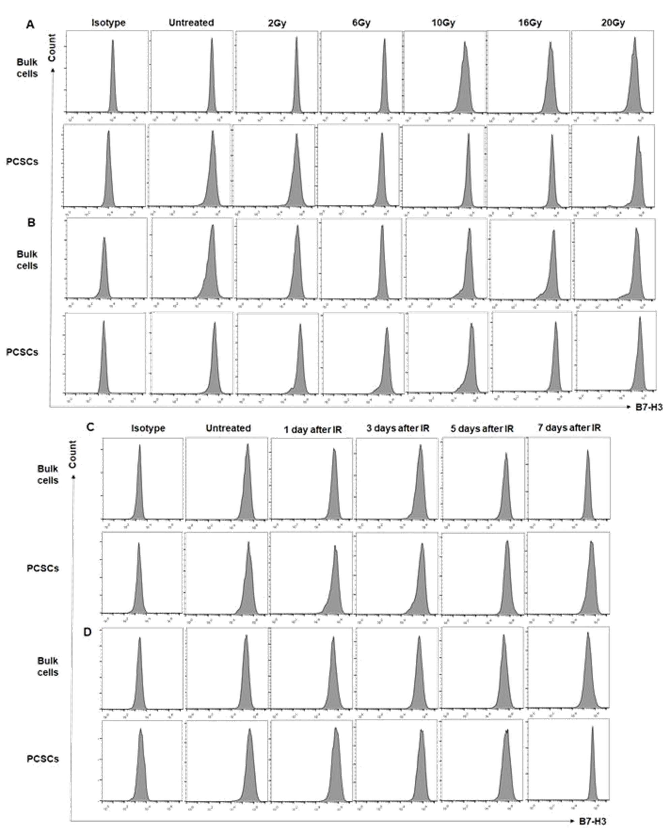
Supplementary Figure 2. IR induced upregulation of B7-H3 on PCa bulk cells and prostate cancer stem cells (PCSCs) is dose- and time-dependent. Sorted ALDH⁺CD44⁺ PCSCs and unsorted bulk tumor cells were irradiated at indicated single doses and 24 hours later, the irradiated and non-irradiated (untreated) cells were stained for B7-H3 cell surface expression with B7-H3-specific mAb 376.96. Flow cytometry histograms of B7-H3⁺ bulk tumor cells and PCSCs are shown for DU145 (A) and PC3 (B) cell lines. A single dose of IR (10 Gy) was given to PCa bulk cells or PCSCs, and B7-H3 expression was detected at the indicated time points. Flow cytometry histograms of B7-H3⁺ bulk tumor cells and PCSCs are shown for DU145 (C) and PC3 (D) cell lines.

Slide 3
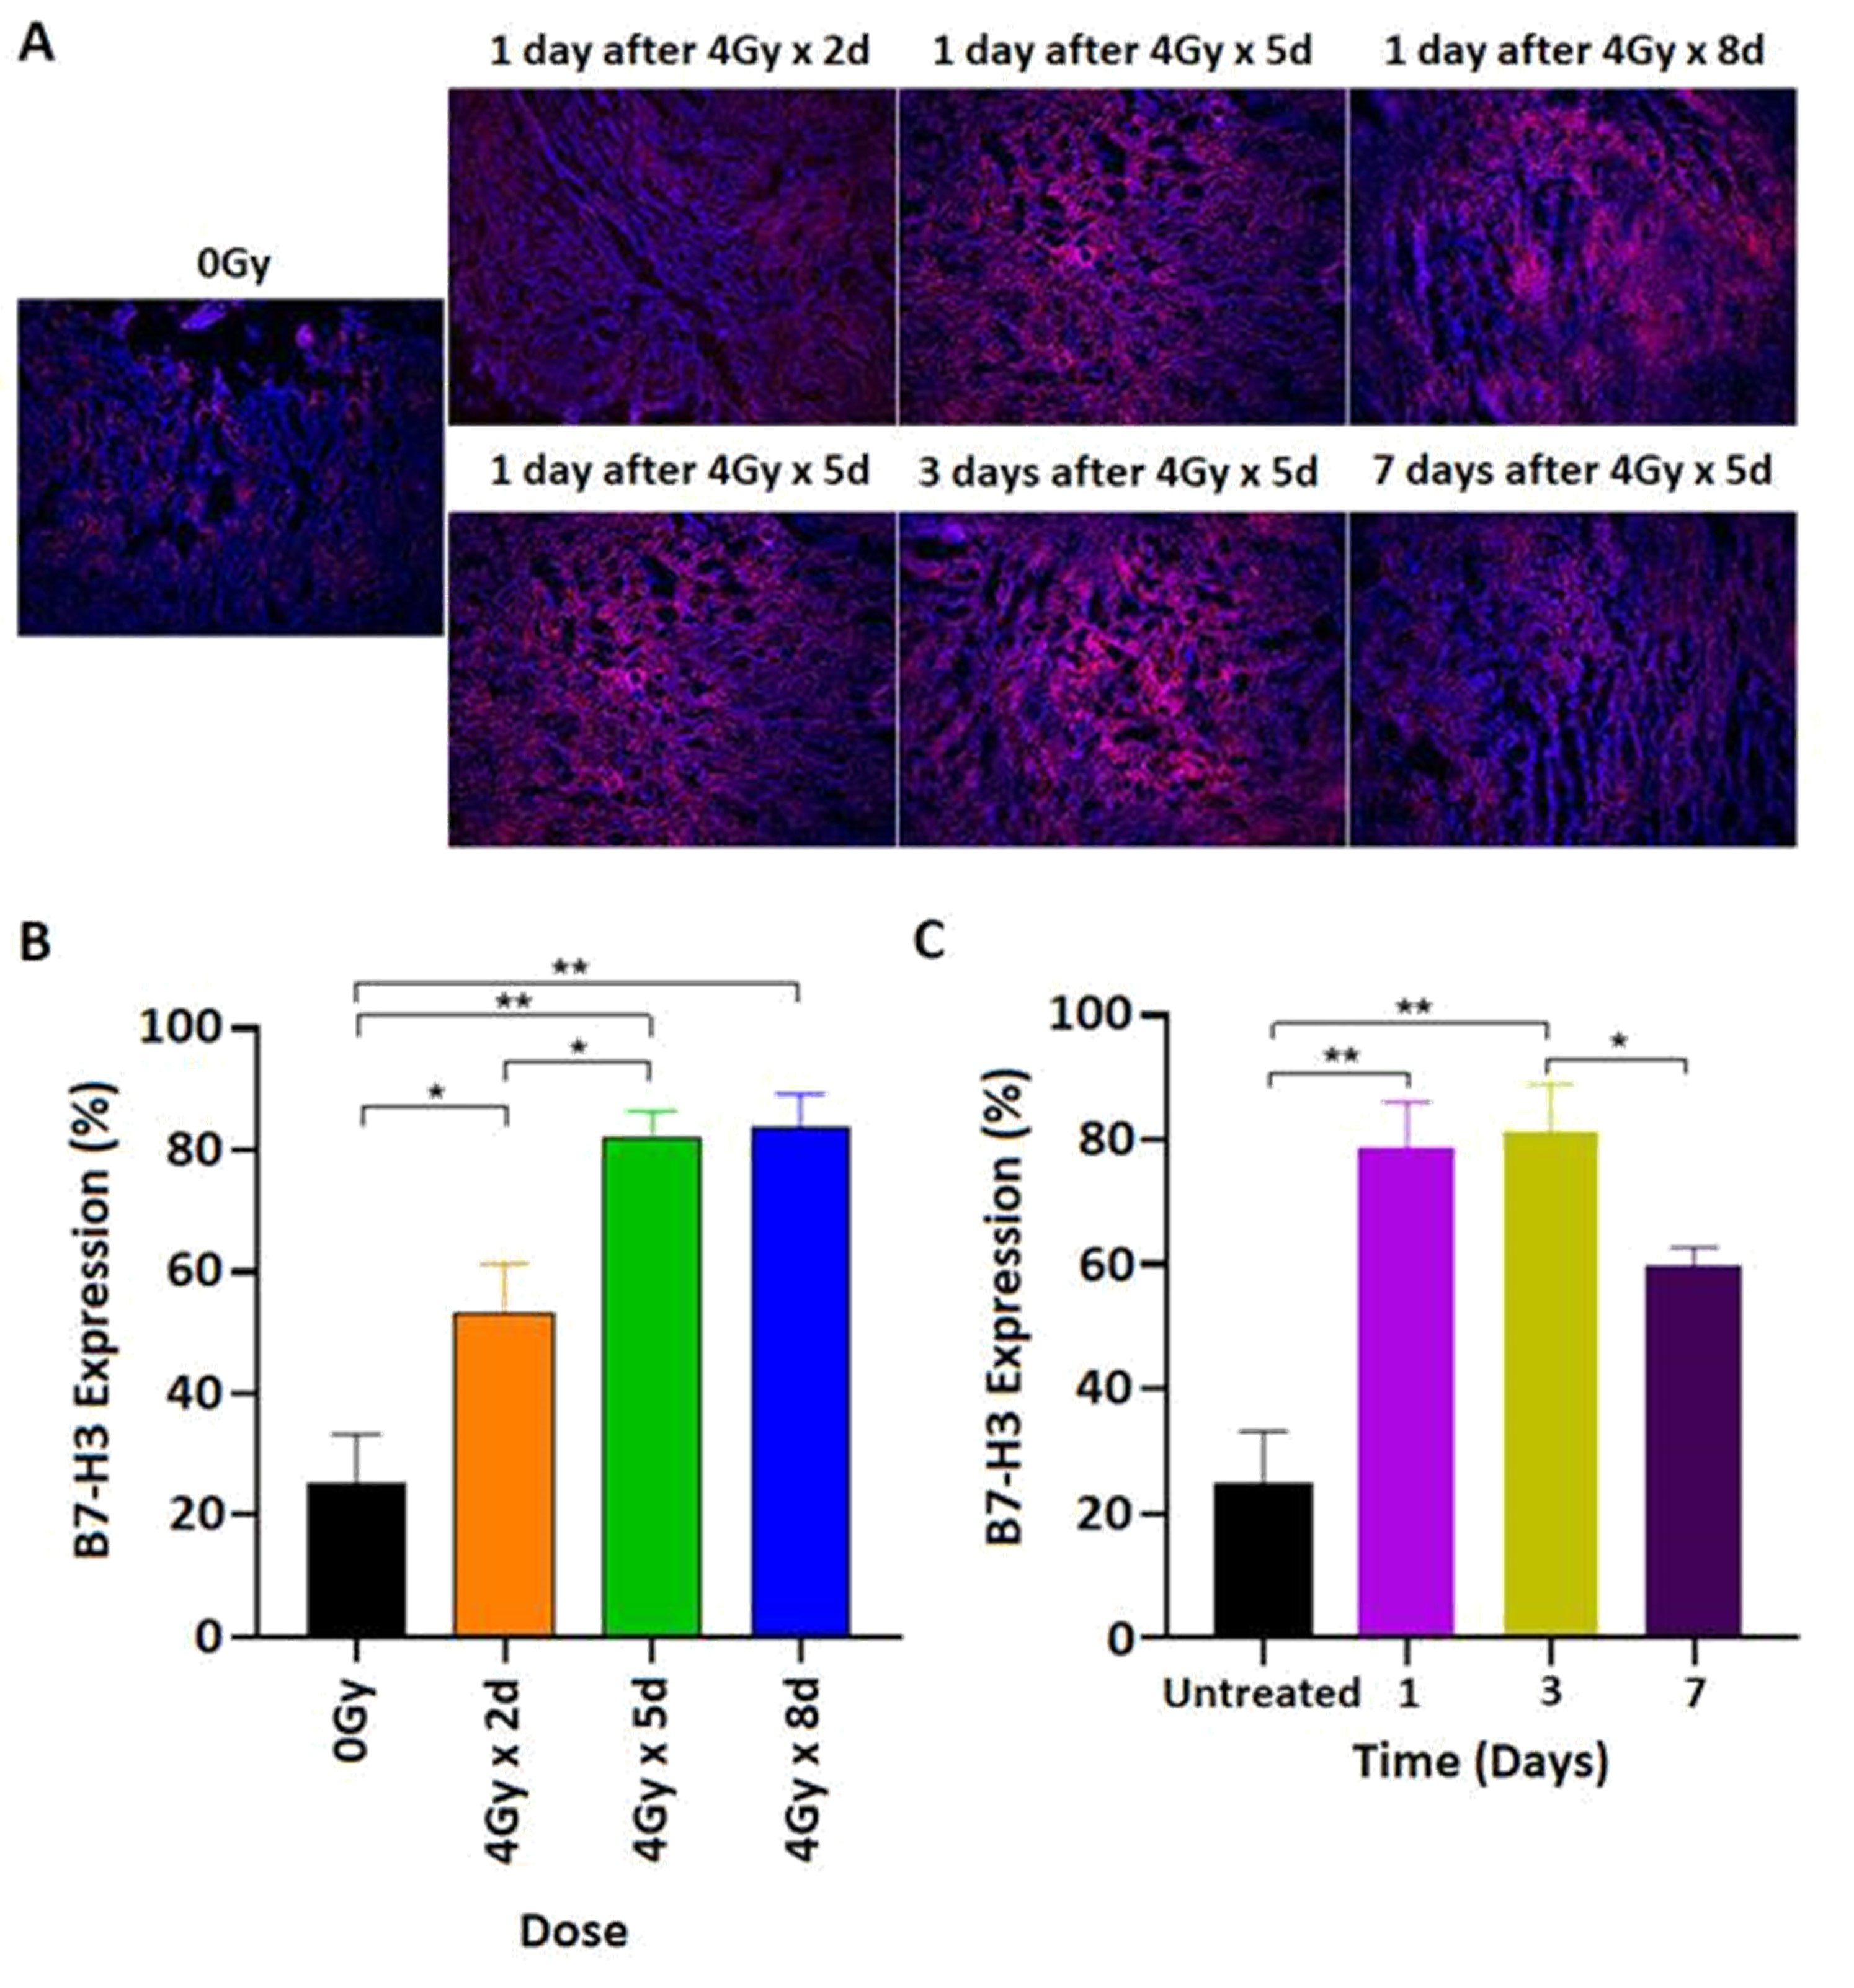
Supplementary Figure 3. FIR induced upregulation of B7-H3 on PC3 derived-xenografts is dose- and time-dependent. PC3 cells (5x10⁶ cells in 50 µL RPMI 1640 serum-free medium mixed with 50 µL Matrigel [Corning]/mouse) were implanted subcutaneously in NSG mice on day 0. Starting from day 7, when tumors reached the size of approximately 50 mm³, FIR at 4Gy per fraction was given for the indicated number of days. One day after completion of FIR treatment, tumors (n=4/group) were collected for immunofluorescence staining of B7-H3 expression on xenograft tumor tissues (A, upper panel). In addition, tumors (n=4/group) were collected at different time points after receiving FIR (4Gy x 5 days) for immunofluorescence staining of B7-H3 expression on xenograft tumor tissues (A, lower panel). Red: Alexa Fluor Plus 594 stained B7-H3, Blue: DAPI stained nuclei. Pictures (100×) were taken by a fluorescence microscope (BZ-X800, Keyence Corporation). Mean ± SD of B7-H3 expression is shown for tumors treated with different doses of FIR (1-day post-treatment) (B) and tumors collected at different timepoints post-FIR (4Gy x 5d) (C). *p<0.01.

