Slide 1
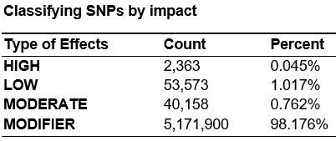
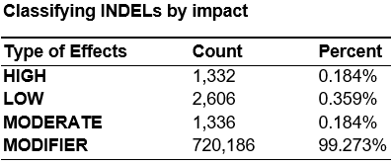
Supplementary Figure 1. Genetic alterations in 8 representative cases of PMBC (A) Classification of SNPs and INDELs by genomic region,
(B) types of SNP in the coding region, and (C) Classification by impacts on gene.
A
Regional effects of SNPs
B
Regional effects of INDELs
C
Notes:
Figure 2. Genetic alterations in 8 representative cases of PMBC (A) Classification of SNPs and INDELs by genomic region, (B) types of SNP in the coding region, and (C) Classification by impacts on gene.

