Slide 1
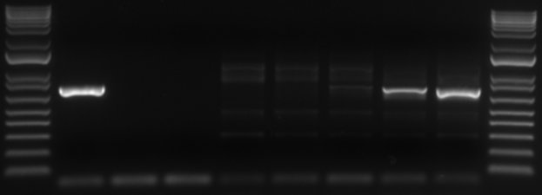
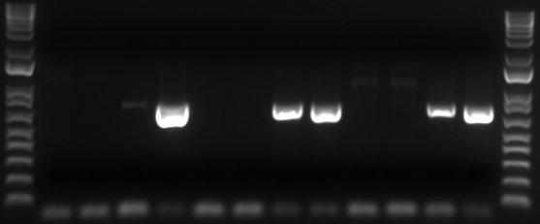
Supplementary Fig. 1
63 dpi
14 dpi
POS
NEG
c-1697
c-1718
c-1726
c-1727
850
Notes:
Supplementary Figure 1. Representative agarose gel electrophoresis image of PCR amplified products of the mpsp fragment from acquisition- and transmission-fed calf blood samples. Acquisition-fed calf 1697 at 63 dpi and transmission-fed calves 1718, 1726, and 1727 at 14 dpi. POS; T. orientalis blood stabilate positive control, NEG; no template control.

