Slide 1
Question from reviewer:
The authors say that peritoneal macrophage isolation was performed collecting the peritoneal cells after peritoneal washing with PBS. The cells were settled for 3 hrs and the non-adherent cells were removed by washing. Did the authors checked the purity of these adherent cells? I don't see any problem in FACS analyses for MHCII, CD80 and CD86 expression in low macrophage purity if the authors show the gate strategy and demonstrated that the analysis were performed only in F4/80+ population (macrophage). This strategy excludes the contamination with others cells such as T-cells. However, if the authors show low macrophage purity, the analysis of NO production (in Fig 11) and gene expression (in Fig. 7 and 8) is compromised. So please, before I accept this paper for publication, show the gate strategy for FACS analysis and the cell purity after macrophage enrichment.
Response from authors:
We show an example of our gating strategy in the next slide. The macrophages (from control group) were freshly harvested from six-well plate and stained directly for flow cytometry. The cells were gated as P1 for CD80 and CD86 analysis. Because no fungal cells were added to the culture, the macrophage purity (87.8% in this case) can be clearly demonstrated by the flow diagram. There were some dead cells in the culture, which might be caused by the repeated flushing with cold PBS (to wash off adherent macrophages) before flow cytometry.

Slide 2
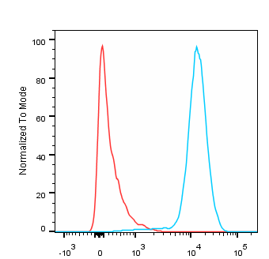
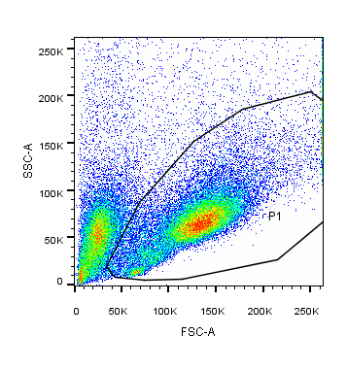
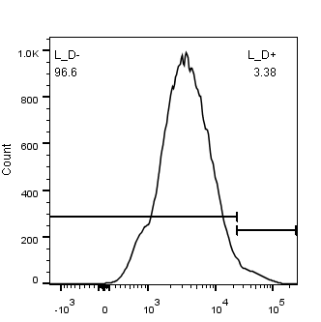
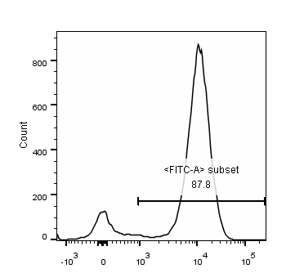
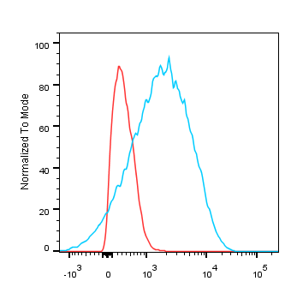
Gating Strategy Example
Gating peritoneal macrophages of control group
Isotype
F4/80+ 87.8%
Live cells
Dead cells
CD80
Isotype
Viability Dye
F4/80
CD86
Verifying viability
Gating macrophages

