Slide 1
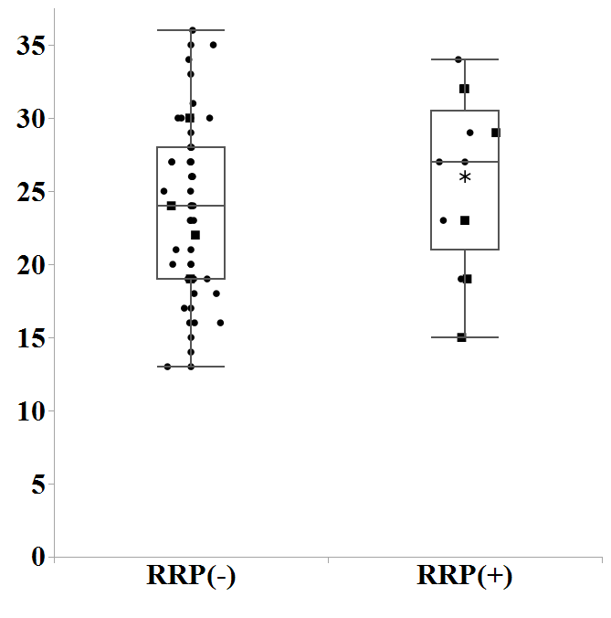
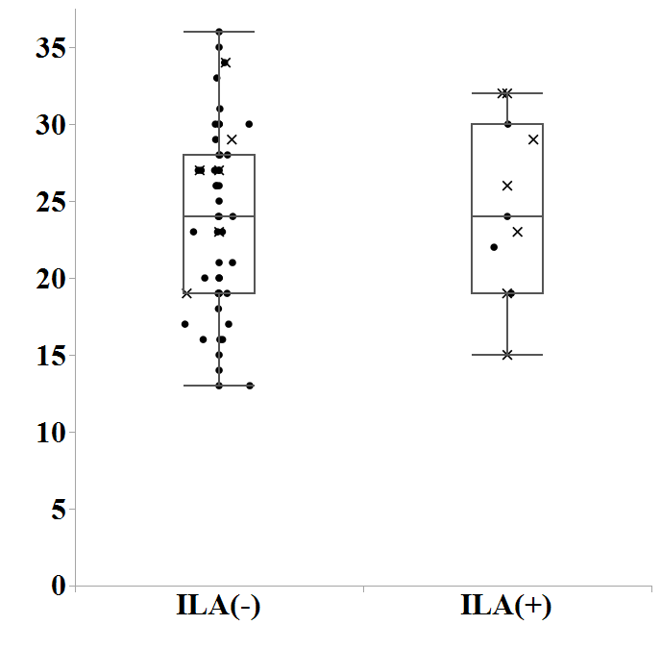
Supplementary Figure 2
(a)
V20
(b)
V20

Slide 2
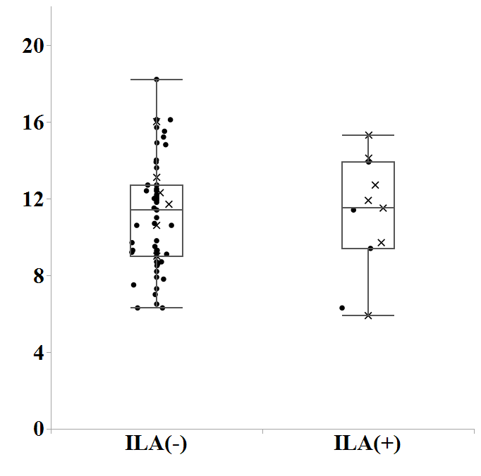
(c)
MLD

