Slide 1
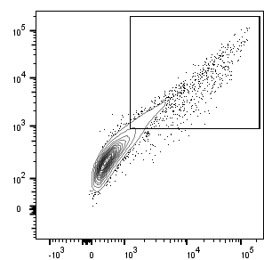
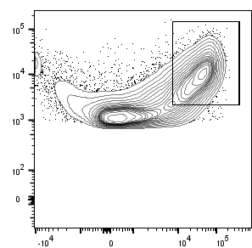
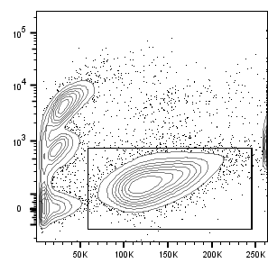
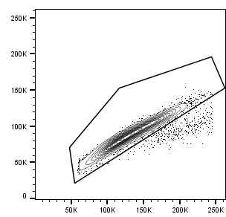
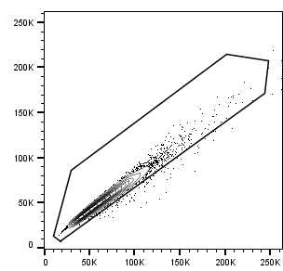
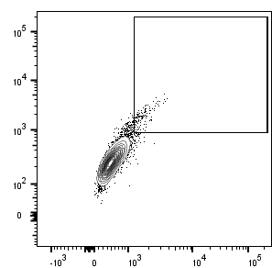
Fig. S1 (related to fig. 1)
hTCR-Ametrine
+ CD3-GFP
Tetramer staining, figure 1.
GFP+ Ametrine+
9.3%
CD3 high
37.4%
FSC singlets
95.6%
SSC singlets
98.5%
Viable
55.5%
Control
GFP
(CD3)
Surface
CD3
Viability
FSC-H
SSC-H
GFP+ Ametrine+
1.6%
FSC
FSC-A
SSC-A
GFP
(CD3)
Ametrine (TCR)
Supplementary Figure 1. Gating strategy for tetramer staining of HEK293T cells transfected with hTCR-Ametrine, CD3-GFP +/- hCD4.

Slide 2
Fig. S2 (related to fig 2)
A
hTCR: HA (retroviral delivery)
+/- Ca²⁺
Measure T cell activation
TCR deficient T cell line +/- hCD4
Sort hTCR high cells
Mix hTCR+ T cells with HLA-DR4+ APCs and peptide
B
+ hCD4
D
- hCD4
C
+ hCD4
E
- hCD4
Supplementary Figure 2. Calcium is not a limiting factor for the sensitivity of the peptide stimulation assay. (A) Schematic of in vitro peptide stimulation of HA-58.NFAT-GFP cells (+/- hCD4) and DR4+ splenocytes stimulated with different dilutions of respective peptides (stock solution 10 mg/ml) in presence or absence of extra calcium (Ca²⁺, 2mM). (B-C) hCD4+ HA-58.NFAT-GFP cells were activated by different dilutions of the cognate peptide presented by DR4+ APCs with or without extra calcium. Data shown as NFAT-GFP signal by flow cytometry (B) and IL-2 by ELISA (C) collected 24h post stimulation. (D-E) hCD4- HA-58.NFAT-GFP cells were stimulated and assayed as in (B-C). Data (n=2) is representative of two independent experiments.

Slide 3
Fig. S3 (related to fig 2)
A
B
Supplementary Figure 3. Tofacitinib inhibits IL-2 release from peptide stimulated TCR expressing 58.NFAT-GFP CD4+ cell line. (A-B) GAD-58. NFAT-GFP hCD4+ cells were co-cultured with T cell deficient DR4+ splenocytes and stimulated with peptide (GAD 10⁻³ dilution, stock solution 10 mg/ml) together with different dilutions of the JAK inhibitor Tofacitinib. (A) IL-2 was measured in supernatants by ELISA 24h after peptide and tofacitinib was added to the culture. (B) NFAT-GFP was measured after 24h by flow cytometry. *P < 0.05, and **P < 0.01 by Kruskal-Wallis test with Dunn´s multiple comparison correction (n=5/group). Data is representative of two independent experiments.

Slide 4
Fig. S4 (related to fig 4)
A
B
C
D
E
F
HA TCR
HA TCR
GAD TCR
GAD TCR
Supplementary Figure 4. anti-CD28 is not necessary for activation of hTCR expressing 58 cells, and excessive TCR crosslinking results in less activation, independently of Fas-FasL. (A) HA and GAD hTCR expressing 58.NFAT-GFP.CD4 cells were stimulated with anti-CD3 and anti-CD28 (1 μg/well) in different combinations for 24h. (B) HA and GAD hTCR expressing 58.NFAT-GFP.CD4 cells were stimulated with HLA/peptide and anti-CD3 (1 μg/well) in different combinations for 24h. IL-2 and NFAT-GFP were measured by ELISA and flow cytometry. (C-D) HA hTCR expressing 58.NFAT-GFP.CD4 cells were stimulated with anti-CD3 (1 μg/well) and different concentrations of blocking FasL for 24h. (E-F) GAD hTCR expressing 58.NFAT-GFP.CD4 cells were stimulated with anti-CD3 (1 μg/well) and different concentrations of blocking FasL for 24h. In all graphs, IL-2 was measured by ELISA, and NFAT-GFP signal was measured by flow cytometry. Statistics calculated with Mann-Whitney test. Data is representative of two independent experiments.

