Slide 1
Supplementary Figure 1
Inclusion Criteria
Confirmed diagnosis of PDAC
Stage I-III disease: Extent of disease limited to borderline resectable or locally advanced PDAC with no evidence of distant metastasis
Treated with neoadjuvant FOLFIRINOX + radiotherapy followed by pancreatic resection with curative intent
Postoperative tumor pathology sections available for collagen proportional area (CPA) quantification with Sirius Red staining
Postoperative follow up data available for survival analysis
114 Patients Treated with Pancreatic Resection
109 patients with borderline resectable or locally advanced PDAC
5 patients excluded for alternate diagnoses: 2 PNET, 2 IPMN, 1 pancreatitis
95 patients treated with neoadjuvant FOLFIRINOX and radiotherapy
14 patients excluded for alternate neodjuvant therapy regimens: 3 FOLFIRINOX monotherapy, 11 gemcitabine/abraxane
93 patients included in the final analysis
2 patients excluded for metastatic disease discovered at surgery
Neoadjuvant Therapy
FOLFIRINOX cycles:
< 4: 1 (1%)
4 – 7: 15 (16%)
8: 67 (73%)
9 – 24: 9 (10%
Operations
Pancreaticoduodenectomy:
43 (46%)
Pancreaticoduodenectomy + IORT:
23 (25%)
Distal Pancreatectomy:
19 (20%)
Distal Pancreatectomy + IORT:
8 (9%)
Adjuvant Therapy
Radiation:
16 (18%)
Chemotherapy:
36 (40%)
Follow Up
No patients were lost to follow up
Median follow up time after surgery:
12 months
Median overall survival after surgery:
35 months
Primary outcome measures
Overall Survival
Disease-Free Survival

Slide 2
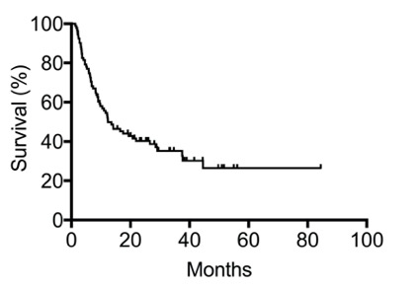
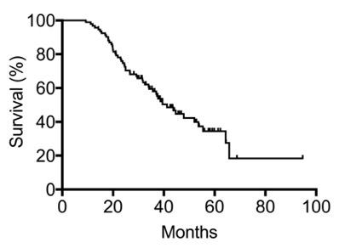
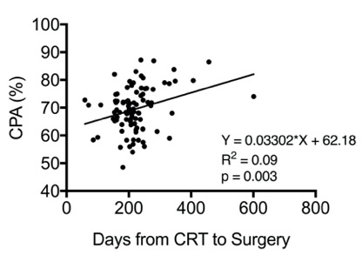
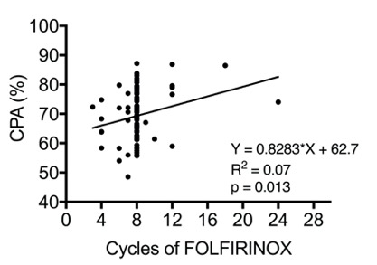
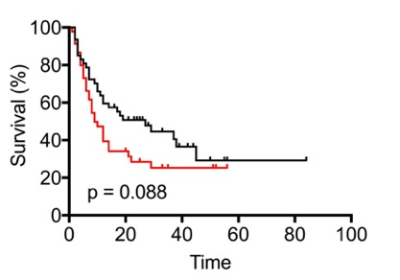
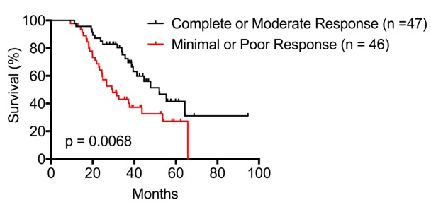
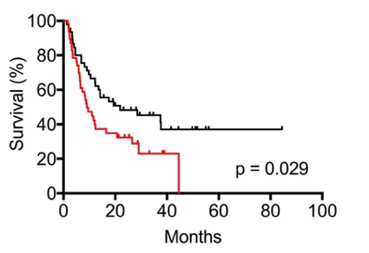
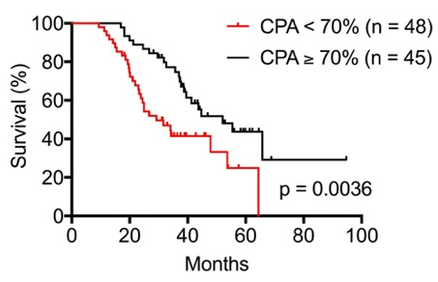
Supplementary Figure 2
A
Disease-Free Survival
Overall Survival
B
C
n = 93
Median = 12.4 months
n = 93
Median = 41.3 months
D
Disease-Free Survival
Overall Survival
E
Disease-Free Survival
Overall Survival

Slide 3
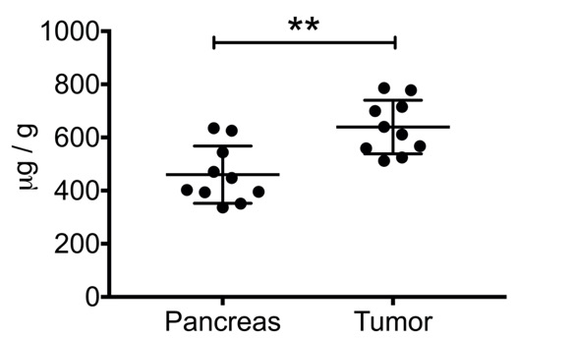
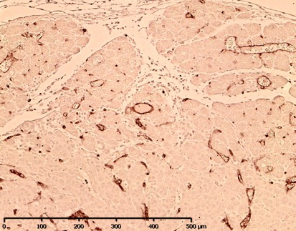
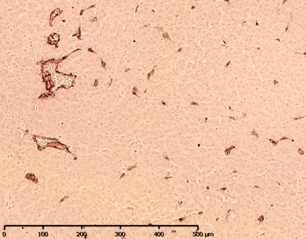
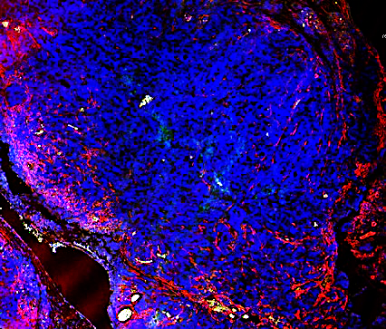
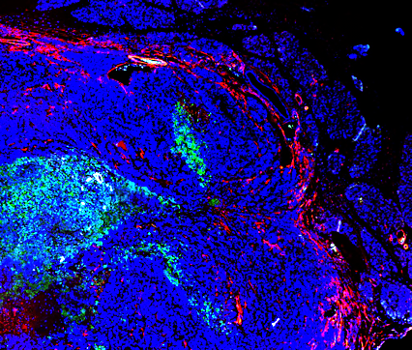
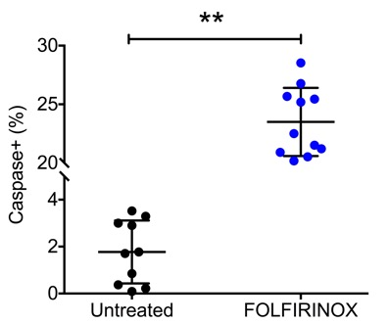
Supplementary Figure 3
A
Hydroxyproline
B
Peripheral
Central
CD31+
C
Untreated
FOLFIRINOX
αSMA / Caspase / DAPI

Slide 4
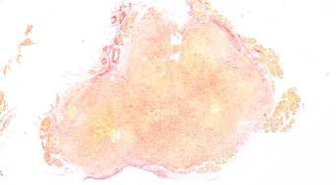
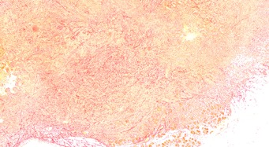
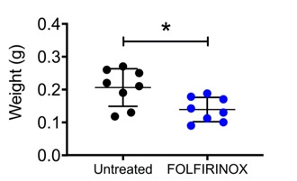
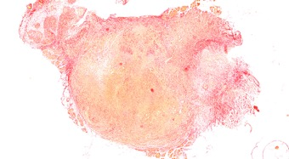
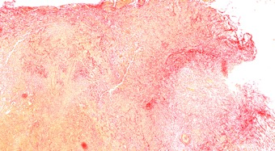
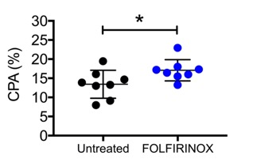
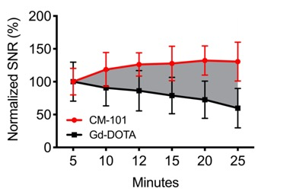
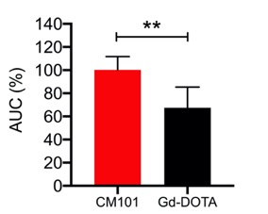
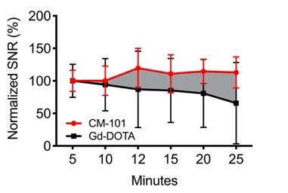
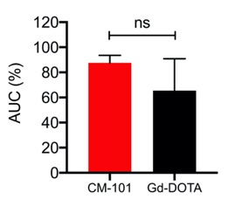
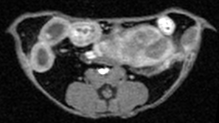
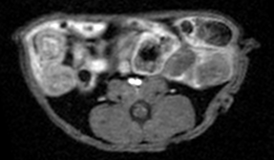
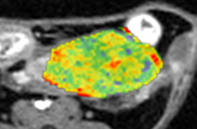
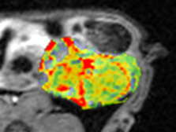
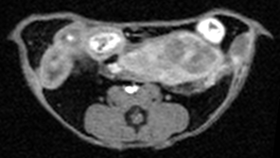
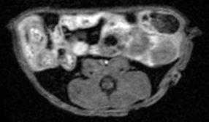

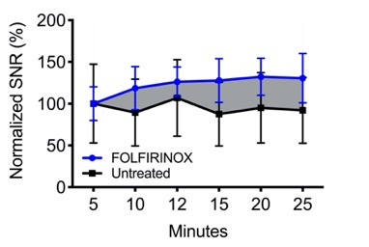
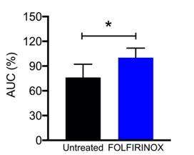
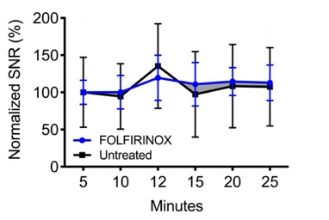
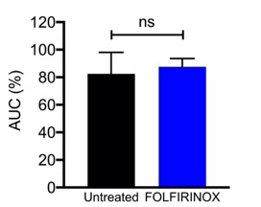
Supplementary Figure 4
A
Untreated
FOLFIRINOX
B
PDAC
C
Pancreas
D
Untreated
E
FOLFIRINOX
5 min
5 min
120
Retention Map
Retention Map
Signal Intensity
60
0
25 min
25 min
100
Signal Intensity
50
0
F
PDAC
Pancreas
G

