Slide 1
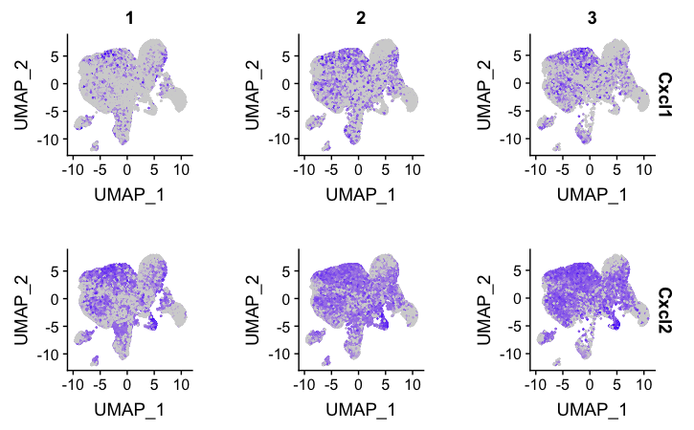
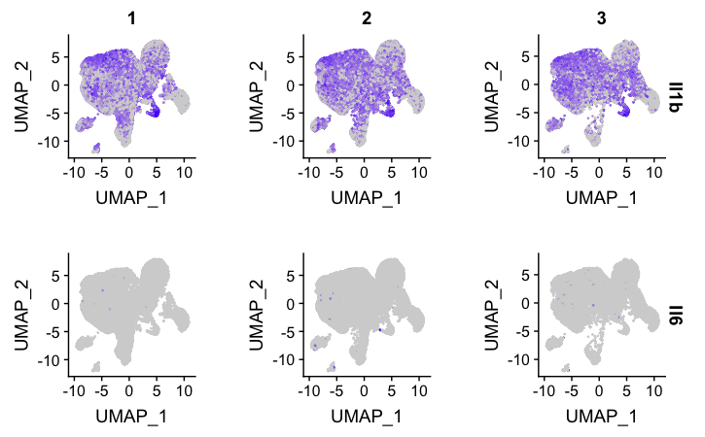
Supplemental Figure 5
Vehicle
Cabozantinib
Cabozantinib /Anti-IL1b
Supplemental Figure 5. Visualization of select RNA transcripts across treatment groups. Visualization of single-cell transcription patterns between vehicle, cabozantinib, or cabozantinib/αIL1B treated tumors. CXCL1 and CXCL2 (murine homologs of human IL-8), IL-1b and IL6 are shown.

