Slide 1
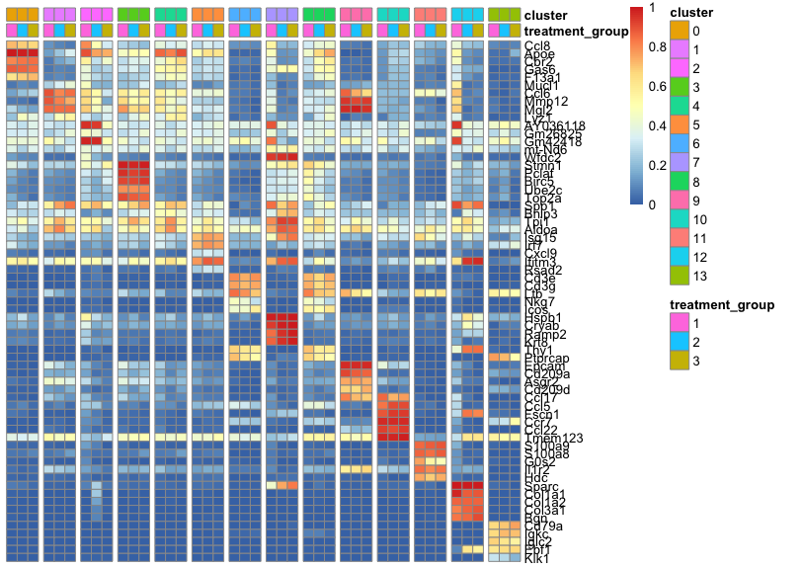
Supplemental Figure 6
Supplemental Figure 6. Visualization of top 5 upregulated RNA transcripts associated with each cluster. Visualization of Top 5 differentially regulated genes across all 13 clusters.

