Slide 1
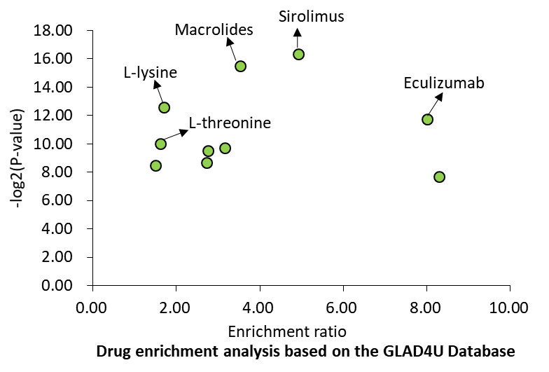
Supplemental Figure S3. Significant gene sets related to drug based on the GLAD4U database enriched by CAD-associated genes identified from Sherlock Bayesian analysis

