Slide 1

The effect of a dermato-oncologic training program on the diagnostic skills and quality of referrals for suspicious skin lesions by general practitioners
E. Marra¹, M.C.J. van Rijsingen¹, J.A.C. Alkemade², J.M.M. Groenewoud³, K.F. Hueskes⁴, C.H.M. Nij Bijvank⁴, F.A. van de Laar^{4,5}, S.F.K. Lubeek¹
¹ Department of Dermatology, Radboud university medical centre, Nijmegen, the Netherlands
² Department of Dermatology, Canisius Wilhelmina hospital, Nijmegen, the Netherlands
³ Department for Health Evidence, Radboud university medical centre, Nijmegen, the Netherlands
⁴ Regional department of the National Association of General Practitioners, Nijmegen, the Netherlands
⁵ Department of Primary and Community care, Radboud university medical centre, Nijmegen, the Netherlands
British Journal of Dermatology. DOI: 10.111/bjd.19214

Slide 2


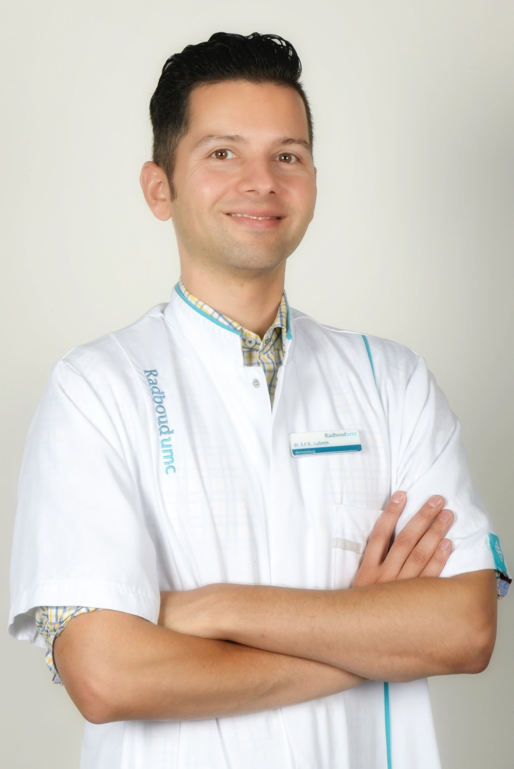



Lead Researcher
S.F.K. Lubeek, MD, PhD, dermatologist
Department of Dermatology, Radboud university medical centre, Nijmegen, the Netherlands
British Journal of Dermatology. DOI: 10.111/bjd.19214

Slide 3
Introduction
What’s already known?
General practitioners (GPs) play an important part in skin cancer care and optimal recognition and referral are considered of vital importance to optimize skin cancer care efficacy
Previous research identified a rather poor clinical recognition of (pre)malignant skin tumours by GPs, leading to a high rate of potentially unnecessary referrals to dermatologists
British Journal of Dermatology. DOI: 10.111/bjd.19214

Slide 4
Objective
The aim of this study was to evaluate if a dedicated dermato-oncologic training program (DOTP) for general practitioners (GPs) improves the diagnostic skills and quality of referrals by GPs.
British Journal of Dermatology. DOI: 10.111/bjd.19214

Slide 5
Methods (1)
A cohort of GPs followed a dedicated dermato-oncologic training program (DOTP)
The DOTP was developed as part of a project called ‘suspicious skin lesions’ in the Nijmegen area (the Netherlands)
The DOTP consisted of: (1) instruction on the project (aims) and guidelines, (2) a mandatory online course on SC (including an examination), and (3) two optional live courses on SC and dermoscopy, respectively.
British Journal of Dermatology. DOI: 10.111/bjd.19214

Slide 6
Methods (2)
All GPs with their own practice in the Nijmegen area (n=194) received an invitation to participate
Two different time periods after the DOTP was finished (September-October 2018 and May-June 2019).
For comparison, both referrals from trained and untrained GPs were included, forming a trained cohort (TC) and an untrained present cohort (UPC).
Comparison was made using a historical control group from previous research on GP referrals in the same population (2008-2010), forming an untrained historical cohort (UHC)
British Journal of Dermatology. DOI: 10.111/bjd.19214

Slide 7
Methods (3)
Primary outcome: agreement between GP referral diagnosis and the final diagnosis made by the dermatologist
Secondary outcomes: (1) the proportion of proper dermatologic descriptions used in the referral letters, (2) the amount of diagnostic procedures (dermoscopy, punch biopsies) performed by the GPs, (3) the amount of additional (pre-)malignant lesions found by the dermatologist, and (4) the proportion of potentially unnecessary referrals.
British Journal of Dermatology. DOI: 10.111/bjd.19214

Slide 8
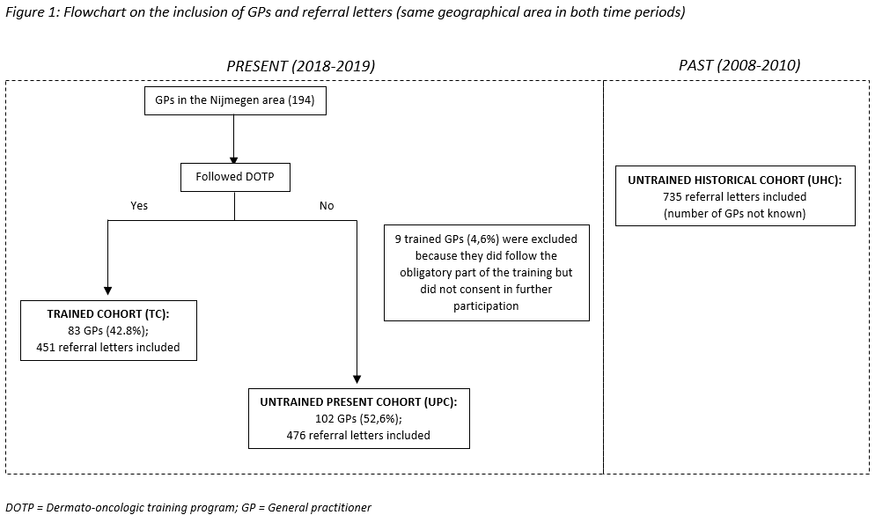
Results (1)
British Journal of Dermatology. DOI: 10.111/bjd.19214

Slide 9
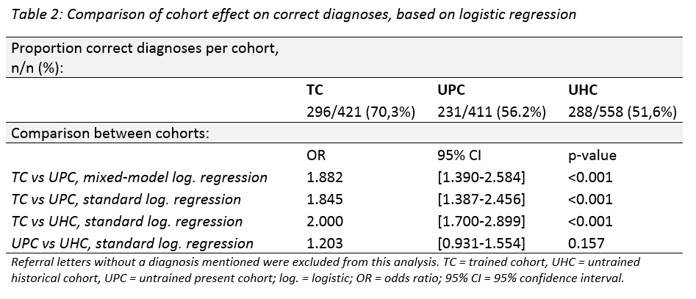
Results
Results (2)
British Journal of Dermatology. DOI: 10.111/bjd.19214

Slide 10
Results (3)
Dermatologic descriptions used in the referral letters:
Diagnostic procedures performed by the GPs
Additional (pre-)malignant lesions found by the dermatologist
Potentially unnecessary referrals
British Journal of Dermatology. DOI: 10.111/bjd.19214

Slide 11
Discussion
This study demonstrates that GPs who followed a DOTP had better diagnostic skills and quality of referrals than untrained GPs
Enhances optimal efficacy in skin cancer (SC) care and might eventually even lead to lower healthcare costs
No difference on the main outcomes comparing referrals from the two time periods (two versus ten months after training). Nevertheless, it would be interesting to find out if these findings persist after a longer period of follow-up.
British Journal of Dermatology. DOI: 10.111/bjd.19214

Slide 12
Discussion
Room for improvement: more treatment of low-risk SC (and premalignant lesions) by GP, total body skin examination by GP, further train GP with a special focus on SC
Substitution of SC care puts more pressure on primary care and a sufficient amount of time, finances and healthcare providers seems essential to facilitate this
Potential bias in the group of trained GPs, since GPs participating in the project could be more interested and motivated in treating SC than other GPs
Therefore, confirmation of these findings in a randomized controlled trial would be beneficial
British Journal of Dermatology. DOI: 10.111/bjd.19214

Slide 13
Conclusions
What does this study add?
This current study demonstrates that GPs who followed a dedicated dermato-oncologic training program had better diagnostic skills and quality of referrals than untrained GPs, leading to less potentially unnecessary referrals
This might enhance a more efficient use of the limited capacity in secondary dermatologic care and consequently leads to lower healthcare costs
British Journal of Dermatology. DOI: 10.111/bjd.19214

Slide 14
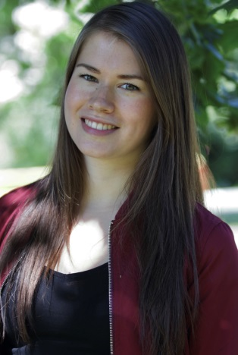
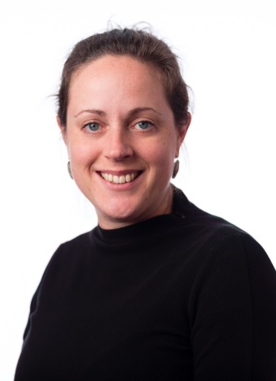
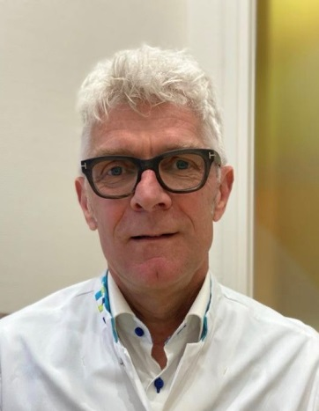
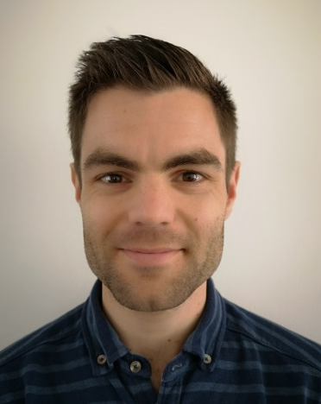
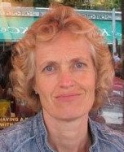
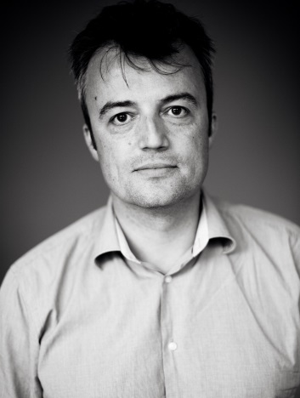

The Team
E Marra
MCJ van Rijsingen
JAC Alkemade
KF Hueskes
CHM Nij Bijvank
FA van de Laar
SFK Lubeek
Not depicted: JMM Groenewoud
British Journal of Dermatology. DOI: 10.111/bjd.19214

Slide 15
Call for correspondence
Why not join the debate on this article through our correspondence section?
Rapid responses should not exceed 350 words, four references and one figure
Further details can be found on the BJD website

