Slide 1
Supplemental Figure 1
A
NIH
GTD
32
%ddcfDNA
1
0.03125
Samples
B
0.8
NIH
GTD
0.6
Relative frequency
(fractions)
0.4
0.2
0.0
.
0
.
5
.
0
5
0
2
5
.
7
C
%ddcfDNA
Bin Center
10.0
7.5
5.0
%ddcfDNA
2.5
0.0
A
B
C
D
E
F
G
H
Samples

Slide 2
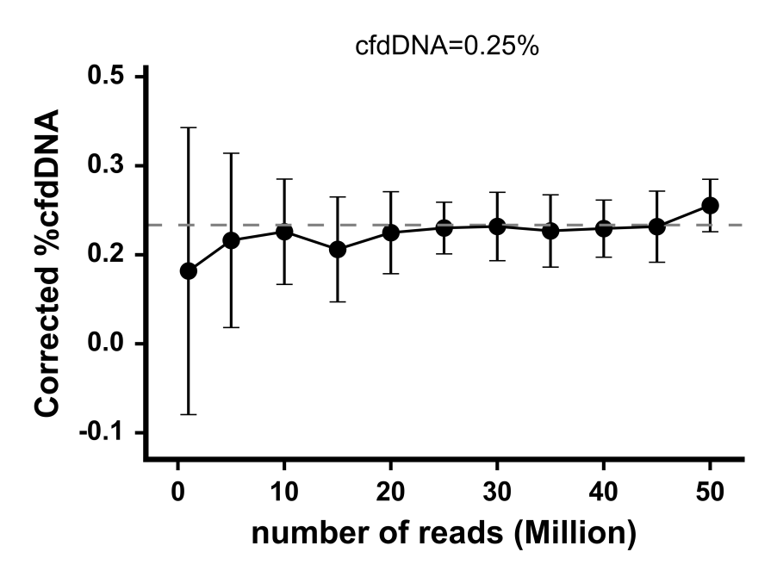
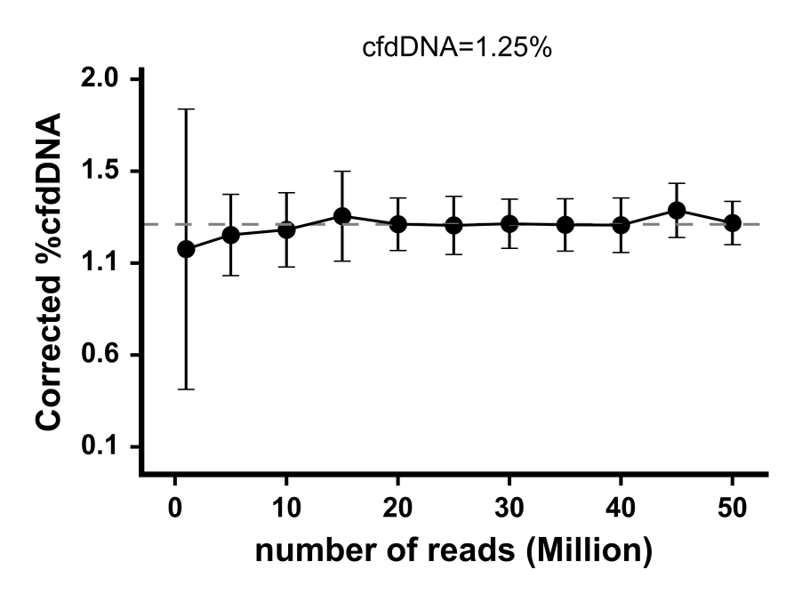
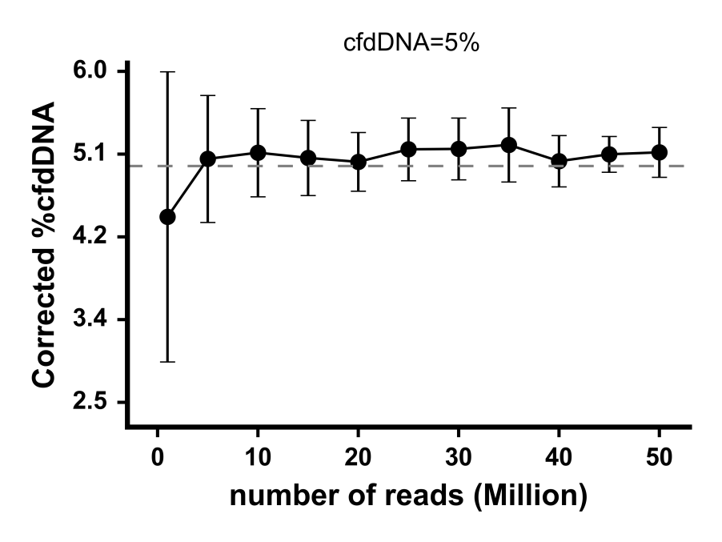
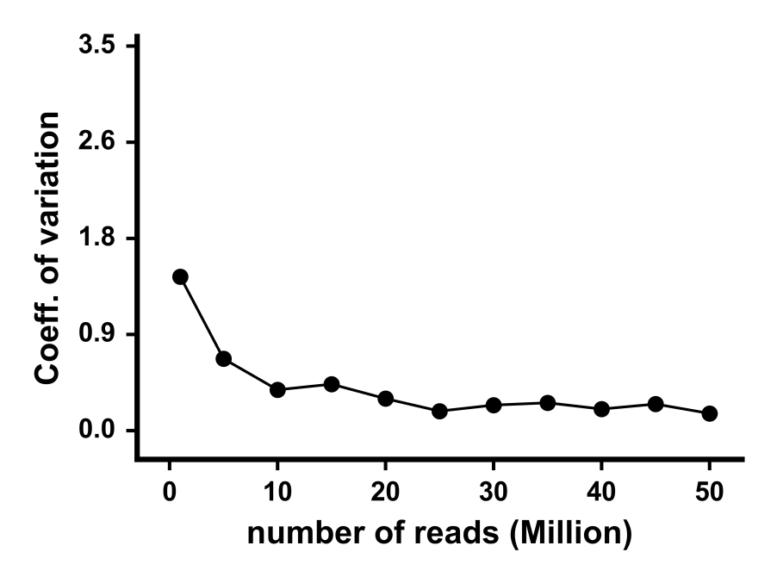
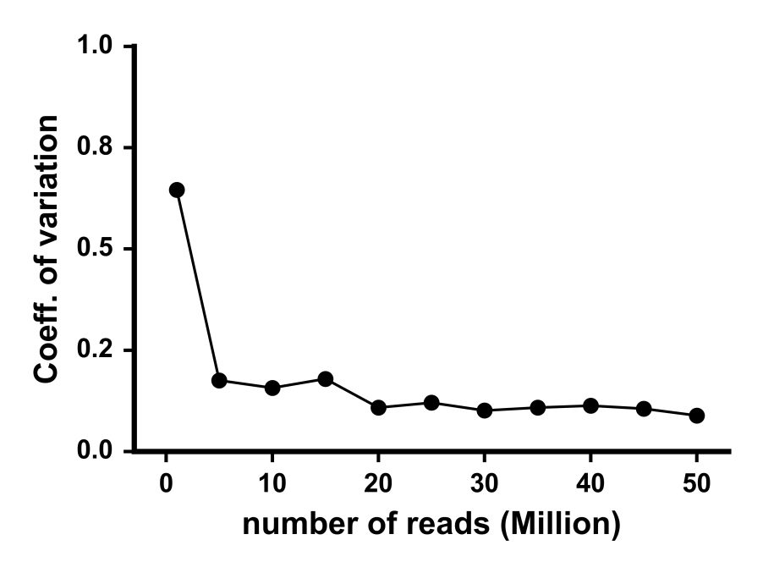
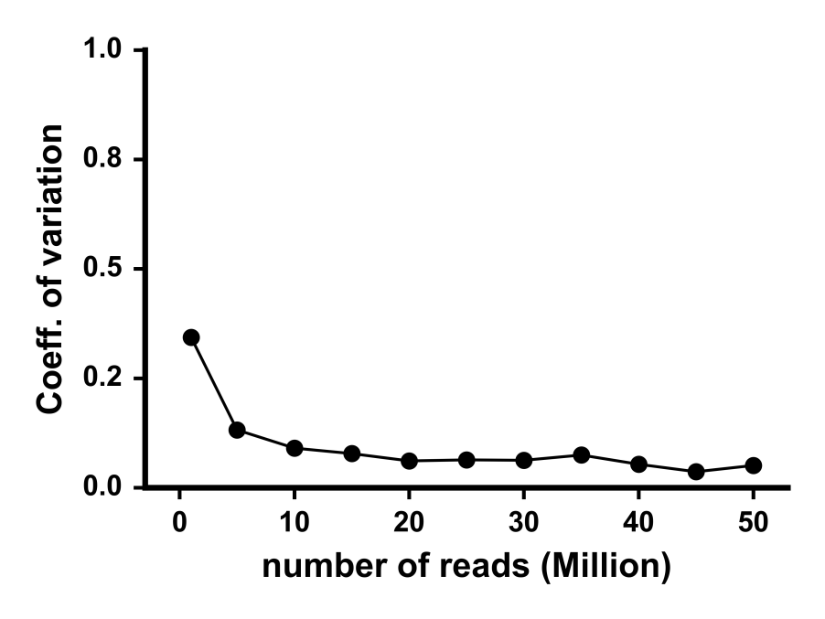
Supplemental Figure 2
A
B
ddcfDNA=0.25%
ddcfDNA=1.25%
Corrected %ddcfDNA
Corrected %ddcfDNA
C
ddcfDNA=5%
D
Corrected %ddcfDNA
E
F

Slide 3
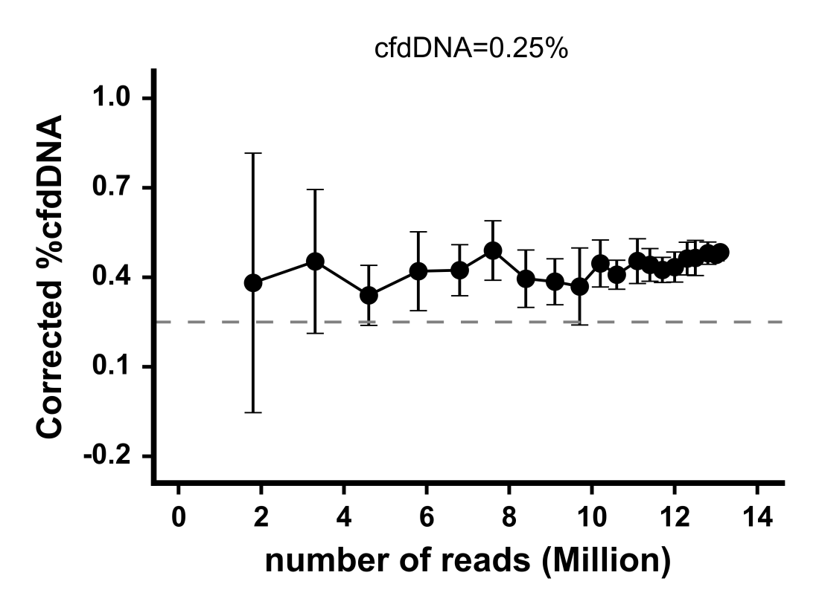
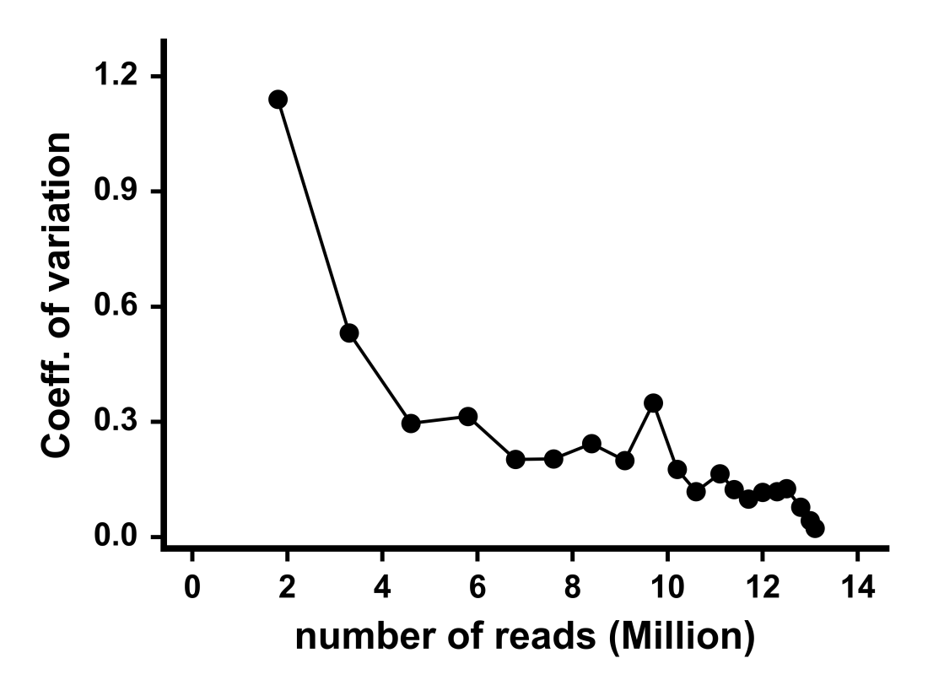
Supplemental Figure 3
A
ddcfDNA=0.25%
Corrected %ddcfDNA
B

