Slide 1
Supplementary Figures
Exosome-mediated delivery of RNA and DNA for gene therapy
*Radha Munagala¹, *Farrukh Aqil^{2,3}, **Jeyaprakash Jeyabalan¹, **Raghuram Kandimalla^{2,4}, **Margaret Wallen¹, Neha Tyagi^{2,4}, Sarah Wilcher⁵, Jun Yan^{2, 6}, David J. Schultz⁷, Wendy Spencer¹ and Ramesh C. Gupta^{1,2, 4, d}
¹3P Biotechnologies, Inc., Louisville, KY 40202, USA
²James Graham Brown Cancer Center, ³Department of Medicine, ⁴Department of Pharmacology and Toxicology, ⁵Research Resources Center, ⁶Department of Surgery, ⁷Department of Biology, University of Louisville, Louisville, KY 40202, USA
*Equal contributors; **Equal contributors
^{d}Corresponding author: Room 304E, University of Louisville, 580 S. Preston Street, Louisville, KY, 40202, USA. rcgupta@louisville.edu; rcgupta3p@gmail.com

Slide 2
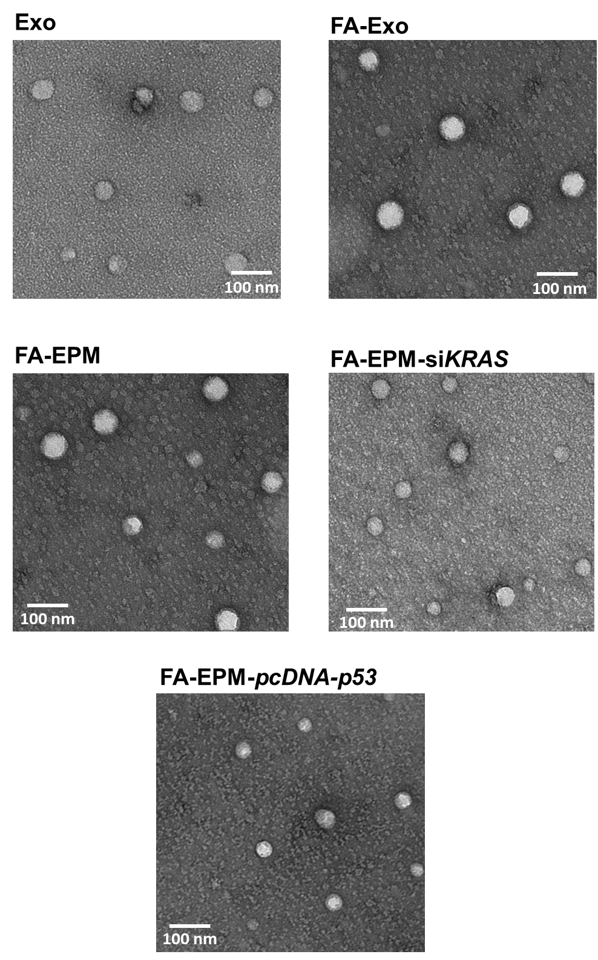
Supplementary Figure 1a
Supplementary Figure 1a. Transmission electron microscopy (TEM) of bovine colostrum-powder derived exosomes (Exo), folic acid (FA)-functionalized exosomes (FA-Exo), FA-Exo entrapped with polyethyleneimine (FA-EPM) and FA-EPM-entrapped siRNA (FA-EPM-siKRAS) and p53 plasmid DNA (FA-EPM-pcDNA-p53). Scalebar shows 100 nm.

Slide 3
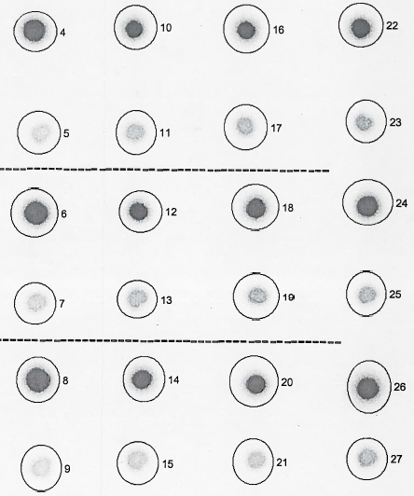
Supplementary Figure 1b
Exo (µg):
0
37.5
75
300
Pellet
Replicate # 1
Sup
Pellet
Replicate # 2
Sup
Pellet
Replicate # 3
Sup
Supplementary Figure 1b. Effect of exosome concentration on the entrapment efficiency of siRNA in EPM. Varying amounts of exosomes were incubated with 37 µg PEI and 0.5 µg non-radioactive siKRAS and 5’⁻³²P-labeled siKRAS as tracer in 150 µl PBS, in triplicate. After 15 min incubation, the reaction mixture was precipitated to recover EPM-5⁻³²P-siKRAS and suspended in PBS. To determine the entrapment efficiency, relative distribution of the radioactivity was determined by spotting aliquots of EPM-5⁻³²P-siKRAS pellet and the supernatant (sup) on a piece of PEI-cellulose thin layer (dot-blot analysis) and the amount of radioactivity was measured by Packard InstantImager.

Slide 4
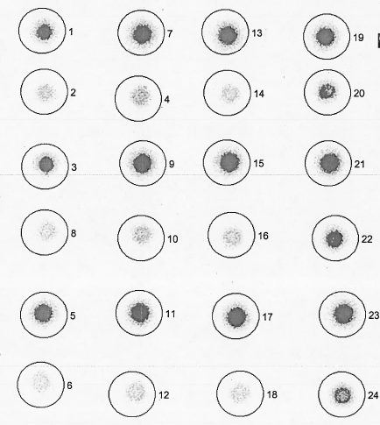
Supplementary Figure 1c
siRKRAS (µg):
0.5
2
10
50
Pellet
Replicate # 1
Sup
Pellet
Replicate # 2
Sup
Pellet
Replicate # 3
Sup
Supplementary Figure 1c. Effect of siKRAS concentration on the entrapment efficiency of siRNA in EPM. Varying amounts of siKRAS were incubated with 75 µg exosomes, 37 µg PEI and 5’⁻³²P-labeled siKRAS as tracer in 150 µl PBS, in triplicate. All other conditions were the same as described in Supplementary Figure 1b.

Slide 5
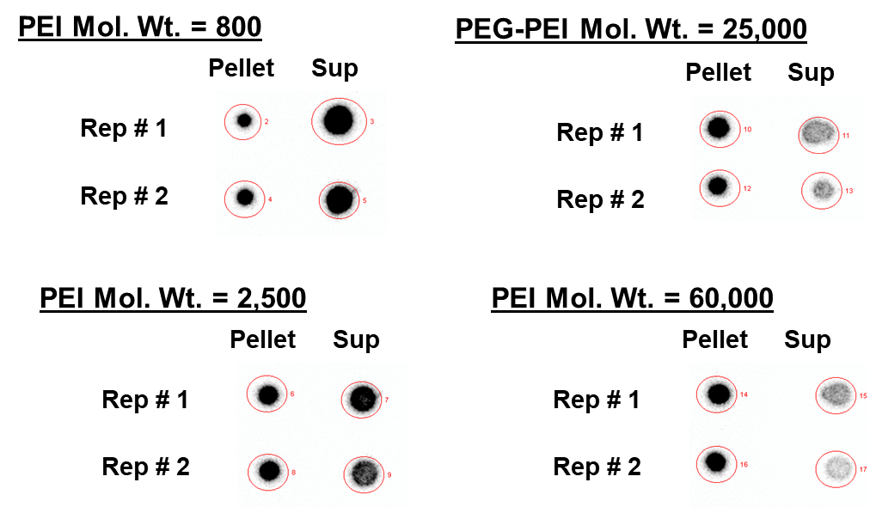
Supplementary Figure 1d
Supplementary Figure 1e
ns
**
***
siKRAS entrapment (%)
PEI Mol. Wt. (kD):
0.8
2.5
25
60
Supplementary Figure 1d and 1e. Effect of polyethyleneimine (PEI) of different MW on the entrapment efficiency of siRNA in exosome-polyethyleneimine matrix (EPM). PEI (37 µg) of different MW were incubated with 75 µg exosomes, 2 µg siKRAS and 5’⁻³²P-labeled siKRAS as tracer in 150 µl PBS, in triplicate. All other conditions were the same as described in Supplementary Figure 1b. Student’s t-test was used for statistical analysis. **, p <0.01; ***, p < 0.001.

Slide 6
Supplementary Figure 1f
ns
*
***
siRNA entrapment (%)
5’-³²P-siVEGF:
+
+
+
+
+
+
siVEGF (µg):
0.5
0.5
0.5
0.5
2
5
7
37
148
37
37
PEI (µg):
15
Exosomes (µg):
300
300
300
300
300
300
Supplementary Figure 1f. Effect of siVEGF and PEI concentrations of the entrapment efficiency of siRNA in EPM. Indicated amounts of PEI-60K were incubated with 300 µg exosomes, and indicated amounts of siKRAS in the presence of and 5’⁻³²P-labeled siKRAS as tracer in 150 µl PBS, in triplicate. All other conditions were the same as described in Supplementary Figure 1b. Statistical analysis was performed by one-way ANOVA followed by Tukey's multiple comparison test to compare between the indicated groups. *, p <0.05; ***, p < 0.001.

Slide 7
Supplementary Figure 1g
Supplementary Figure 1g. Entrapment efficiency of polyethyleneimine MW 60K (PEI) in EPM. Exosomes (300 µg) were incubated with 37 µg PEI labeled with Alexa fluor-750 (AF750) in 150 µl PBS, in triplicate. After a brief incubation the EPM was recovered by precipitation with ExoQuick and the relative amount of AF750 present in the EPM (the pelleted fraction) and supernatant (sup) was determined by spectrofluorometry.

Slide 8
Supplementary Figure 2a
**
**
Untreated
Exo-AF750
EPM-AF750
FA-Exo-AF750
FA-EPM-AF750
Supplementary Figure 2a. Effect of folic acid (FA) functionalization of Alexafluor-750 (AF750)-labeled exosomes (Exo), with and without entrapment of polyethyleneimine MW 60K (EPM) in accumulation of exosomes in lung tumor. A549 subcutaneous lung tumor-bearing female nude mice (n=3) were treated with indicated exosome formulations intravenously. Four hours later, animals were euthanized and tumor tissues were imaged ex vivo using advanced molecular imager (AMI1000). Data represent mean ± SD (n=3). Florescent intensity represent as mean photons per second that leave a square centimeter of tissue and radiate into a solid angle of one steradian (photons/s/cm^2/sr). Statistical analysis was performed by one-way ANOVA followed by Tukey's multiple comparison test to compare between the indicated groups. **, p < 0.01.

Slide 9
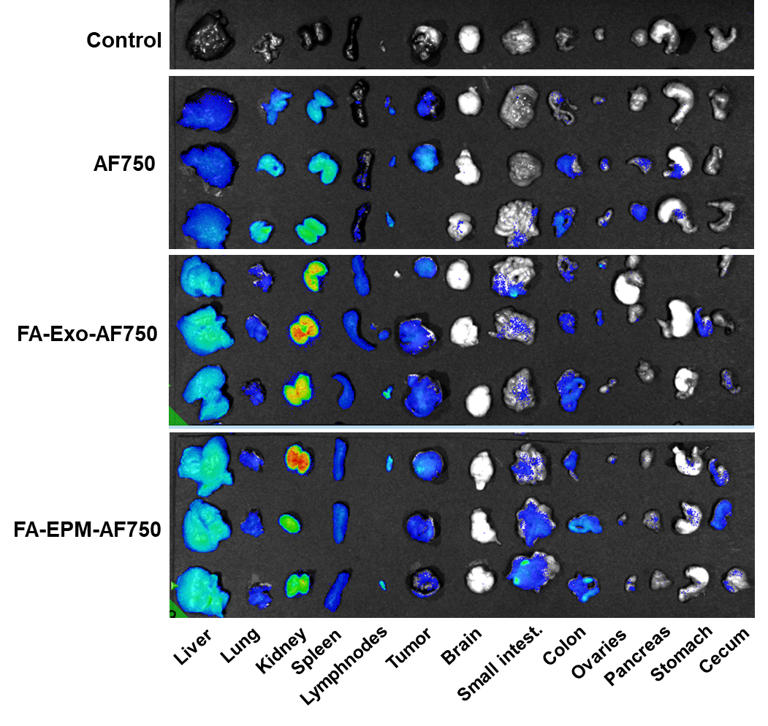
Supplementary Figure 2b
Supplementary Figure 2b. Tissue distribution of folic acid (FA)-functionalized exosomes labeled with Alexa Fluor-750 (AF750), with and without entrapment of poly MW 60K (PEI) 4 h after the treatment. A549 subcutaneous lung tumor-bearing female nude mice (n=3) were treated intravenously with AF750-labeled Exo and EPM; Unbound AF750 was removed essentially completely (>99%) by ultrafiltration. AF750 alone was included as a control, along with untreated group. Four hours later, animals were euthanized and various tissues and tumors were collected and imaged ex vivo and fluorescence was quantified using advanced molecular imager (AMI1000). Data represent mean ± SD (n=3). Florescent intensity represent as mean photons per second that leave a square centimeter of tissue and radiate into a solid angle of one steradian (photons/s/cm^2/sr).

Slide 10
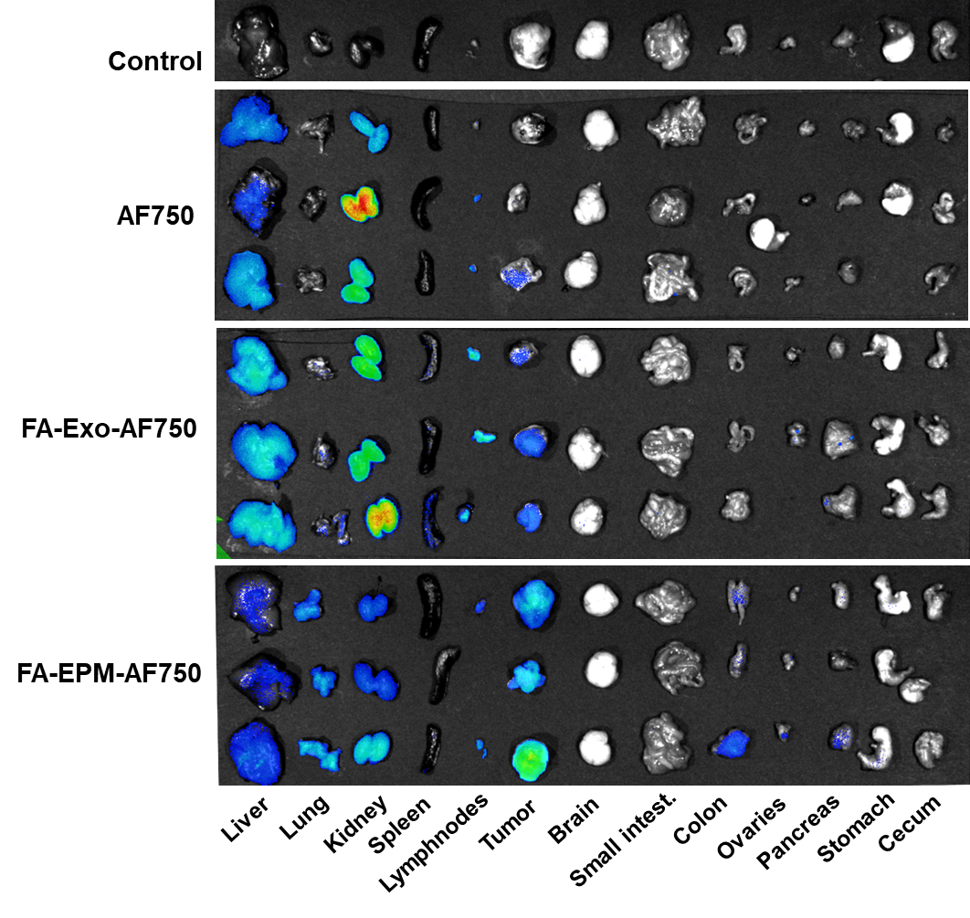
Supplementary Figure 2c
Supplementary Figure 2c. Tissue distribution of folic acid (FA)-functionalized exosomes labeled with Alexa Fluor-750 (AF750), with and without entrapment of PEI 24 h after the treatment. Experimental conditions were the same as described in Supplementary Figure 2C legend, except animals were euthanized 24 h after the treatment.

Slide 11
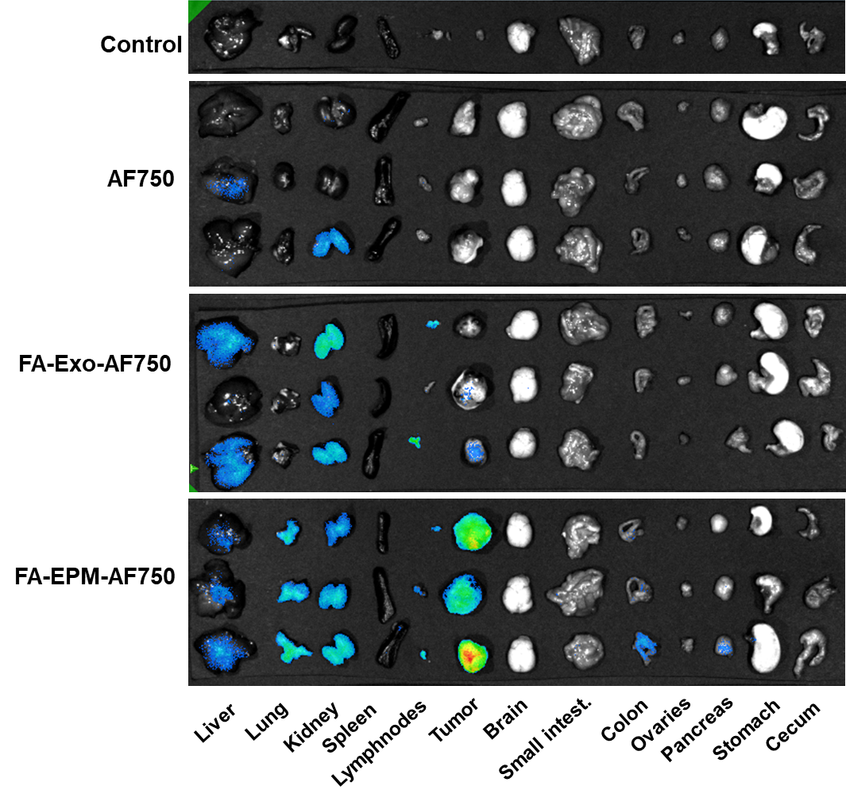
Supplementary Figure 2d
Supplementary Figure 2d. Tissue distribution of folic acid (FA)-functionalized exosomes labeled with Alexafluor-750 (AF750), with and without entrapment of PEI 48 h after the treatment. Experimental conditions were the same as described in Supplementary Figure 2C legend, except animals were euthanized 48 h after the treatment.

Slide 12
Supplementary Figure 2e
**
#
*
Supplementary Figure 2e. Effect of folic acid (FA) functionalization of Alexa Fluor-750 (AF750)-labeled exosomes (Exo), with and without entrapment of polyethyleneimine MW 60K (PEI) (EPM) in accumulation of exosomes in mammary tumor. MDA-MB-231 orthotopic mammary tumor-bearing nude mice (n=3) were treated with indicated exosome formulations intravenously. Four hours later, animals were euthanized, and tumor tissues were imaged ex vivo using advanced molecular imager (AMI1000). Data represent mean ± SD (n=3). Florescent intensity represent as mean photons per second that leave a square centimeter of tissue and radiate into a solid angle of one steradian (photons/s/cm^2/sr). Student’s t-test was used for statistical analysis. #,*, p<0.05; **, p < 0.01. A comparison of groups to AF750 is represented by asterisks whereas a comparison of Exo-AF750 and FA-EPM-AF750 is shown by the # sign.

Slide 13
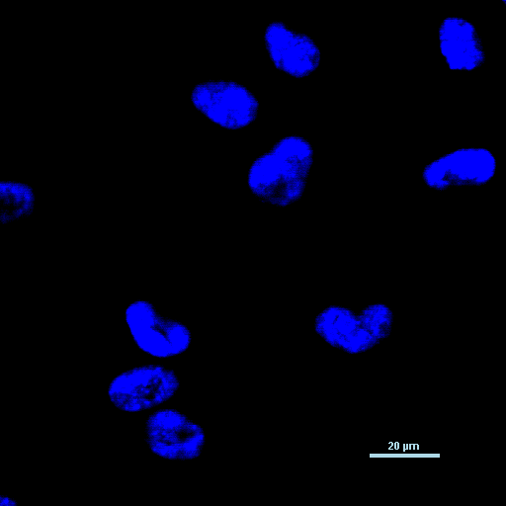
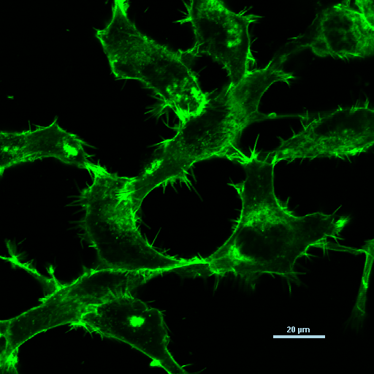
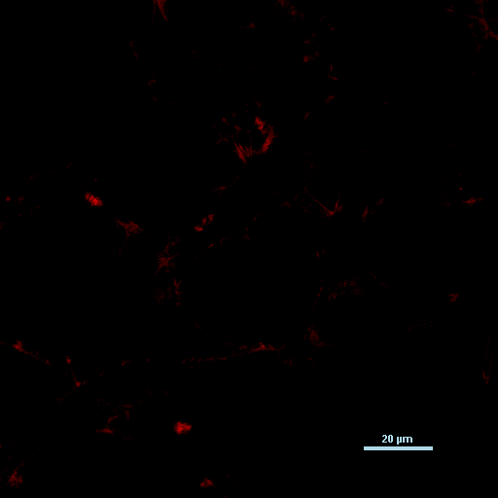
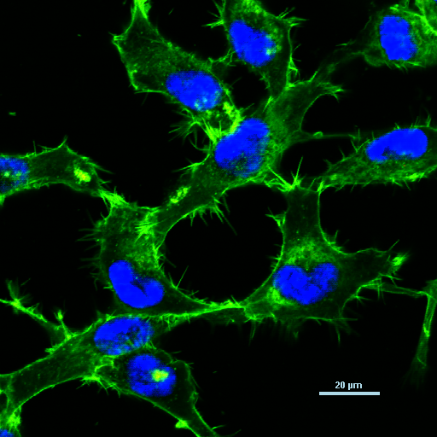
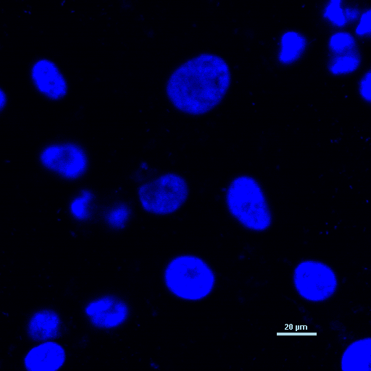
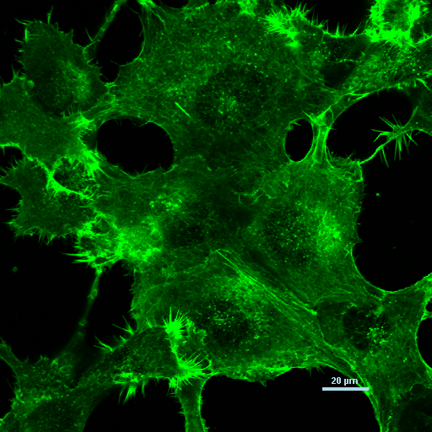
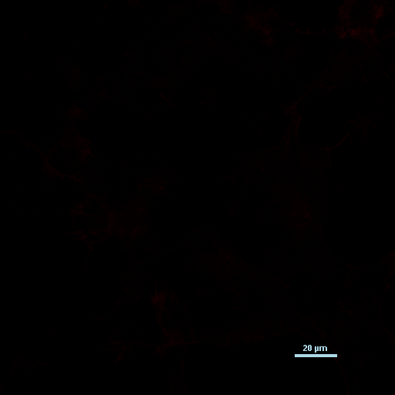
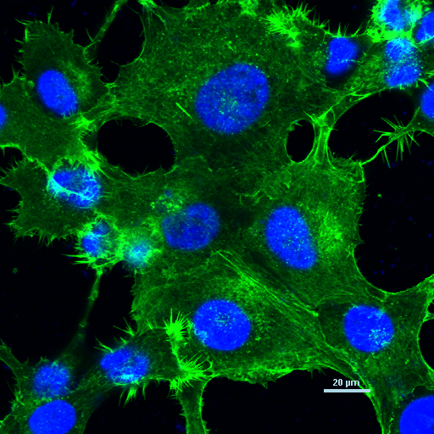
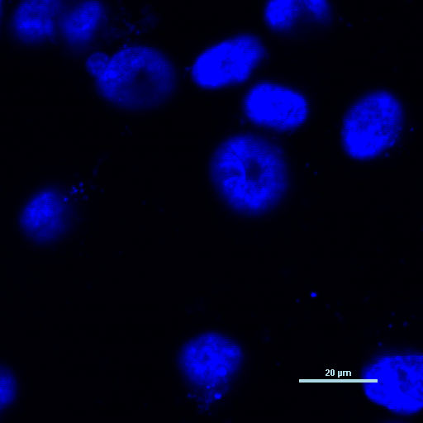
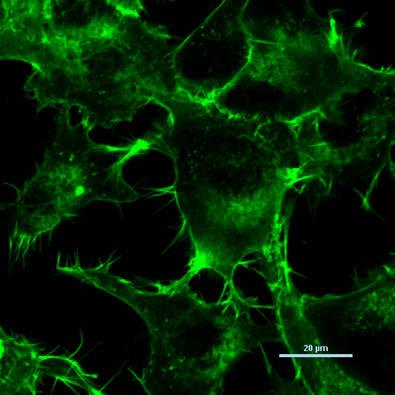
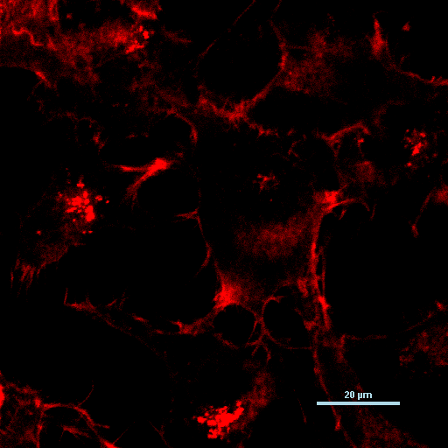
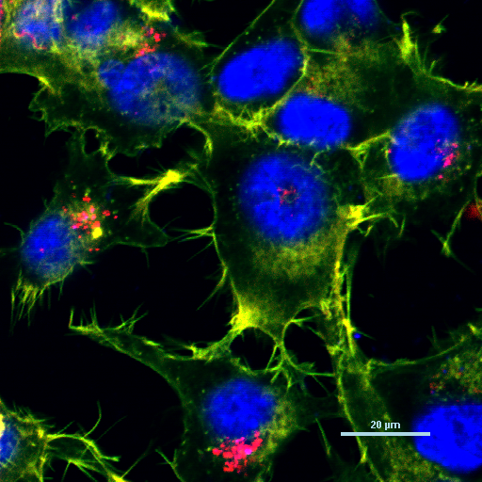
Supplementary Figure 3a
Nuclei
Actin
TR siRNA
Merge
PEI-siRNA
Exo-siRNA
EPM-siRNA
200 µm
Supplementary Figure 3a. Uptake of Texas red (TR)-labeled siRNA entrapped in exosome-PEI matrix (EPM) in human H1299 lung cancer cells. Lung cancer cells were treated with EPM-Texas red siRNA for 24 h, nuclei and actin were stained with DAPI and Phalloidin 488, respectively and analyzed by confocal microscopy (Scalebar shows 20 µM). TR siRNA = Texas Red siRNA.

Slide 14
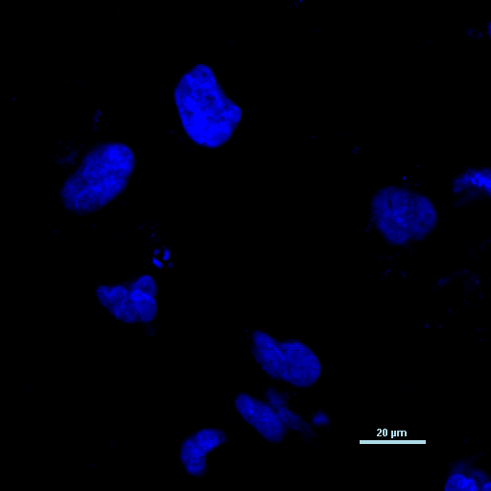
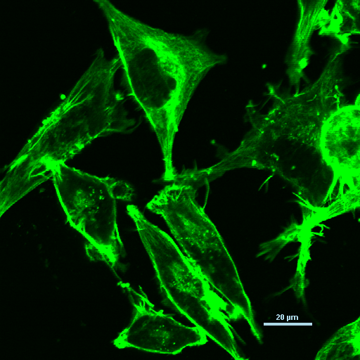
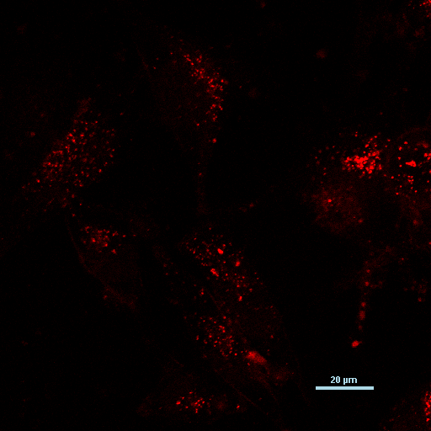
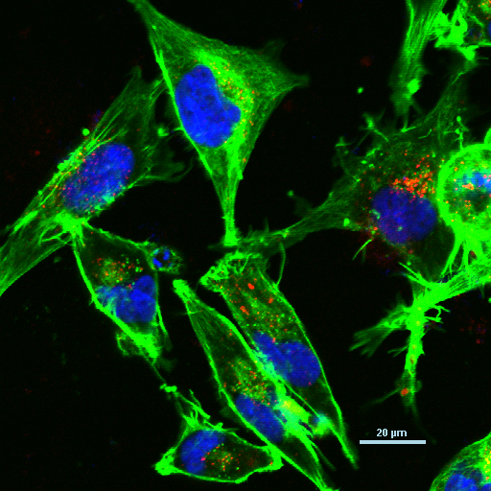
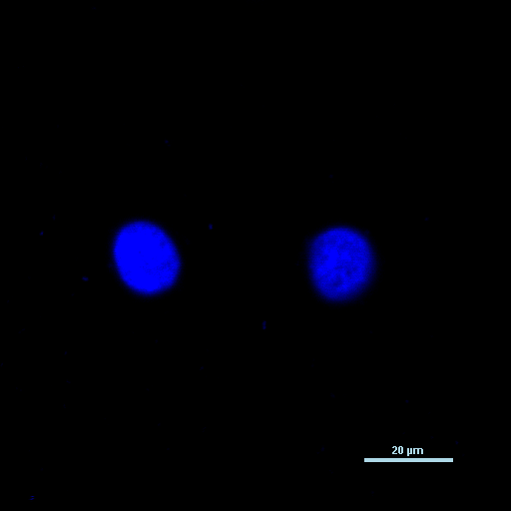
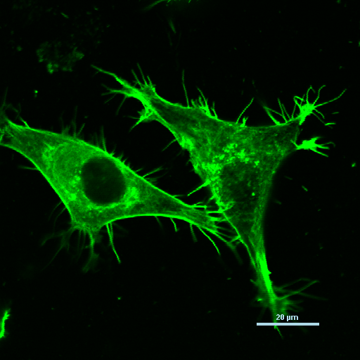

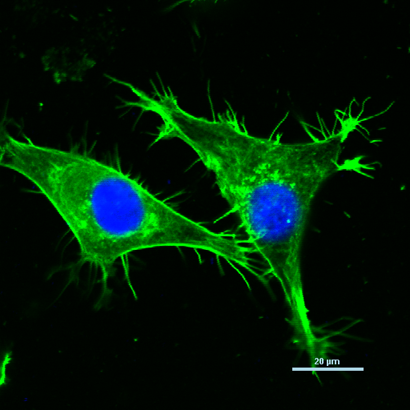
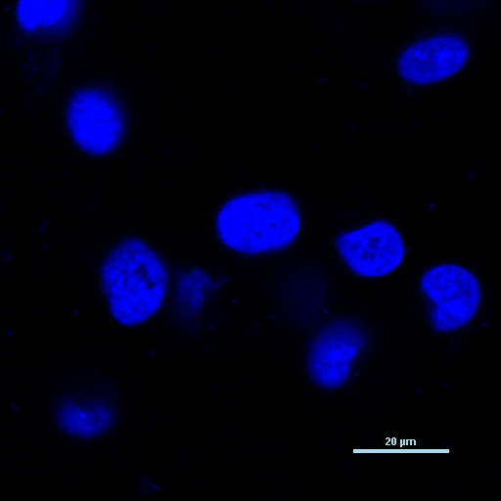
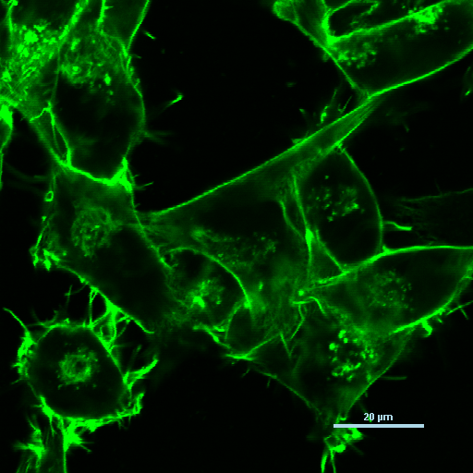
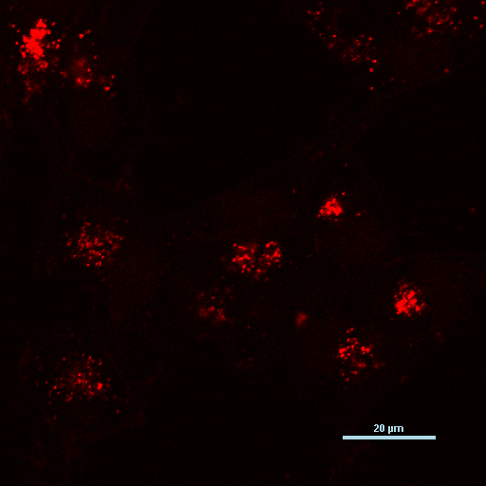
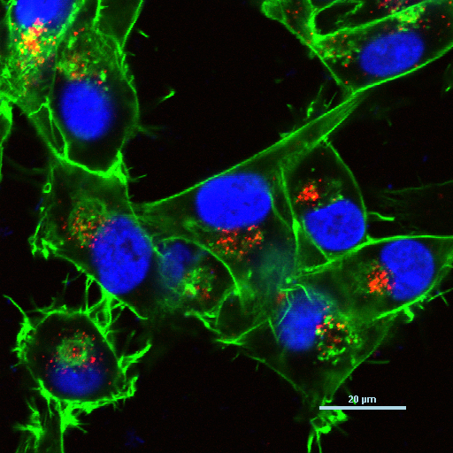
Supplementary Figure 3b
Nuclei
Actin
TR siRNA
Merge
PEI-siRNA
Exo-siRNA
EPM-siRNA
Supplementary Figure 3b. Uptake of Texas red (TR)-labeled siRNA entrapped in exosome-PEI matrix (EPM) in human MiaPaCa-2 pancreatic cancer cells. Pancreatic cancer cells were treated with EPM-Texas red siRNA for 24 h, nuclei and actin were stained with DAPI and phalloidin, respectively and analyzed by confocal microscopy (scalebar shows 20 µM). TR siRNA = Texas Red siRNA.

Slide 15


Supplementary Figure 3c
Fold Change:
1
0.21
0.45
0.17
0.16
0.21
0.08
0.21
0.15
0.17
KRAS
β-Actin
siKRAS:
Control
siR-1
siR-2
siR-3
siR-4
siR-5
siR-6
siR-7
siR-8
siR-9
Supplementary Figure 3c. Effect of siKRAS (siR) entrapped in exosomes-PEI matrix (EPM) on modulation of KRAS expression in A549 lung cancer cells. Lung cancer cells were treated for 48 h with EPM entrapped with siKRAS purchased from different vendors – siR-1, siR-2, siR-3, siR-4 (Dharmacon), siR-5, siR-6, siR-7 (IDT) and siR-8, siR-9 (Sigma), and cell lysates were analyzed by western blot. EPM-siKRAS was prepared by mixing 150 µg exosomes, 37 µg PEI MW 60K and 4 µg siKRAS in 150 µl PBS.

Slide 16

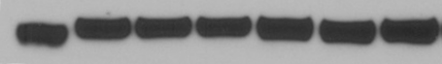
Supplementary Figure 3d
Fold Change:
1
1.1
1
1
0.36
0.12
0.18
KRAS
β-Actin
PEI : 0
(MW x1000)
0.8
1.8
2.5
5
60
600
Supplementary Figure 3d. Effect of molecular weight of polyethyleneimine (PEI) in EPM-siKRAS formulation on modulation of KRAS expression in A549 lung cancer cells. Lung cancer cells were treated with EPM-siKRAS for 48 h, and cell lysates were analyzed by western blot. EPM-siKRAS was prepared by mixing 150 µg exosomes, 37 µg PEI of indicated MW and 4 µg siKRAS in 150 µl PBS. Reactions were performed in triplicates. Data, quantitated by ImageJ software, represent mean ± SD (n = 3; blots shown from only one replicate for presentation purpose). Std deviation (5-20%) is not shown.

Slide 17
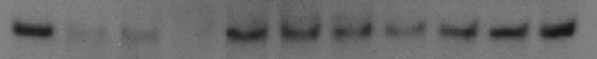
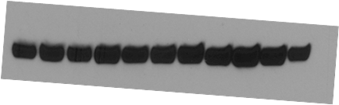
Supplementary Figure 3e
Fold Change:
1
0.22±0.08*
0.68±0.13*
0.41±0.13*
1
KRAS
β-Actin
PEI (µg):
0
37
18.5
9.25
0
Supplementary Figure 3e. Effect of concentration of polyethyleneimine MW 60K (PEI) in EPM-siKRAS formulation on modulation of KRAS expression in A549 lung cancer cells. Cells were treated with EPM-siKRAS for 48 h, and cell lysates were analyzed by western blot. EPM-siKRAS was prepared by mixing 150 µg exosomes, 37 µg PEI MW 60K and 4 µg siKRAS in 150 µl PBS. Reactions were performed in triplicates. Data, quantitated by ImageJ software, represent mean ± SD (n = 3). Student’s t test was used to calculate the statistical significance; *p < 0.05 .

Slide 18
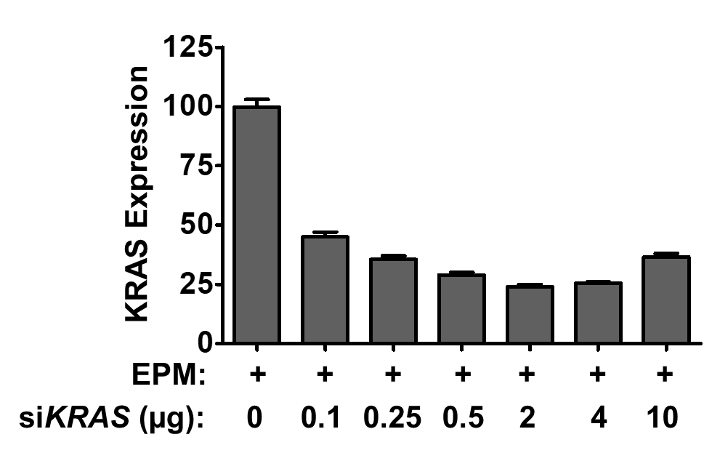
Supplementary Figure 3f
ANOVA (***p< 0.001)
**
*
*
ns
*
Supplementary Figure 3f. Effect of concentration of siKRAS in EPM-siKRAS formulation on modulation of KRAS expression in A549 lung cancer cells. Cells were treated with EPM-siKRAS for 48 h, and cell lysates were analyzed by western blot. EPM-siKRAS was prepared by mixing 150 µg exosomes, 37 µg PEI MW 60K and different concentrations of siKRAS in 150 µl PBS. Reactions were performed in triplicates. Data, quantitated by ImageJ software, represent mean ± SD (n = 3). Statistical analysis was performed by one-way ANOVA followed by Tukey's multiple comparison test to compare between the indicated groups. *, p < 0.05, **, p < 0.01.

Slide 19
Supplementary Figure 3g
Fold Change:
1
0.32 ± 0.09**
0.64 ± 0.04
KRAS
β-Actin
Control
CExo
MExo
Supplementary Figure 3g. Effect of exosomes derived from bovine colostrum powder (CExo) or bovine mature milk (MExo) in entrapping polyethyleneimine (PEI) and siKRAS (EPM-siKRAS) on modulation of KRAS expression in A549 lung cancer cells. Lung cancer cells were treated with EPM-siKRAS for 48 h, and cell lysates were analyzed by western blot. EPM-siKRAS was prepared by mixing 75 µg CExo or MExo, 37 µg PEI MW 60K and 4 µg siKRAS in 150 µl PBS. Reactions were performed in triplicates. Data, quantitated by ImageJ software, represent mean ± SD (n = 3). Student’s t test was used to calculate the statistical difference between CExo and MExo; **p < 0.01 .

Slide 20
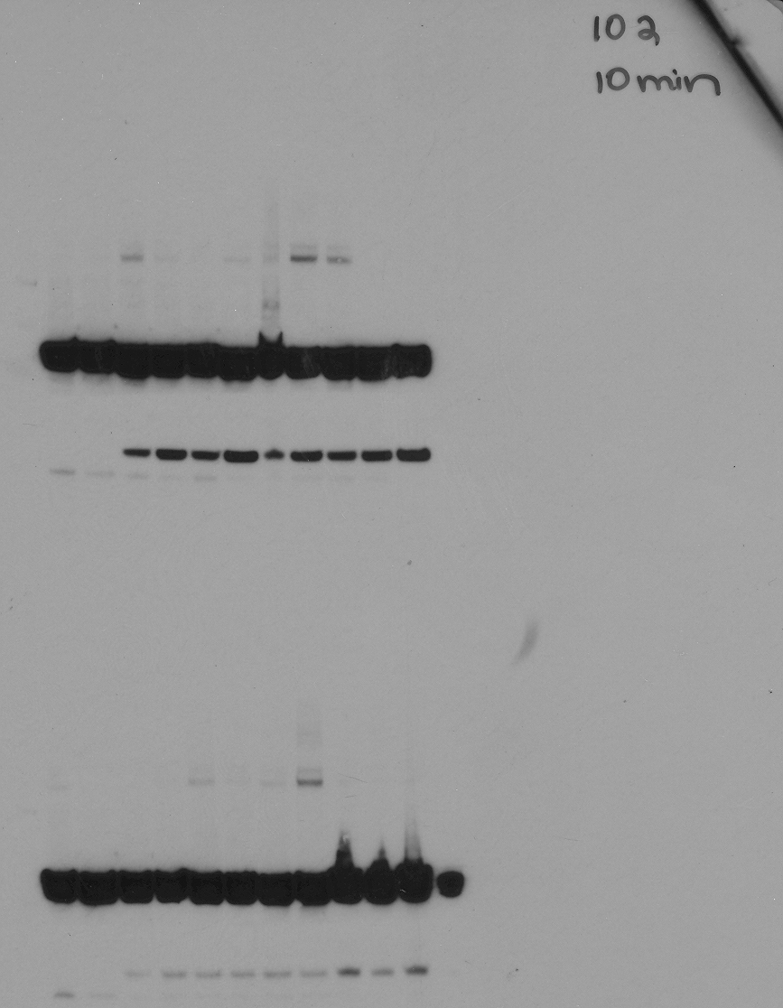
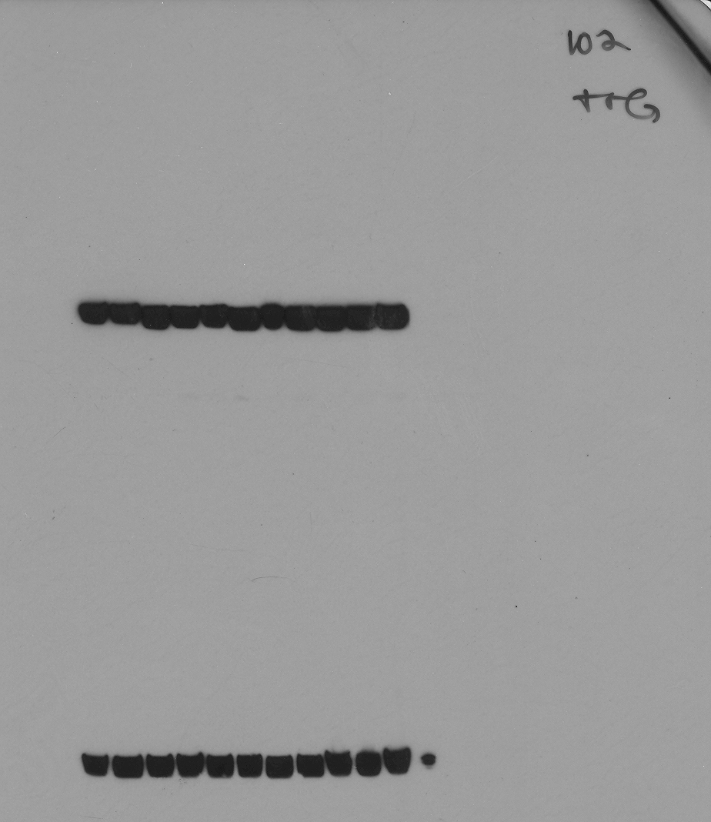
Supplementary Figure 4a
Fold Change:
1
9.4 ± 3.0***
9.8 ± 3.4***
10.1 ± 1.9***
emGFP
β-Actin
EPM-pemGFP (µg):
0
4
7
10
Supplementary Figure 4a. Effect of pemGFP plasmid DNA concentrations in EPM-pemGFP DNA in knock-in of GFP in human A549 lung cancer cells. EPM-pemGFP DNA was prepared by mixing indicated amounts EPM-pemGFP DNA, 75 µg of exosomes and 37 µg polyethyleneimine (PEI) MW 60K in 150 µl PBS. EPM-pemGFP DNA was recovered by precipitated with ExoQuick prior to the transfection. Lung cancer cells were treated for 48 h, and cell lysates were analyzed by western blot. Reactions were performed in triplicates. Data, quantitated by ImageJ program, represent mean ± SD (n = 3). ). Statistical analysis was performed by one-way ANOVA followed by Tukey's multiple comparison test to compare between the indicated groups. ***, p < 0.001.

Slide 21
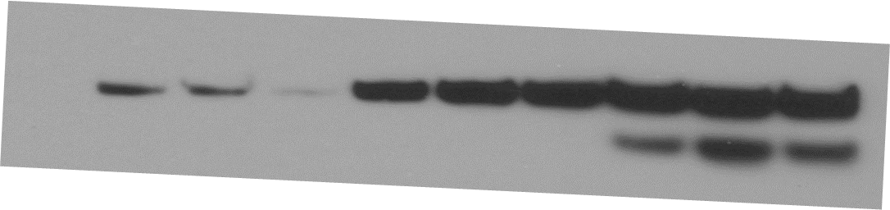
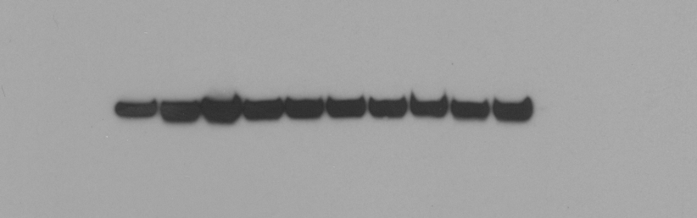
Supplementary Figure 4b
Fold Change:
1 ± 0.7
6.1 ± 1.5**
8.9 ± 0.71***
p53
β-Actin
Untreated
12 h
24 h
48 h
Supplementary Figure 4b. Effect of incubation period on knock-in efficiency of WT p53 in human H1299 lung cancer cells treated with EPM-pcDNA-p53. EPM-pcDNA-p53 was prepared by mixing 4 µg of pcDNA-p53, 75 µg of exosomes and 37 µg polyethyleneimine (PEI) MW 60K in 150 µl PBS. Lung cancer cells were treated with pcDNA-p53 entrapped in EPM for up to 48 h, and cell lysates were analyzed by western blot. Other experimental conditions were the same as described in Supplementary Figure 4a. Data, quantitated by ImageJ software, represent mean ± SD (n = 3). Statistical analysis was performed by one-way ANOVA followed by Tukey's multiple comparison test to compare between the indicated groups. **, p < 0.01; ***, p < 0.001.

Slide 22
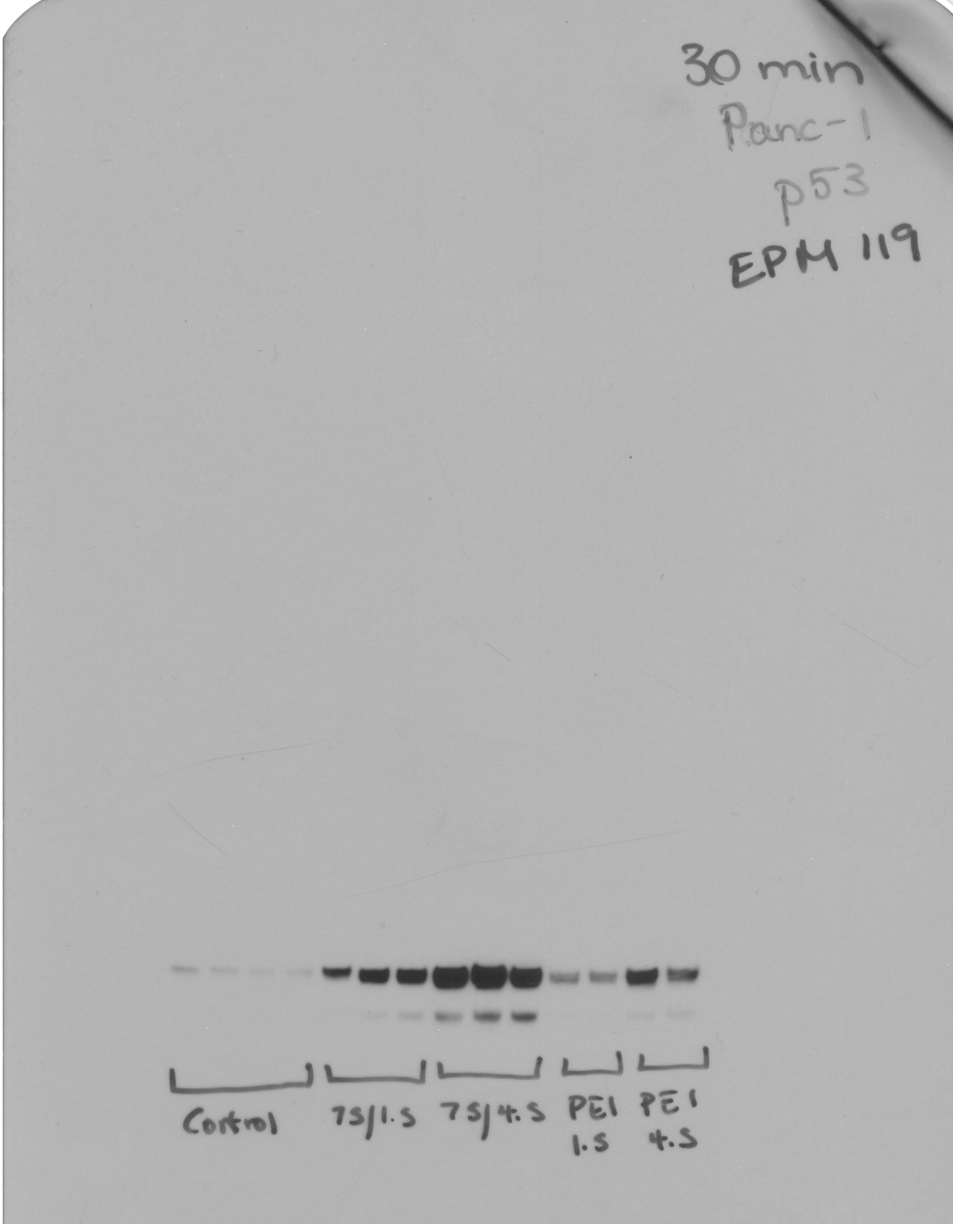
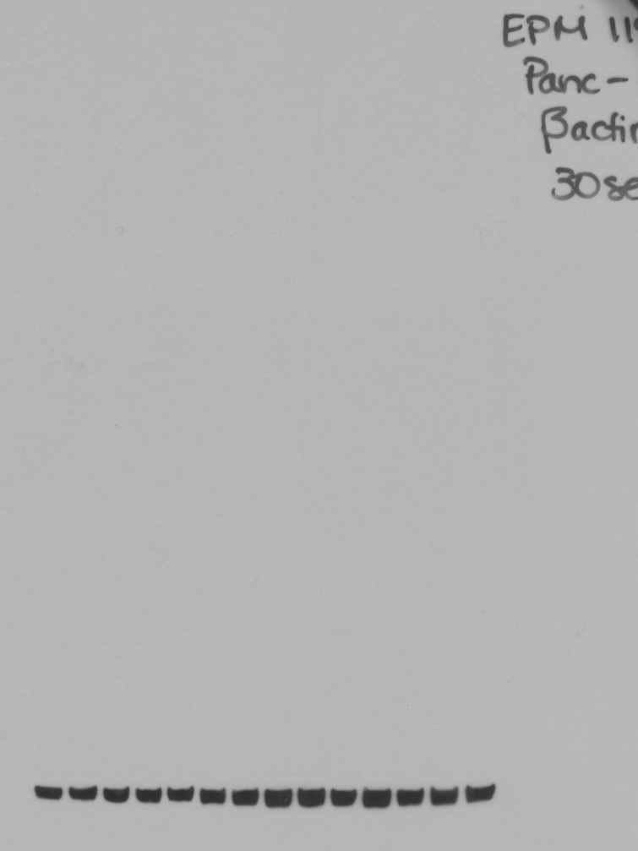
Supplementary Figure 4c
Fold Change:
1 ± 0.4
13.3 ± 2.6***
20.2 ± 1.4***
3.8 ± .2
10.9 ± 3***
p53
β-actin
p53 (µg):
0
1.5
4.5
1.5
4.5
PEI ( 37 µg):
-
+
+
+
+
Exo (µg):
0
75
75
0
0
Supplementary Figure 4c. Effect of concentration of p53 plasmid DNA in knock-in efficiency of WT p53 in human Panc-1 pancreatic cancer cells treated with EPM-pcDNA-p53. Pancreatic cancer cells were treated with EPM-pcDNA-p53 for 48 h. Formulation lacking exosomes (i.e., PEI-pcDNA-p53) was included as control. Cell lysates were analyzed by western blot. All other experimental conditions were the same as described in Supplementary Figure 4a. Data, quantitated by ImageJ software, represent mean ± SD (n = 3).

Slide 23
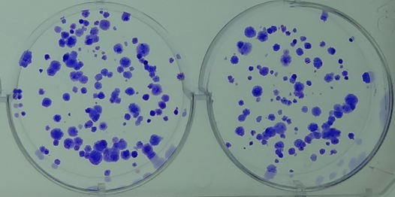
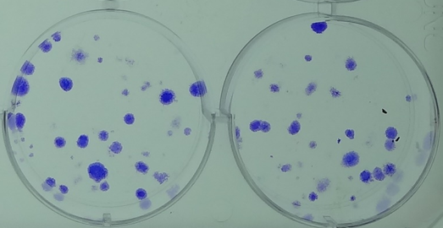
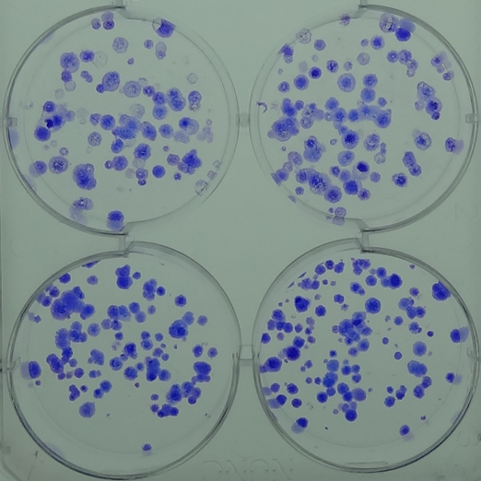
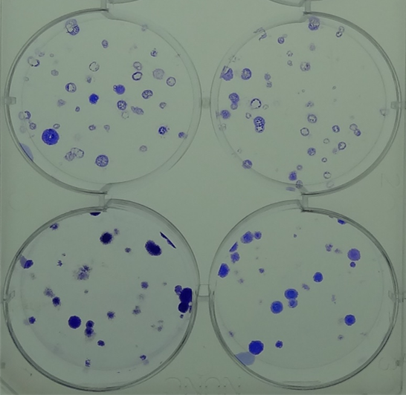
Supplementary Figure 4d
A549
H1299
Control
EPM
PEI-p53
Supplementary Figure 4d. Effect of EPM and PEI-p53 on colony-forming in human lung cancer A549 and H1299 cells. H1299 and A549 cells (500) were plated in 6-well plates and treated with EPM containing 75 µg Exo and 37 µg PEI and p53 with PEI. After 10 days, colonies were washed with PBS and stained with crystal violet. Colonies were counted and inhibition of colony formation was calculated. Data shown are from two replicates.

Slide 24
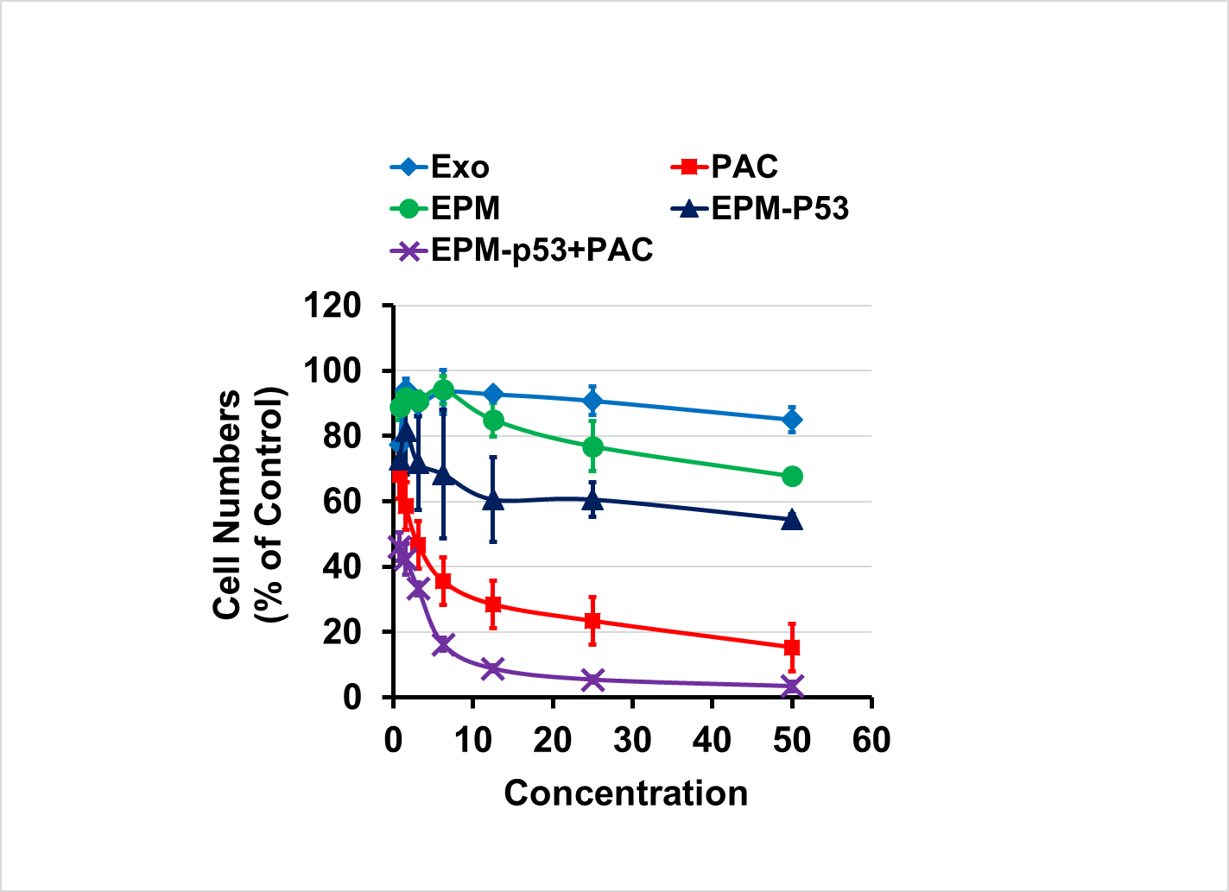
Supplementary Figure 4e
Exo
PAC
EPM
EPM-pcDNA-p53
EPM-pcDNA-p53 + PAC
Number of Colonies
(% of Control)
Supplementary Figure 4e. Colony formation in H1299 lung cancer cells treated with Exo, PAC, EPM, EPM-pcDNA-p53 and combination of EPM-pcDNA-p53 and PAC. After 10 days, cells were fixed and stained with trypan blue. The figure is a representative of three experiments with similar results. Quantification was performed by manual colony counting.

Slide 25
Supplementary Figure 5
A
B
Supplementary Figure 5. Effect of FA-EPM and mixture of FA-exosomes and polyethyleneimine (PEI) on diet consumption (A) and average body weight (B) in wild-type female C57BL/6 mice. Groups of animals (n= 5-9) were treated three times a week for 4 weeks by intravenous treatment with FA-EPM and FA-exosomes + PEI (which contains FA-EPM and free PEI); untreated group served as control. FA-EPM was prepared by mixing FA-exosomes and PEI, followed by precipitation of FA-EPM to remove unbound (>70%) PEI. The mixture of FA-exosomes and PEI lacked the precipitation step. Body weight and diet consumption was recorded twice a week. Animals were euthanized 24 h after the last dose and blood and plasma was analyzed for the toxicity parameters. Data represent mean ± SD.

Slide 26
Supplementary Table I. Particle size analysis of exosomes and its formulations.
Formulation* | Parameters | Preparation |  |  | Average | SD
 |  | #1 | #2 | #3
Exosome (Exo) | Size | 69 | 66 | 64 | 66 | 2.52
 | PDI | 0.28 | 0.28 | 0.27 | 0.28 | 0.01
 | ZP | -8.49 | -9.68 | -9.56 | -9.2 | 0.66
FA-Exo | Size | 78 | 77 | 75 | 77 | 1.53
 | PDI | 0.22 | 0.21 | 0.23 | 0.2 | 0.01
 | ZP | -6.49 | -5.84 | -6.92 | -6.4 | 0.50
EPM | Size | 107 | 99 | 98 | 101 | 4.93
 | PDI | 0.21 | 0.18 | 0.18 | 0.2 | 0.02
 | ZP | -7.54 | -8.46 | -7.5 | -7.8 | 0.54
FA-EPM | Size | 67 | 65 | 62 | 65 | 2.52
 | PDI | 0.37 | 0.3 | 0.28 | 0.32 | 0.05
 | ZP | -4.53 | -5.47 | -5.27 | -5.1 | 0.50
EPM-siKRAS | Size | 105 | 101 | 101 | 102 | 2.31
 | PDI | 0.16 | 0.15 | 0.131 | 0.1 | 0.01
 | ZP | -7.5 | -8.46 | -7.5 | -7.8 | 0.55
FA-EPM-siKRAS | Size | 69 | 71 | 80 | 73 | 5.86
 | PDI | 0.27 | 0.3 | 0.36 | 0.31 | 0.05
 | ZP | -5.5 | -6.89 | -6.11 | -6.2 | 0.70
*Exo, colostrum exosomes; FA-Exo, folic acid-conjugated exosomes; EPM, exosome-polyethyleneimine (PEI) matrix; FA-EPM, folic acid conjugated exosome-polyethyleneimine (PEI) matrix; EPM-siKRAS, siKRAS entrapped EPM; FA-EPM- siKRAS, siKRAS entrapped FA-EPM

Slide 27
Supplementary Table II. Tissue distribution of AF750-labeled FA-functionalized and non-functionalized formulations. – expressed as tissue-specific signals
Tissue | RFU (Mean ± SD, x10⁷)
 | Exo-AF750 | FA-Exo-AF750 | EPM-AF750 | FA-EPM-AF750
Liver | 12.0 ± 3.5 | 16.0 ± 2.4 | 9.8 ± 0.9 | 17.5 ± 3.2
Lung | 10.7 ± 2.3 | 10.5 ± 2.0 | 16.2 ± 1.1 | 19.8 ± 2.4
Kidney | 14.8 ± 3.8 | 15.6 ± 4.3 | 39.3 ± 4.3 | 39.0 ± 6.6
Spleen | 12.6 ± 1.9 | 9.5 ± 2.9 | 16.3 ± 2.4 | 20.5 ± 2.9
Brain | 2.6 ± 0.3 | 4.7 ± 0.9 | 1.5 ± 0.7 | 4.9 ± 0.9
Intestine | 12.2 ± 3.6 | 12.7 ± 4.2 | 6.7 ± 4.3 | 11.3 ± 8.6
Colon | 19.3 ± 4.7 | 24.4 ± 6.5 | 6.9 ± 3.2 | 11.2 ± 3.4
Ovary | 8.2 ± 2.2 | 6.7 ± 1.5 | 3.2 ± 1.2 | 5.0 ± 1.5
Pancreas | 7.3 ± 1.4 | 7.9 ± 0.7 | 3.4 ± 0.6 | 3.7 ± 0.1
Abdomen | 7.2 ± 0.2 | 8.0 ± 1.4 | 6.1 ± 1.0 | 5.3 ± 2.8
Cecum | 18.9 ± 5.2 | 26.6 ± 2.1 | 8.8 ± 5.6 | 13.5 ± 5.0
Lymph node | 3.8 ± 0.8 | 3.6 ± 1.3 | 5.3 ± 3.6 | 12.6 ± 4.0
Tumor | 24.4 ± 5.5 | 44.2 ± 7.9 | 21.8 ± 2.3 | 48.7 ± 3.8
Total | 154 | 191 | 145 | 213

Slide 28
Supplementary Table IIA. Tissue distribution of AF750-labeled FA-functionalized and non-functionalized formulations – expressed as percent of total tissues.
Tissue | Percent RFU
 | Exo-AF750 | FA-Exo-AF750 | EPM-AF750 | FA-EPM-AF750
Liver | 7.9 | 8.4 | 6.7 | 8.2
Lung | 7.0 | 5.5 | 11.1 | 9.3
Kidney | 9.7 | 8.2 | 27.0 | 18.3
Spleen | 8.2 | 5.0 | 11.2 | 9.6
Brain | 1.7 | 2.5 | 1.1 | 2.3
Intestine | 8.0 | 6.7 | 4.6 | 5.3
Colon | 12.6 | 12.8 | 4.7 | 5.3
Ovary | 5.3 | 3.5 | 2.2 | 2.4
Pancreas | 4.8 | 4.2 | 2.4 | 1.7
Abdomen | 4.7 | 4.2 | 4.2 | 2.5
Cecum | 12.4 | 14.0 | 6.0 | 6.4
Lymph node | 1.7 | 1.9 | 3.6 | 5.9
Tumor | 16.0 | 23.2 | 15.0 | 22.8

