Slide 1
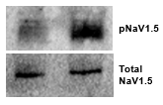
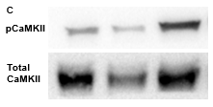
Supplementary Figure 1
A
B
B

Slide 2
Supplementary Figure 2
A
B
C
D
E
F
G
H
I
J

Slide 3
Supplementary Figure 3

Slide 4
Supplementary Figure 4
A
B
C
D
E
F
G
H
I
J
K
L
M
N
O

Slide 5
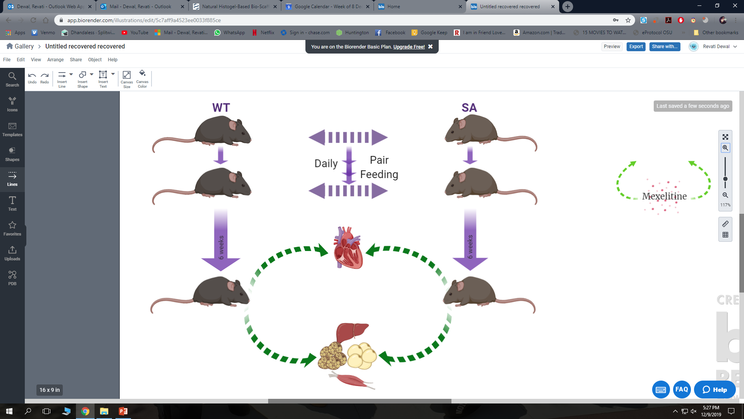
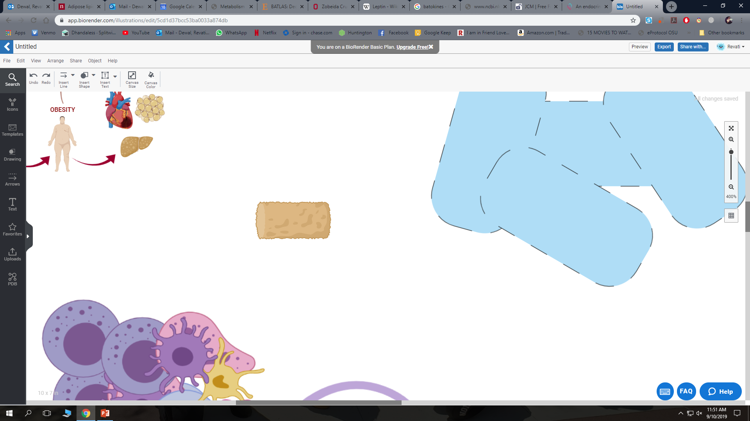
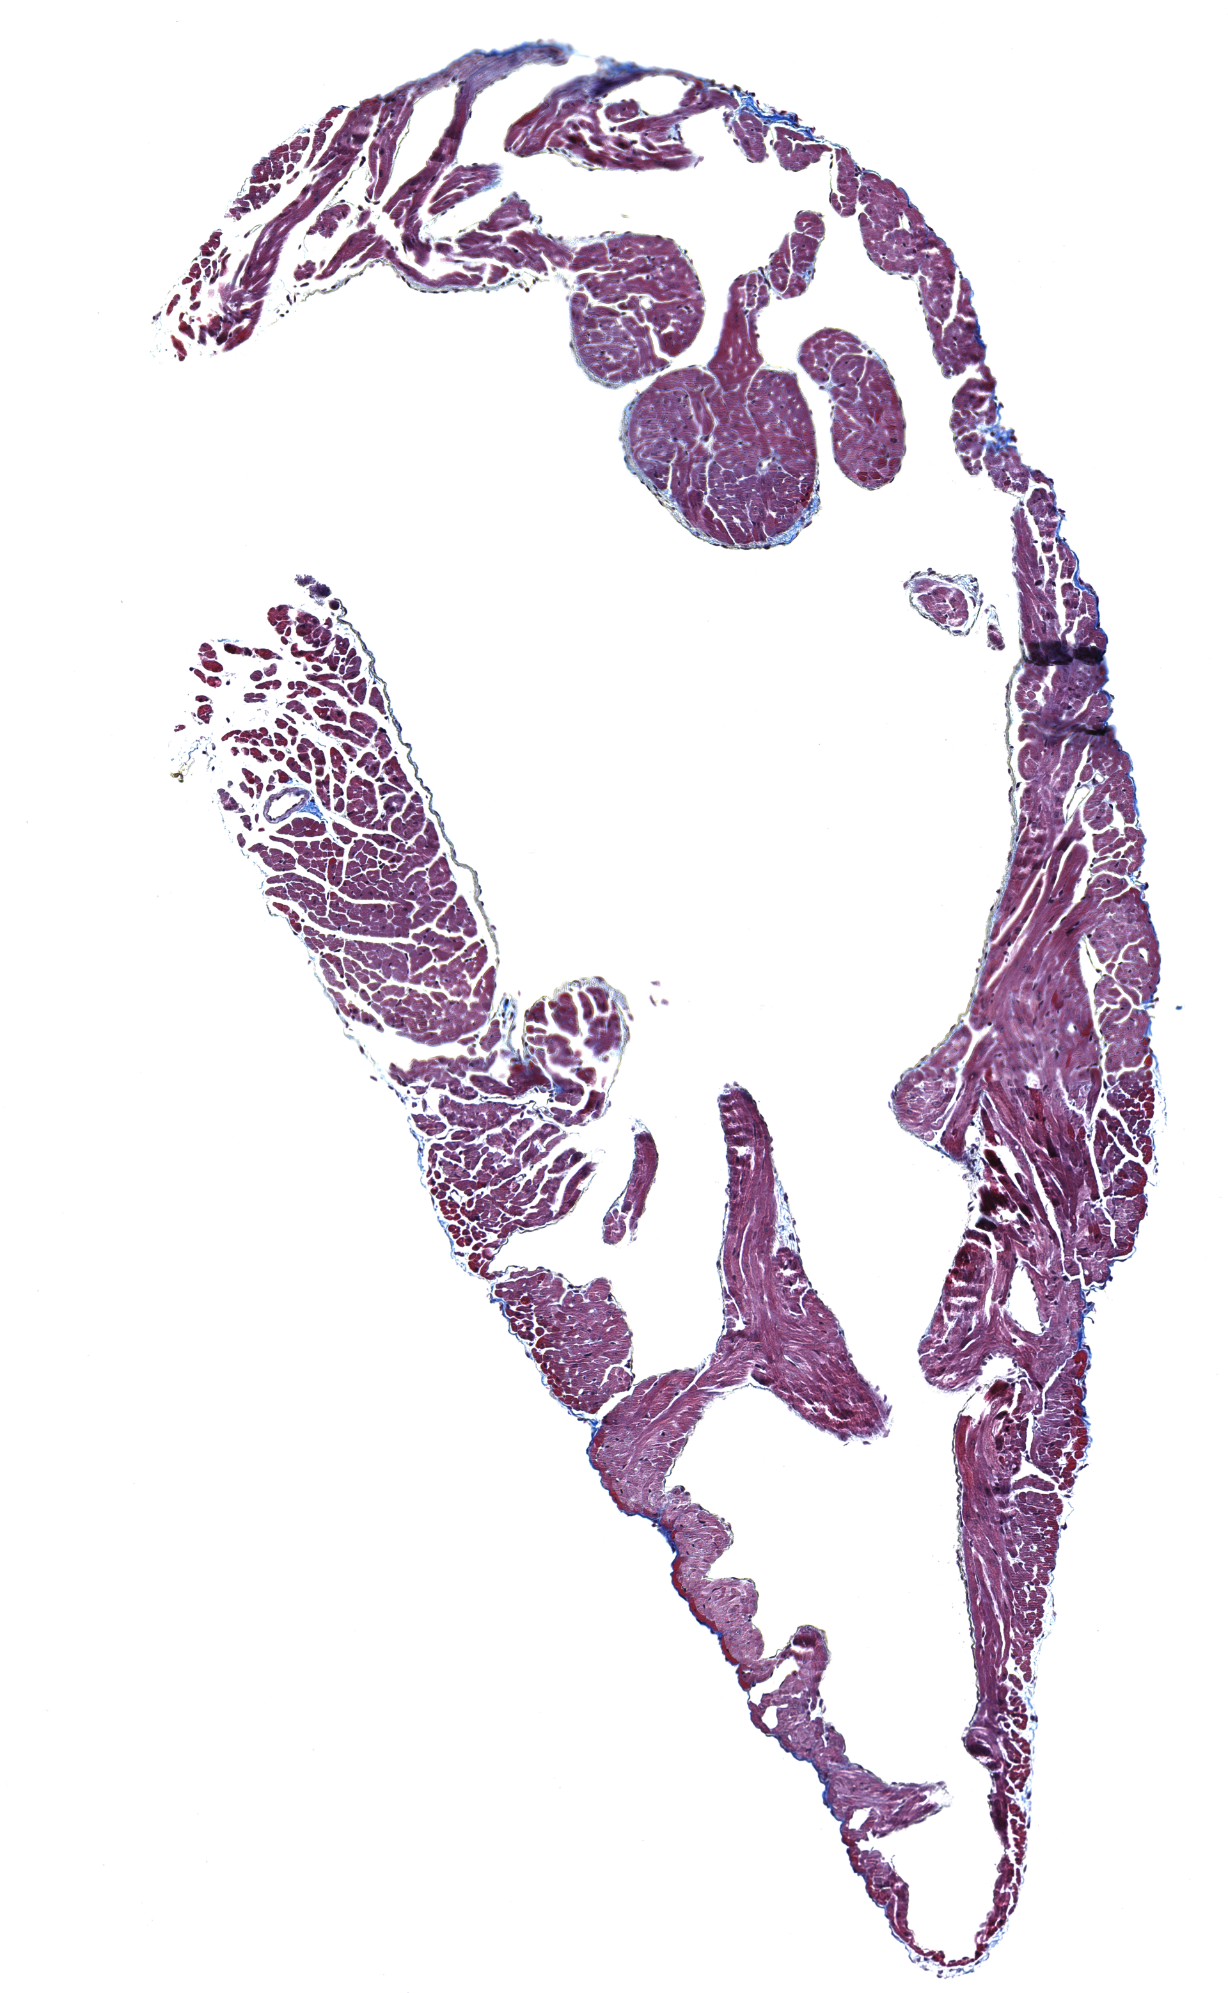
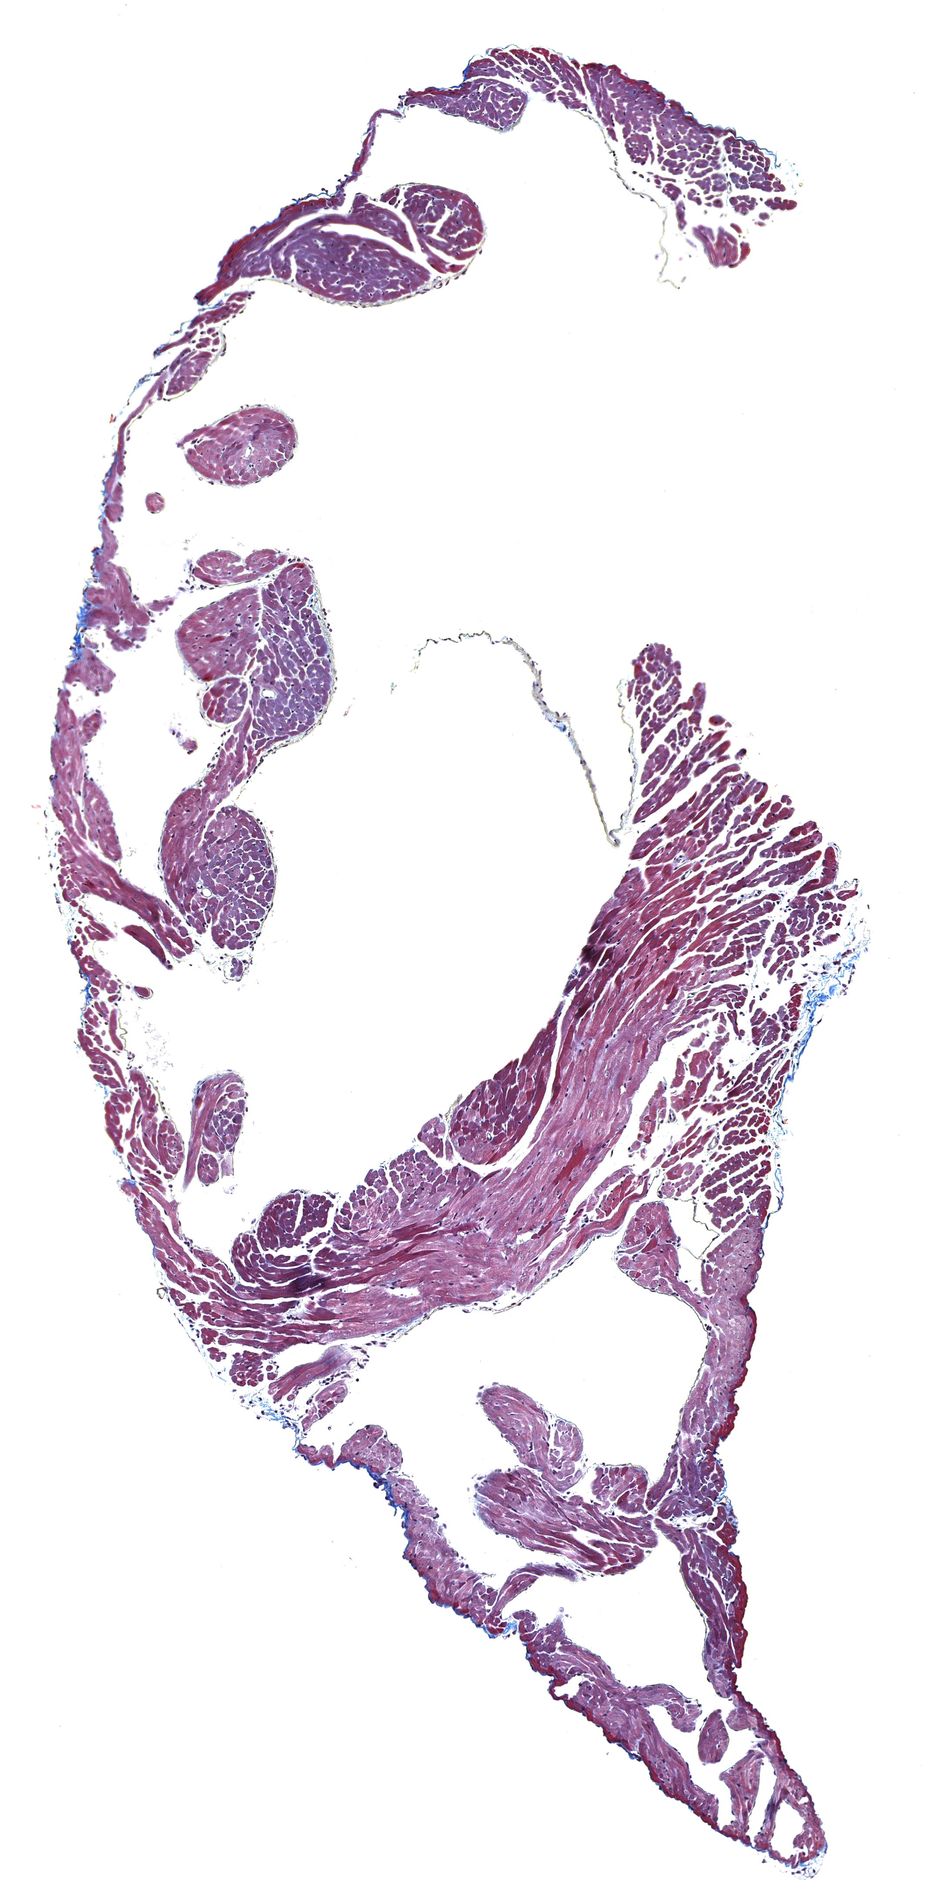
Supplementary Figure 5
A
(pair-fed)
(ad lib)
B
6 weeks
C
D
E
F
G
200μm
SA HFD
WT HFD PF
H
I

