Slide 1




A
B
C
D
Tunicamycin 5 μg/mL
Control
Control
0 4 8 24 hrs
Tunicamycin
Oleic Acid
**
*
HSP90
*
E4BP4
*
GRP78
Chop E4bp4
Chop E4bp4
Chop E4bp4
CHOP
Supplementary Figure 1. Tunicamycin induces E4bp4 in Hepa1c1c7 cells. The mouse hepatoma Hepa1c1c7 cells were treated with either DMSO or tunicamycin (5 μg/ml) (A & D) or palmitate (400 μM) (B) or oleic acid (300 μM) (C) for 16 hrs before harvest. Both the mRNA and protein levels were analyzed. The data were presented as Mean + SEM. *p < 0.05 and **p <0.01 by the Student t-test. The experiments were repeated at least three times with similar results.

Slide 2





Regular chow
HFLMCD diet
A
DMSO
B
C
D
Tunicamycin
DMSO Tunicamycin
***
E4BP4
Regular chow
HFLMCD diet
E4BP4
Relative mRNA Levels
GRP78
Lamin A/C
*
CHOP
***
HSP90
Chop E4bp4
Grp78
Chop
E4bp4
Supplementary Figure 2. Tunicamycin induces E4bp4 in mouse macrophage RAW cells (A&B). The RAW cells were treated with either DMSO or tunicamycin (5 μg/ml) for 16 hrs before harvest. Both mRNA and protein levels were analyzed. The data were presented as Mean + SEM. **p <0.01 and ***p <0.001 by the Student t-test. The experiments were repeated at least three times with similar results. Liver E4BP4 expression in WT male mice after 10-wk HFLMCD feeding (C&D). The liver mRNA levels of Chop and E4bp4 were measured by RT-qPCR (C) and the nuclear E4BP4 protein was detected by immunoblotting (D).

Slide 3
A
DMSO
****
Tunicamycin
****
*
****
****
****
Relative mRNA Levels
E4bp4 ^{flox/flox} E4bp4-LKO
E4bp4 ^{flox/flox} E4bp4-LKO
E4bp4 ^{flox/flox} E4bp4-LKO
B
C
*
*
Relative mRNA Levels
****
***
Relative mRNA levels
**
****
****
****
E4bp4 ^{flox/flox} E4bp4-LKO
E4bp4 ^{flox/flox} E4bp4-LKO
E4bp4 ^{flox/flox} E4bp4-LKO
Supplementary Figure 3. Gene expression profile of lipid metabolism in tunicamycin-treated E4bp4-LKO vs. E4bp4^{flox/flox} PMHs. (A) E4bp4 and ER stress markers (Grp78 and Chop), (B) lipid droplet genes (Plin2 and Cidea); and (C) lipid uptake and secretion (CD36 and Mttp1), *p <0.05, **p <0.01, and ***p < 0.001 by the Student’s t-test.

Slide 4
DMSO
A
Tunicamycin
**
****
****
***
****
*
Relative mRNA Levels
***
E4bp4 ^{flox/flox} E4bp4-LKO
E4bp4 ^{flox/flox} E4bp4-LKO
E4bp4 ^{flox/flox} E4bp4-LKO
E4bp4 ^{flox/flox} E4bp4-LKO
E4bp4 ^{flox/flox} E4bp4-LKO
B
DMSO
Tunicamycin
****
**
n.s
*
**
****
****
****
****
*
Relative mRNA Levels
***
****
n.s
n.s
****
E4bp4 ^{flox/flox} E4bp4-LKO
E4bp4 ^{flox/flox} E4bp4-LKO
E4bp4 ^{flox/flox} E4bp4-LKO
E4bp4 ^{flox/flox} E4bp4-LKO
E4bp4 ^{flox/flox} E4bp4-LKO
E4bp4 ^{flox/flox} E4bp4-LKO
E4bp4 ^{flox/flox} E4bp4-LKO
Supplementary Figure 4. Gene expression analysis of hepatic lipid metabolism in tunicamycin-treated E4bp4 ^{flox/flox} vs. E4bp4-LKO PMHs. (A) The mRNA levels of lipolysis genes (Atgl, Cgi58, Hsl, Magl, and Pnpla3); (B) The mRNA levels of autophagy genes.

Slide 5
DMSO
Tunicamycin
Bax
Bim
Noxa
Puma
Bcl-2l1
n.s.
*
*
*
**
Relative mRNA Levels
*
*
*
E4bp4 ^{flox/flox} E4bp4-LKO
E4bp4 ^{flox/flox} E4bp4-LKO
E4bp4 ^{flox/flox} E4bp4-LKO
E4bp4 ^{flox/flox} E4bp4-LKO
E4bp4 ^{flox/flox} E4bp4-LKO
Supplementary Figure 5. The expression of apoptotic genes in tunicamycin-treated E4bp4-LKO vs. E4bp4^{flox/flox} PMHs. The mRNA levels of apoptotic genes (Bax, Noxa, Puma, and Bcl2l2) in PMHs were measured by RT-qPCR. *p <0.05, **p <0.01, and ***p < 0.001 by the Student’s t-test. n.s.: not significant

Slide 6
A
E4bp4^{flox/flox}
B
E4bp4-LKO
*
Body Weight (g)
Liver Triglycerides (μg/mg)
Liver Cholesterol (μg/mg)
C
D
Serum Triglycerides (mg/dL)
Serum Cholesterol (mg/dL)
Serum ALT (IU/L)
Supplementary Figure 6. Metabolic phenotype of E4bp4-LKO vs. E4bp4^{flox/flox} mice on regular chow. Two-month male mice on regular chow was dissected and metabolic assays were performed as follows: (A) body weight, (B) liver triglycerides and cholesterol, (C) serum triglycerides and cholesterol, and (D) serum ALT.

Slide 7
E4bp4 ^{flox/flox}
B
A
E4bp4-LKO
Relative mRNA Levels
Relative mRNA Levels
C
D
Relative mRNA Levels
Relative mRNA Levels
Supplementary Figure 7. Gene expression analysis of lipid metabolism in the liver of HFLMCD-fed E4bp4-LKO vs. E4bp4^{flox/flox} mice: (A) lipolysis, (B) cholesterol biosynthesis, (C) fatty acid oxidation, and (D) fatty acid uptake.

Slide 8
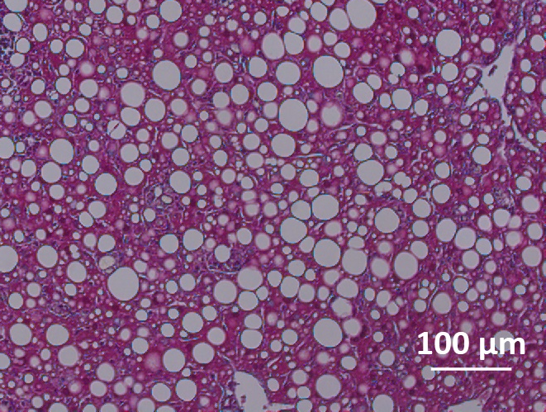
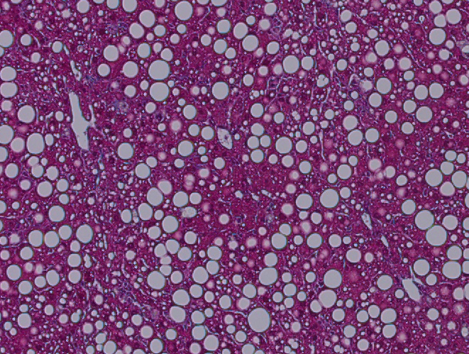
E4bp4^{flox/flox}
A
E4bp4-LKO
Relative mRNA Levels
C
E4bp4^{flox/flox}
B
E4bp4-LKO
*
Relative mRNA Levels
Supplementary Figure 8. Gene analysis of hepatic inflammation and fibrosis as well as fibrosis staining of the liver of HFLMCD-fed E4bp4^{flox/flox} vs. E4bp4-LKO mice. (A) mRNA levels of inflammatory genes, (B) mRNA levels of fibrotic genes, and (C) Masson’s Trichrome staining of liver section of E4bp4^{flox/flox} vs. E4bp4-LKO mice.

Slide 9








A
E4bp4^{flox/flox}
E4bp4-LKO
B
E4bp4^{flox/flox}
E4bp4-LKO
AMPKα1/α2
Relative mRNA Levels
AMPKβ1
AMPKγ1
HSP90
Ampk subunit:
α1
α2
β1
β2
γ1
γ2
C
D
DMSO
Tunicamycin
DMSO Tunicamycin
E4BP4
*
AMPKα1/α2
Relative mRNA Levels
AMPKβ1
AMPKγ1
Ampk subunit:
α1
a2
β1
β2
γ1
γ2
HSP90
Supplementary Figure 9. The protein and mRNA expression of AMPK subunits in liver tissues from both E4bp4 ^{flox/flox} and E4bp4-LKO mice (A&B). The liver tissues isolated from either E4bp4^{flox/flox} mice (n=10) or E4bp4-LKO (n=8) mice on regular chow were used to examine the mRNA (A) and protein (B) expression of AMPK subunits. The protein and mRNA expression of AMPK subunits in tunicamycin-treated PMHs (C&D). PMHs were treated with either DMSO or tunicamycin (2.5 μg/ml) overnight. (C) The mRNA levels of Ampk subunits; (D) The protein levels of AMPK subunits.

Slide 10







Tunicamycin
HFLMCD diet
A
Ad-Flag-E4bp4
B
C
Ad-GFP
ER stress
CHOP
IP: anti-AMPKβ1
AMPKβ1-polyubiquitin conjugates
IB: anti-ubiquitin
Ad-GFP
Ad-Srebp-1c
E4BP4
SREBP-1c
Induction of AMPK-specific E3 ligases?
Hepatocyte
HSP90
AMPK-β1
AMPK pathway
FLAG-E4BP4
Lysates
HSP90
AMPKβ1
Lipid accumulation
Hepatocyte death
Supplementary Figure 10. (A) E4BP4 promotes ubiquitination of AMPK-β1 in mouse hepatocytes. PMHs were transduced with either Ad-GFP or Ad-E4BP4 for 36 hrs and and then treated with MG132 for 6 hrs before harvest. The protein lysates were used in denaturing immunoprecipitation with anti-AMPKβ1. The AMPKβ1-polyubiquitin conjugates were detected by anti-ubiquitin. (B) Overexpression of SREBP-1c does not affect the protein abundance of AMPKβ1 in hepatocytes. Hepa1c1c7 were transduced with either Ad-GFP or Ad-Srebp-1c and harvested 36 hrs later. The protein levels of SREBP-1c and AMPK-β1 were examined by immunoblotting. (C)The working model. Tunicamycin and HFLMCD diet potently induce E4BP4 in hepatocytes and the mouse liver. The ER stress transcription factor CHOP partially contributes to the induction of E4BP4 in these conditions. ER stress-induced E4BP4 may up-regulate AMPK-specific ubiquitin E3 ligases to inhibit the AMPK activity, leading to lipid accumulation and hepatocyte death in the liver.

