Slide 1
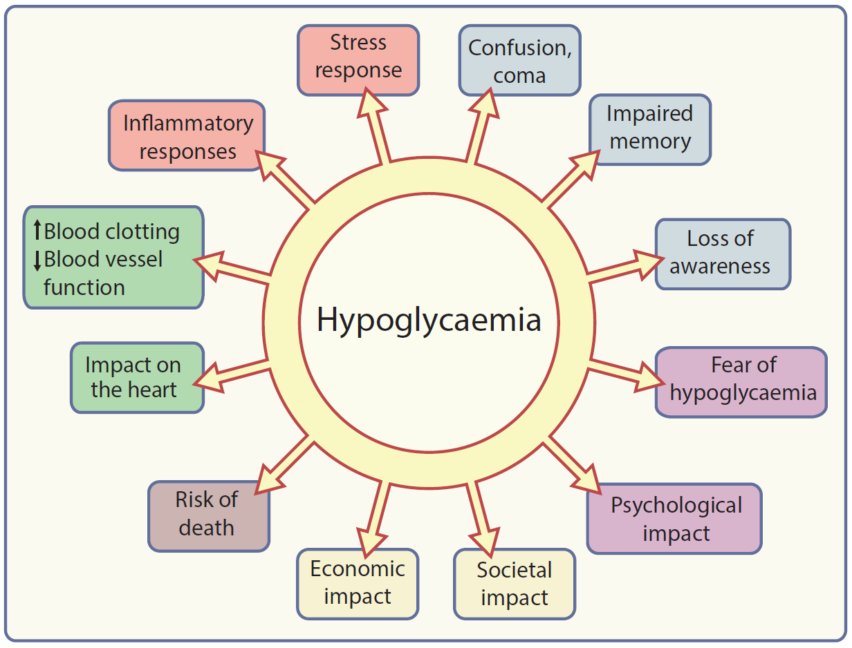
A graphical summary of the potential consequences of hypoglycaemia
Stephanie A. Amiel (2021) Diabetologia DOI 10.1007/s00125-020-05366-3
©The Authors 2021. Distributed under the terms of the CC BY 4.0 Attribution License (http://creativecommons.org/licenses/by/4.0/)

