Slide 1
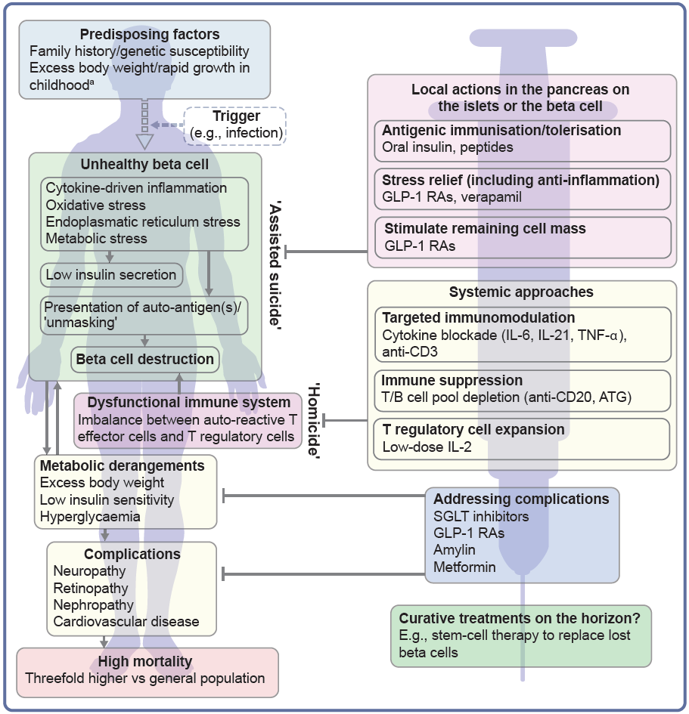
Hallmarks of the evolving profile of the individual with type 1 diabetes, and current and future options for the prevention of this disease and for the management of its associated complications
von Scholten et al (2021) Diabetologia DOI 10.1007/s00125-021-05398-3
©The Authors 2021. Distributed under the terms of the CC BY 4.0 Attribution License (http://creativecommons.org/licenses/by/4.0/)

