Slide 1
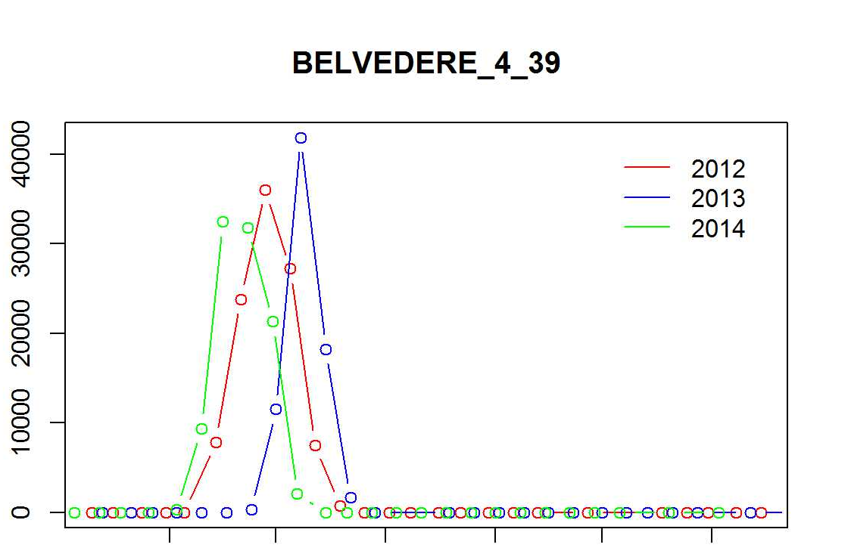
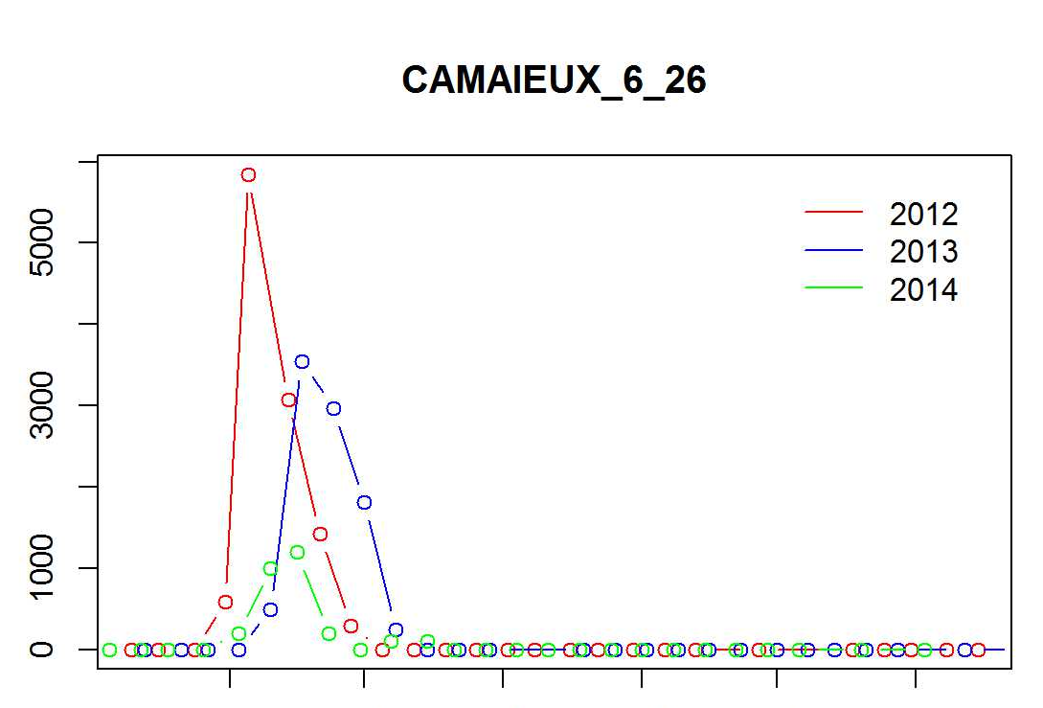
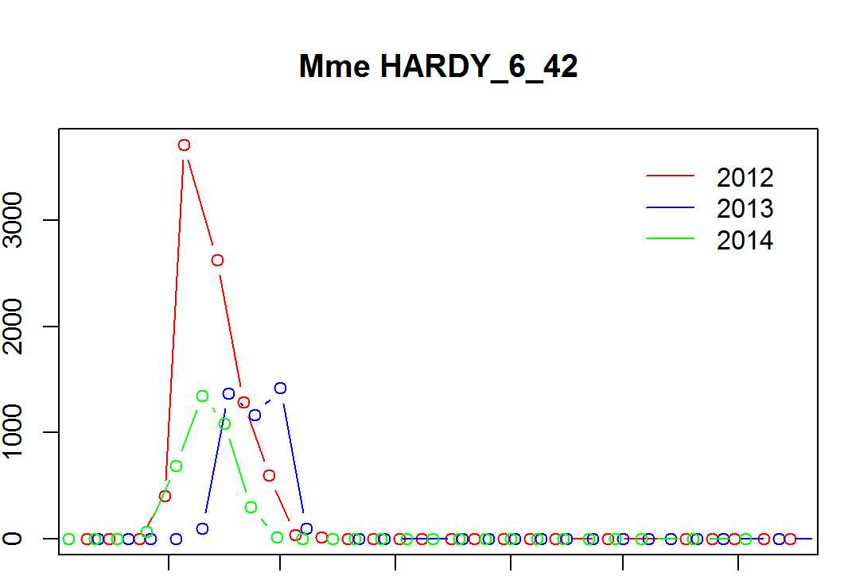
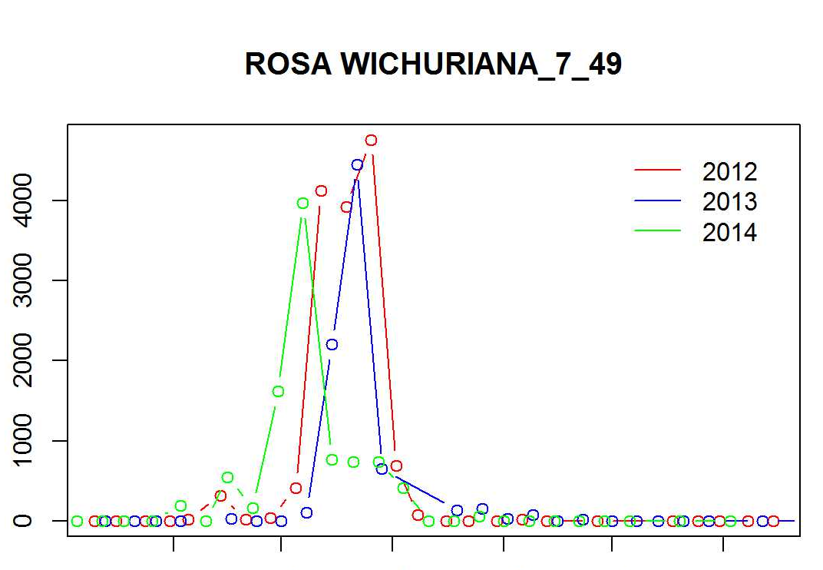
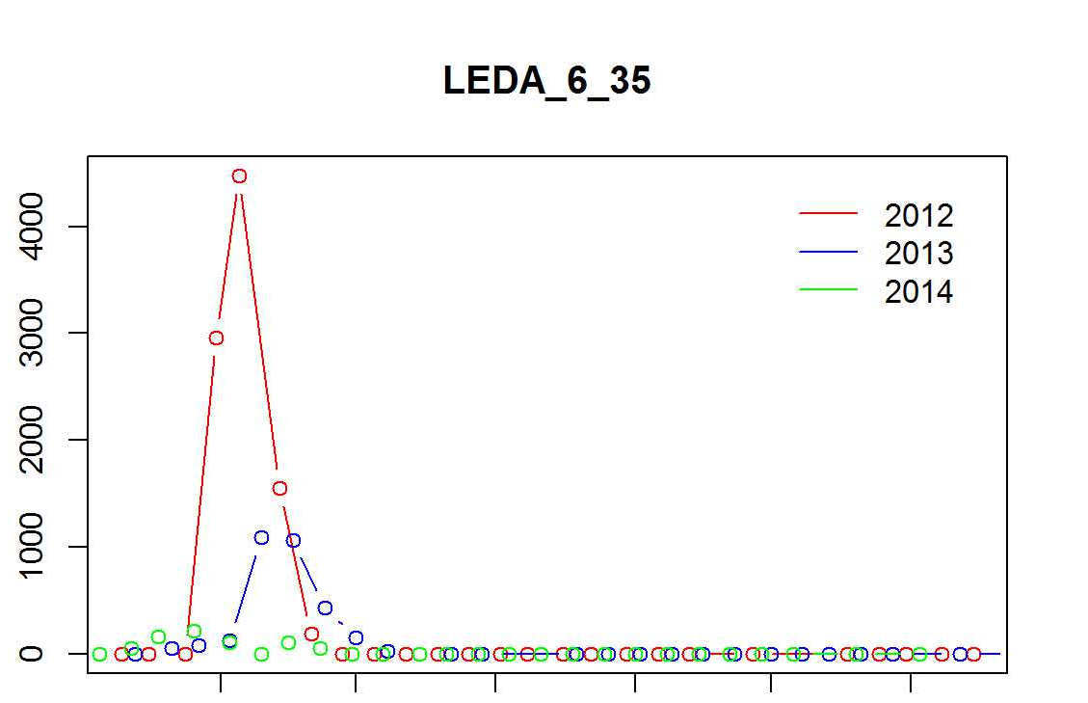
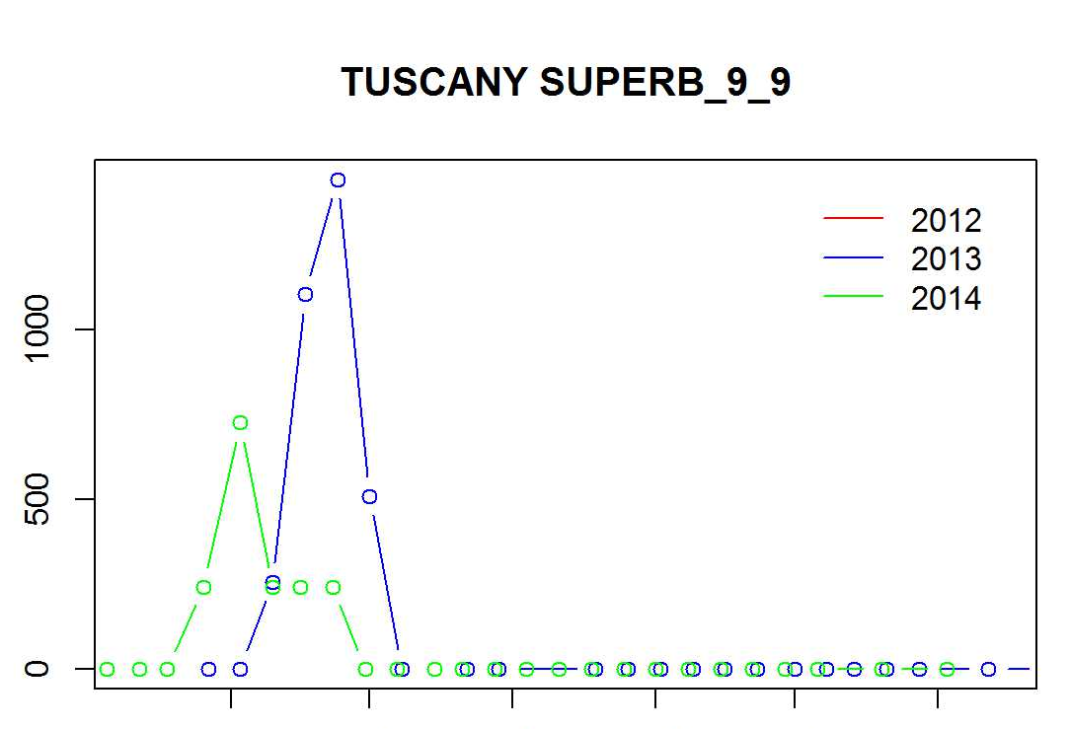
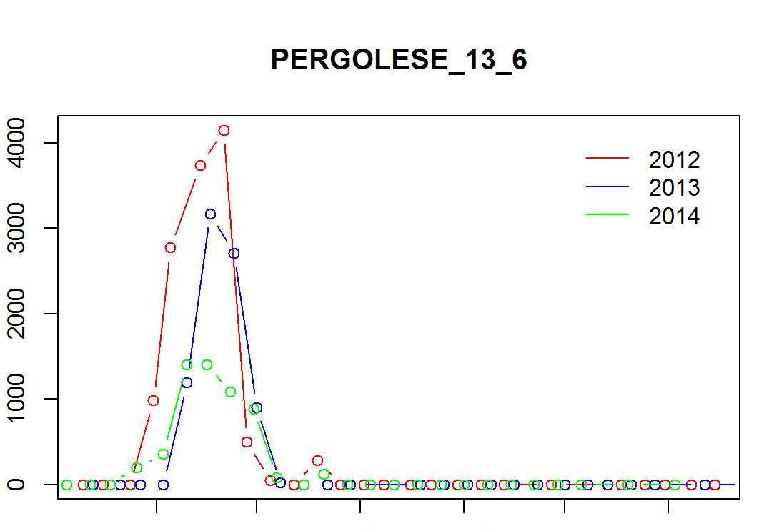
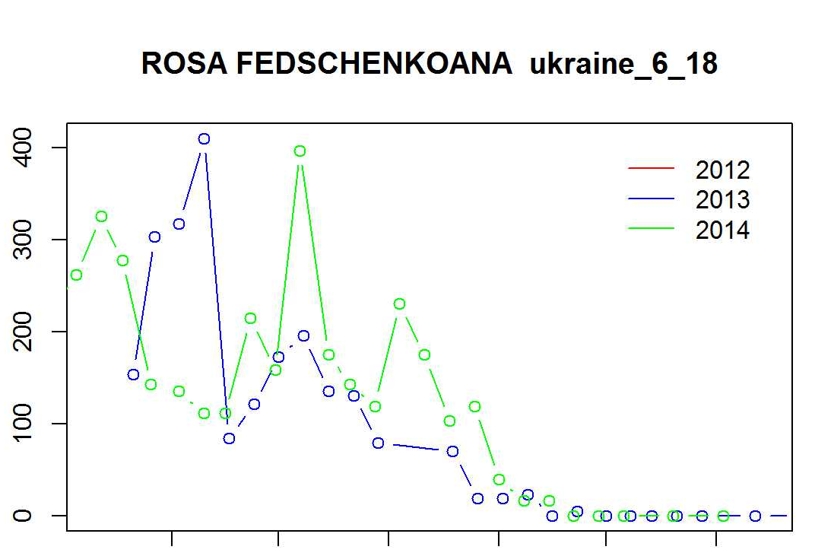
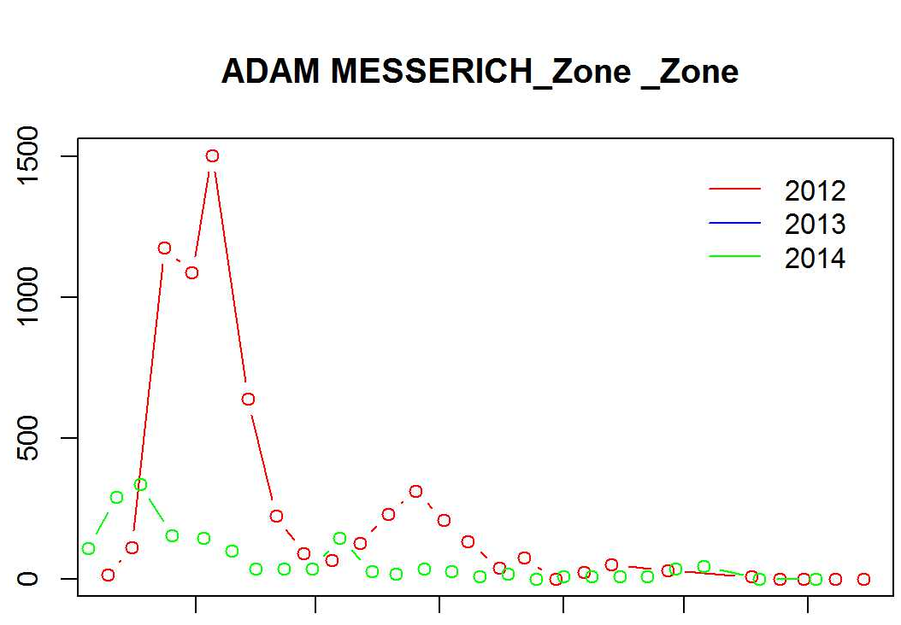
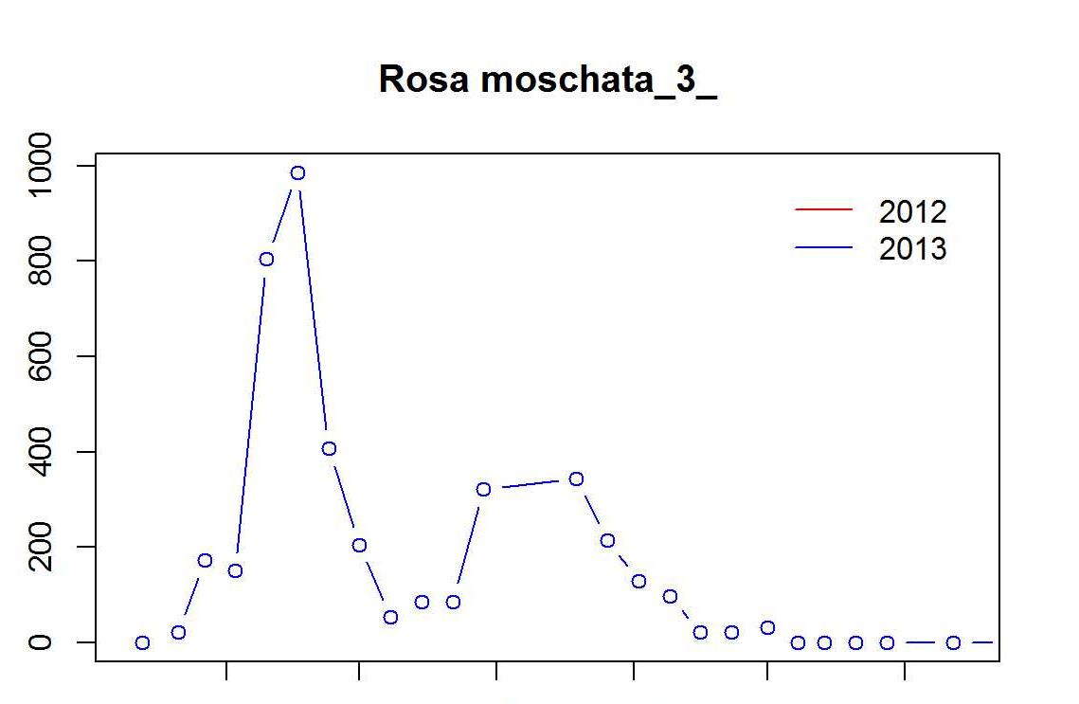
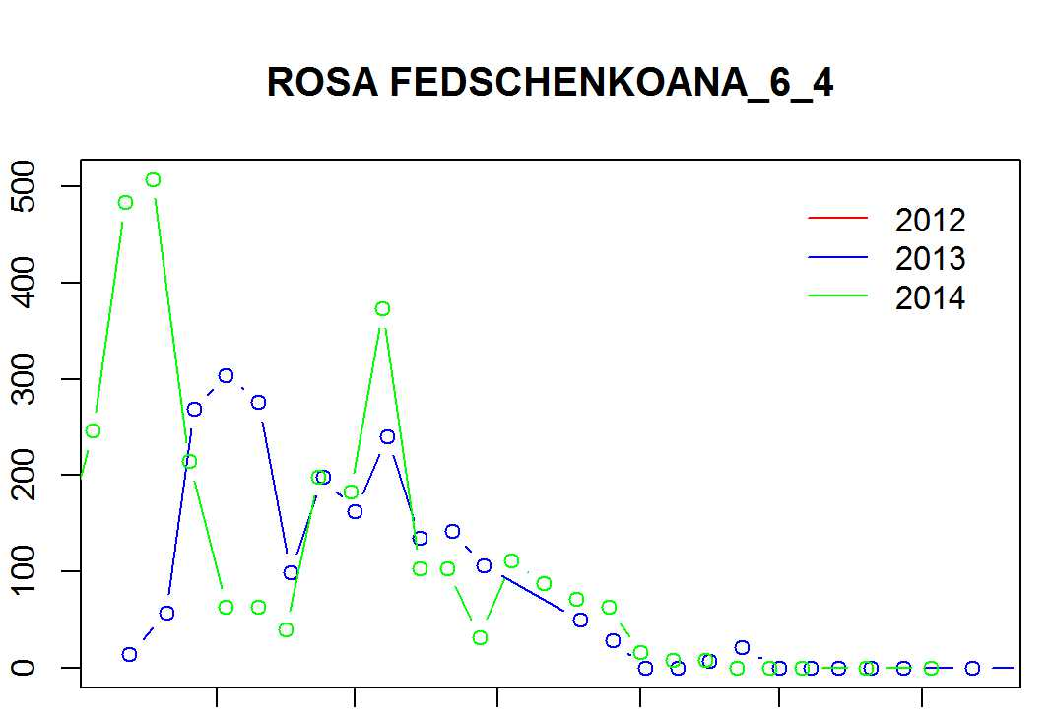
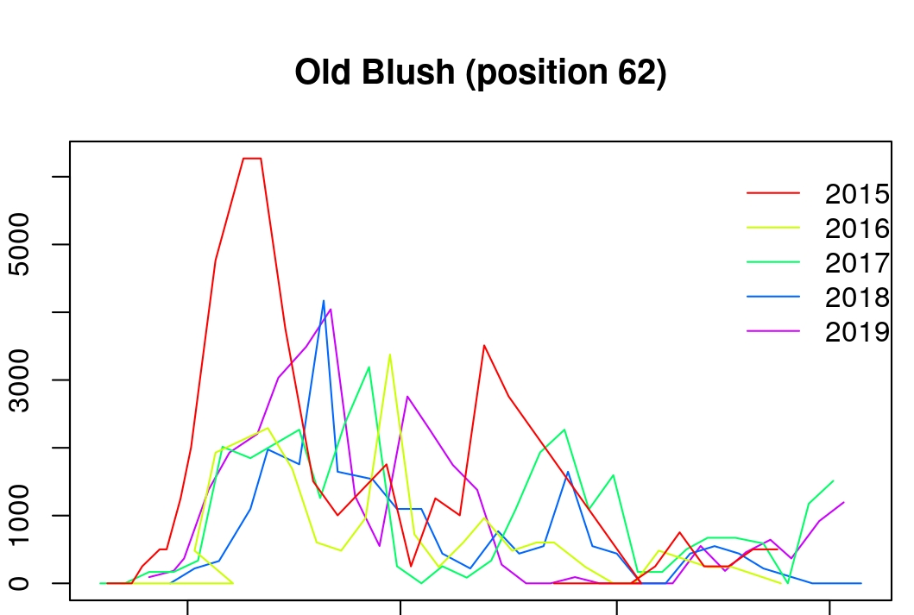
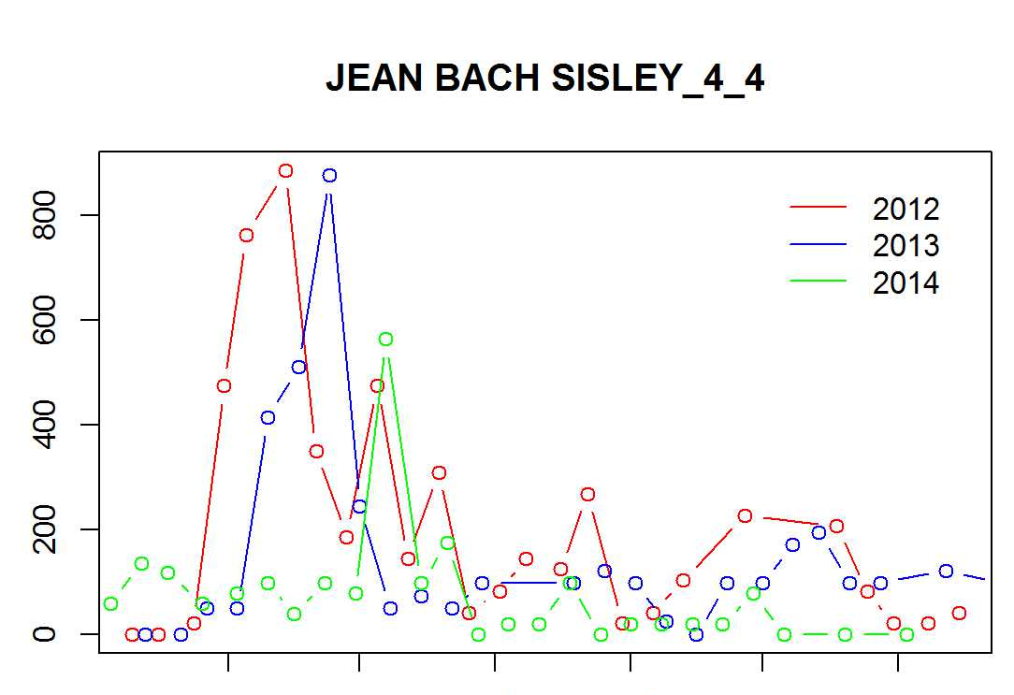
a
Density of opened flowers (f/m²)
Jun Jul Aug Sept Oct Nov
Jun Jul Aug Sept Oct Nov
Jun Jul Aug Sept Oct Nov
Density of opened flowers (f/m²)
May Jun Jul Aug Sept Oct Nov
May Jun Jul Aug Sept Oct Nov
May Jun Jul Aug Sept Oct Nov
Density of opened flowers (f/m²)
b
May Jun Jul Aug Sept Oct Nov
Density of opened flowers (f/m²)
May Jun Jul Aug Sept Oct Nov
May Jun Jul Aug Sept Oct Nov
Density of opened flowers (f/m²)
c
May Jun Jul Aug Sept Oct Nov
May Jun Jul Aug Sept Oct Nov
Density of opened flowers (f/m²)
May Jun Jul Aug Sept Oct Nov
May Jun Jul Aug Sept Oct Nov
Supplementary Figure 2

