Slide 1
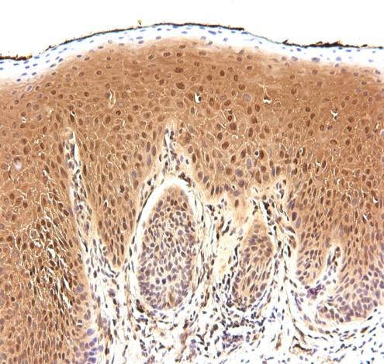
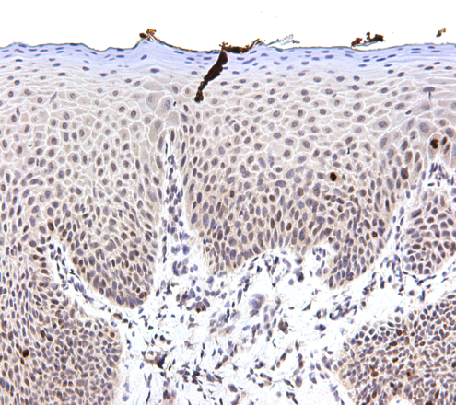
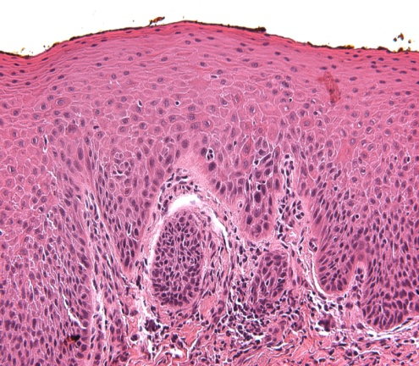
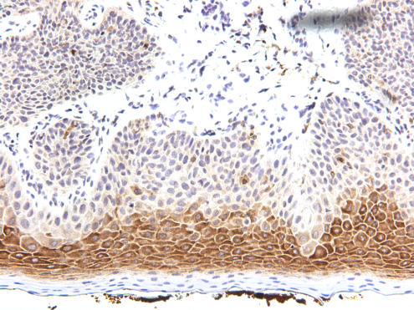
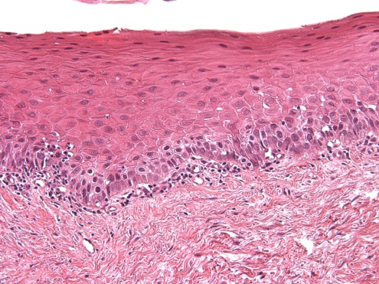
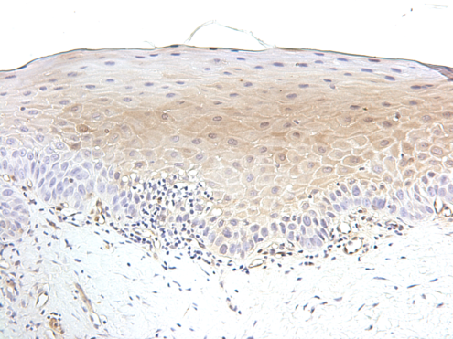
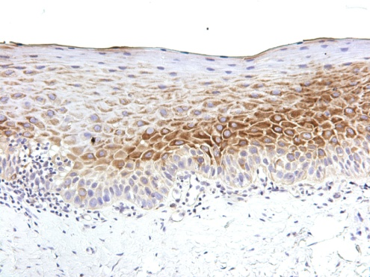
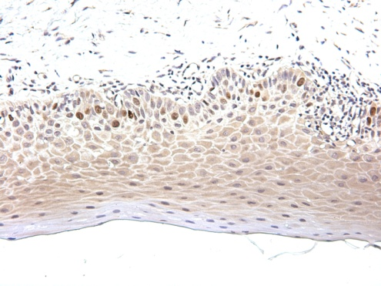
Supplementary S1A
Mod Dysplasia
pERK
pS6
KI67
BL
6-M
Mild Dysplasia
Figure S1A: Biomarker modulation of case #16 (moderate dysplasia at baseline (Pre-Tx) became mild dysplasia post treatment at 6 months (6-M)). pERK was highly expressed in the baseline (BL) tissue which was downregulated after 6 months of treatment (6-M). PS6 and Ki-67 were also highly expressed at baseline and slightly downregulated after treatment for 6 months (6-M). Statistically significant downregulation was only observed for pERK expression. (200X magnification).

Slide 2
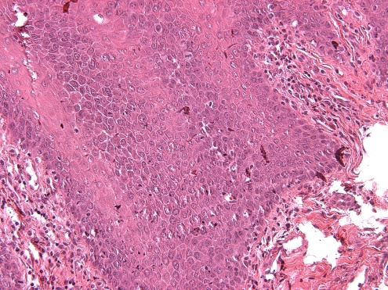
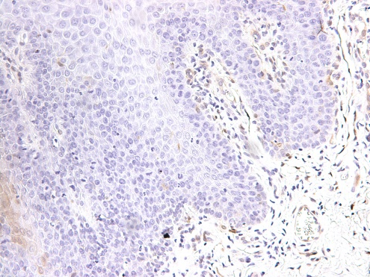
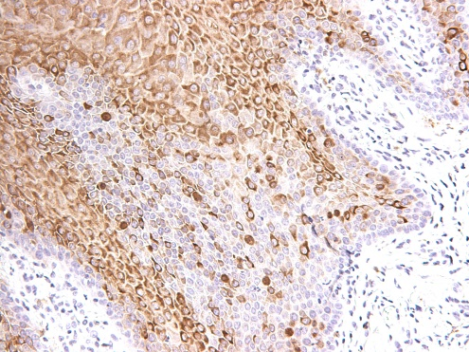
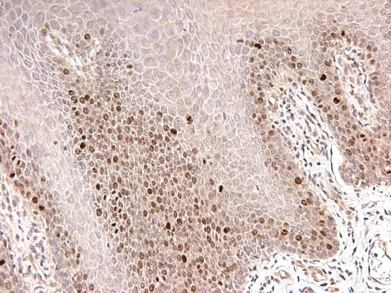
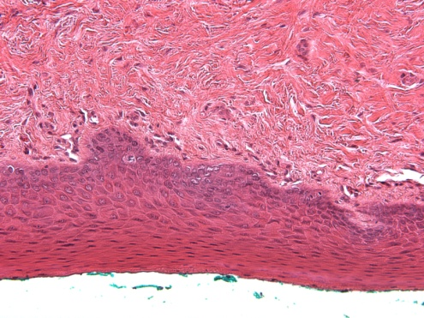
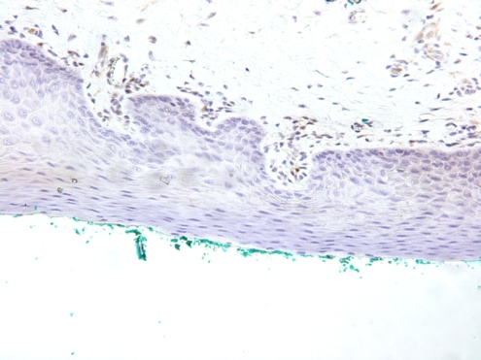
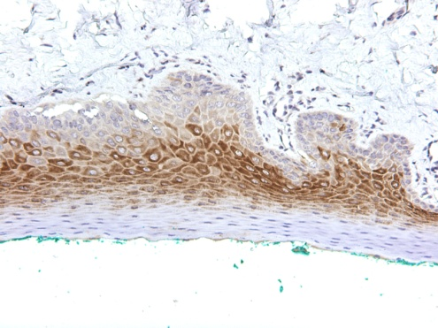
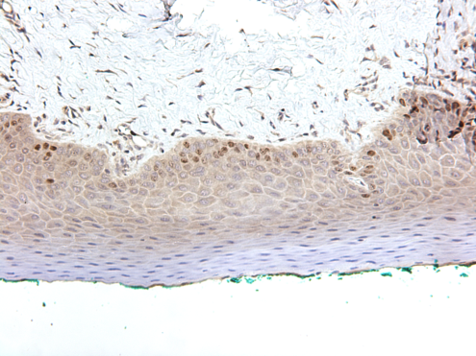
Supplementary S1B
Mild Dysplasia
pERK
pS6
KI67
BL
6-M
No dysplasia
Figure S1B: Biomarker modulation of case #3 (mild dysplasia at baseline (Pre-Tx) became normal epithelium in post treated tissue at 6 months (6-M)). pERK, pS6 & KI67 expression in baseline (BL) tissue as well as 6 months of treatment (6-M). pERK was expressed at a very low level in both BL and 6-M treatment samples. pS6 & KI67 were expressed at both BL & 6-M post treatment, however, this case did not show any difference in expression of these biomarkers post treatment (6-M). There was no statistical significance observed for these particular markers (which may be related to small sample size). 200X magnification.

