Slide 1
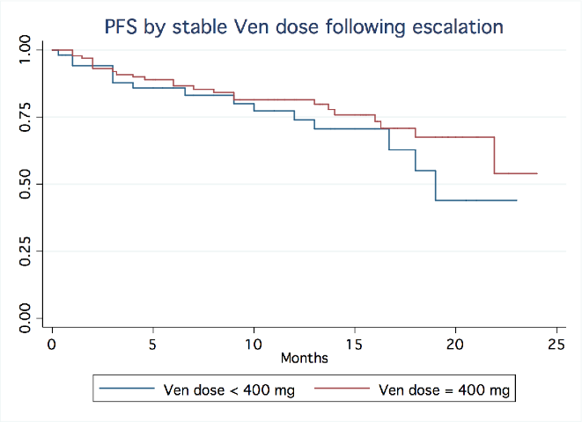
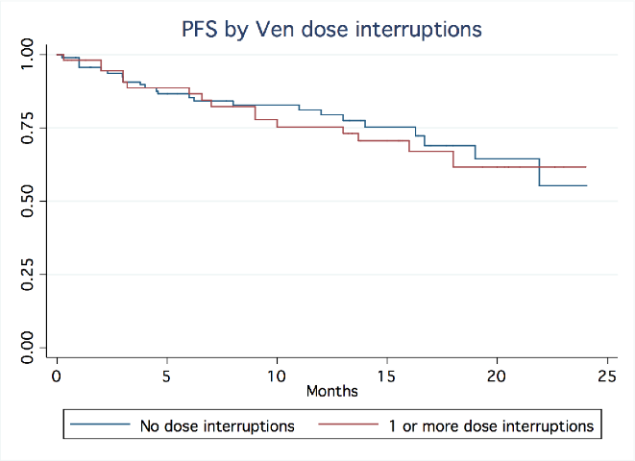
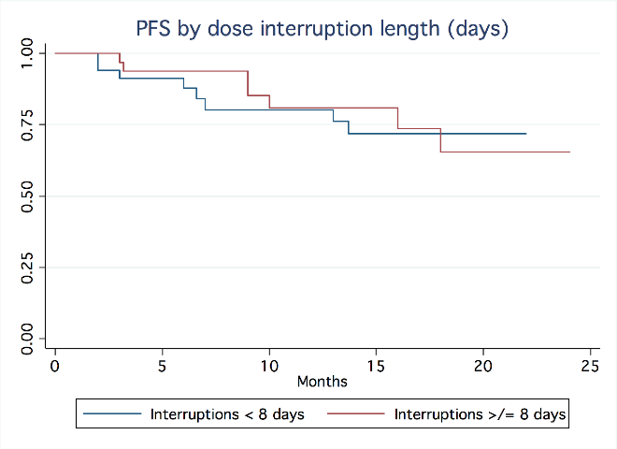
Supplemental Figure 1A.
p=0.29
Supplemental Figure 1B.
p=0.46
Supplemental Figure 1C.
p=0.80

