Slide 1
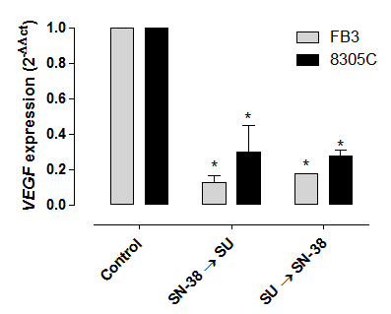
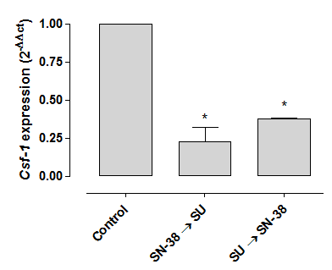
Supplementary figure 1S
A
Figure 1S. VEGF (A) and CSF-1 (B) gene expression (2^{-ΔΔCt}) in 8305C and FB3 cells exposed to sunitinib (SU) and SN-38 in a sequential, reverse combination and treated with vehicle alone for 72h. Columns and bars, mean values±S.D., respectively. *P<0.05 vs. vehicle-treated controls. Amplifications were normalized to glyceraldehyde 3-phosphate dehydrogenase, and the quantitation of gene expression was performed using the ΔΔCt calculation, where Ct is the threshold cycle; the amount of target, normalised to the endogenous control and relative to the calibrator (vehicle-treated control cells), is given as 2^{-ΔΔCt}.
B

Slide 2
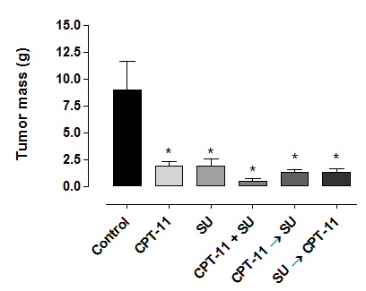
Supplementary figure 2S
Figure 2. Tumor weights of 8305C tumors xenotransplanted in CD nu/nu mice calculated at day 14 from after the beginning of therapy (because of the presence of all the groups) accordingly to the method of Geran and colleagues [Geran RI et al., Cancer Chemother. Rep., 3: 51-61, 1972] from linear measurements using the formula: tumor weight (mg) = length (mm) × [width (mm)]²/2. Columns and bars, Mean ± SE. *, P < 0.05 vs vehicle-treated controls.

