Slide 1
Linkage disequilibrium patterns, population structure and diversity analysis in a worldwide durum wheat collection including Argentinian genotypes
Pablo Federico Roncallo¹, Adelina Olga Larsen², Ana Laura Achilli¹, Carolina Saint Pierre³, Cristian Andrés Gallo¹, Susanne Dreisigacker³, Viviana Echenique¹*
¹ Centro de Recursos Naturales Renovables de la Zona Semiárida (CERZOS), Departamento de Agronomía, Universidad Nacional del Sur (UNS)-CONICET, Bahía Blanca, Argentina.
² CEI Barrow, Instituto Nacional de Tecnología Agropecuaria (INTA), Tres Arroyos, Buenos Aires, Argentina.
³ International Maize and Wheat Improvement Center (CIMMYT), El Batán, Edo. de México, México.
*Corresponding author:
E-mail: echeniq@criba.edu.ar

Slide 2
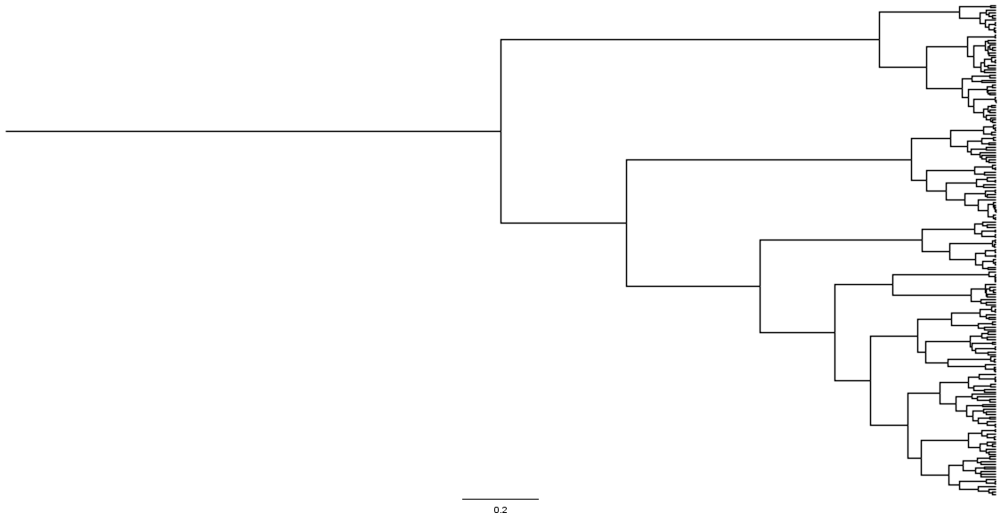
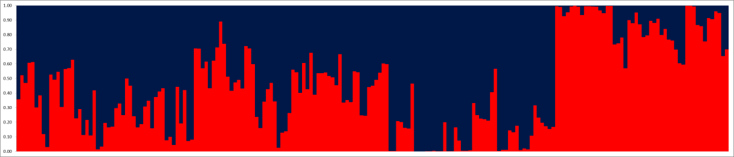
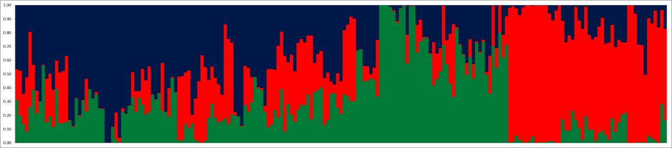
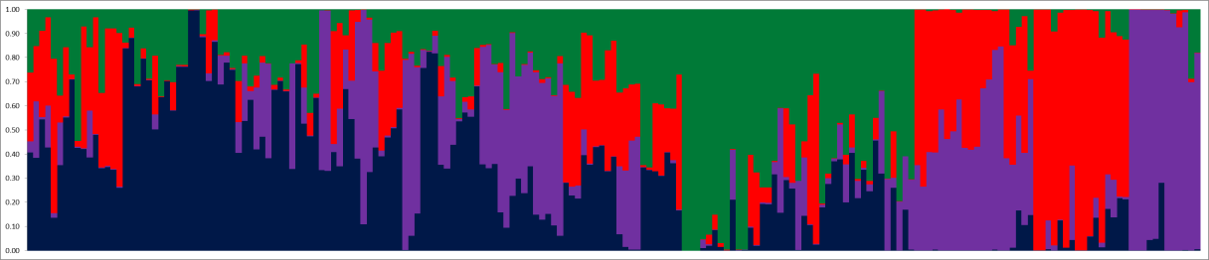
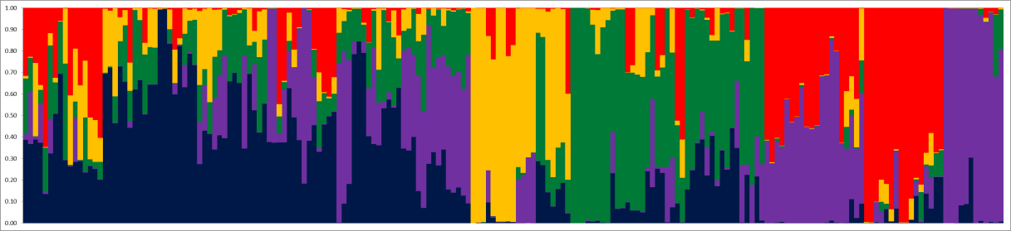
Ward clustering
K=2
K=3
STRUCTURE
K=4
K=5
DAPC
Q1
Q2a
Q4
Q3
Q5
Q2b
Fig. S5a

Slide 3
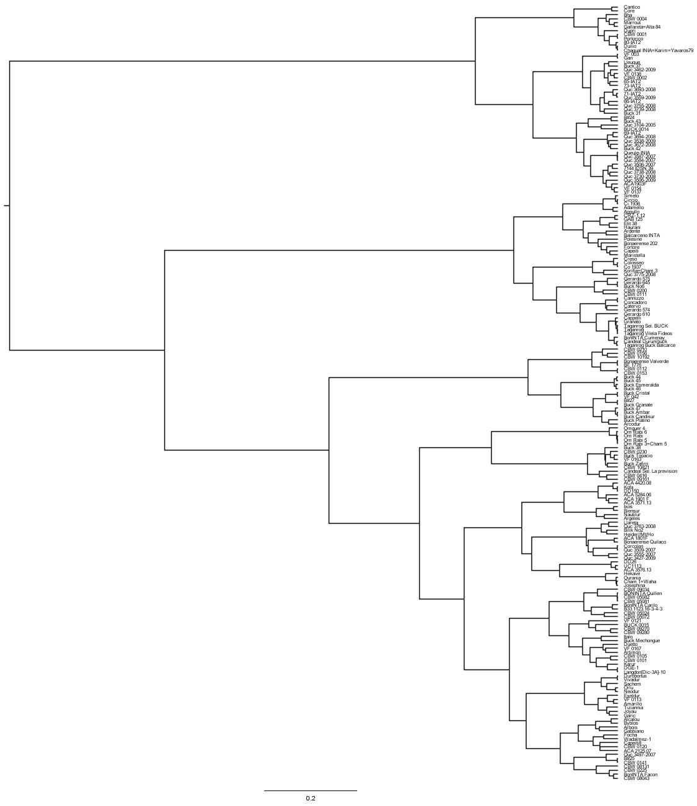

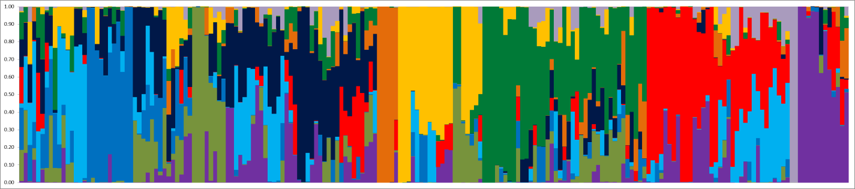
K=5
K=10
Old and modern Italiann
+ Old Argentinian
French, Chilean and
WANA region
Altar 84 + Yavaros 79
CIMMYT derivatives
Argentinian modern
(Buck Ambar derivatives)
Chilean and Argentinian breeding lines +
CIMMYT germplasm
Om Rabi group
French + WANA region
Argentinian modern + French
Argentinian modern
Argentinian modern
Fig. S5b

