Slide 1
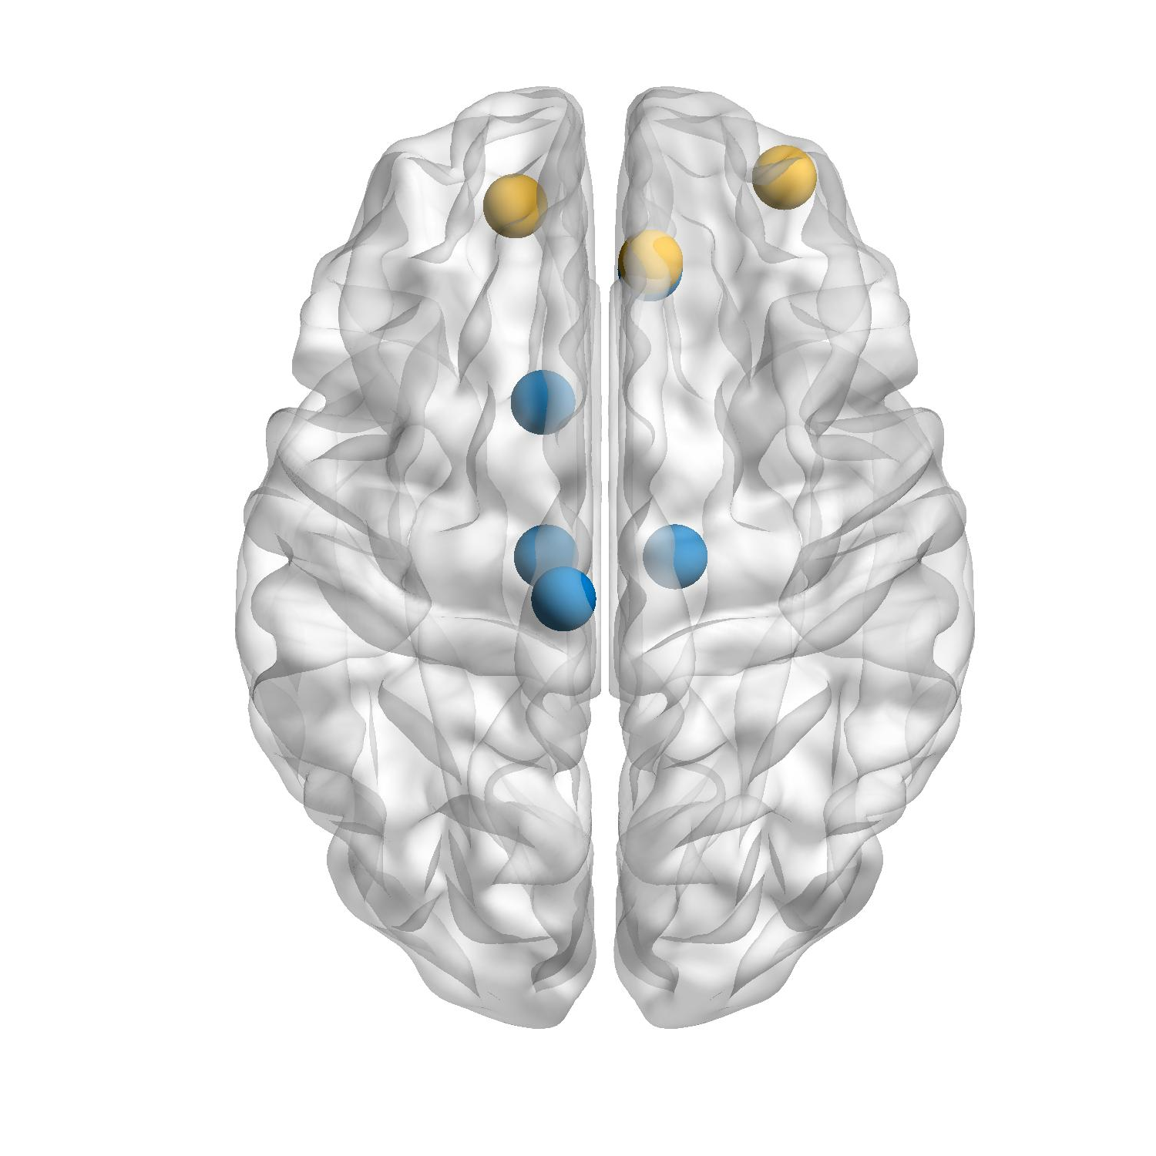
Supplementary2-Nodal Betweenness
A
B
*
ORBmid.R
ORBsup.L
*
*
ACG.R
REC.R
CAU.L
THA.L
THA.R
C
PCL.L
*
*
*
*
*

Slide 2
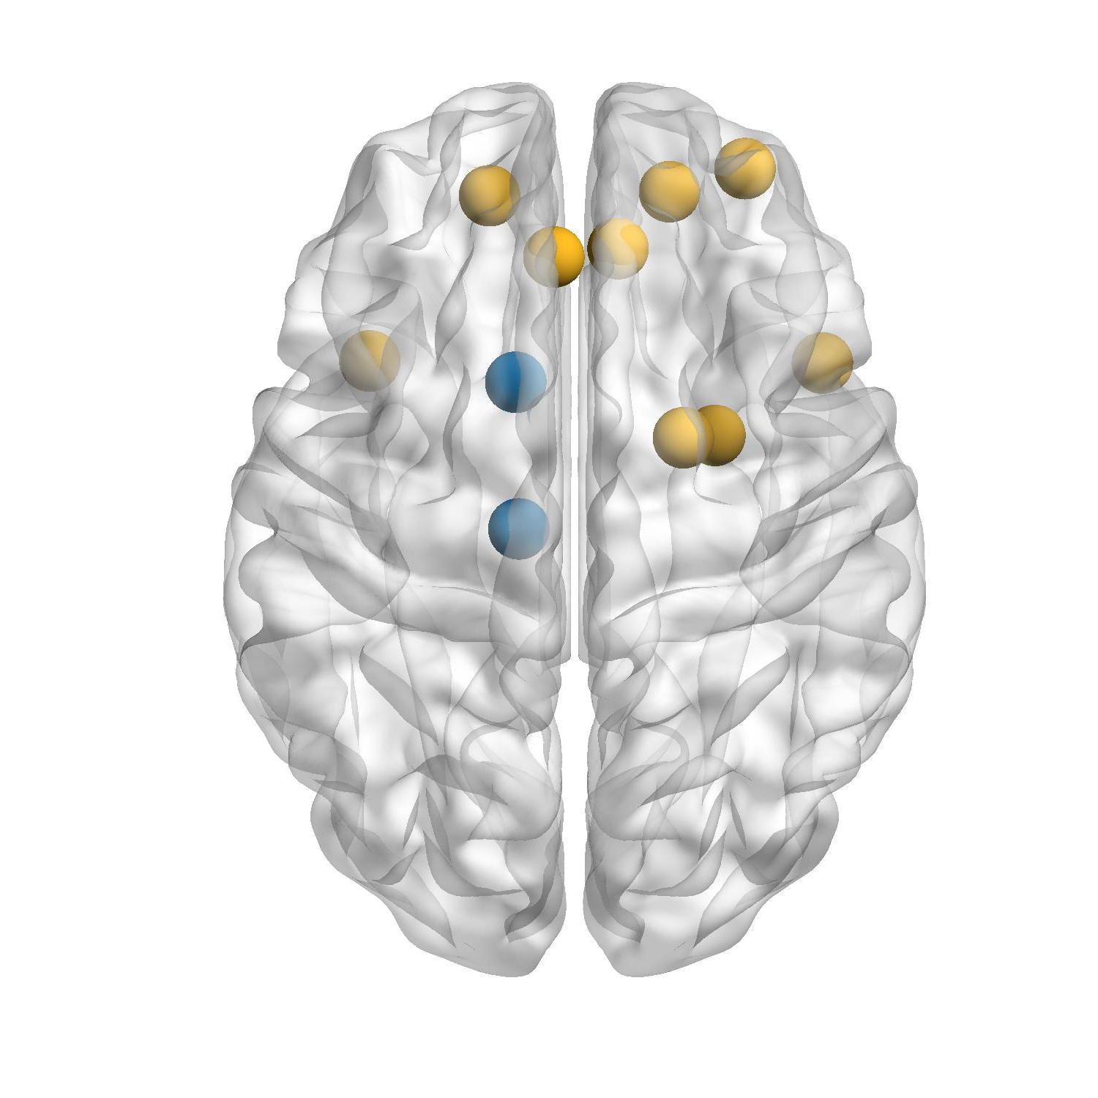
Supplementary2-Nodal Efficiency
A
B
ORBsup.L
ORBmid.R
ORBsup.R
*
*
*
*
*
ACG.L
ACG.R
*
*
*
TPOsup.L
CAU.L
TPOsup.R
PAL.R
AMYG.R
*
THA.L
ORBsup.L ORBsup.R ORBmid.R ACG.L ACG.R AMYG.R PAL.R TPOsup.L TPOsup.R
C
*
*
Notes:
节点效率—信息交互

Slide 3
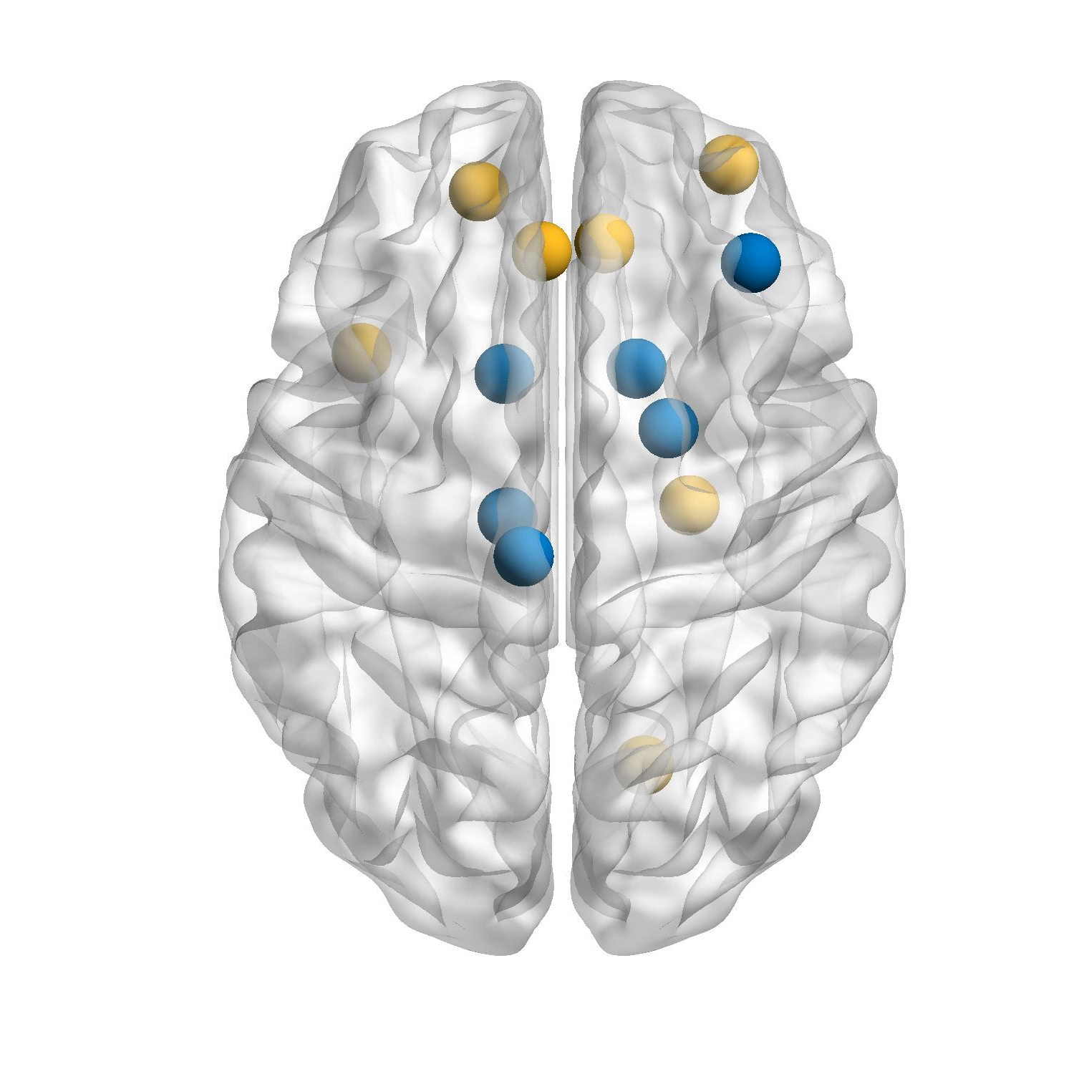
Supplementary2-Nodal Degree
A
B
*
*
ORBmid.R
*
*
*
*
ORBsup.L
*
ACG.L
ACG.R
MFG.R
*
TPOsup.L
CAU.R
CAU.L
PAL.R
THA.L
ORBsup.L ORBmid.R ACG.L ACG.R PHG.R LING.R PAL.R TPOsup.L
PHR.R
PCL.L
C
*
*
*
LING.R
*
*

