Slide 1
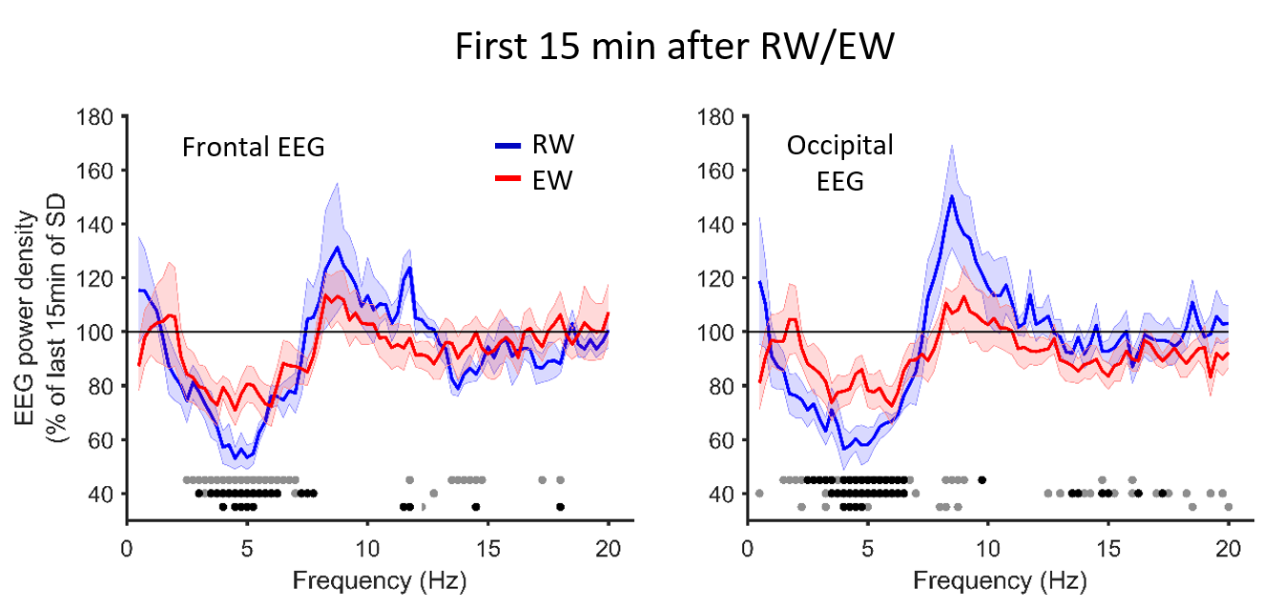
Figure S1
Notes:
Replot as shaded errobar, mazbe

Slide 2
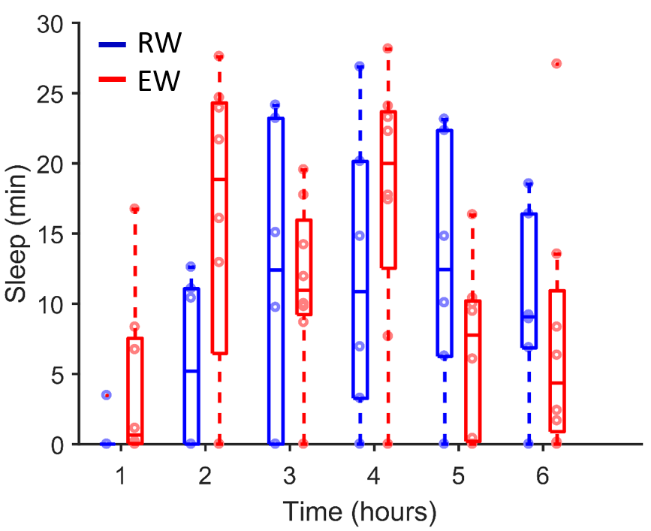
Figure S2
Notes:
Replot as shaded errobar, mazbe

Slide 3
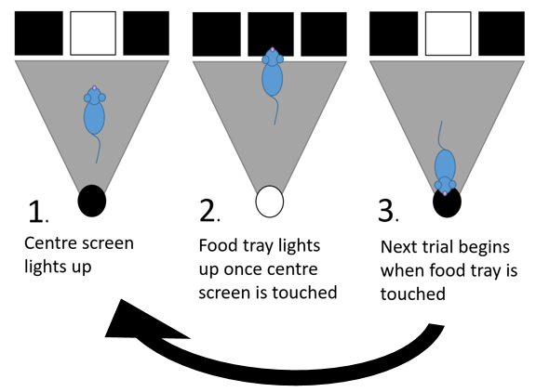
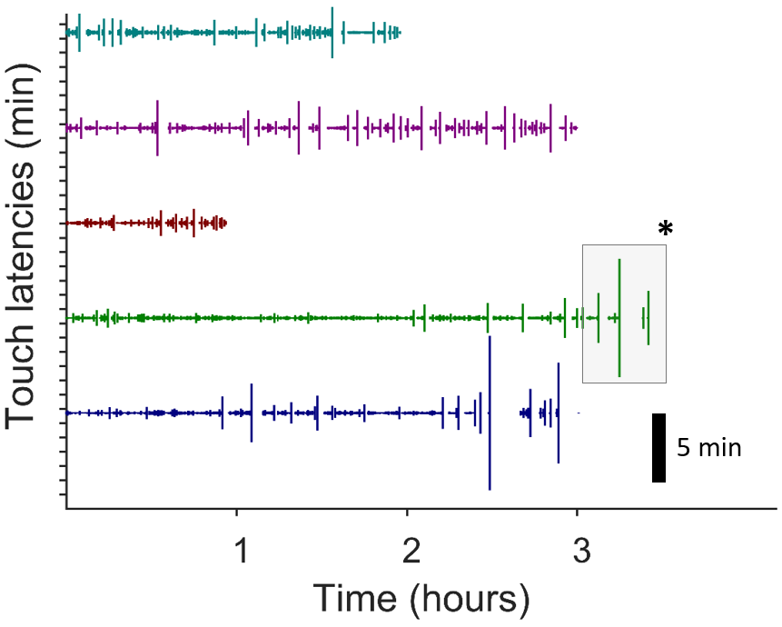
Figure S3
A B
C
Notes:
Replot as shaded errobar, mazbe

Slide 4
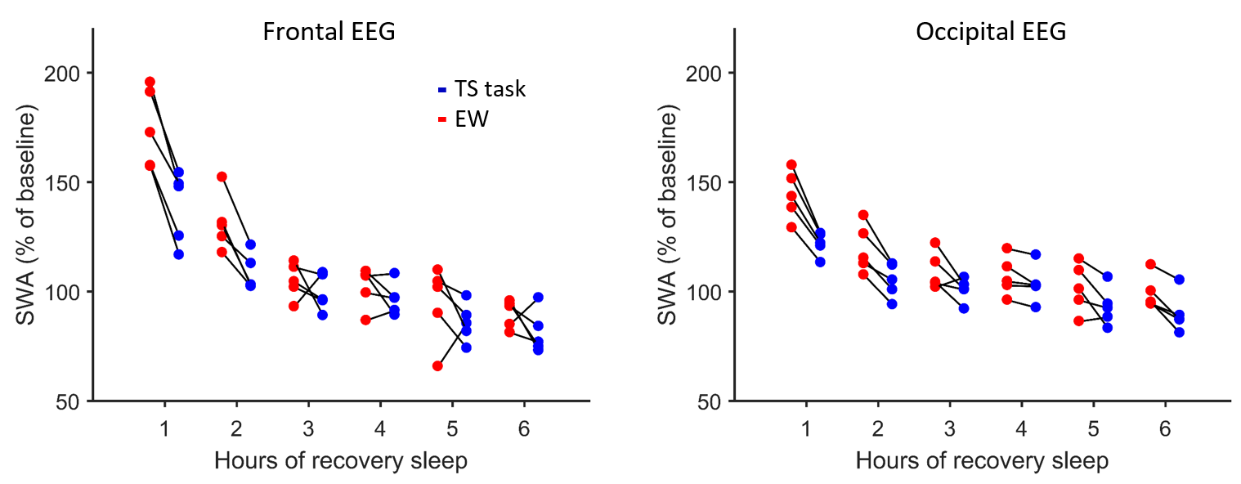
Figure S4
Notes:
Replot as shaded errobar, mazbe

Slide 5
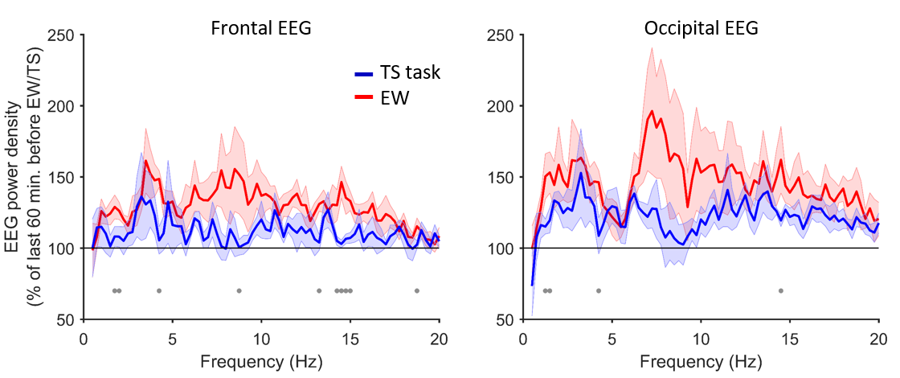
Figure S5
A B
Notes:
Replot as shaded errobar, mazbe

